Slide 1
Workforce Development
Let’s get to work!
David Helgerson
October 11, 2019

Slide 2
Our Timeline
Blue Work Training
&
Blue Work TV
Under Development
CWB described their Northwest Regional Workforce Guides
?
2015
2017
2019
2021
Workforce Development:
What should we do?
How should we do it?
Who do we collaborate with?
Hands-On Activities to introduce Careers Preferred
The potential for other Regional Workforce Guides was discussed in a panel session.

Slide 3
Panelists
Joe Youcha
Building To Teach
President of TWSBA
Experienced Leader of Pre-Apprentice Programs
Kelley Watson
Port Townsend High School, CTE Maritime Program
Experienced Hands-on Maritime Educator
Contributor to 2017 TWSBA Conference Panel on Regional Maritime Workforce Development
Tom Brandl,
ED, Tidewater Wooden Boat Workshop
USMC, Ret.
Decade of educational boatbuilding experience
Tom Sommers,
Outreach Director, UBC Regional Training Fund
Susan Field,
Placement Director, UBC National Job Corps Training Fund

Slide 4
New Since 2017 Conference
Pre-Apprentice Program starting at TWBW.
Partnerships:
UBC partnering in: Milwaukee, WI; Alexandria, VA; Buffalo, NY; Philadelphia, PA; & Camden, NJ.
Maritime Academies with Charter & Public Schools: Anne Arundel, MD; Harbor School, NY; Philadelphia, PA.
Blue Work Training concept development
Regional hands-on activities to introduce careers
TWSBA orgs as operating partners; engaging the students
Mobile shops and grants for new staff to expand outreach
Blue Work TV
Video cameos to describe water-related careers
Now available online
More to come . . .
What else?

Slide 5
Interested Parties
Sea-Level Rise Mitigation
Persistent, Age-Appropriate Engagement
Maritime Operations
Marine Recreation
Start at
5th Grade
Don’t overlook the
Disconnected Youth
Primary/Secondary Students
Adult Workers
Water-related Careers
Business Communities That Need Workers
Marine Manufacturing
Community Organizations
Sewage Treatment
Green Energy
Aquaculture
Etc.

Slide 6
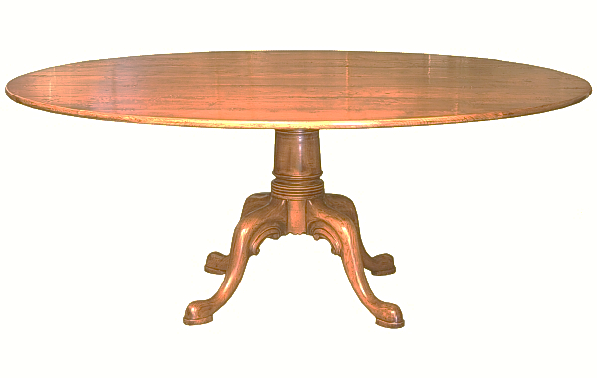
Perspectives; What is needed now?
Businesses need new workers; what does workforce development look like?
TWSBA Communities; what do your students need? What interests your Board?
Benefactors; what makes a program worth funding?
Partnerships; what makes partnership worth participation?
Let’s round table these questions and look for common themes.

