Slide 1


WELCOME

Slide 2
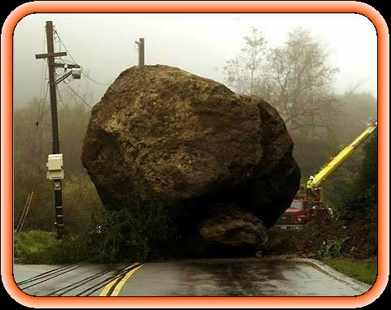

Slide 3
Components

Slide 4


Slide 5


Slide 6


Slide 7
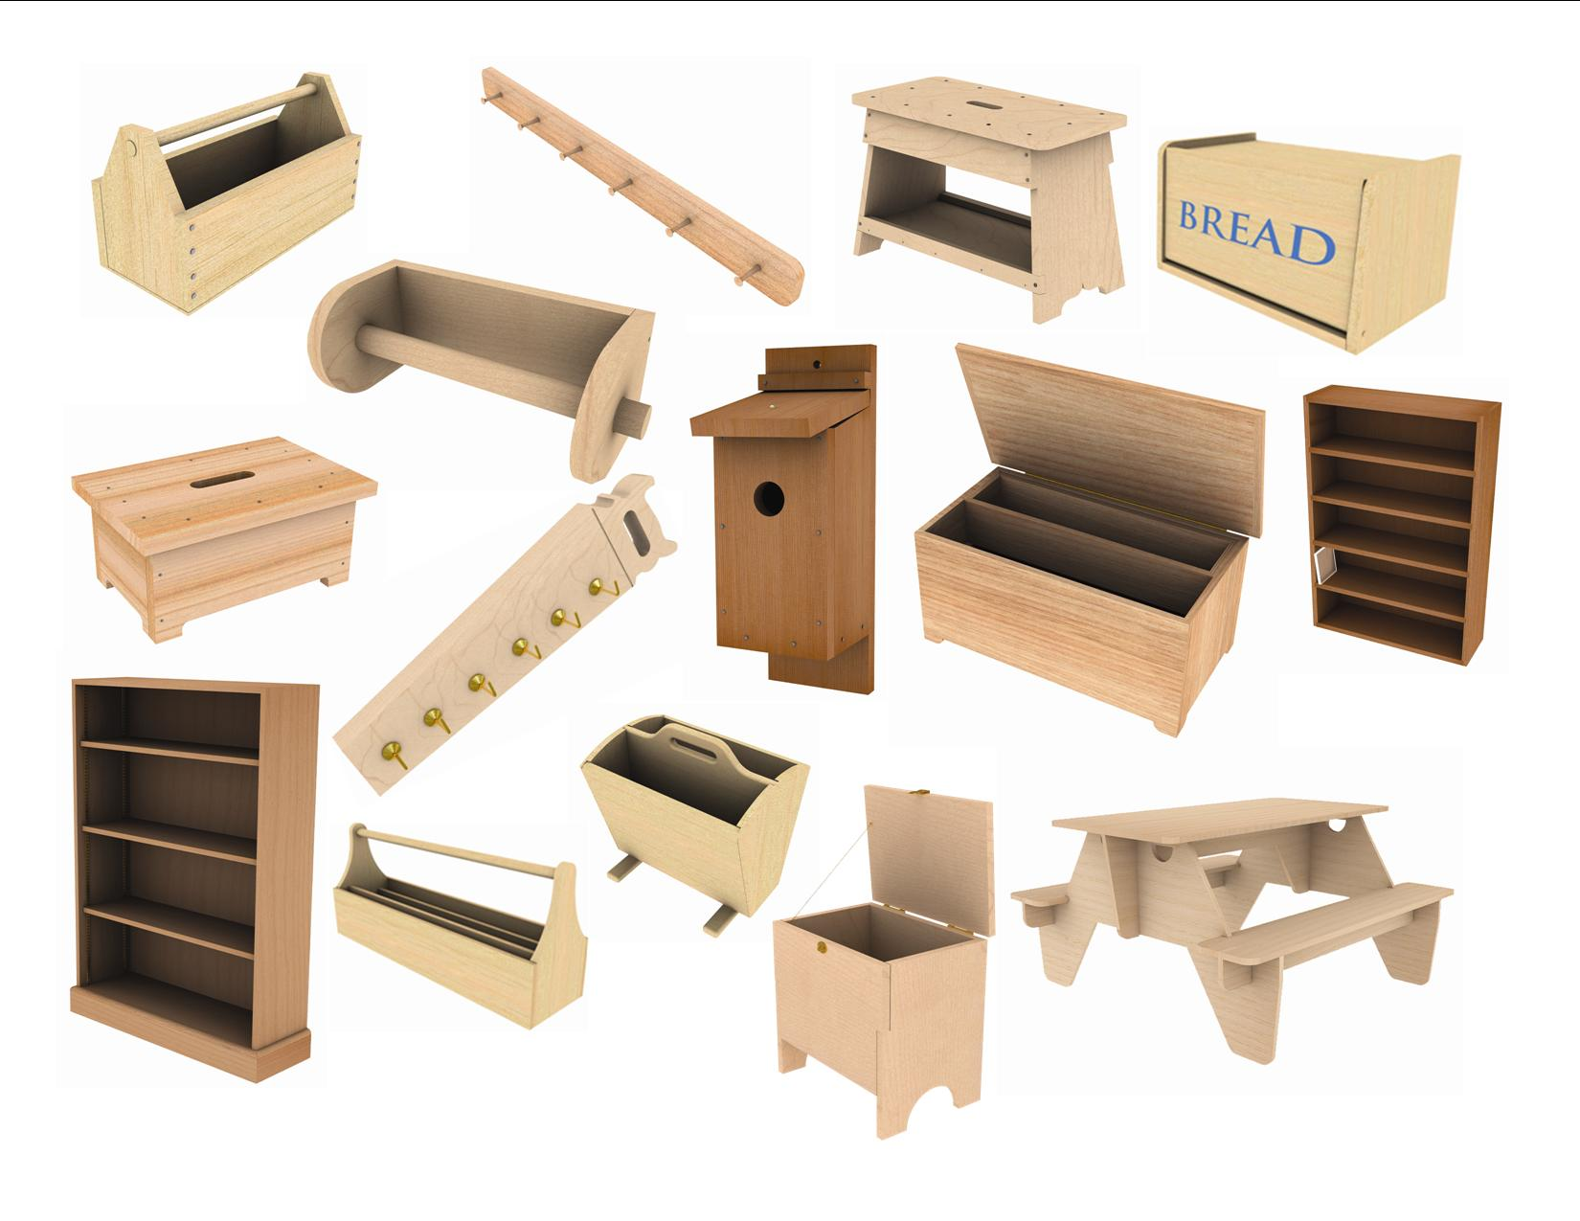

Slide 8
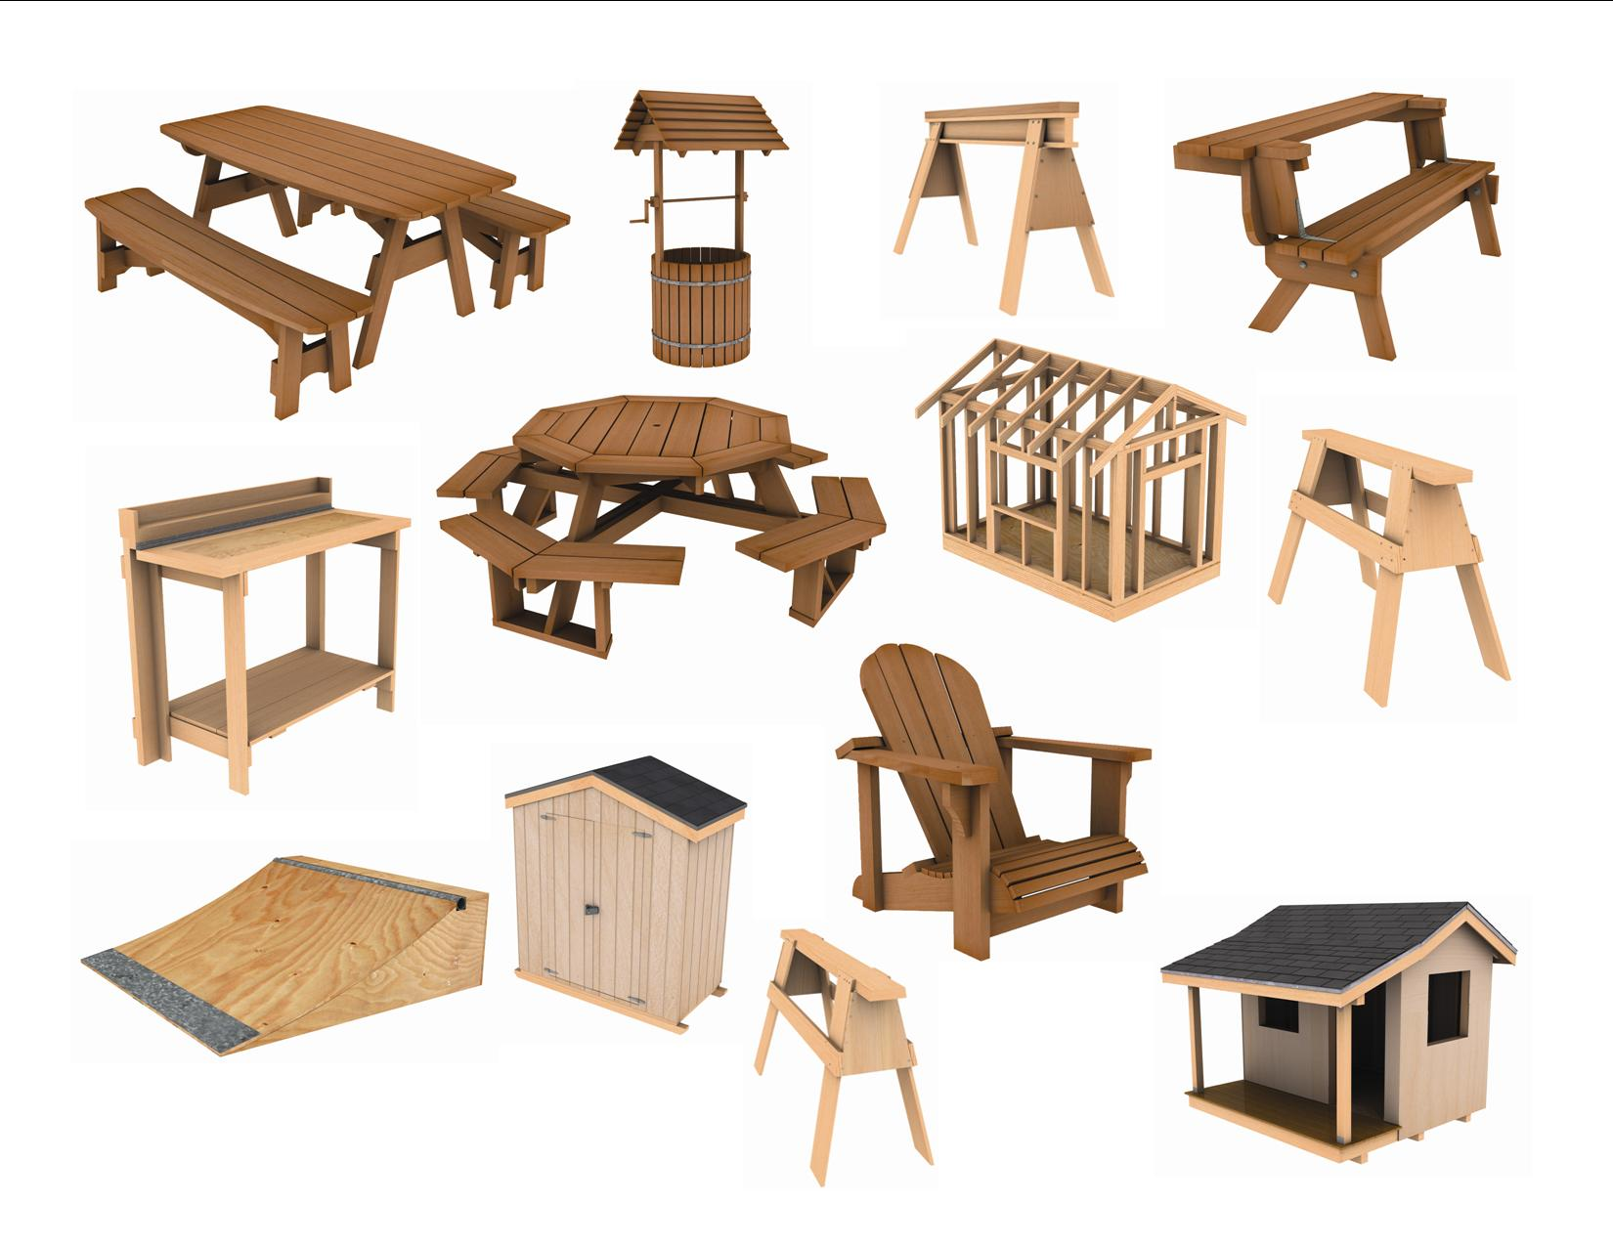

Slide 11
The “BIG 3”
Designed by professional carpenters – ensures performance to professional standards
Procedures tested through building the projects – saves time and confusion
Local support – Outreach Specialist familiar with the program and what is happening locally

Slide 12

Feature/Benefit
One Trade, Many Careers
Feature
  “Shout Outs” and other info on careers in construction trade
Benefit
  Shows the trades as a good option to college
Feature
  Bite-size bits of information
Benefit
  Benefits students with poor reading skills

Slide 13
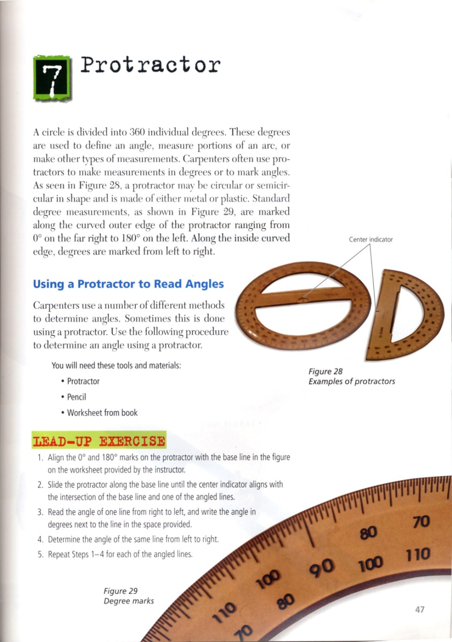
Feature/Benefit Project Books
Feature
  Lead Up Exercises
Benefit
  Build student’s confidence before large project

Slide 14
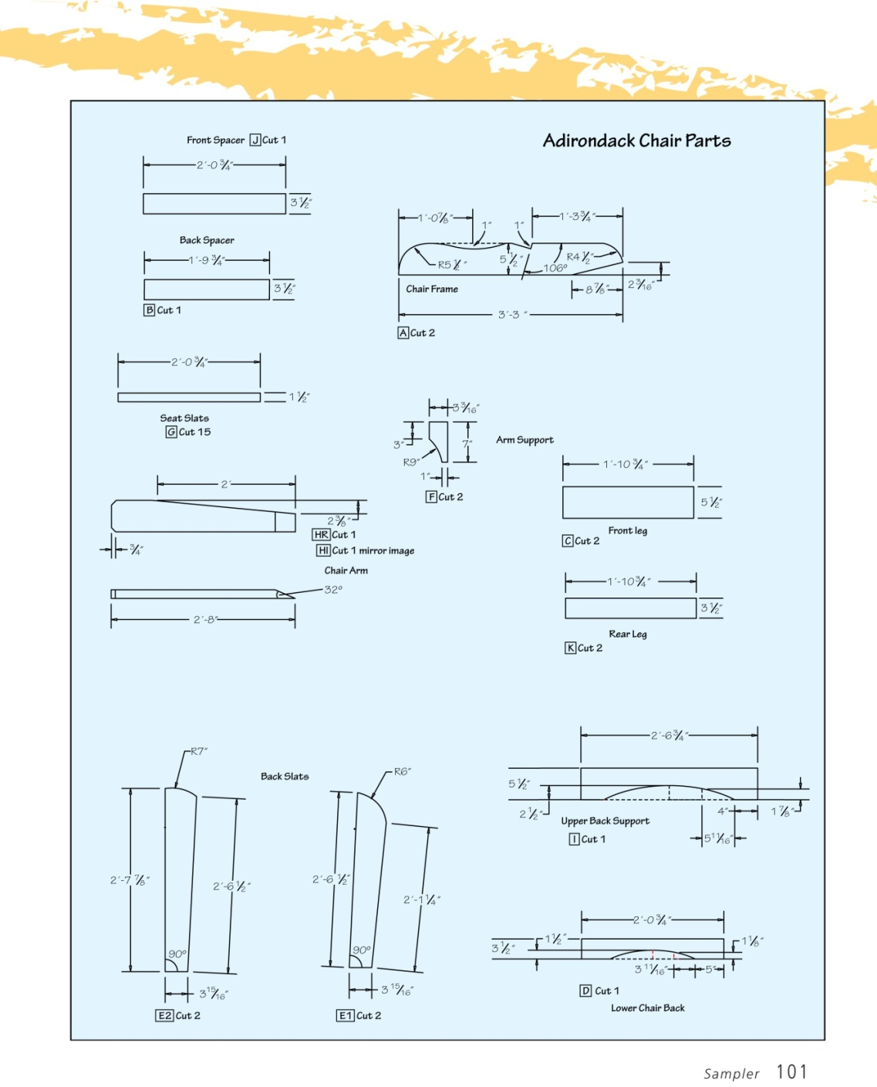
Feature/Benefit Project Books
Feature
  Prints are provided for each project
Benefit
  Helps the students learn to build from prints rather than procedures

Slide 15
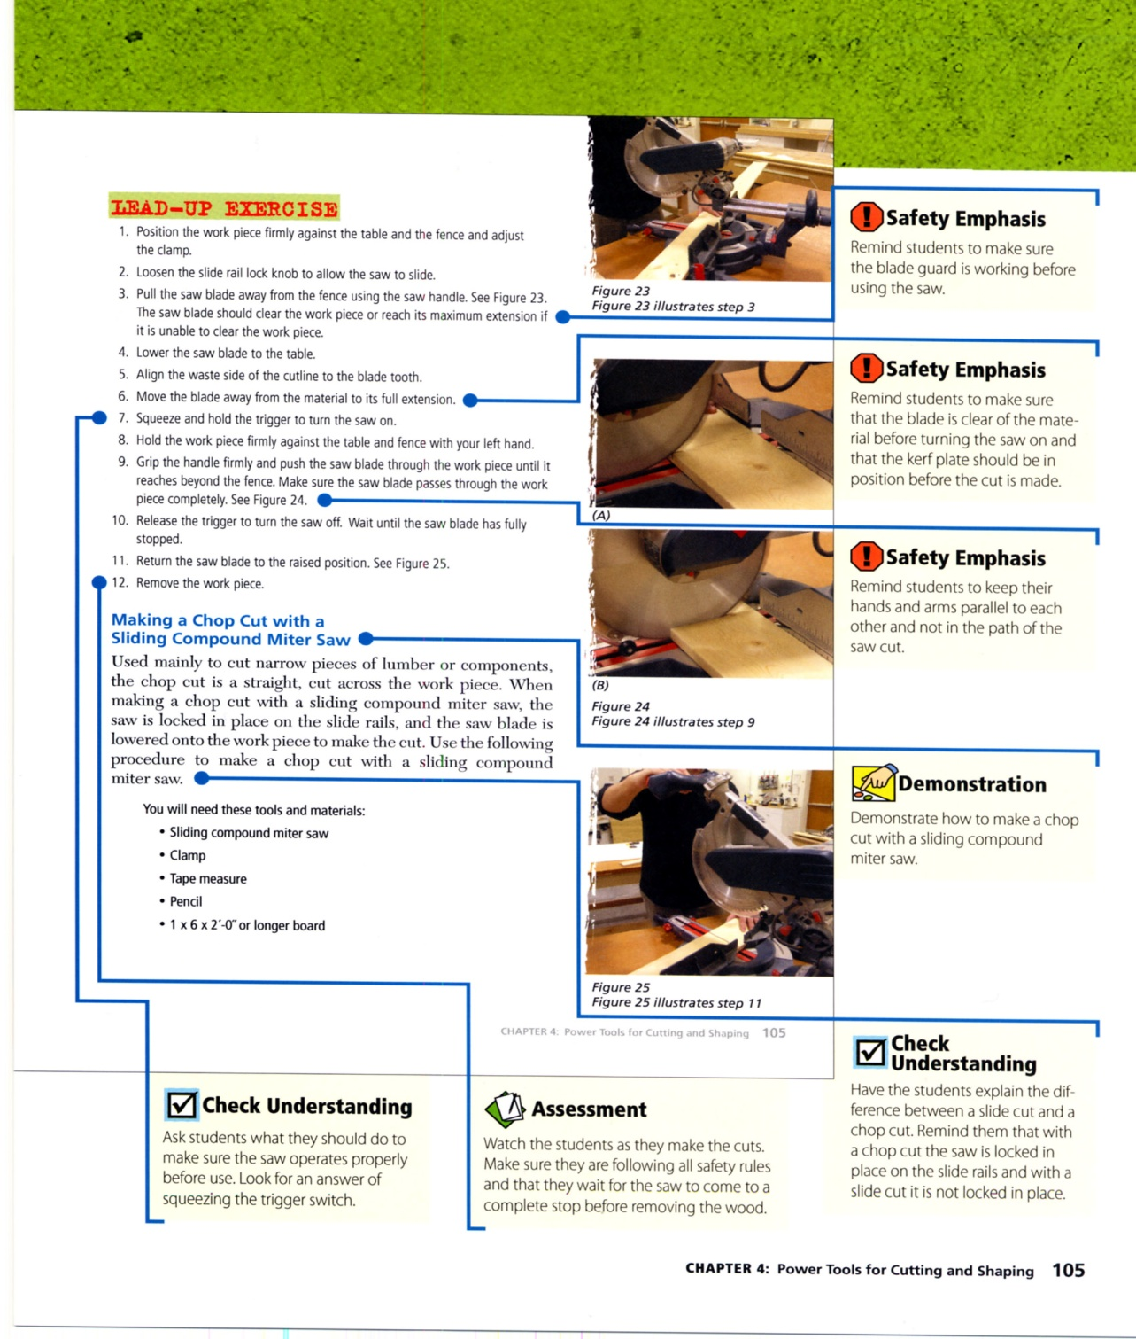
Feature/Benefit Teacher Annotated Edition
Feature
  Pages of Student Editions with Teacher Tips and other notes
Benefit
  Easy class prep for teachers

Slide 16
How to Use the Program
Timelines for Teaching

Slide 17
Tour through the Resource CD and Video

Slide 18
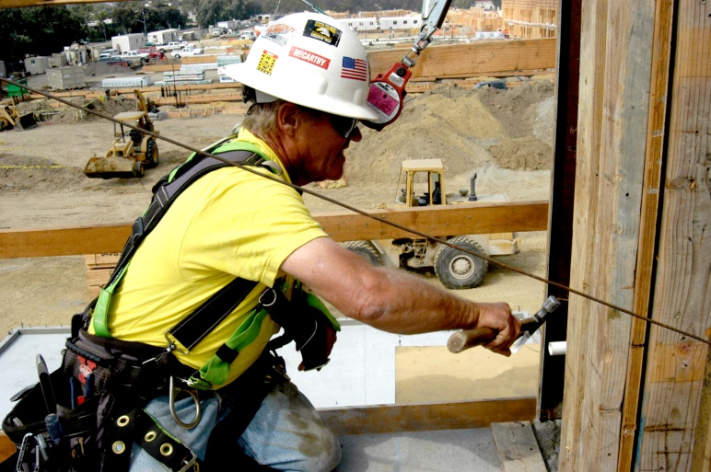

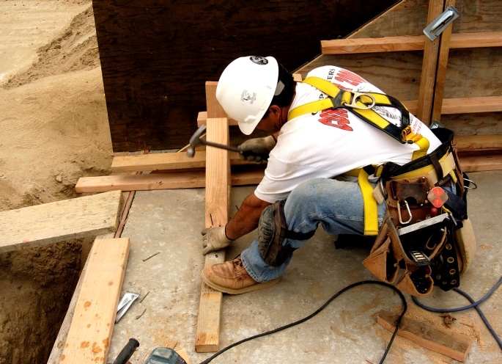
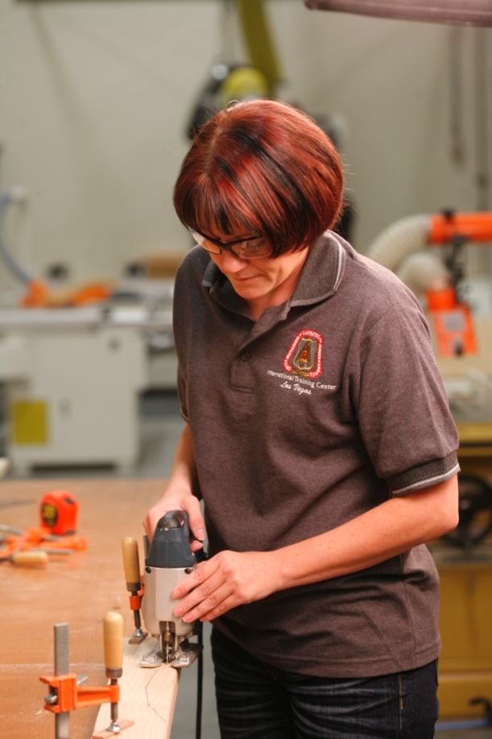
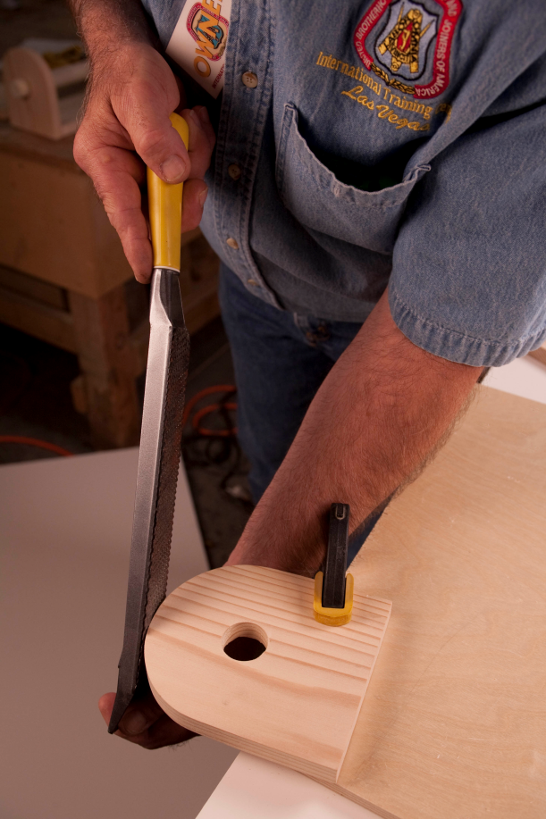
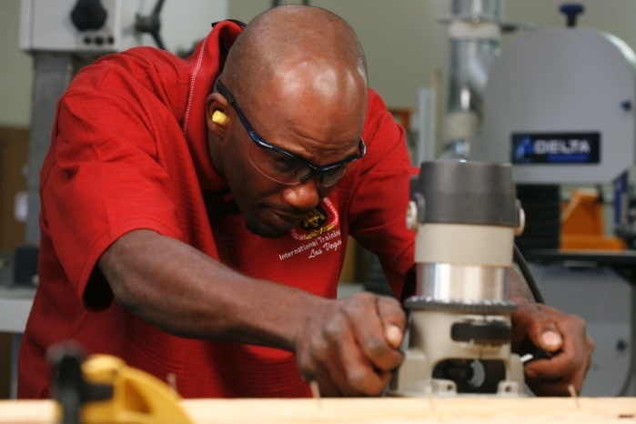
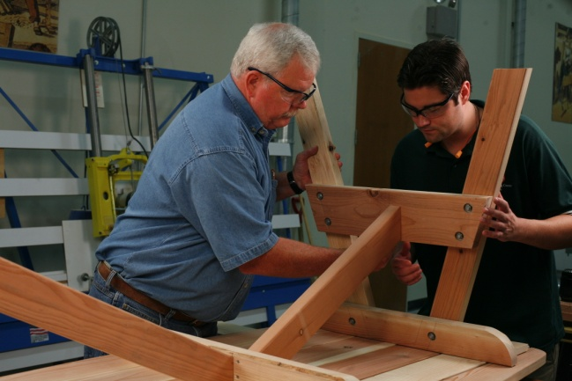

Slide 19



Slide 20



Slide 21



Slide 22
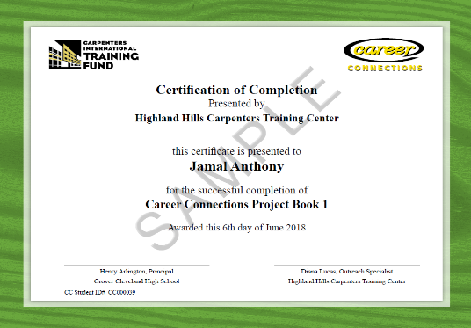
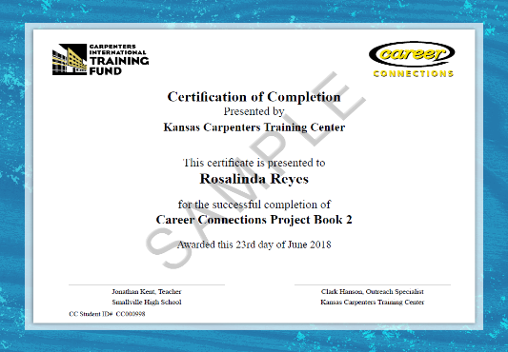
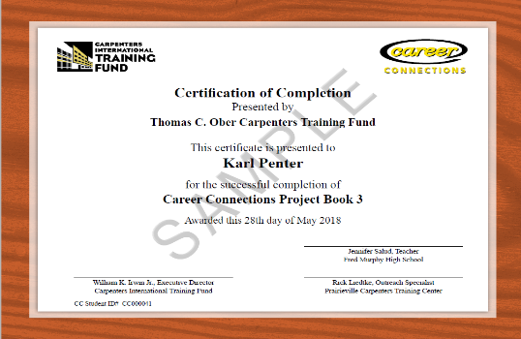


Certificates of Completion

Slide 23
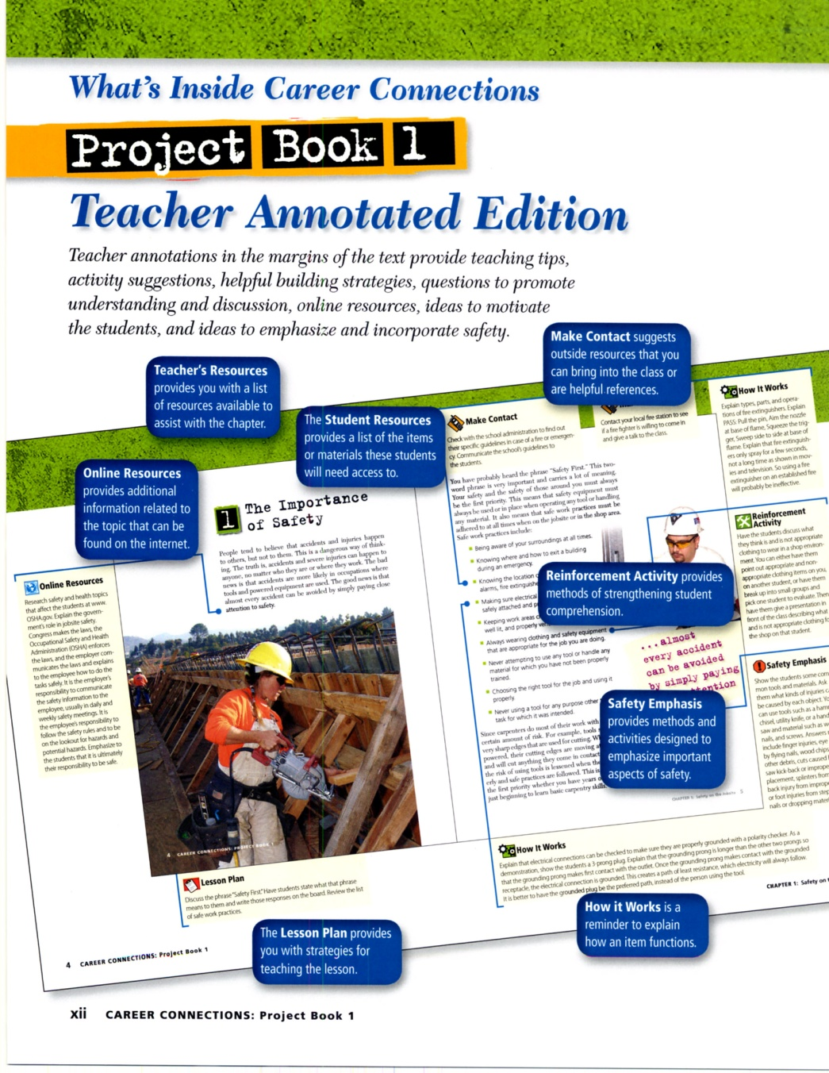
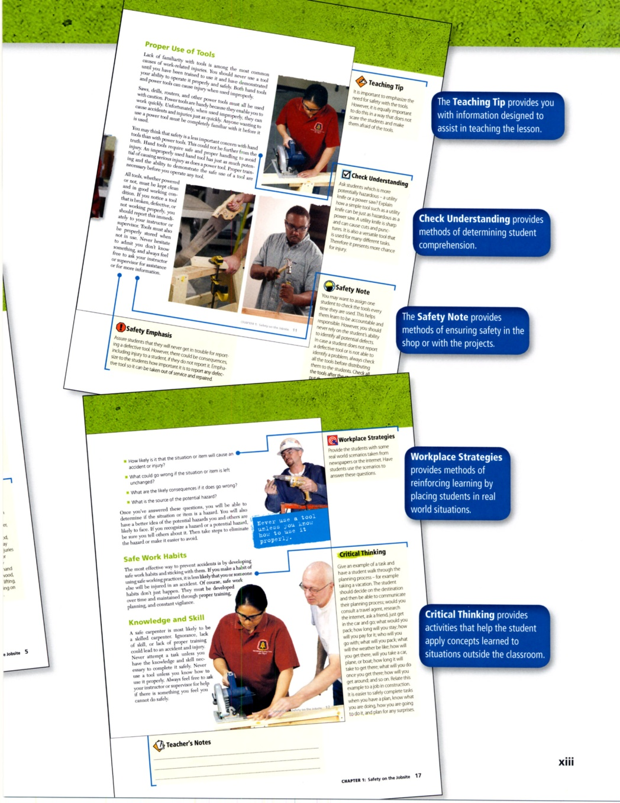

Slide 24
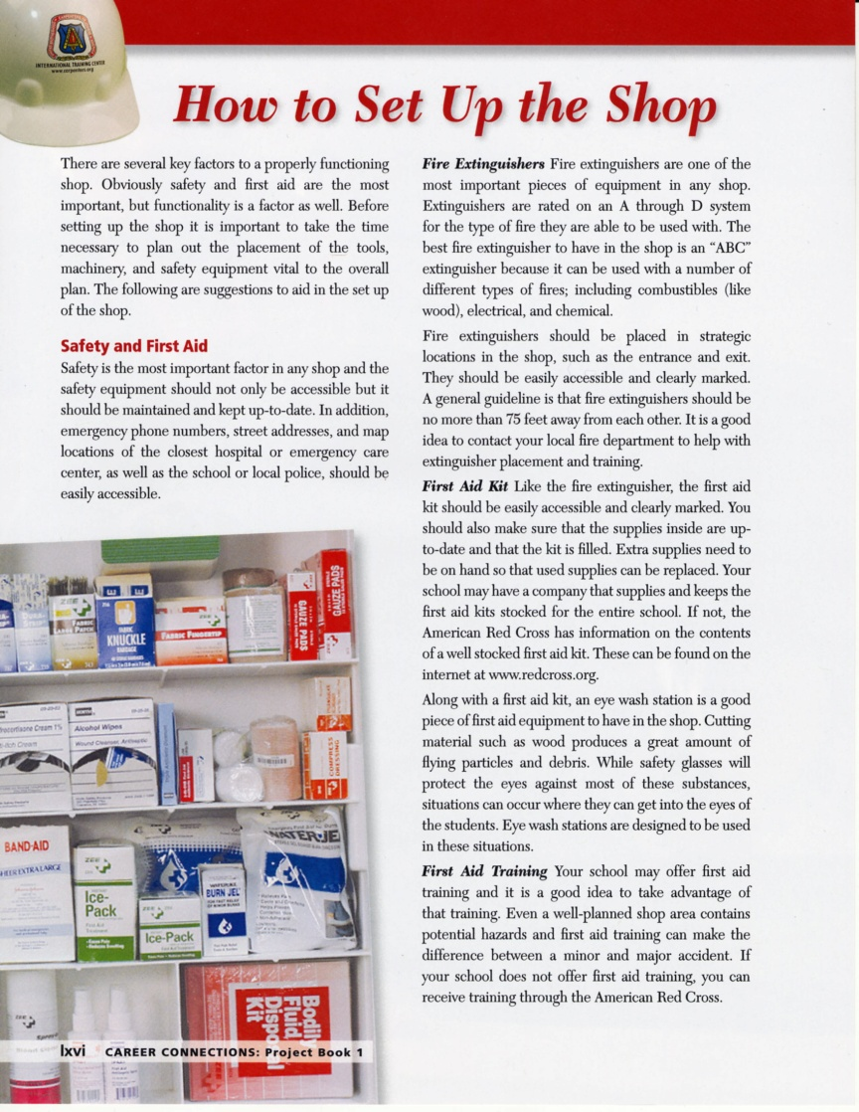
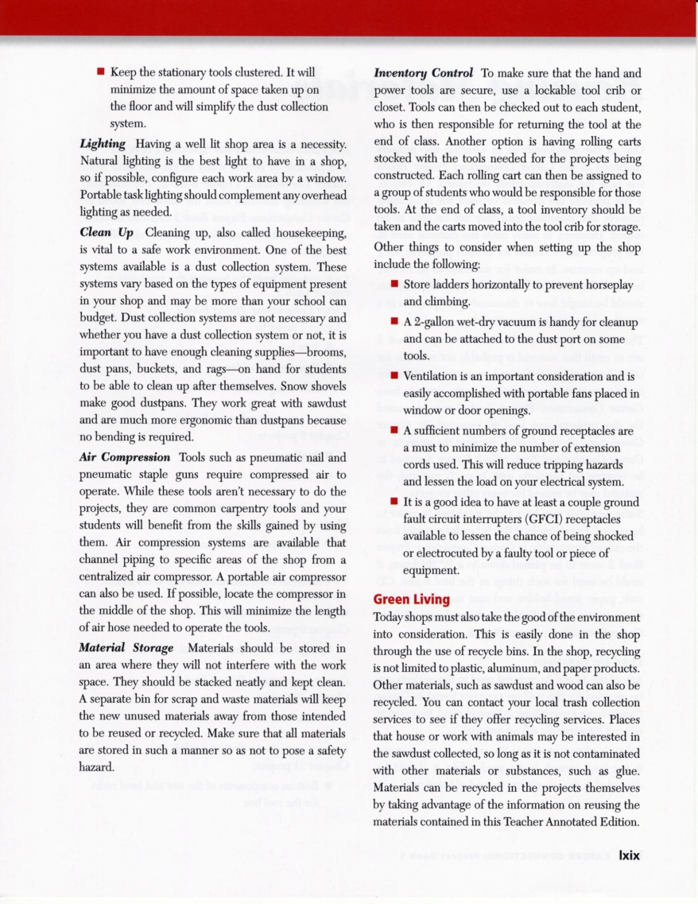
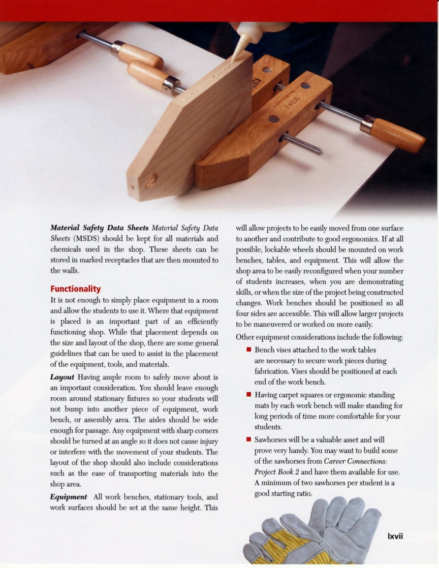

Slide 25

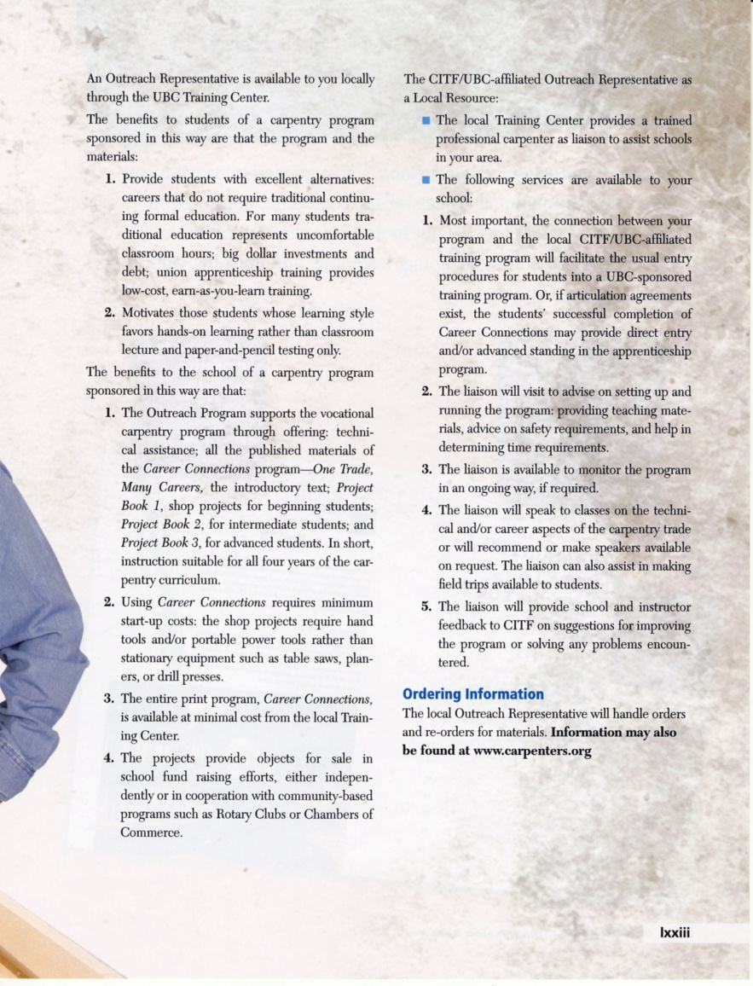

Slide 26
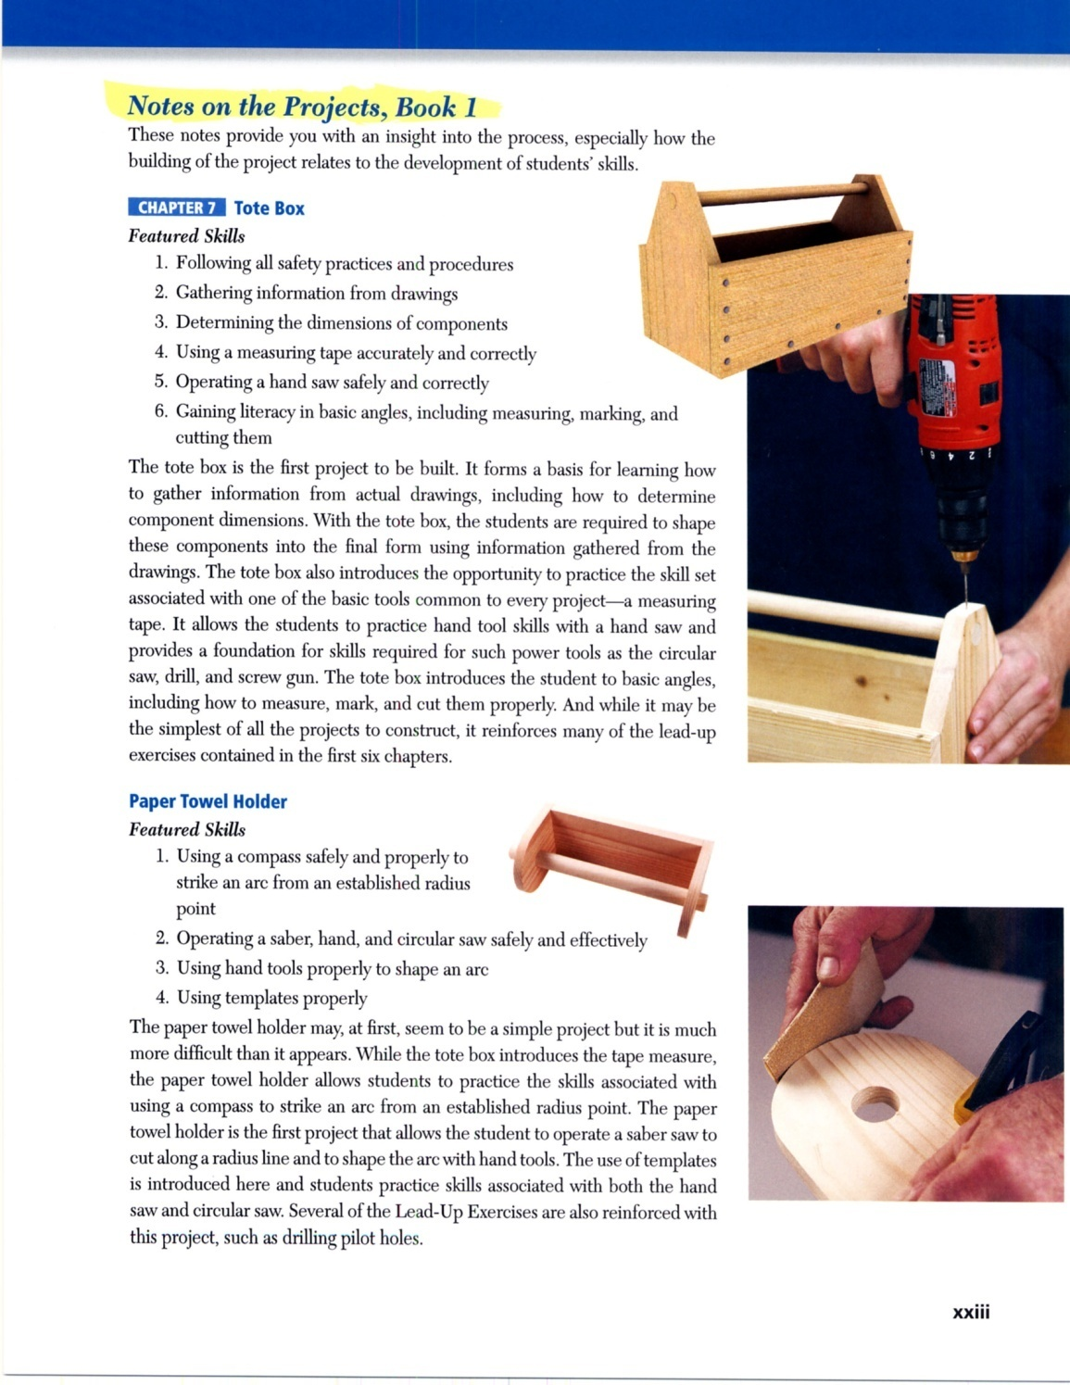

Slide 27
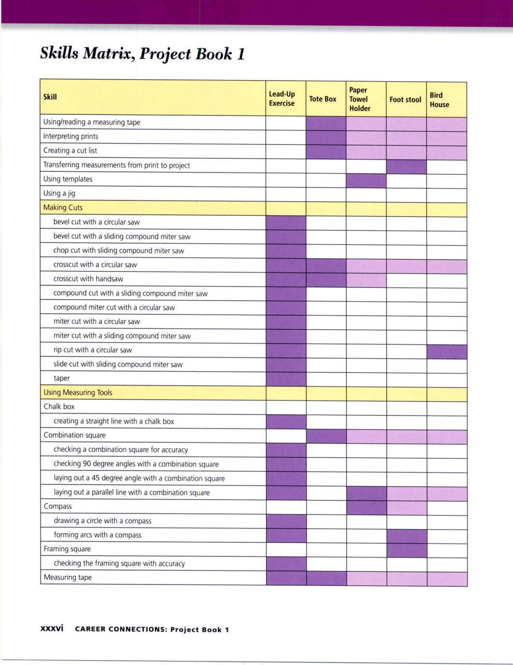
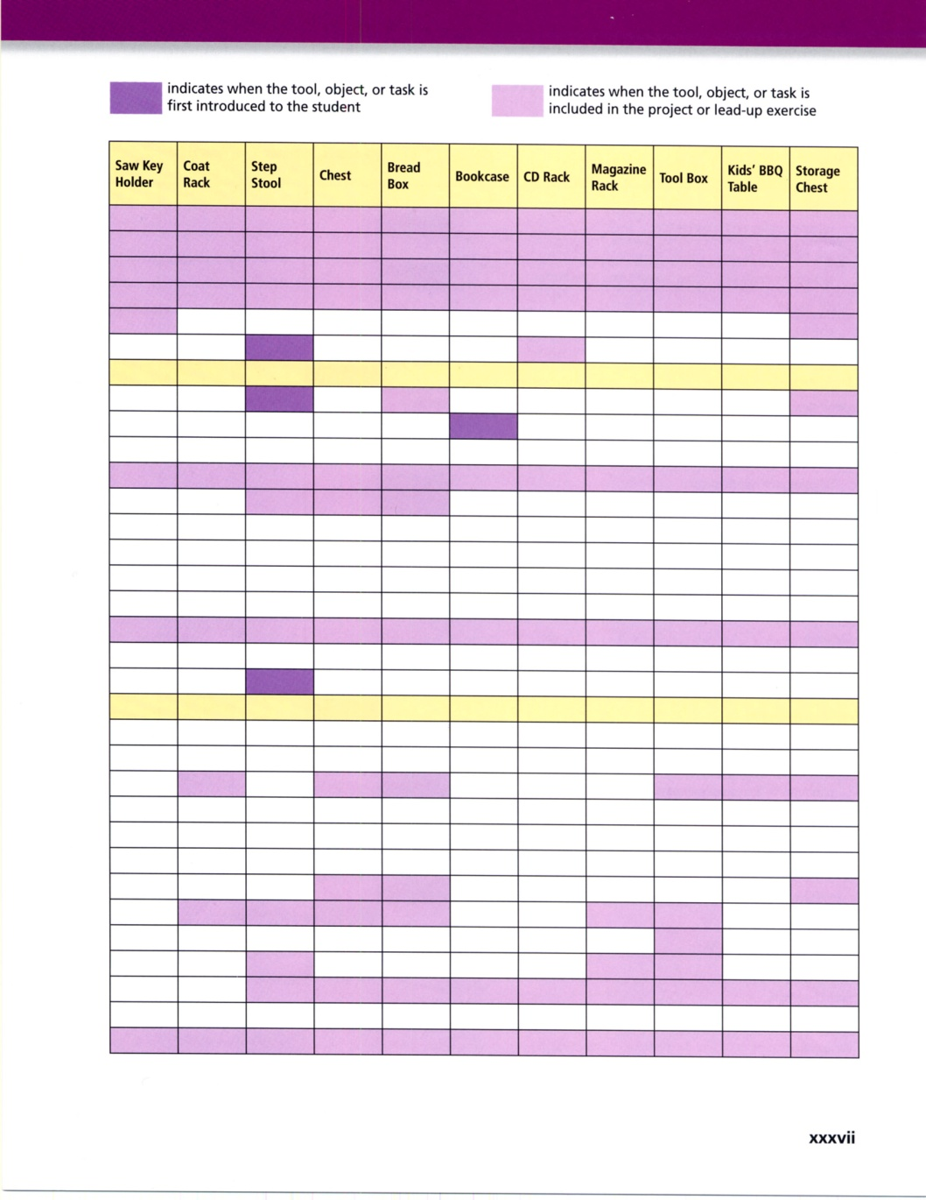

Slide 28
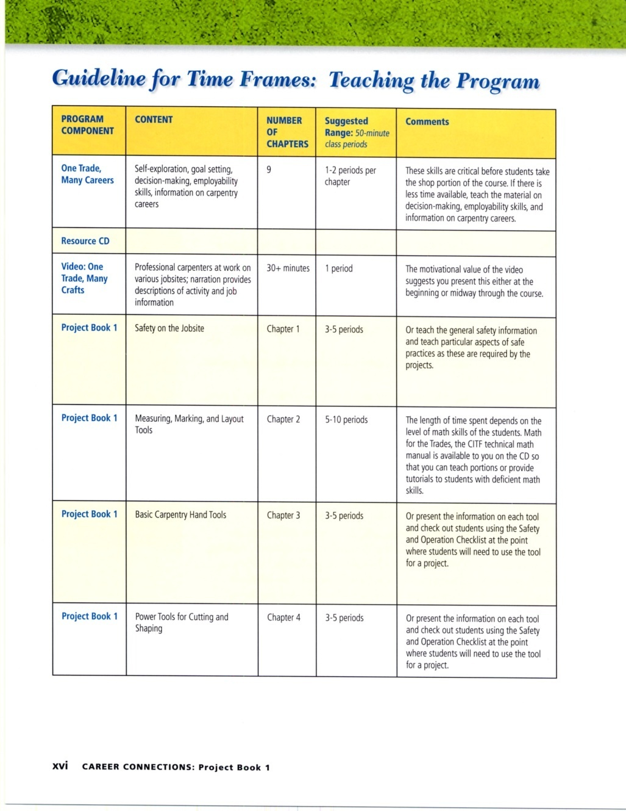
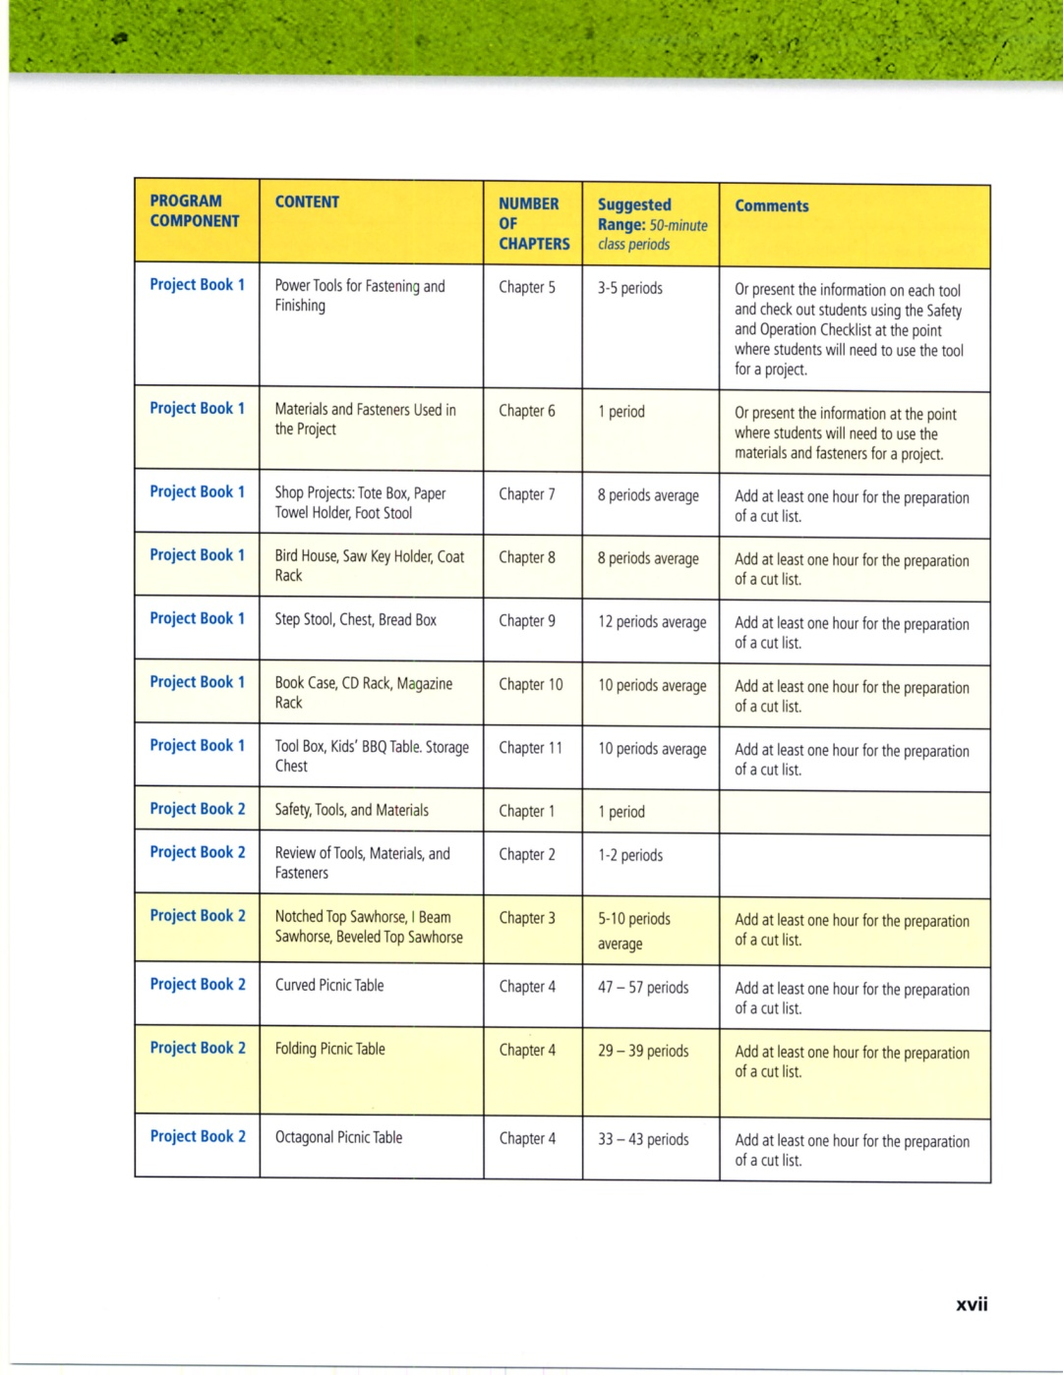

Slide 29
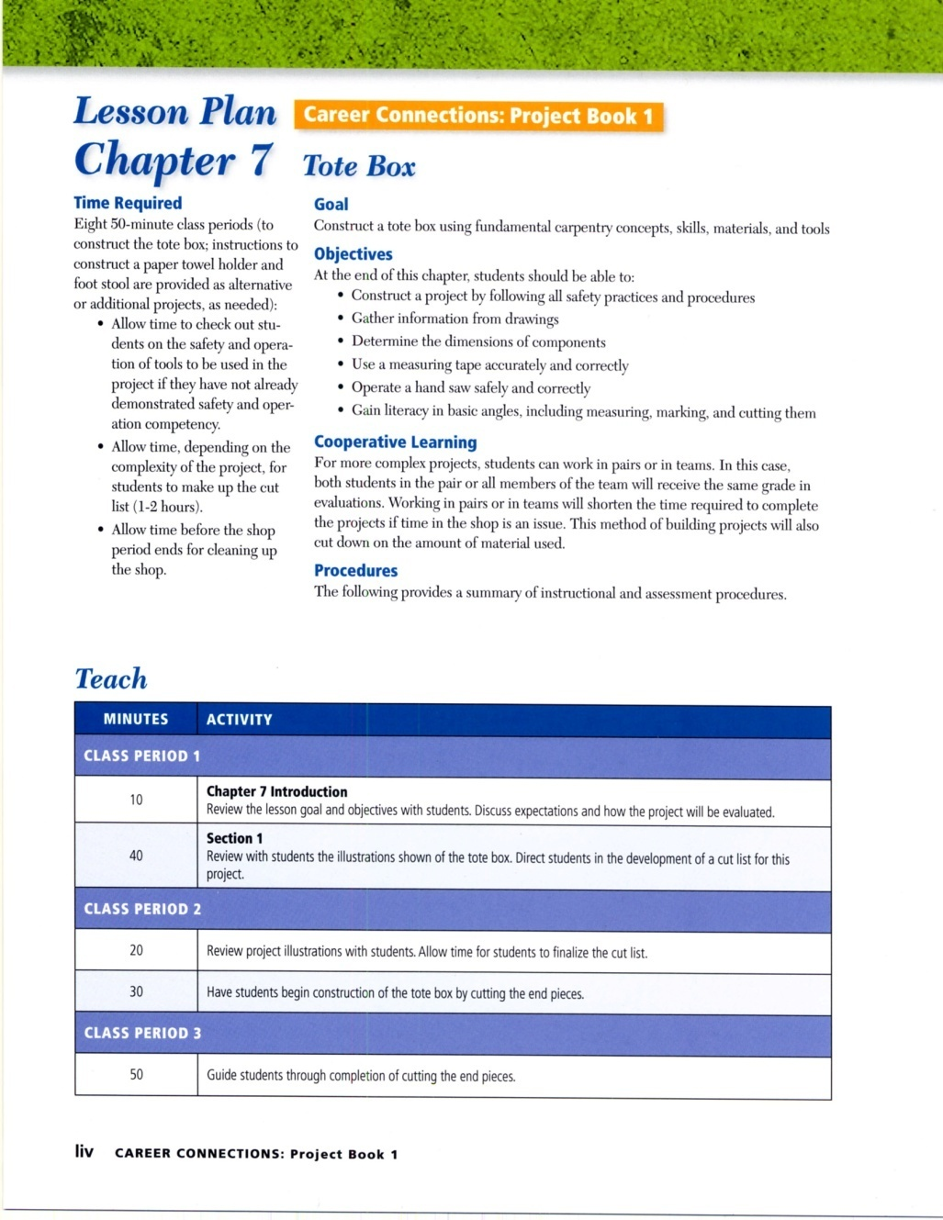
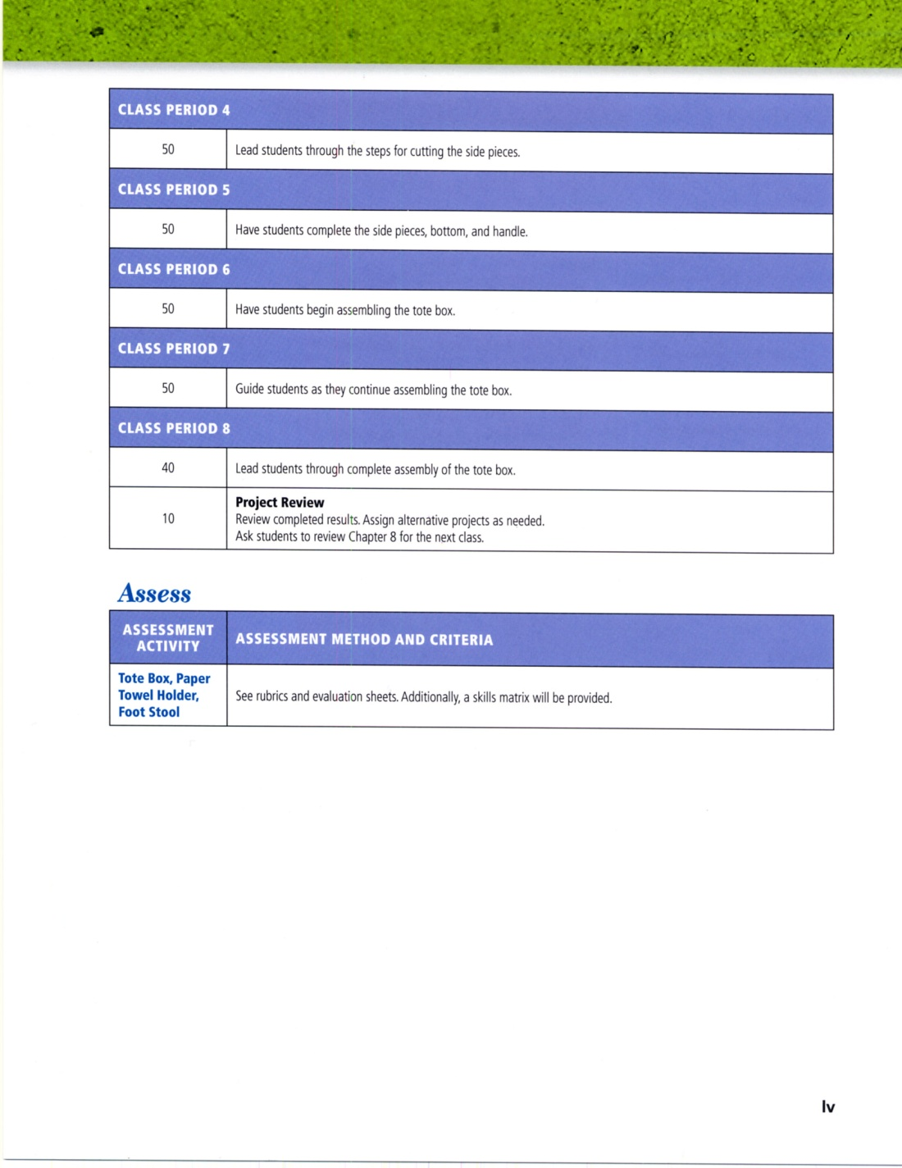

Slide 30
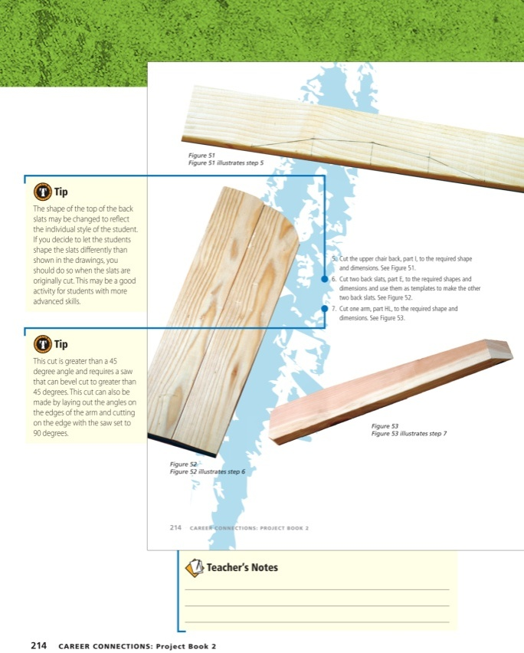
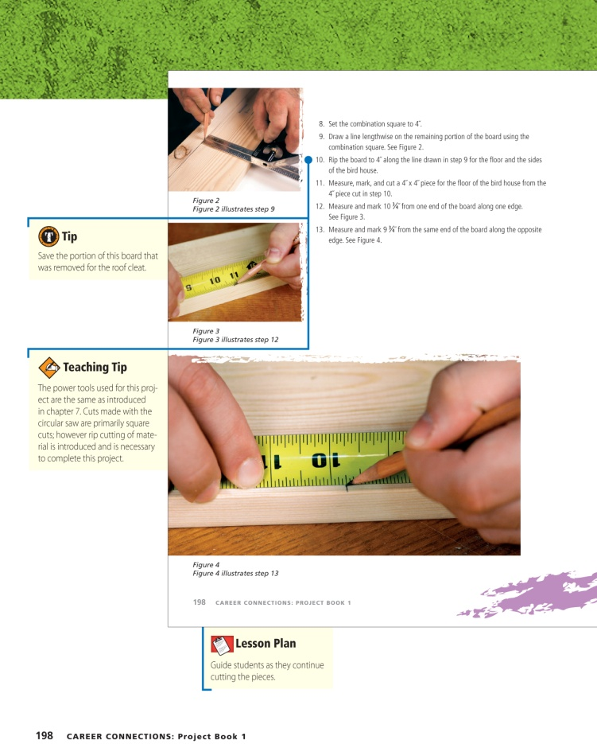
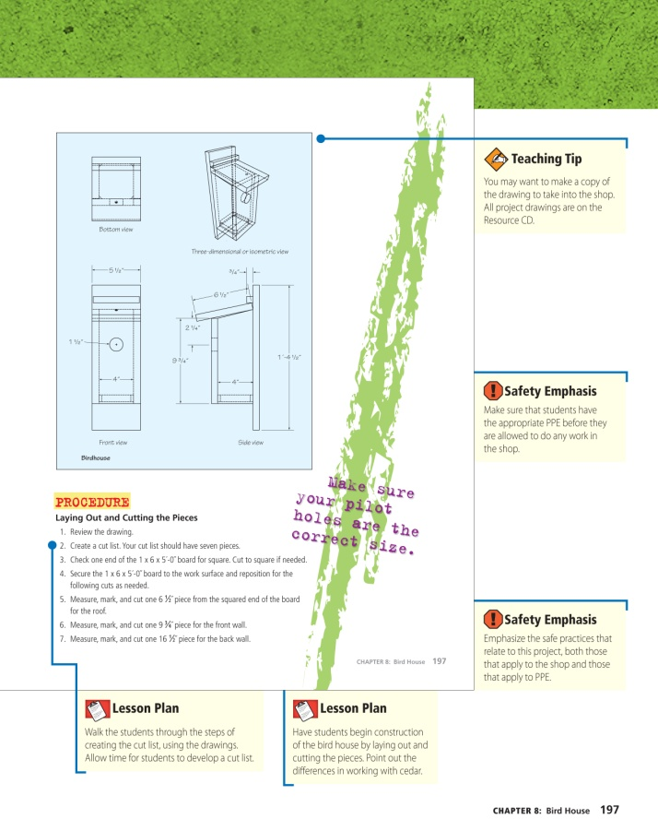
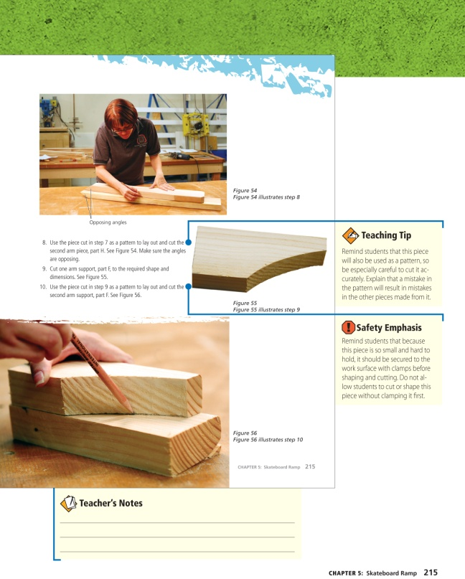

Slide 31
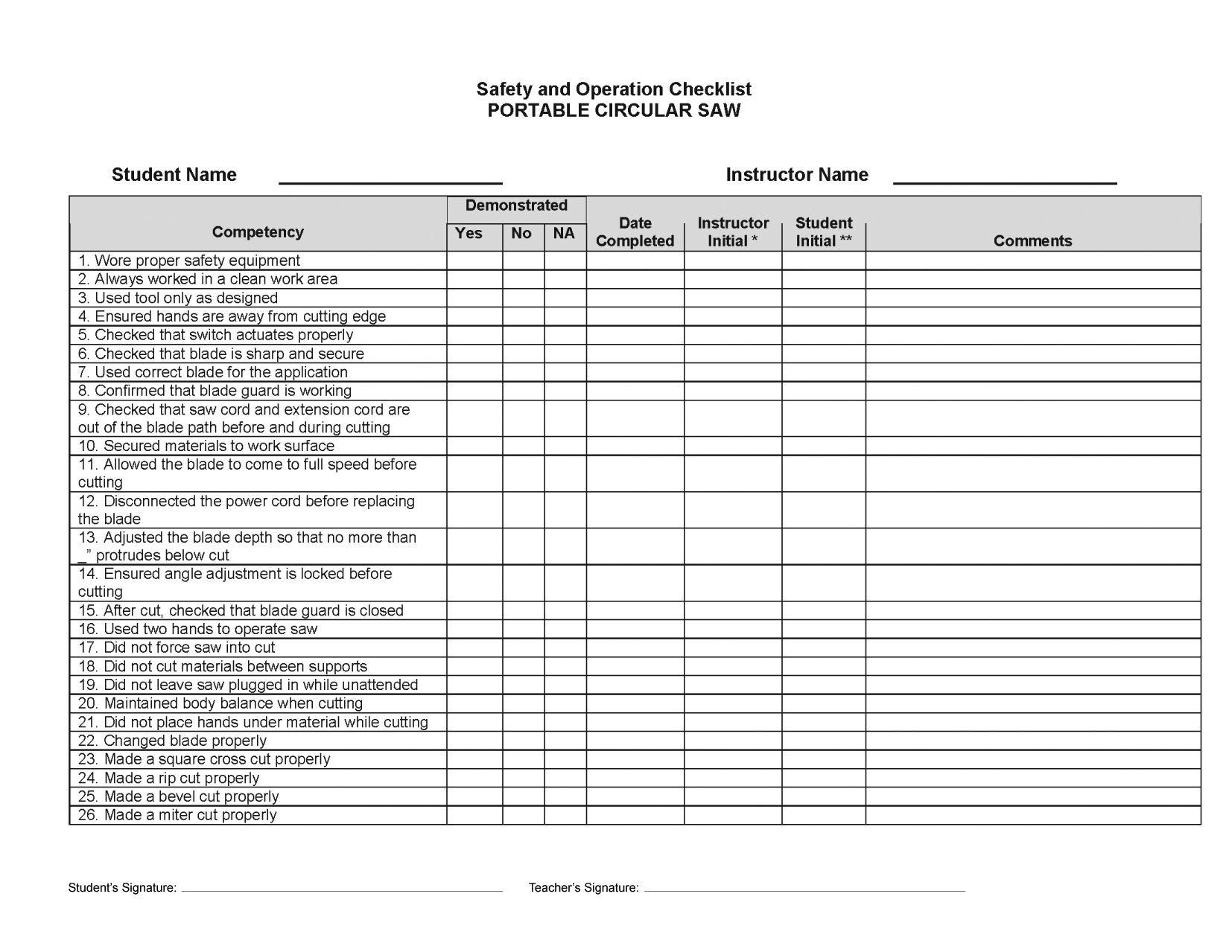

Slide 32
How the Projects Work
Walk-through a Shop Project

Slide 33


Slide 34
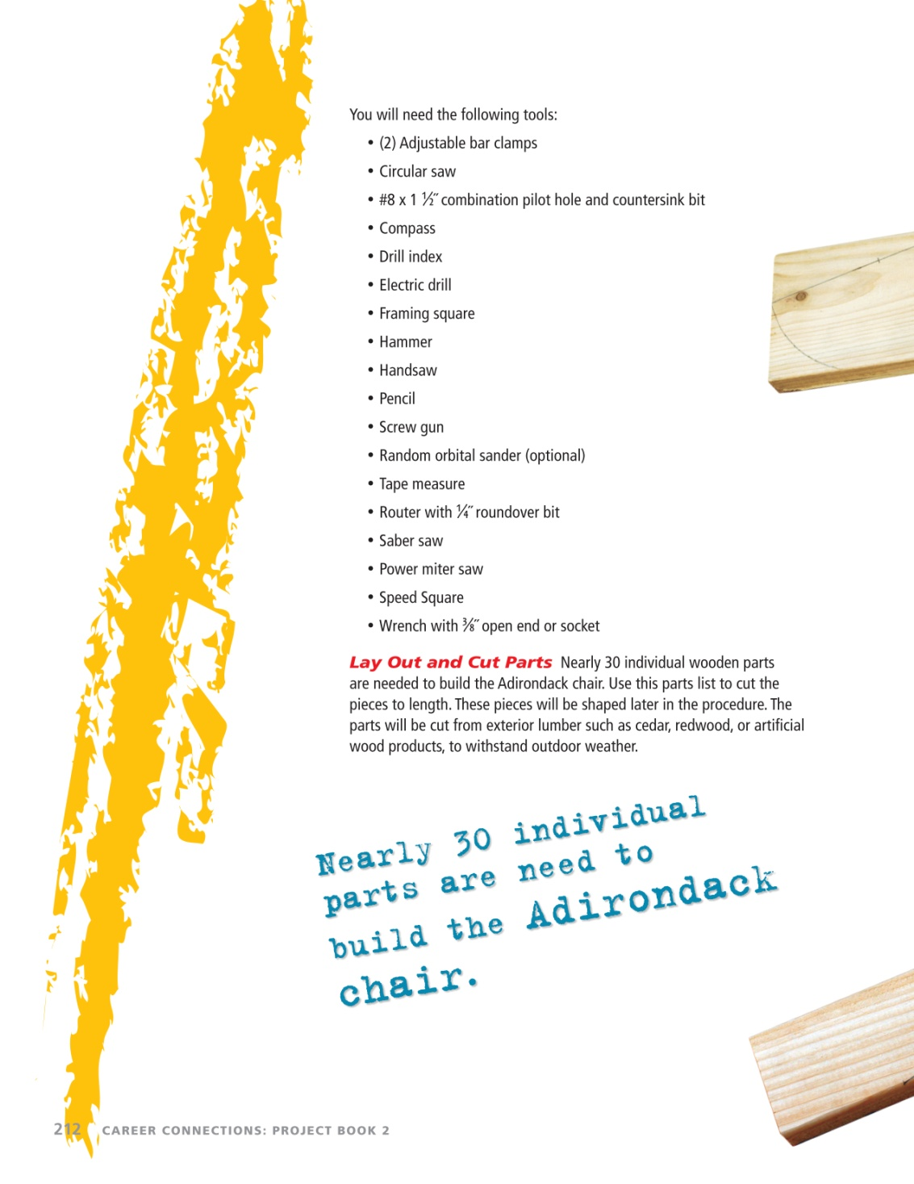

Slide 35
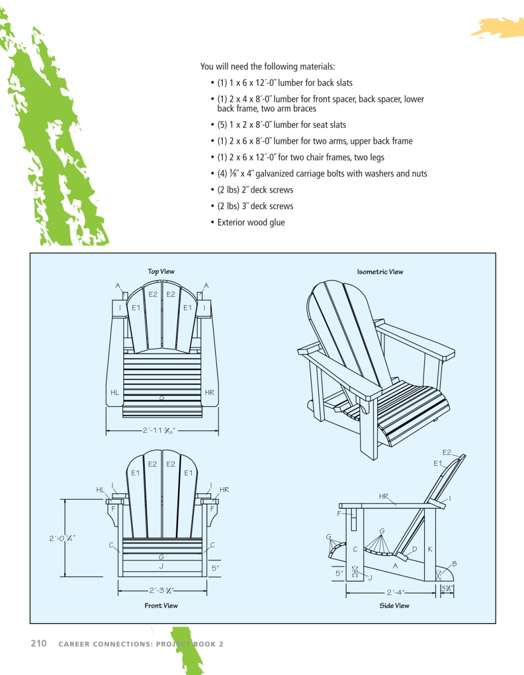
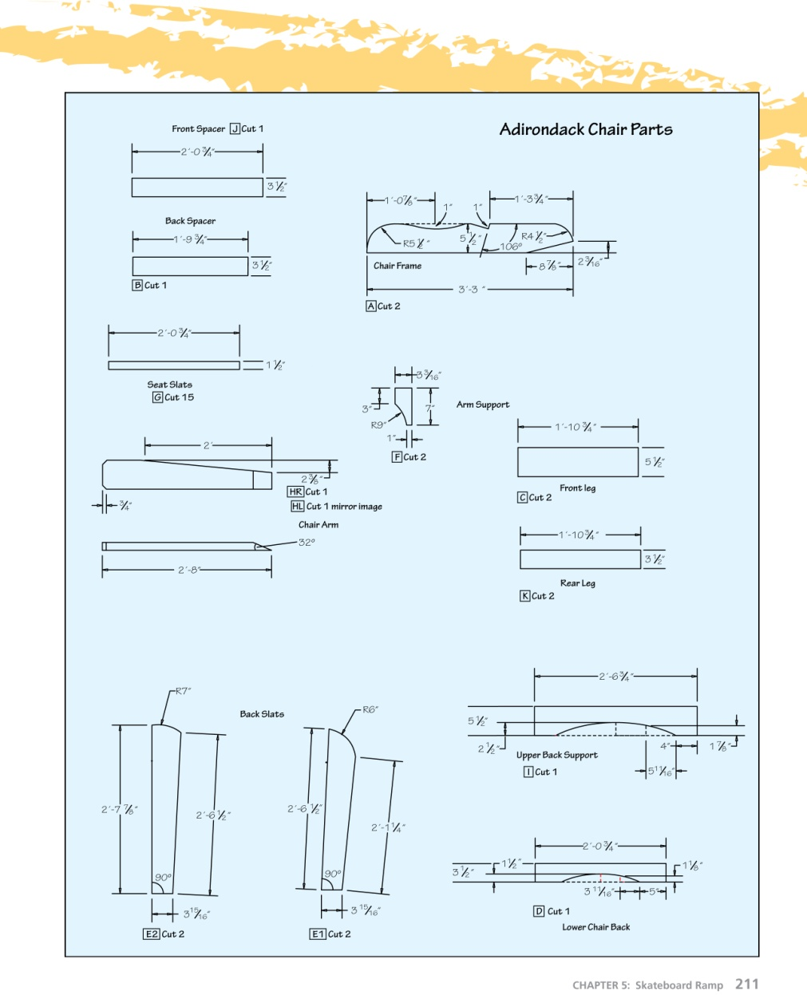

Slide 36
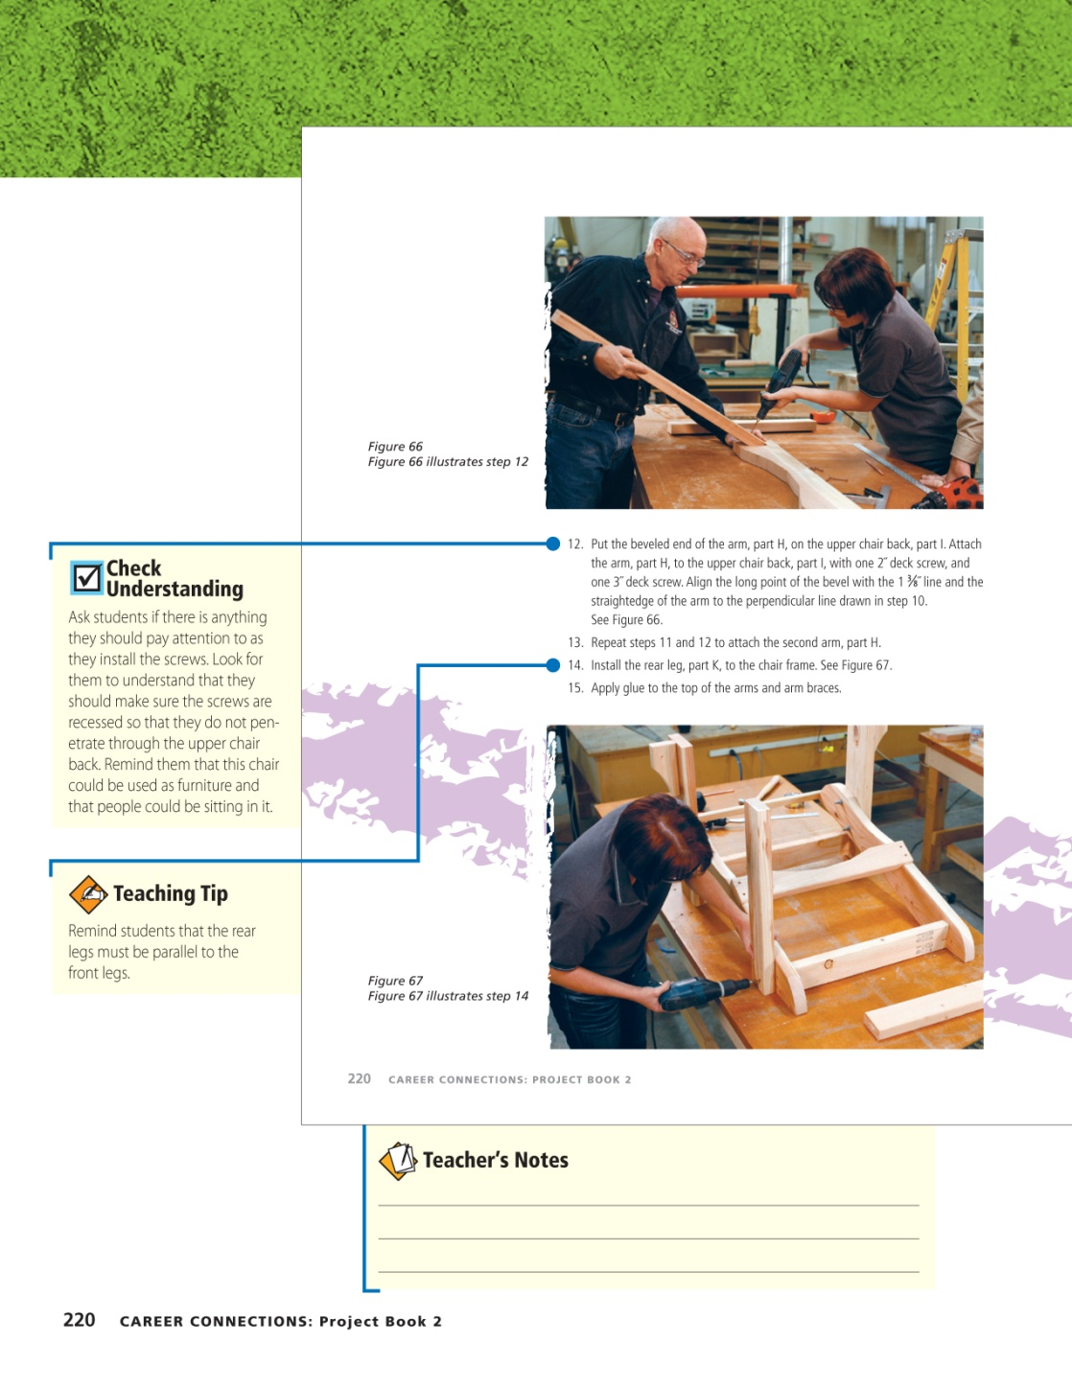
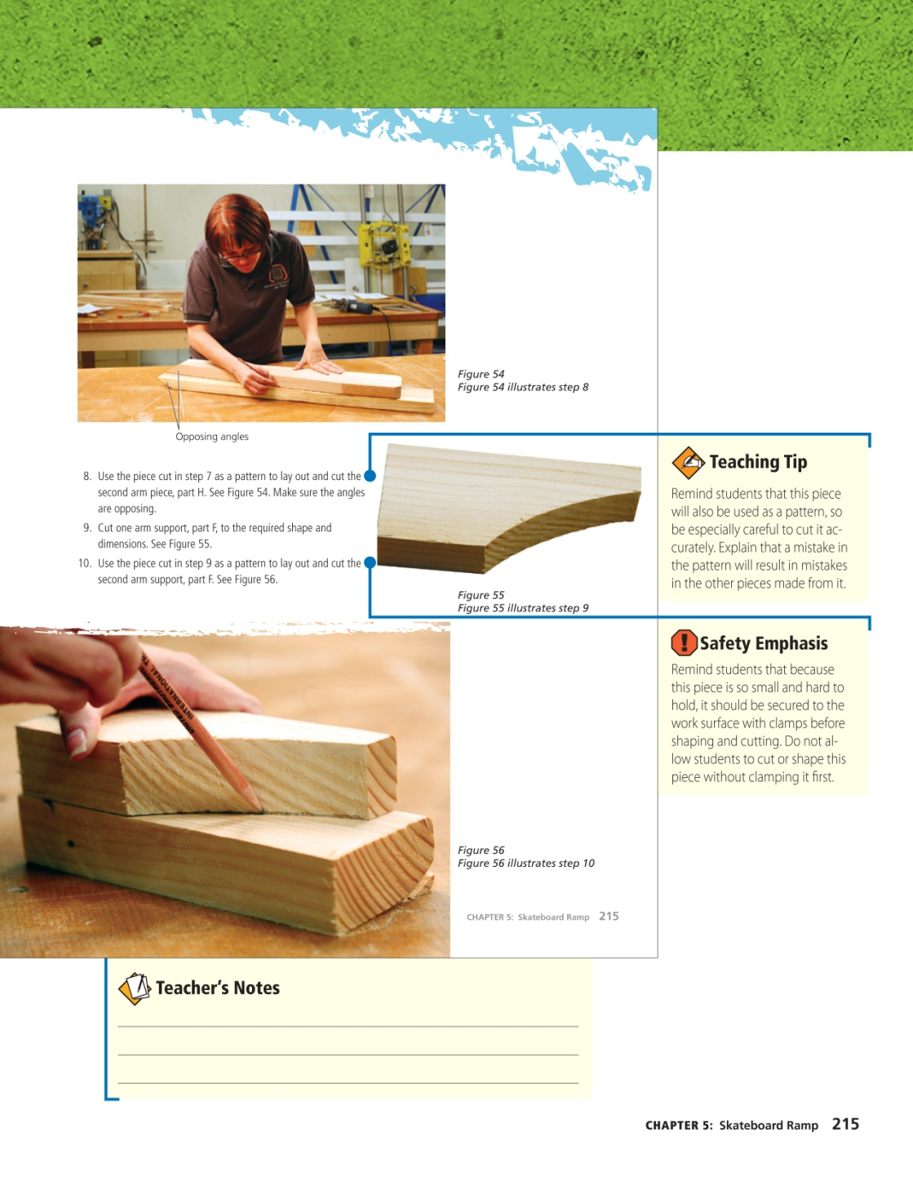

Slide 37
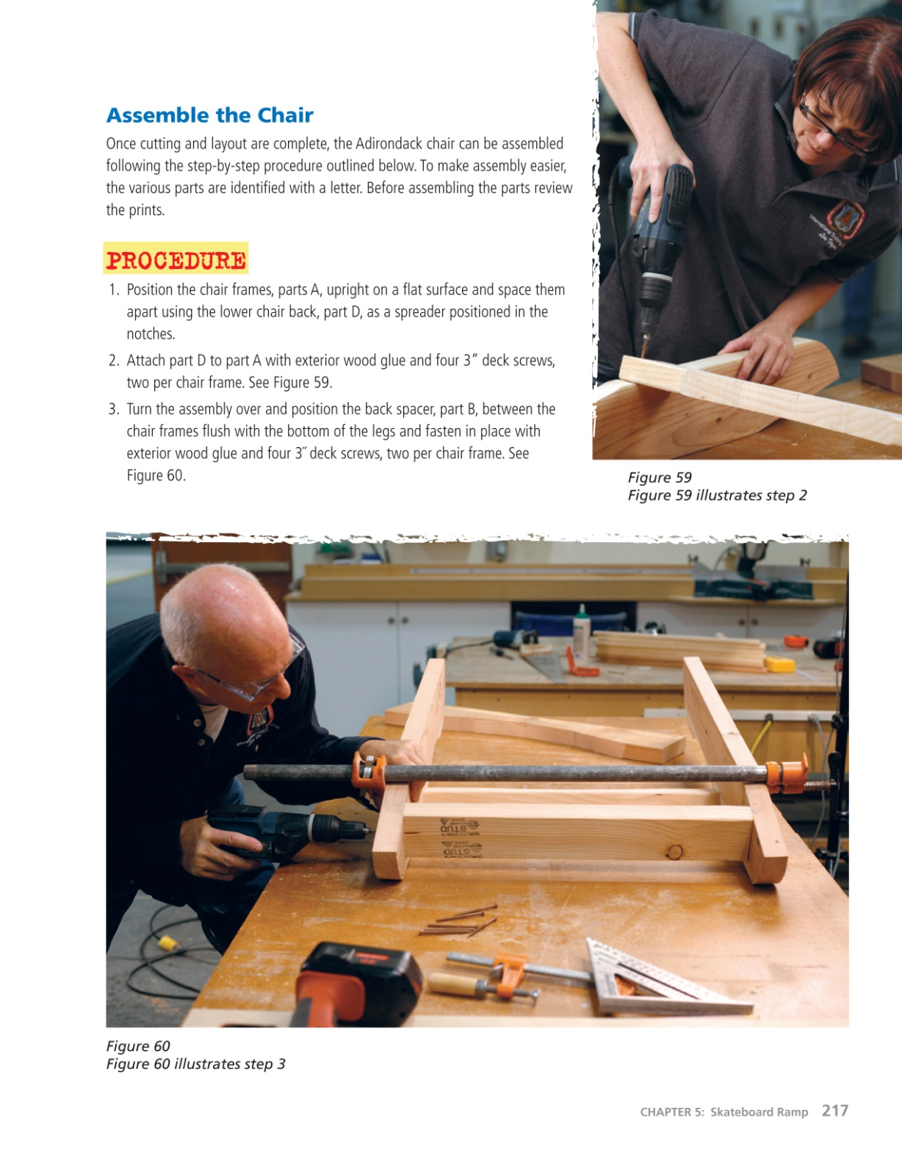

Slide 38
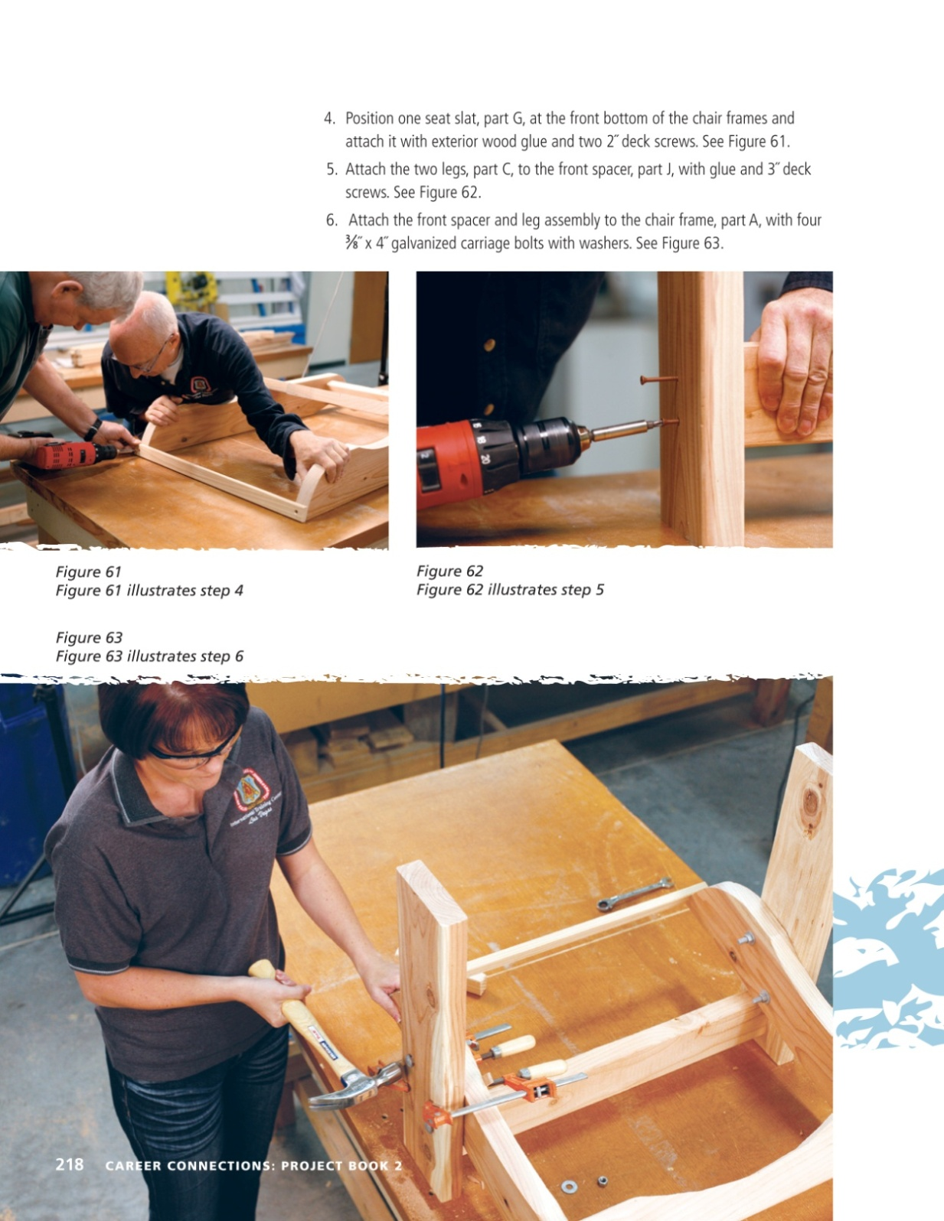

Slide 39
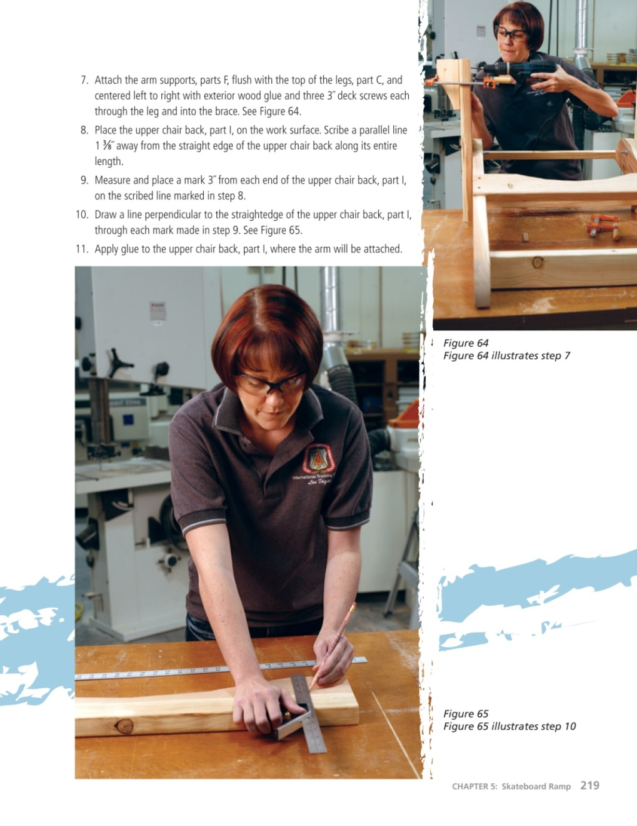
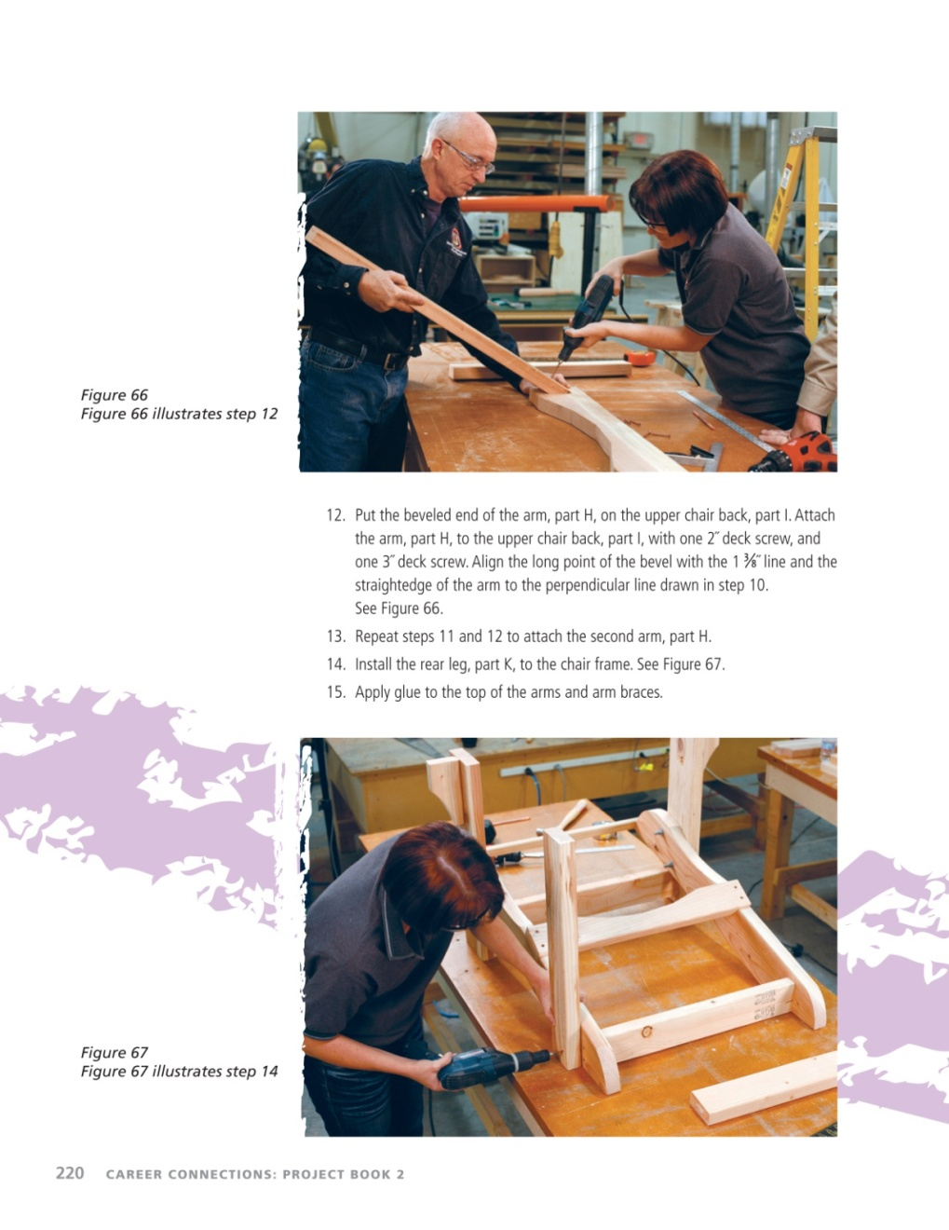

Slide 40
