Slide 1
Succession Planning & Organizational Sustainability
Betsy Davis
October 6, 2019

Slide 2
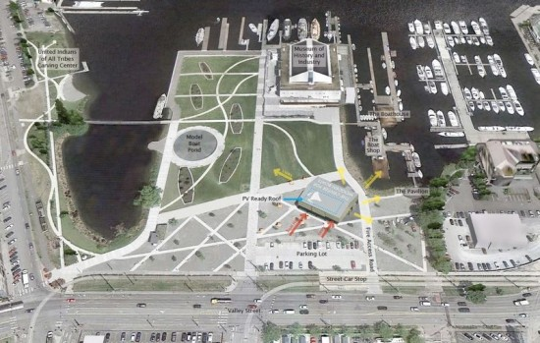
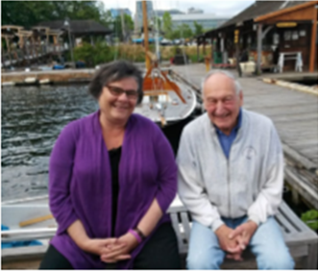
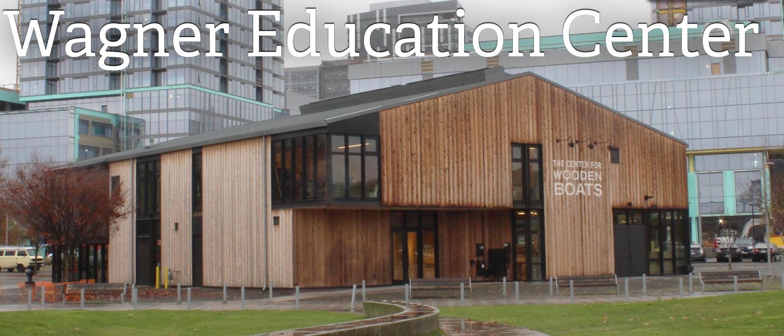

Slide 3
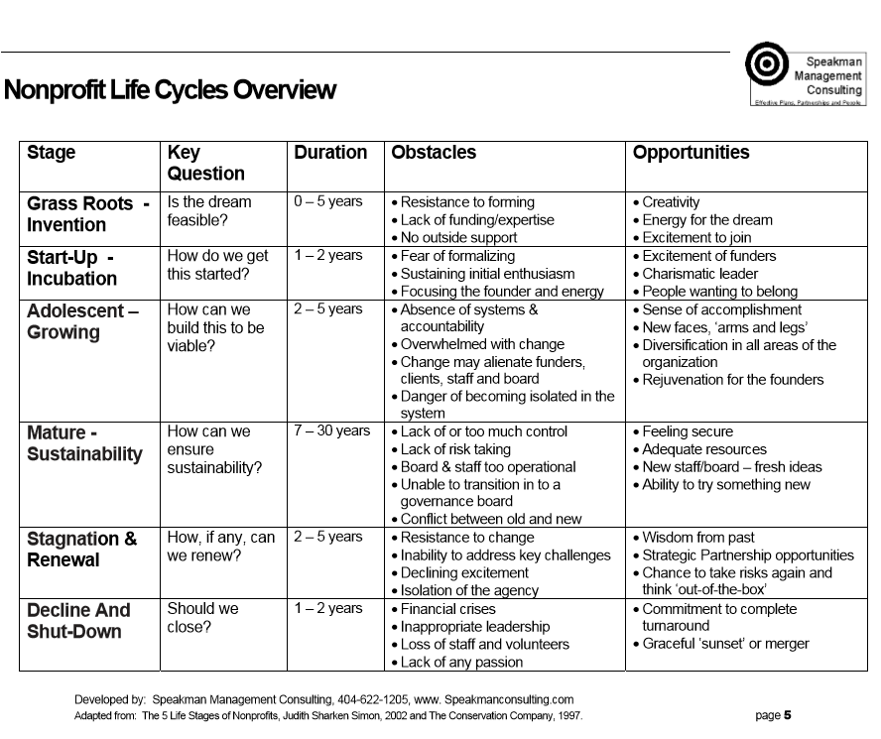
Different leadership skills are required at various phases in a non-profit’s life-cycle

Slide 4
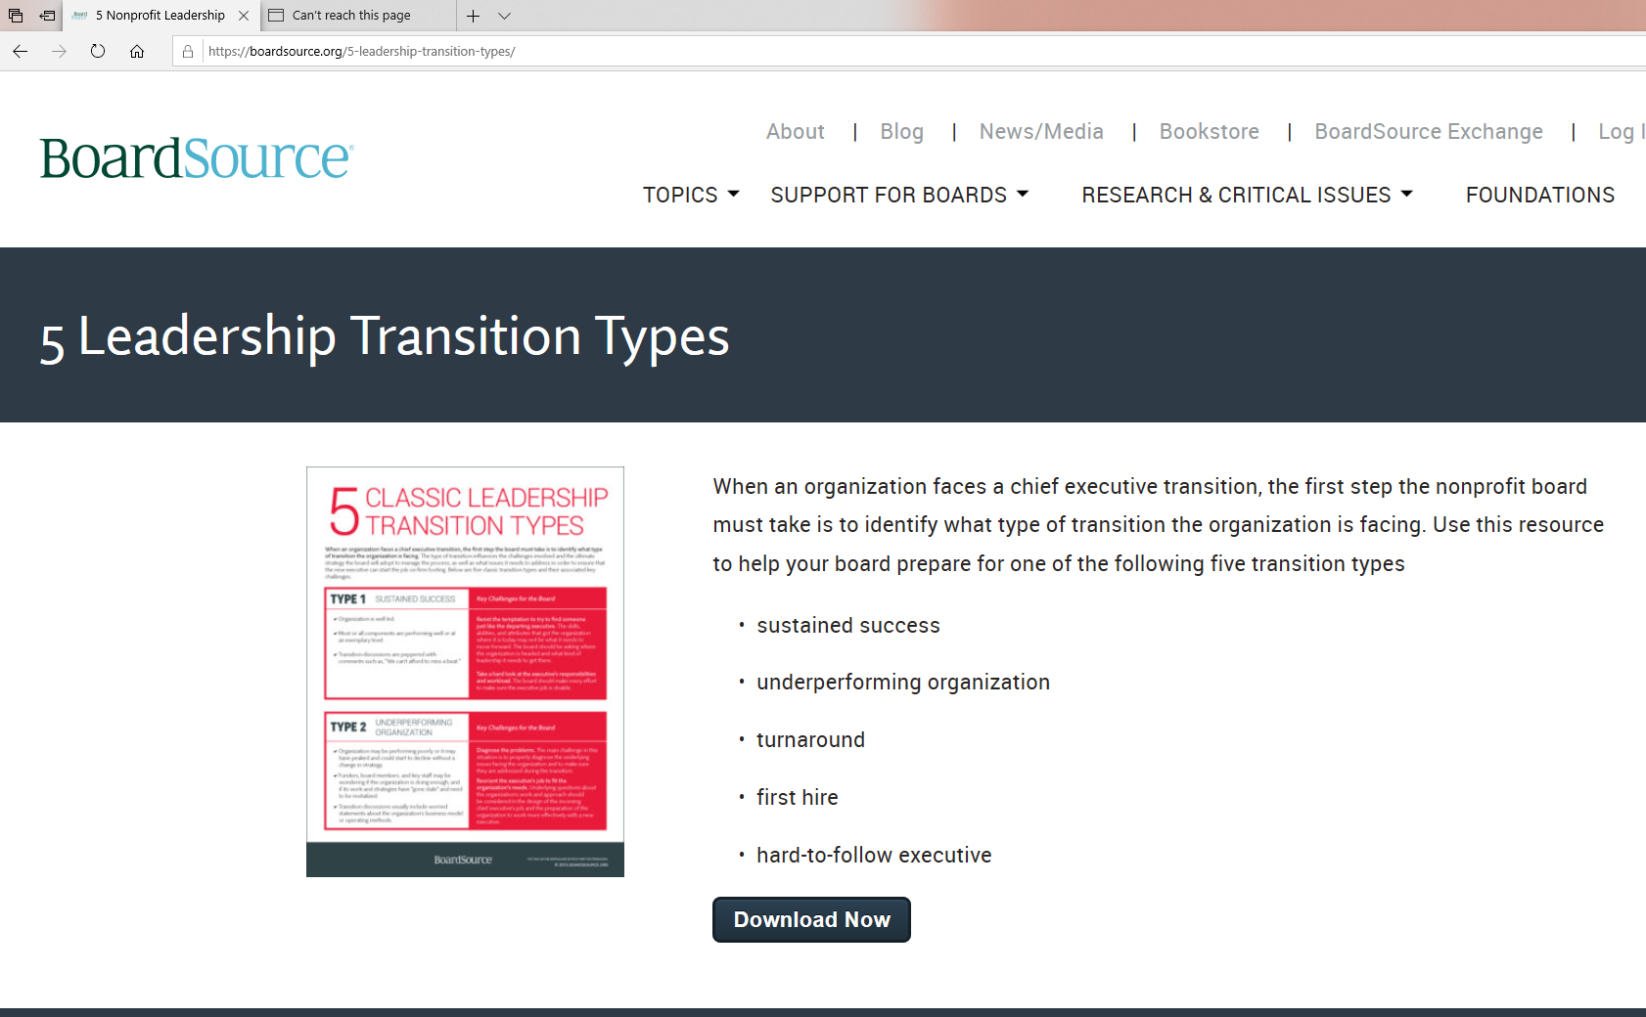
Different leadership skills are required based on the current state of the organization.

Slide 5
Moving to a new Non-Profit
Applying Lessons Learned
Prioritize teamwork with board
Expect excellence from the board
(and help build it)
‘Overcommunicate’ with the board
Prioritize accurate financial reporting and forecasting
Model with “Technical Lead” and “Administrative Lead” can work well.
Balance rate of growth with sustainability
Keep delegating (but make it manageable)

Slide 6

Preparing for Succession
Build a strong and positive culture
Articulate a shared purpose and shared values
Build a strong team
Create solid systems that go beyond the individual
Document procedures
Move information from heads into database(s)
Build an Operating Reserve
Build a strong board

