Slide 1
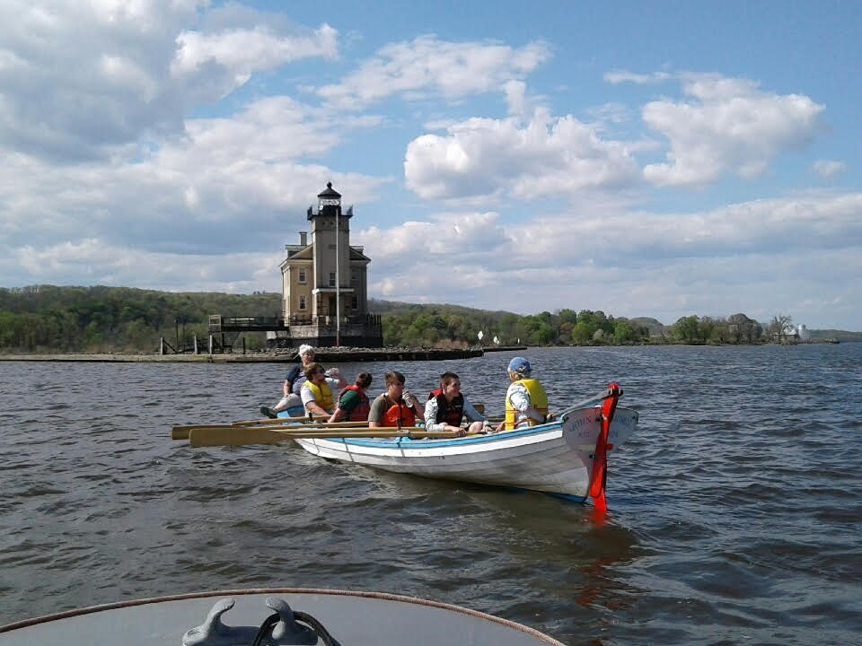
Hudson River Maritime Museum
Wayne Ford
October __, 2019

