Slide 1
A Big Toolbox: How The Carpenter's Boat Shop Does Long-Term Residential Programming
Sarah Highland
October, 2019
September 9, 2019
1
Notes:
1

Slide 2
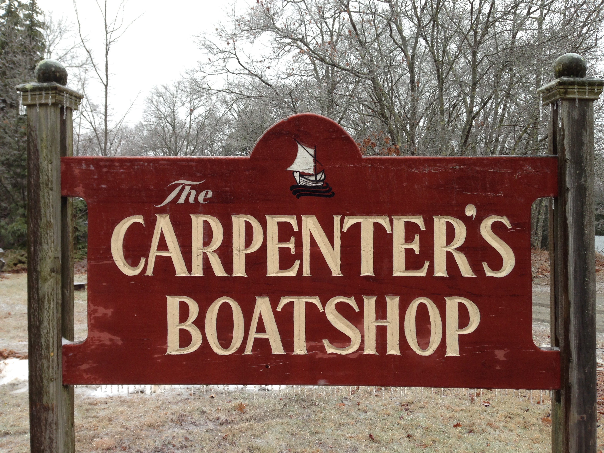
Building Boats, Nurturing Lives, Serving Others

Slide 3
Vital Statistics
Nine Months
Tuition-free
Residential
10 Apprentices per year
Ages 18 – 80 (commonly mid-20's)
Religious roots, broad interpretation
20% boat sales, 80% fundraising
Since 1979

Slide 4
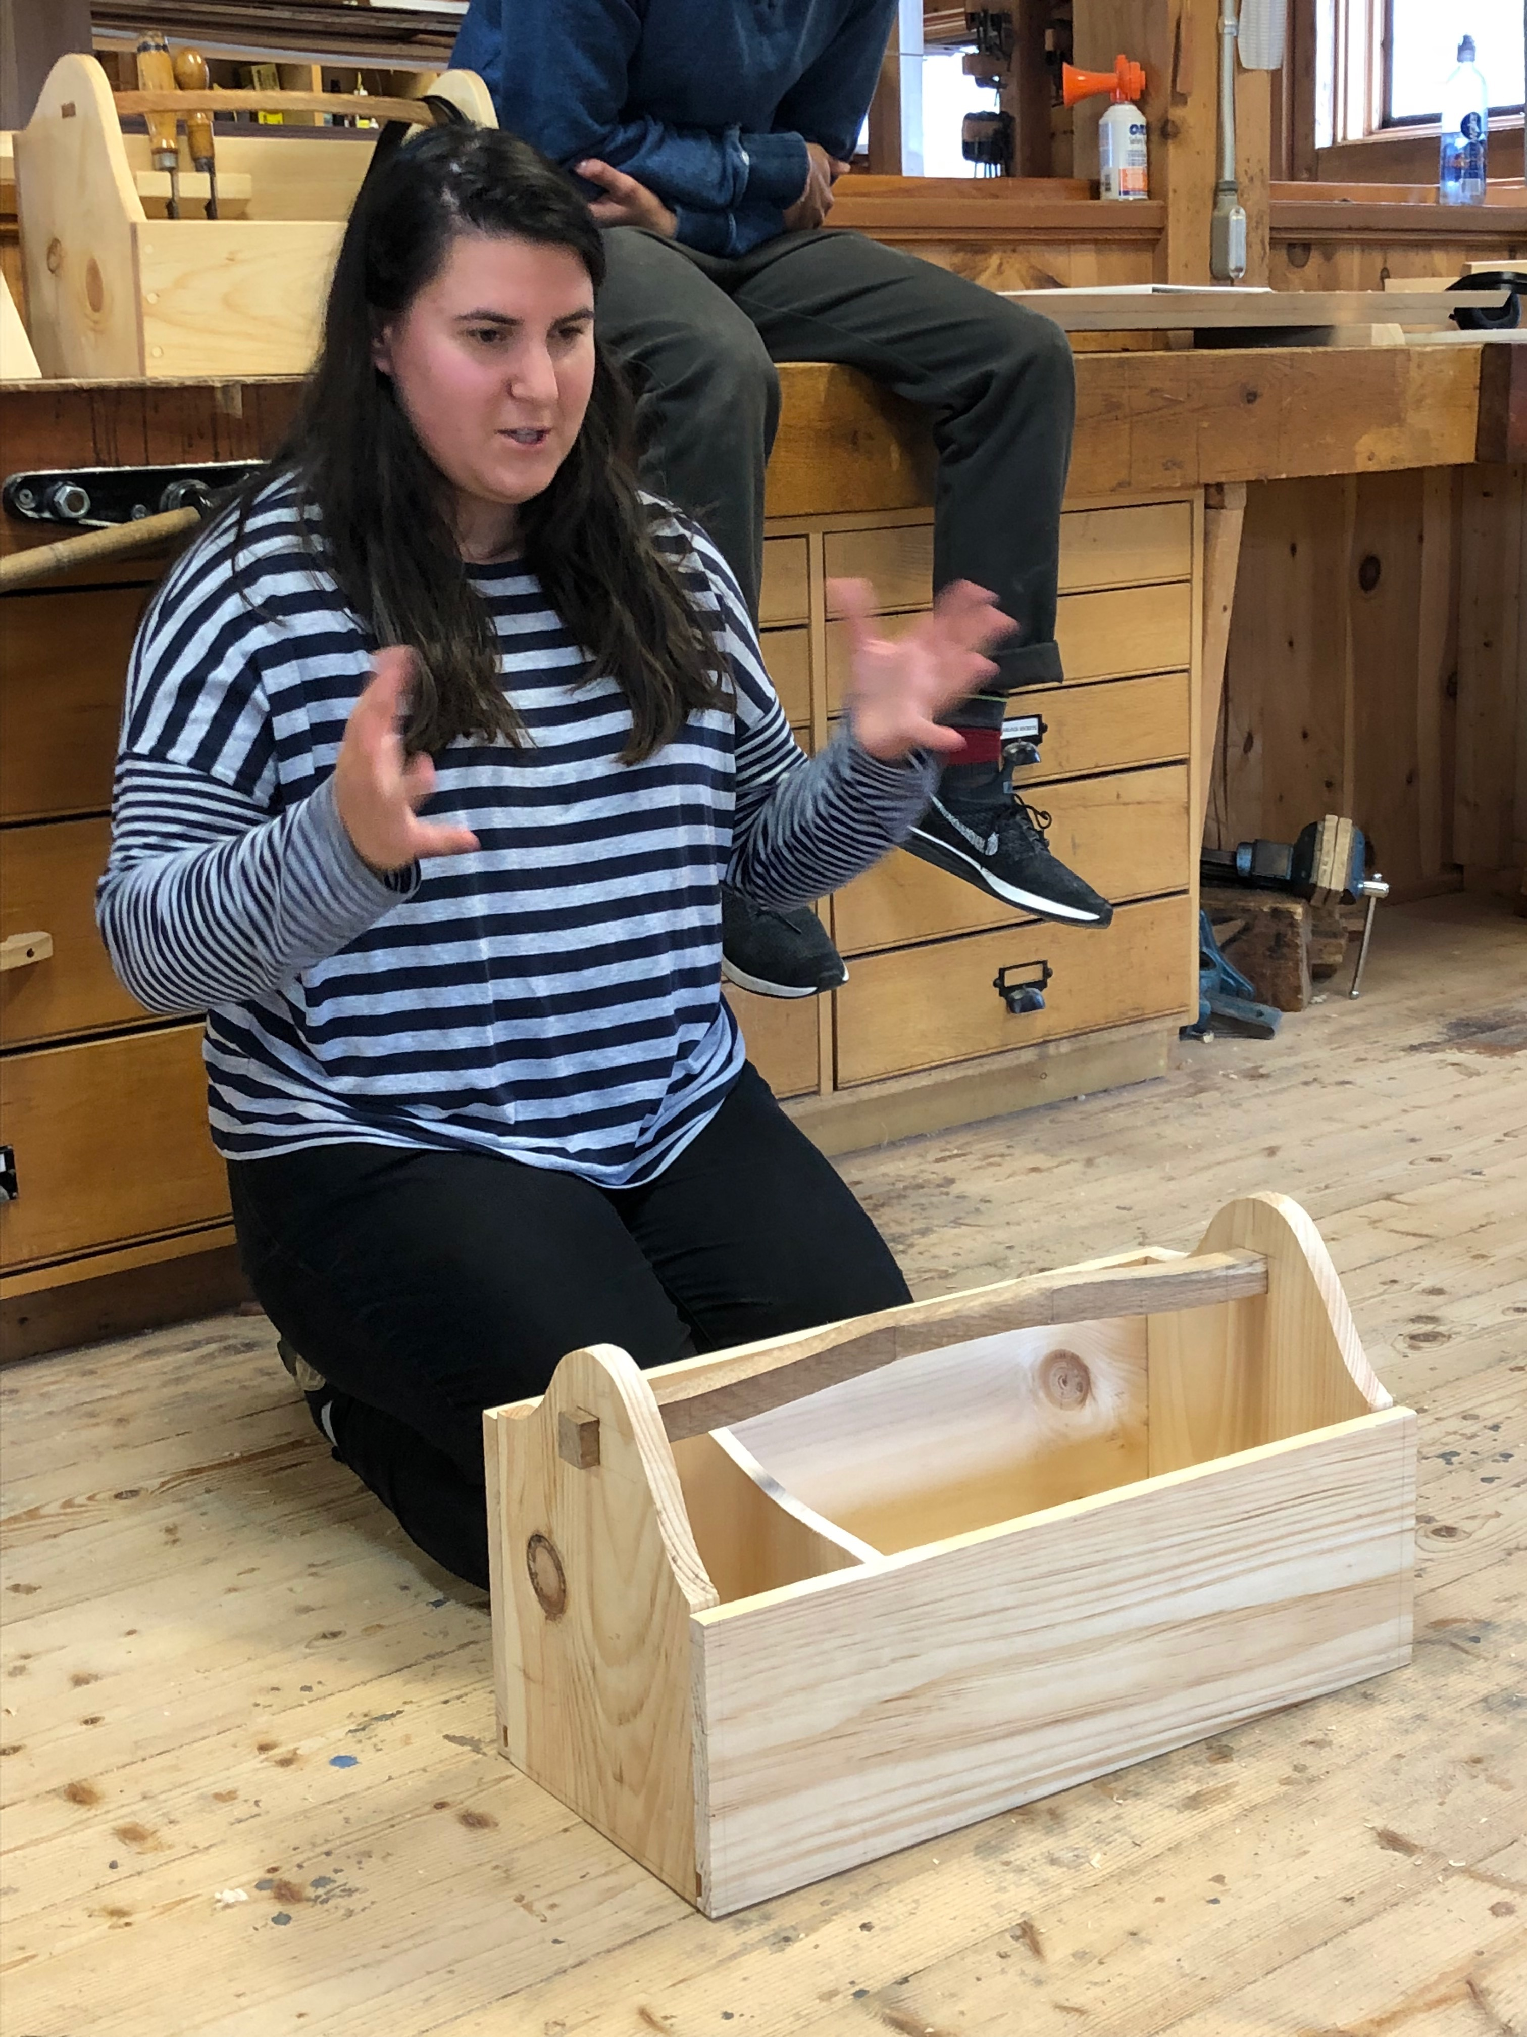
Our Toolbox:

Slide 7
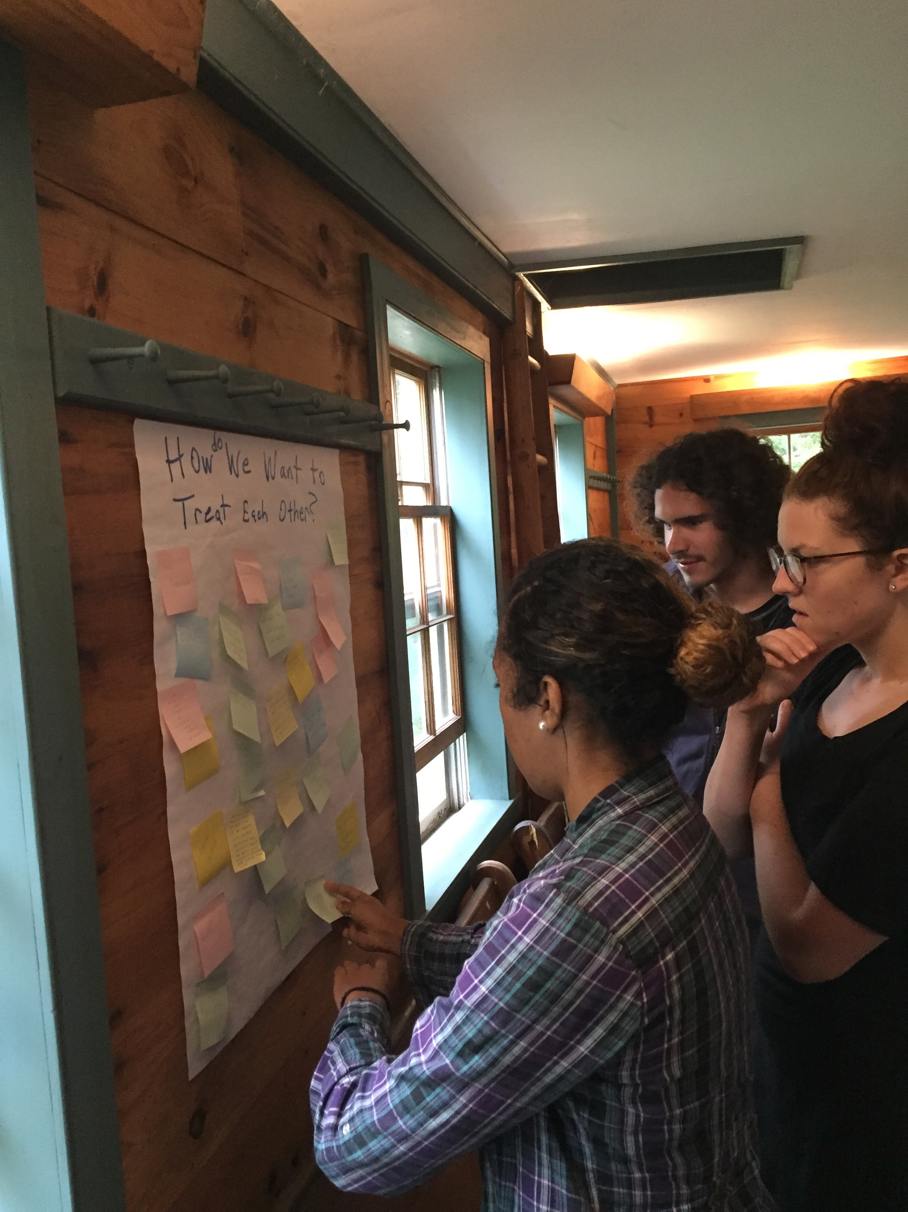

Slide 8
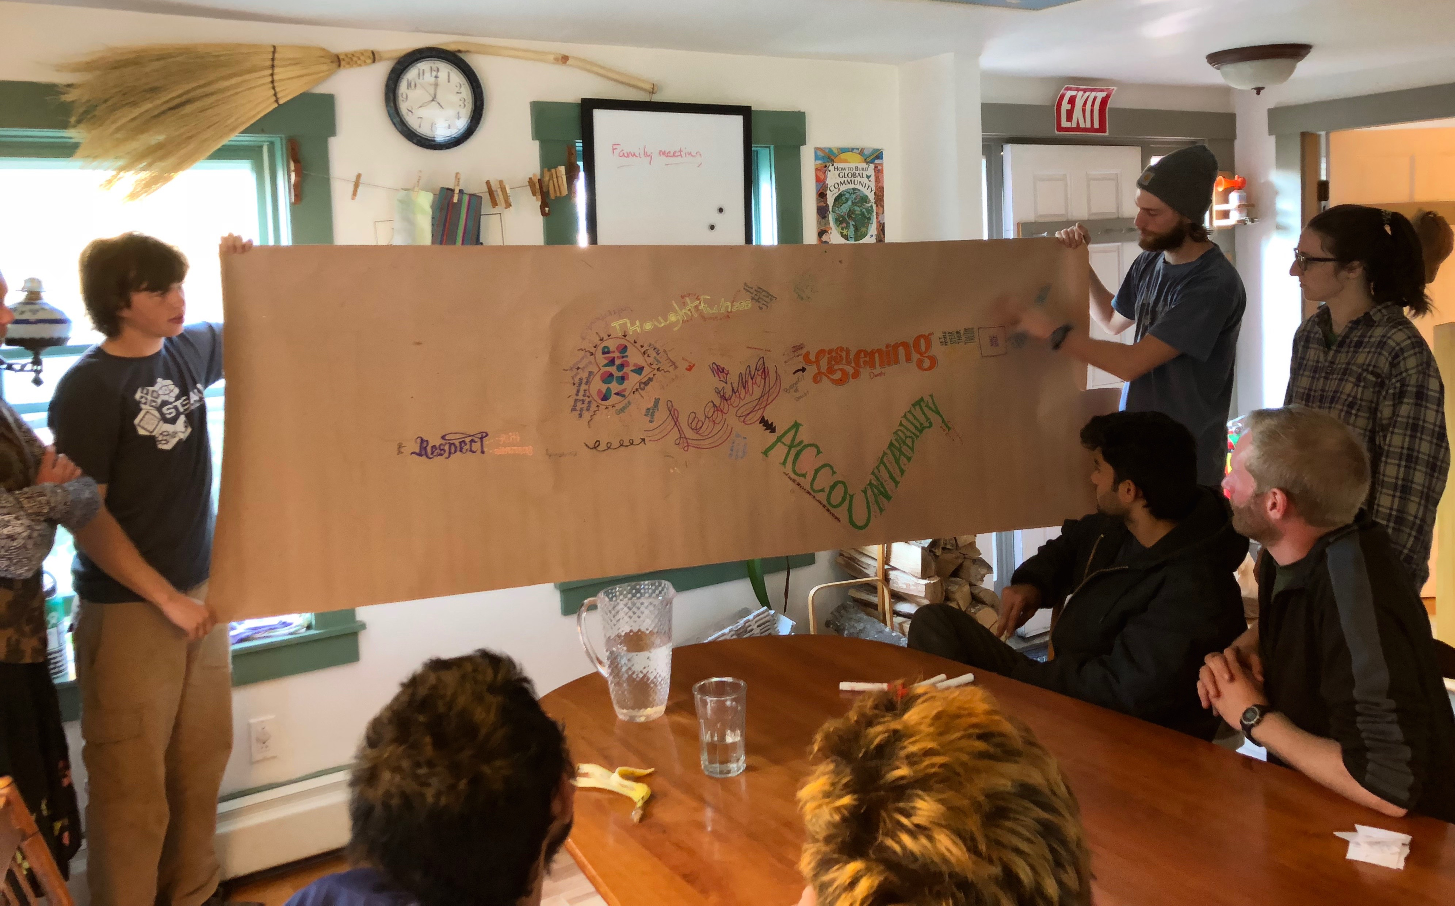
Community Covenant

Slide 9
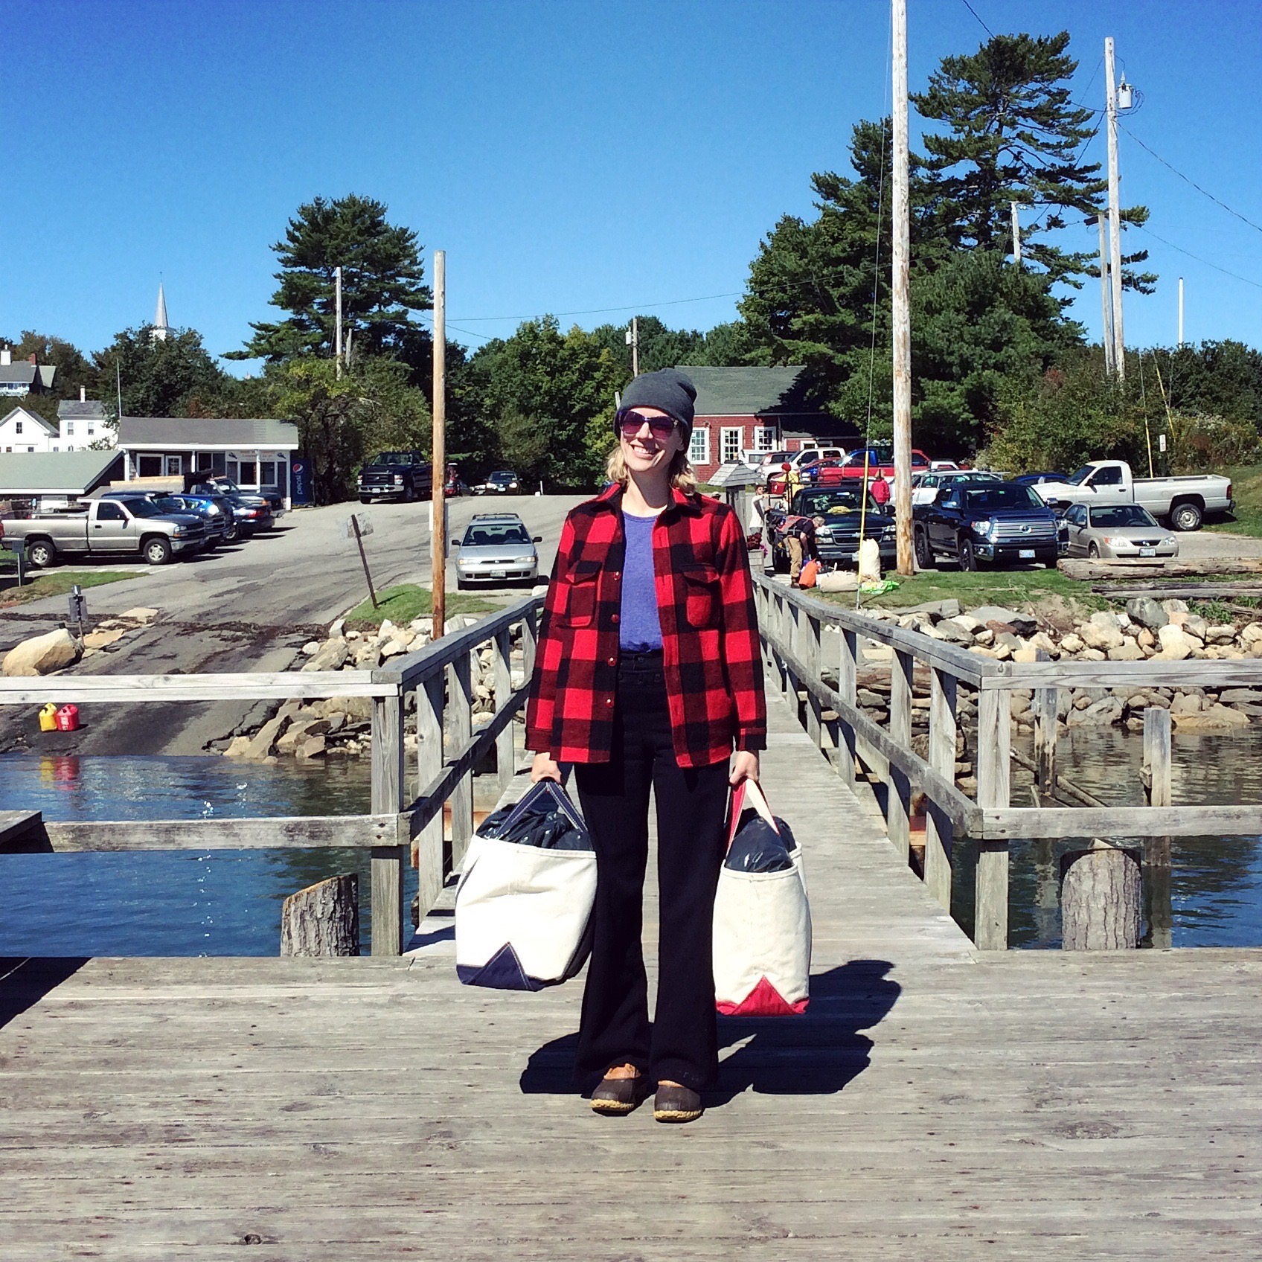
Island Solo Weekend

Slide 10
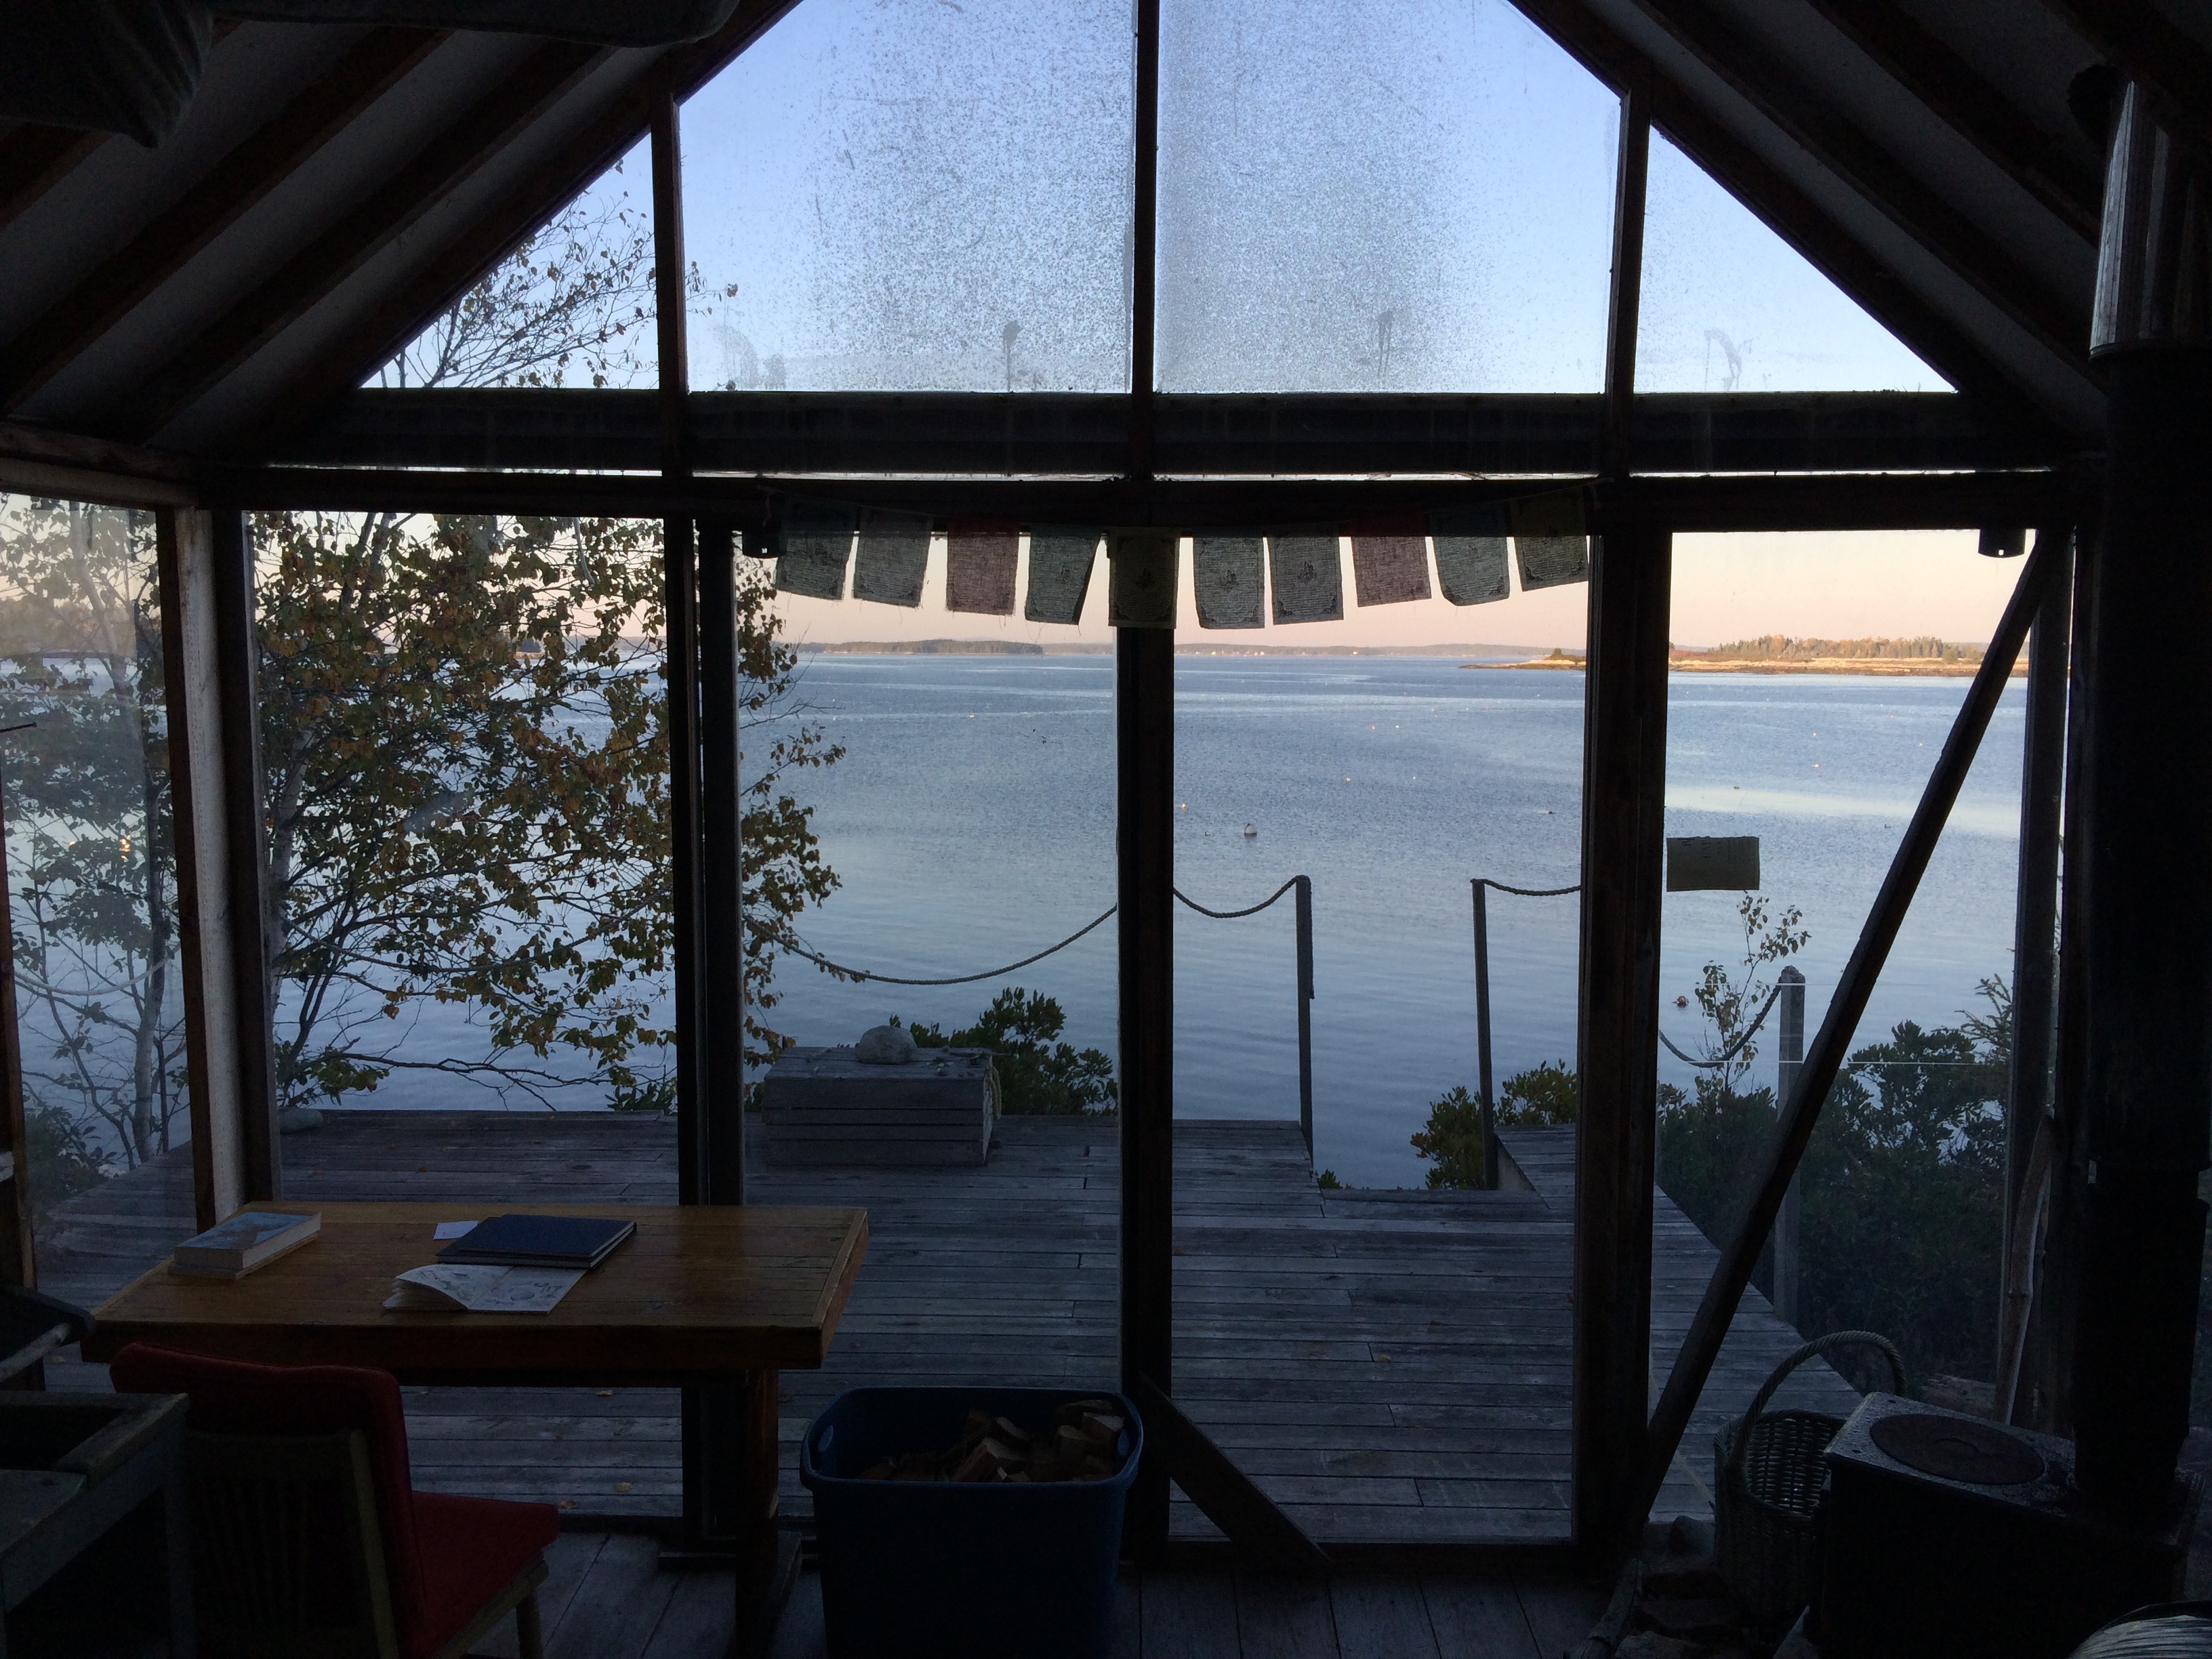

Slide 11
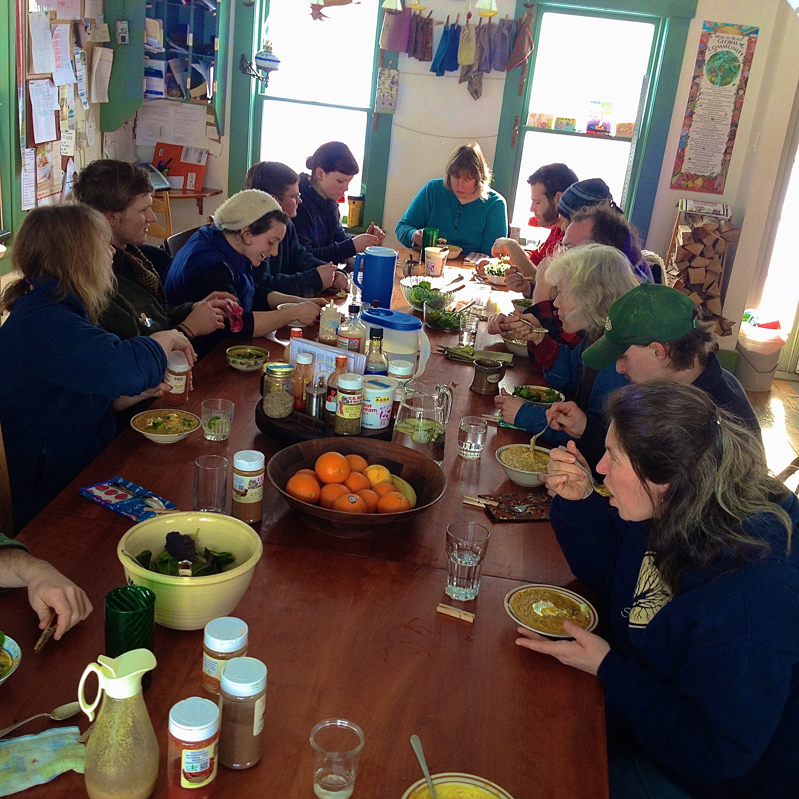
Community Table, and...

Slide 12
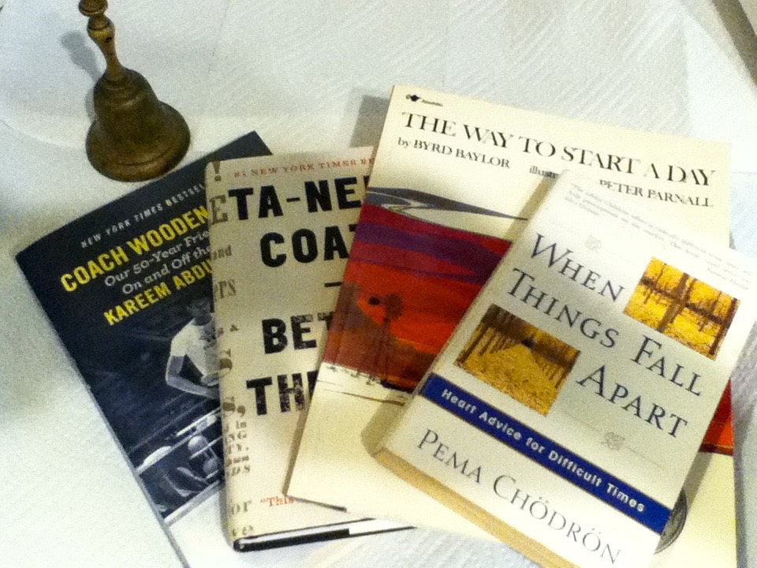
After-meal Reflections

Slide 13
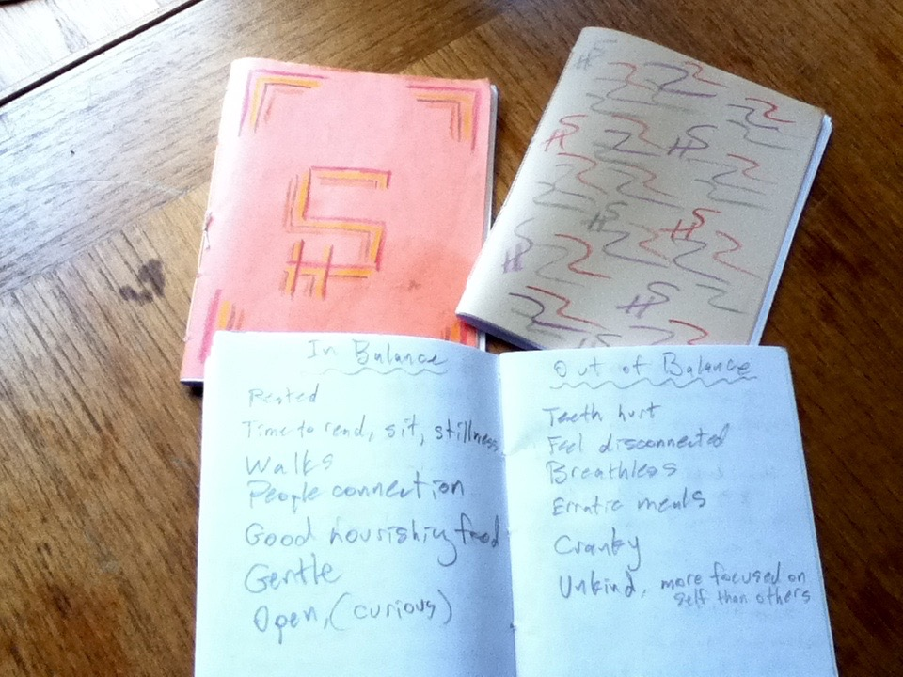
Homemade Journals

Slide 14
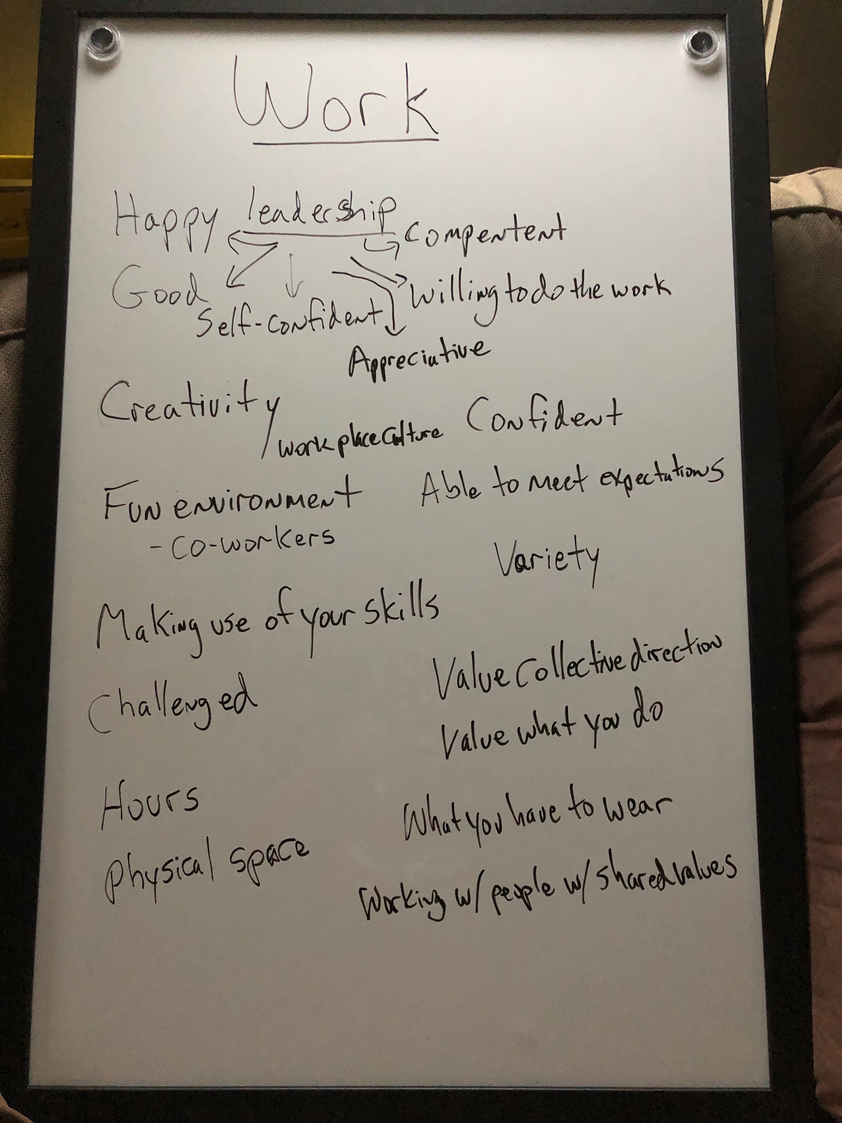

Slide 15
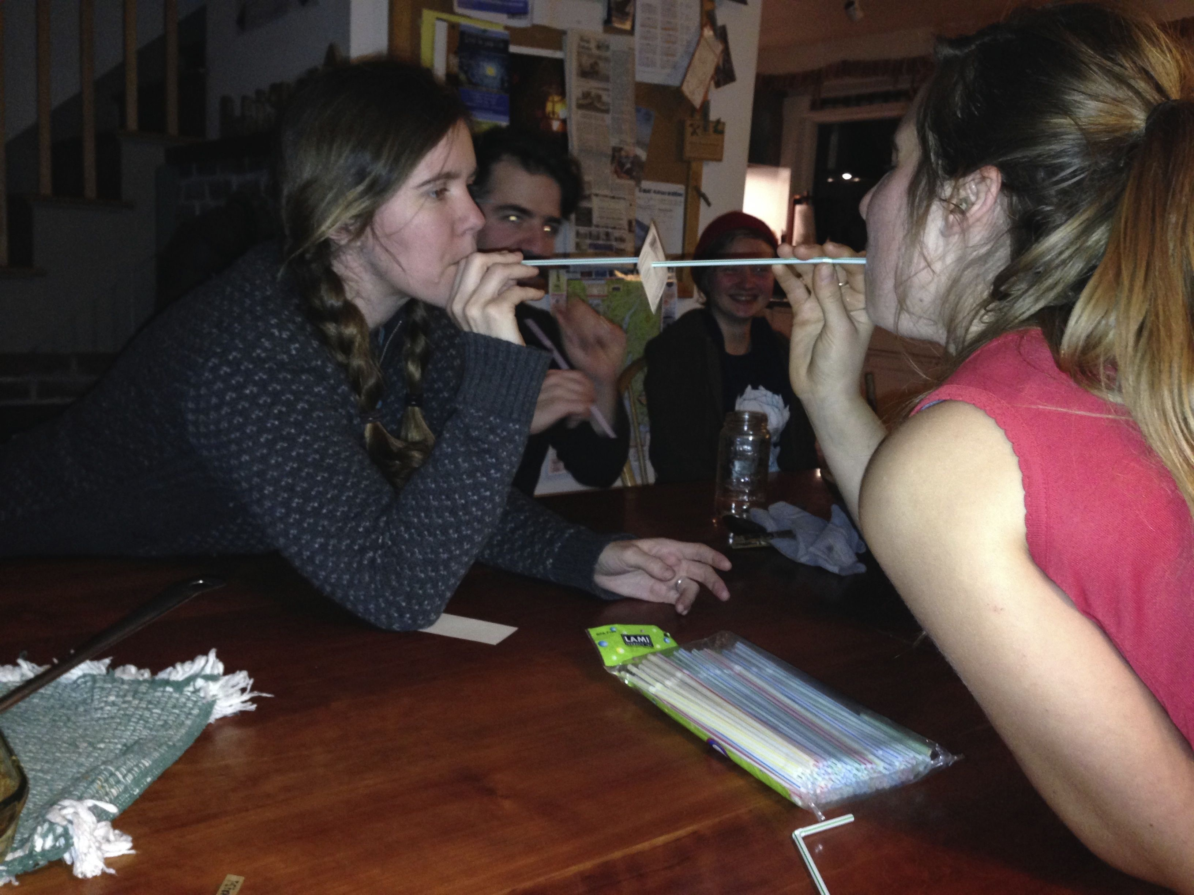

Slide 16
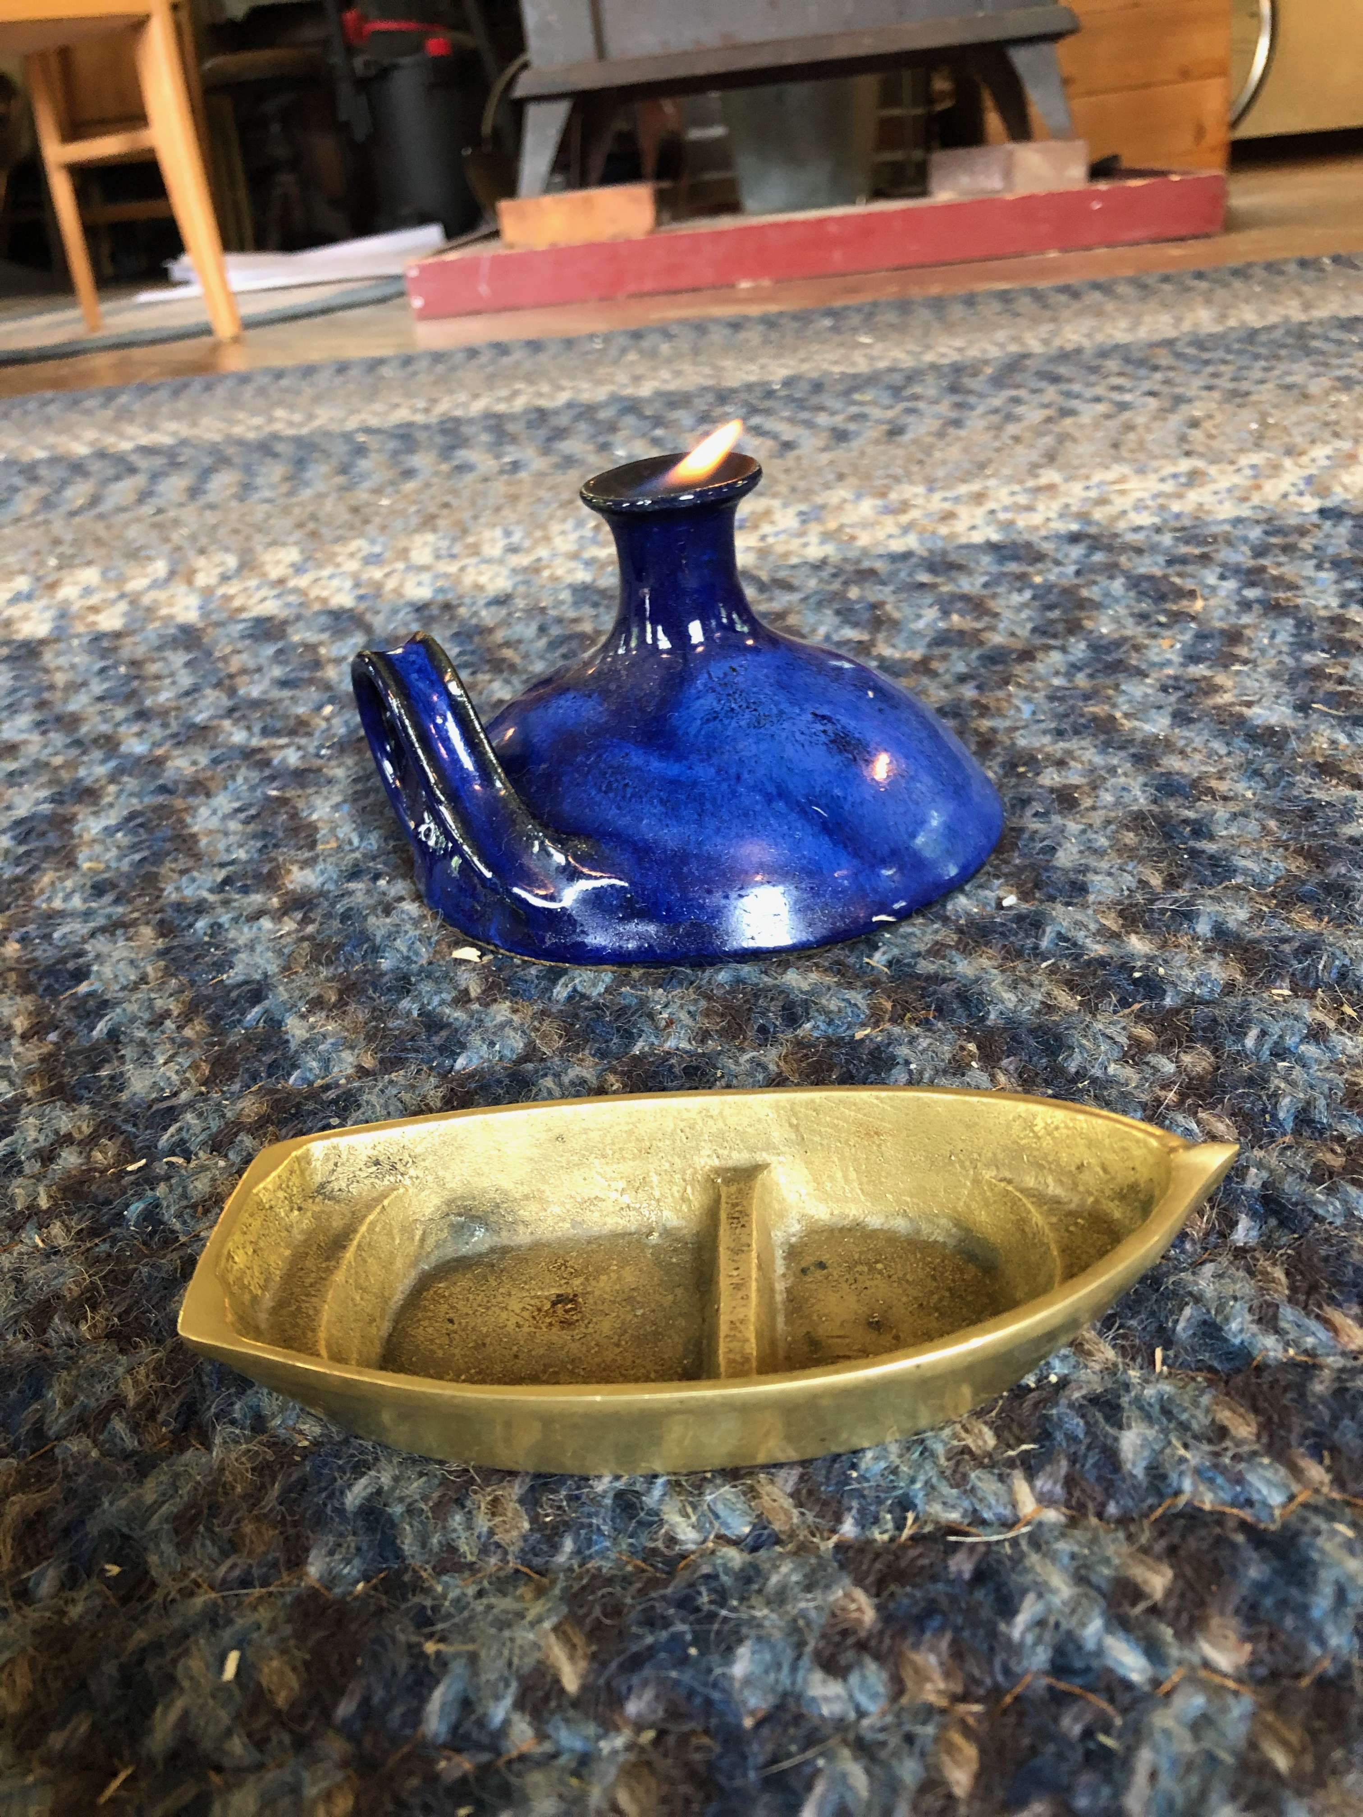
Weekly Chapel

Slide 17
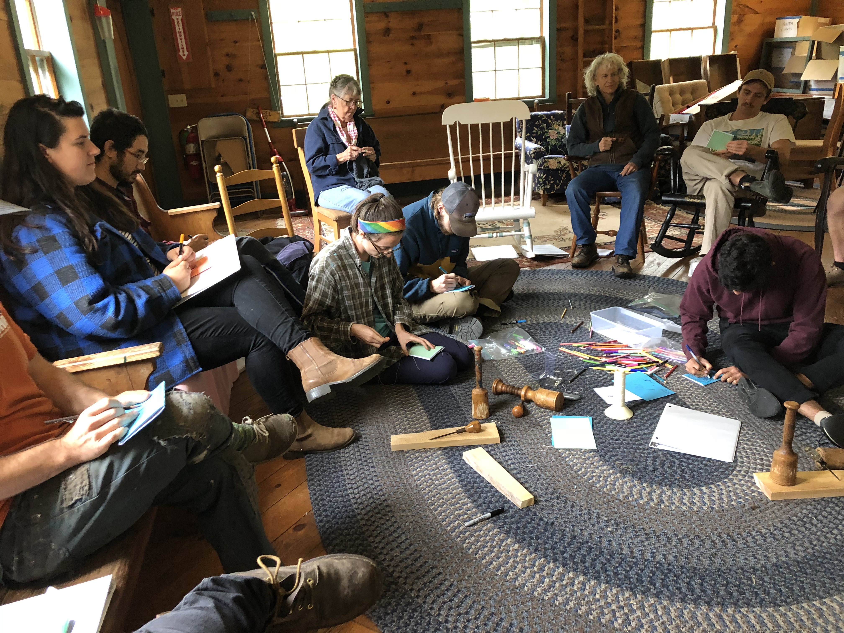

Slide 18
Pond Hockey!

Slide 19
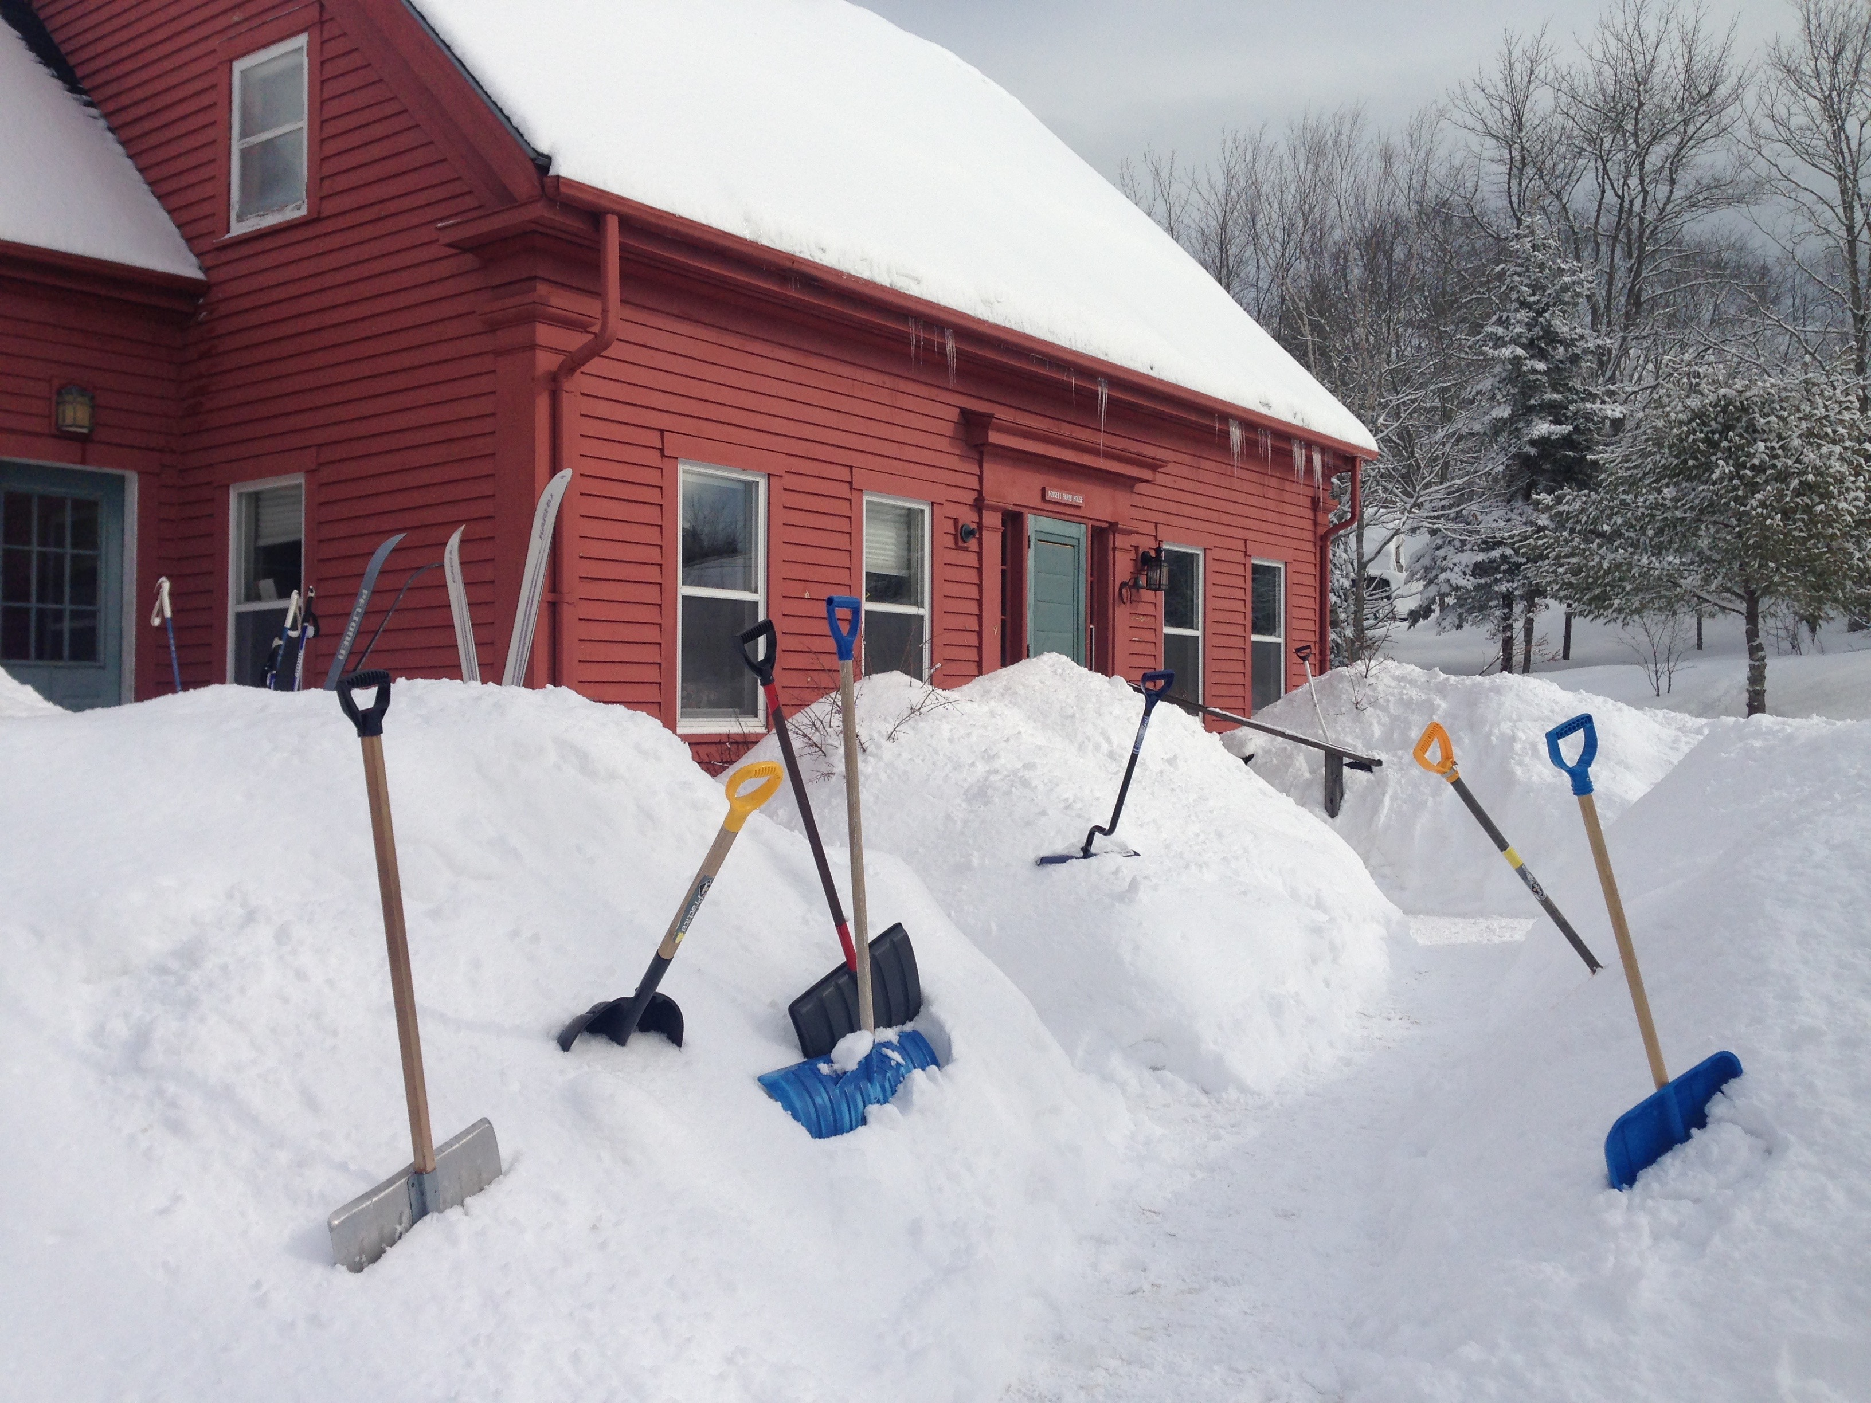
Serving Each Other and Our Neighbors...

Slide 20
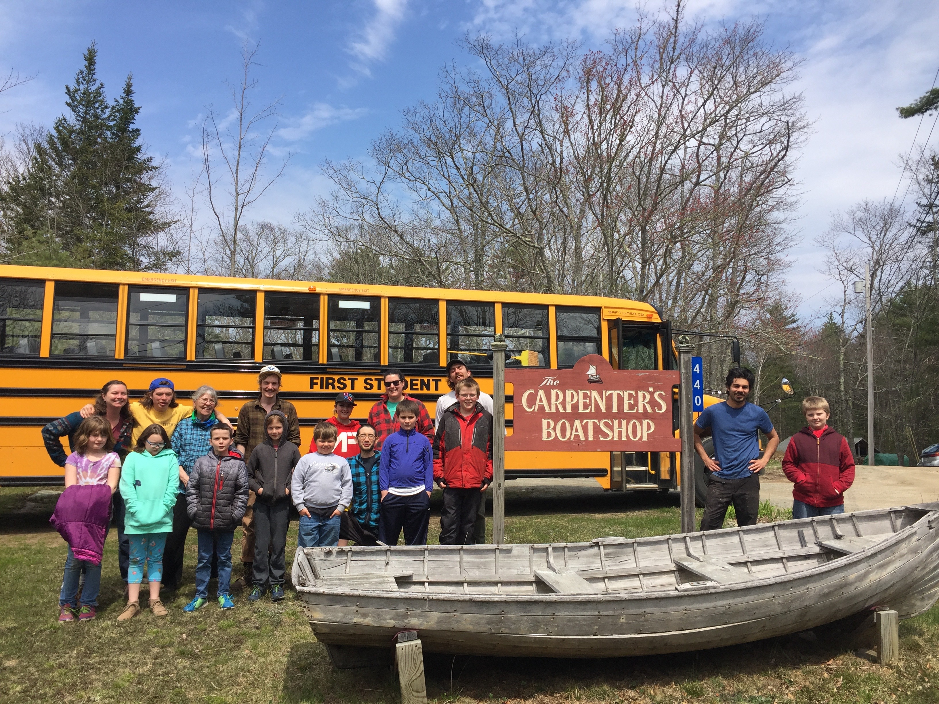
...Of All Ages

Slide 21
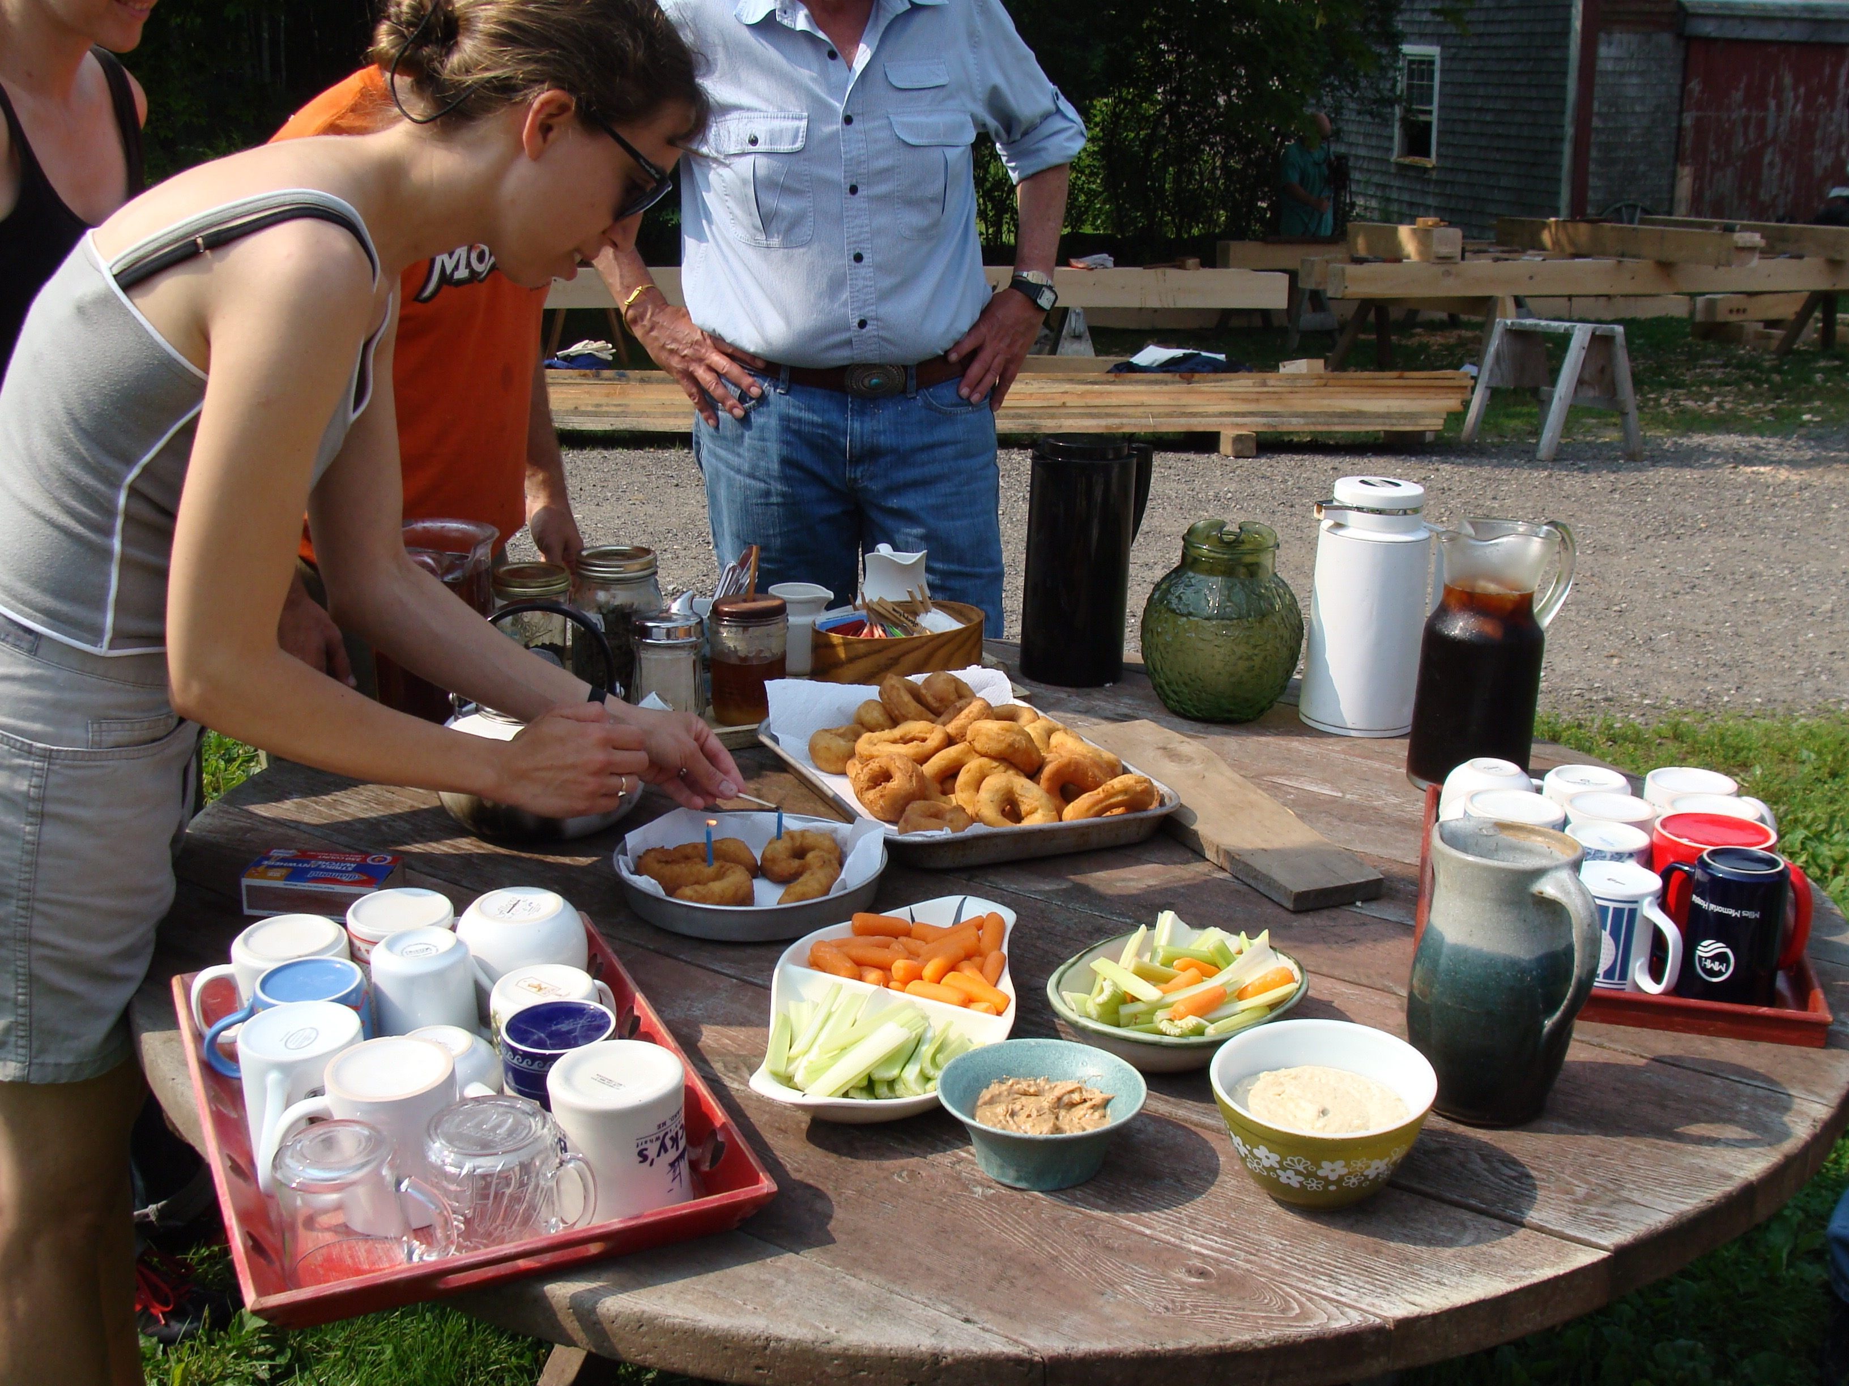
Tea Time: 10:00 AM daily – please come!

