Slide 1
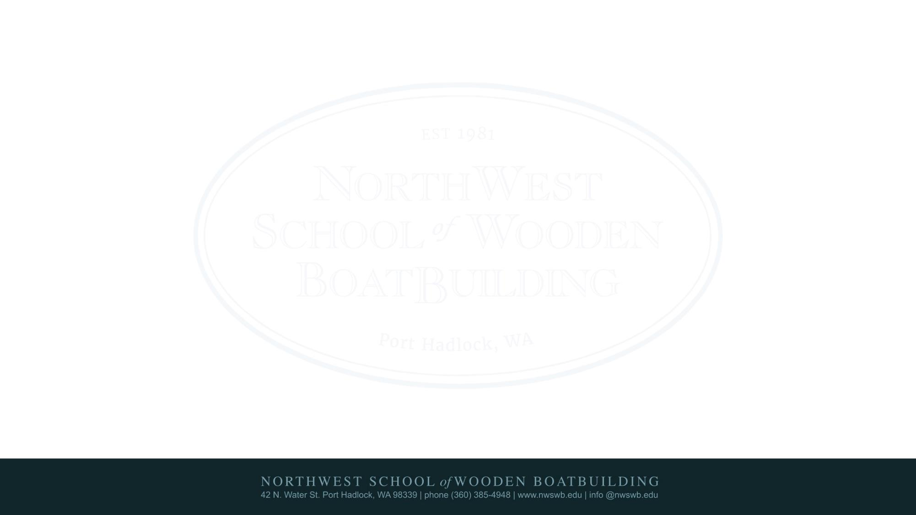

Tools for Building an Organizational Plan
Betsy Davis, Executive Director
Northwest School of Wooden Boatbuilding
Notes:
Transition from Sean to me. Leadership requires all the above …

Slide 2
Some Basic Questions …
How will you serve?
Who will your serve?
What need is this addressing?
How will you uniquely address that need?
Notes:
In a location where boatbuilding has happened for over a century. This photo reminds us of the incredible natural resources our economies here were based on.

Slide 3




Five questions create a common framework to allow organizations to learn from each other and better serve their communities.
Charting Impact
Notes:
Transition from Sean to me. Leadership requires all the above …

Slide 4
What is your organization aiming to accomplish?
What are your strategies for making this happen?
What are your organization’s capabilities for doing this?
How will your organization know if you are making progress?
What have and haven’t you accomplished so far?
Charting Impact’s Five Questions
Notes:
Transition from Sean to me. Leadership requires all the above …

Slide 5
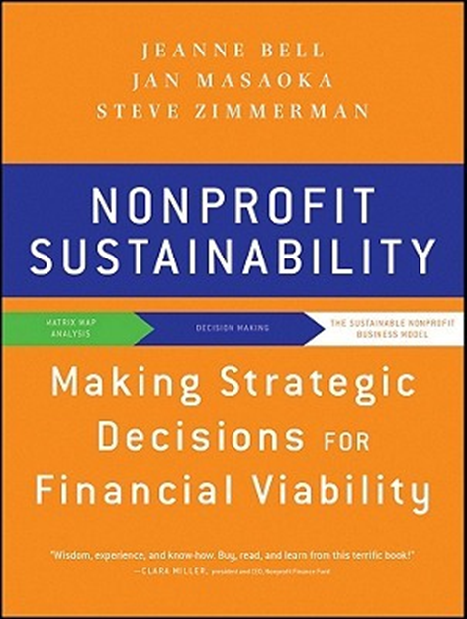
mission impact and financial viability
Notes:
Transition from Sean to me. Leadership requires all the above …

Slide 6
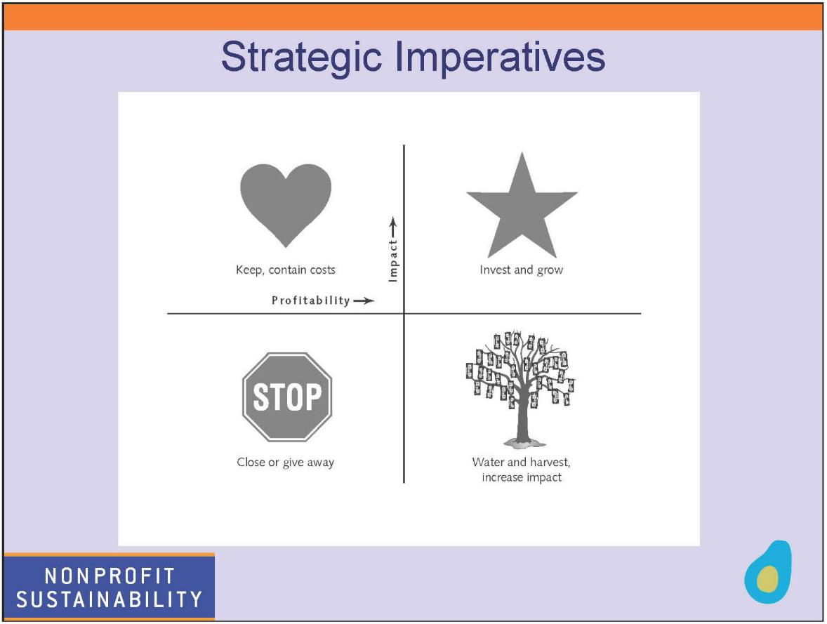
Notes:
Transition from Sean to me. Leadership requires all the above …

Slide 7
Notes:
Transition from Sean to me. Leadership requires all the above …

Slide 8
Notes:
Transition from Sean to me. Leadership requires all the above …

Slide 9
Notes:
Transition from Sean to me. Leadership requires all the above …

Slide 10
Notes:
Transition from Sean to me. Leadership requires all the above …

Slide 11
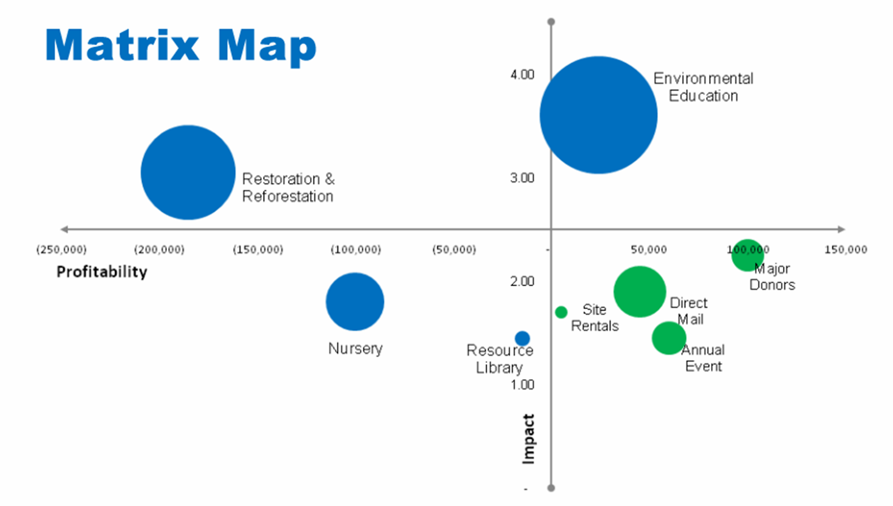
Notes:
Transition from Sean to me. Leadership requires all the above …

Slide 12
SWOT Analysis
Strengths
Weaknesses
External Internal
Opportunities
Threats
Notes:
Transition from Sean to me. Leadership requires all the above …

Slide 13
Appreciative Inquiry
Problem Solving | Appreciative inquiry
1. "Felt Need," identification of Problem | 1. Appreciating & Valuing the Best of "What Is"
2. Analysis of Causes | 2. Envisioning "What Might Be"
3. Analysis & Possible Solutions | 3. Dialoguing "What Should Be"
4. Action Planning (Treatment)
Basic Assumption: An Organization is a Problem to be Solved | Basic Assumption: An Organization is a Mystery to be Embraced
This table comes from the Cooperrider and Whitney (2001) article (Case Western Reserve) and is used to describe some of the distinctions between AI and approaches to organizational development not based on what they call positive potentia
Notes:
Transition from Sean to me. Leadership requires all the above …

Slide 14
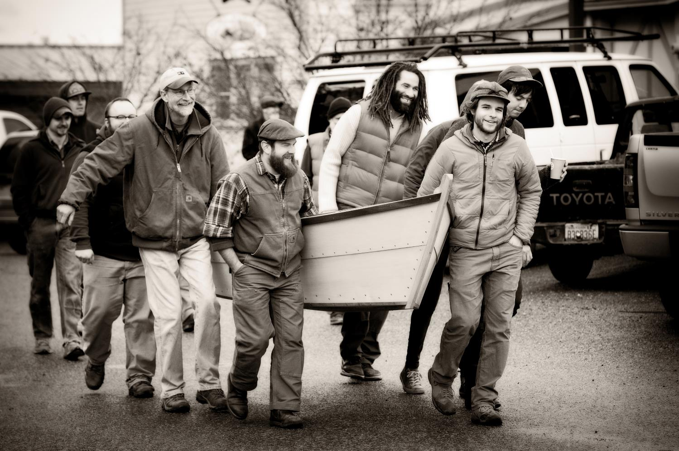
Mission
Our mission is to teach and preserve traditional and contemporary wooden boatbuilding skills, while developing the individual as a craftsman.
Notes:
The Boat School programs are split into three different paths consisting of 9-month or 12-month degrees. Most students receive a AOS degree upon completion. In Traditional Large craft, students construct vessels such as fishing boats, tugs, cruising yachts, and motorboats with structural element such as decks, cabin houses, interiors, and inboard engines.

Slide 15
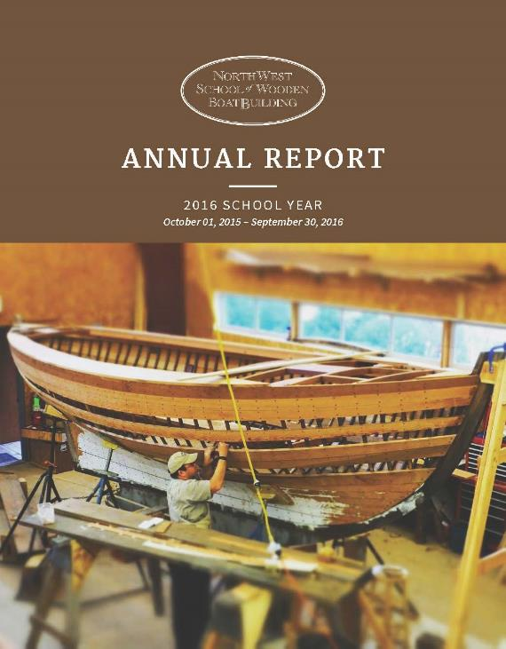
Example - Purpose:
Provide quality education and job readiness
Preserve and teach craftsmanship
Bring vitality to our local community
Notes:
In a location where boatbuilding has happened for over a century. This photo reminds us of the incredible natural resources our economies here were based on.

Slide 16
Example: Values
Experiential Learning
Authenticity
Tradition
Relevance
Problem solving and innovation
Community
Continuous improvement
Integrity
Craftsmanship – “A skilled craftsman gets a job done well, quickly, efficiently and at a reasonable cost. Integrity is not just doing a good job to your standards, it also means spending your client’s resources as efficiently as you can. We believe that good craftsmanship is a measure of the harmony with which the tasks for any given project are finished.”
Chief Instructor Emeritus
Jeff Hammond
Notes:
In a location where boatbuilding has happened for over a century. This photo reminds us of the incredible natural resources our economies here were based on.

Slide 17
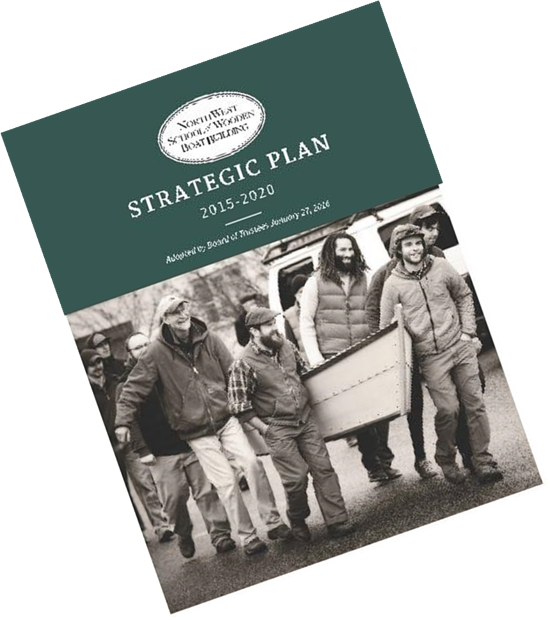
1 ½ years
Instructors and other staff
Board of Directors
Other volunteers
Alums
Program Advisory Committee
Other Employers
Community Members
Notes:
In a location where boatbuilding has happened for over a century. This photo reminds us of the incredible natural resources our economies here were based on.

Slide 18
Summary re: Planning Tools
Some Basic Questions
Charting Impact
Nonprofit Sustainability
SWOT Analysis
Appreciative Inquiry
Notes:
In a location where boatbuilding has happened for over a century. This photo reminds us of the incredible natural resources our economies here were based on.

