Slide 1
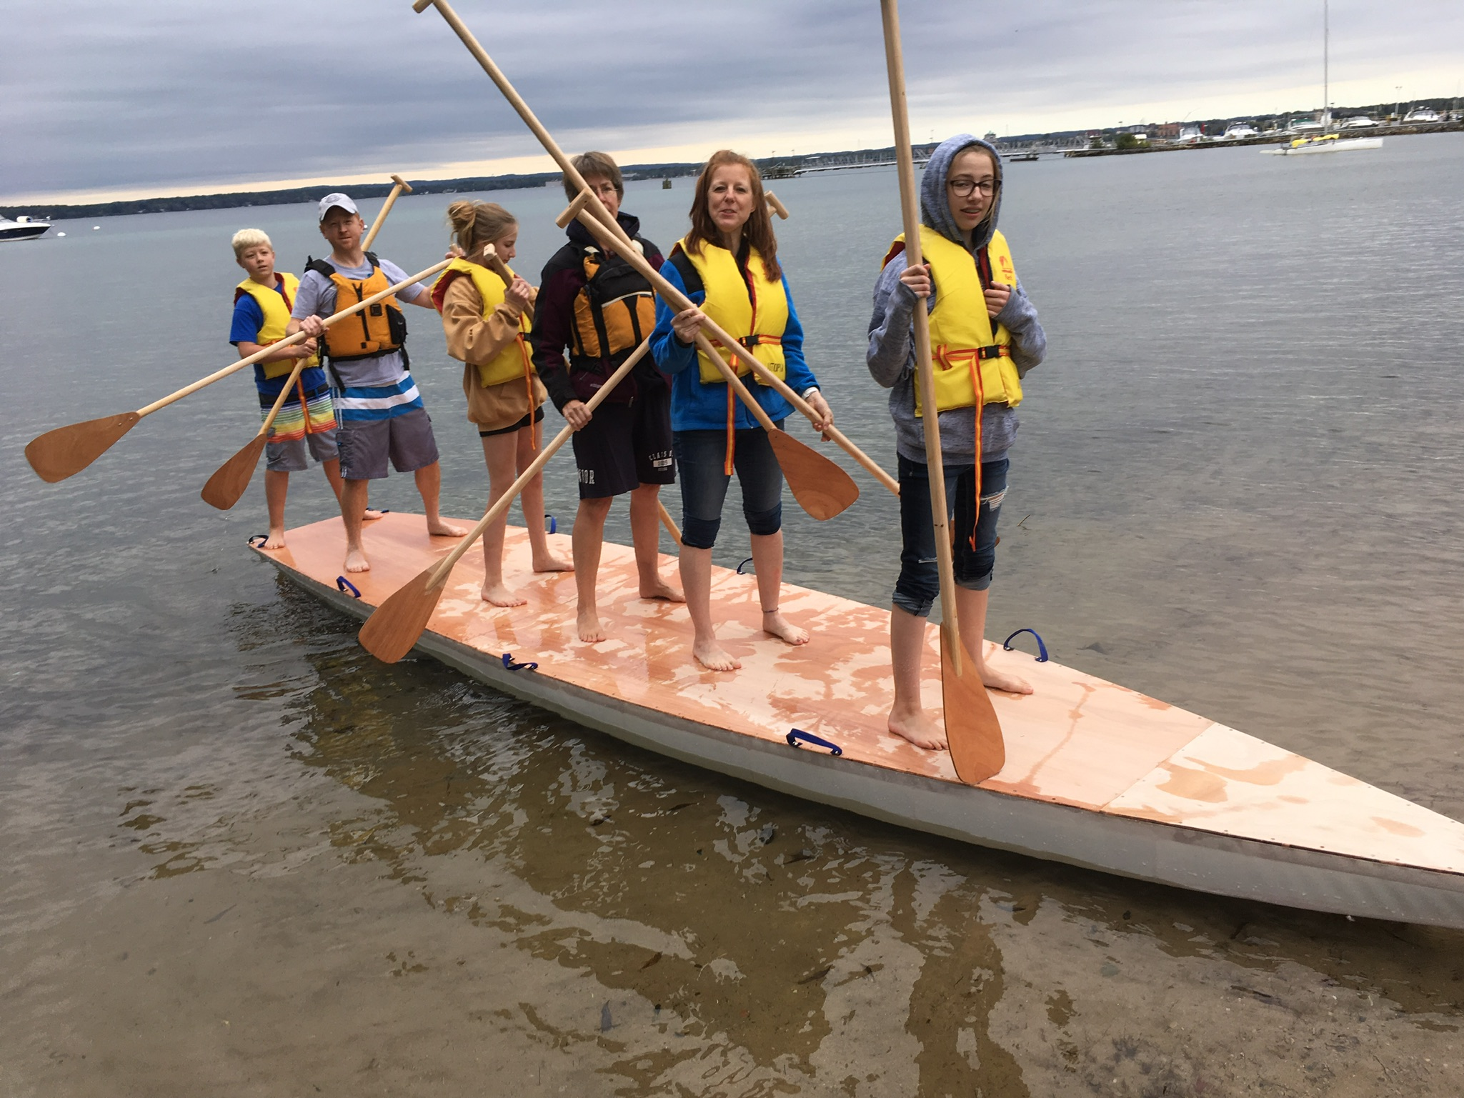
Title
Multi-person Skin-on-Frame SUP!
Adam Burks
Inland Seas Education Association
October 1, 2019

Slide 2
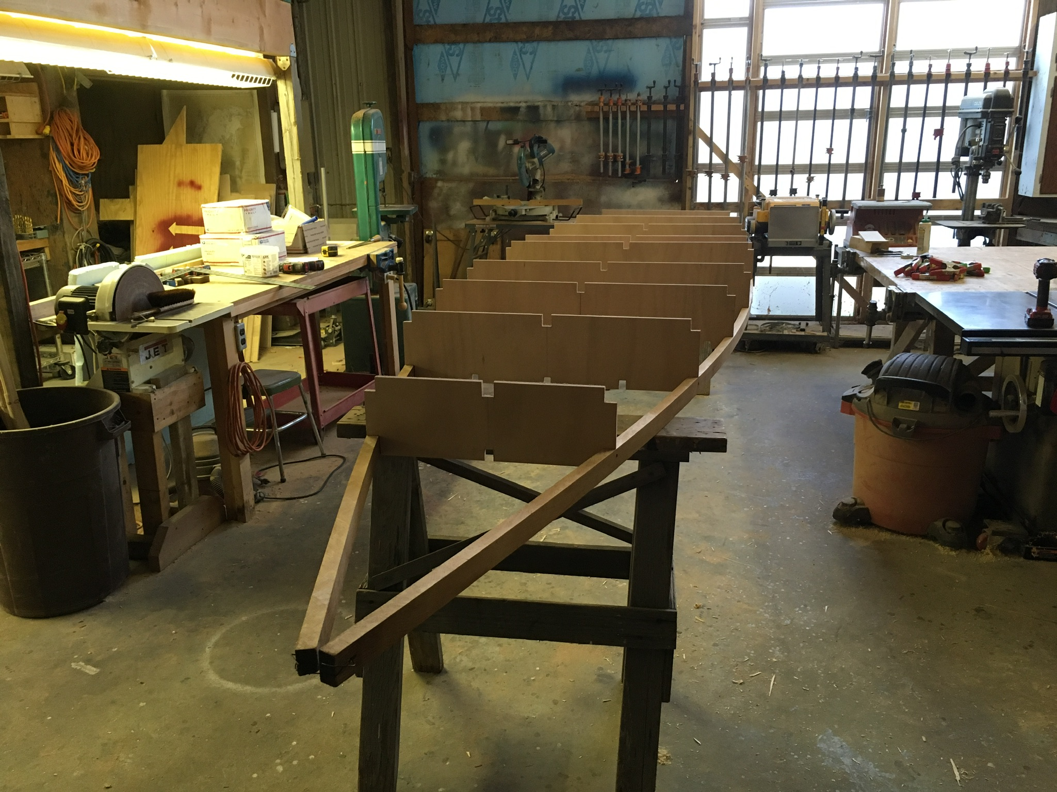
Boat Building Distilled
Standard Text slide
ry to keep it simple and minimize bullets.

Slide 3
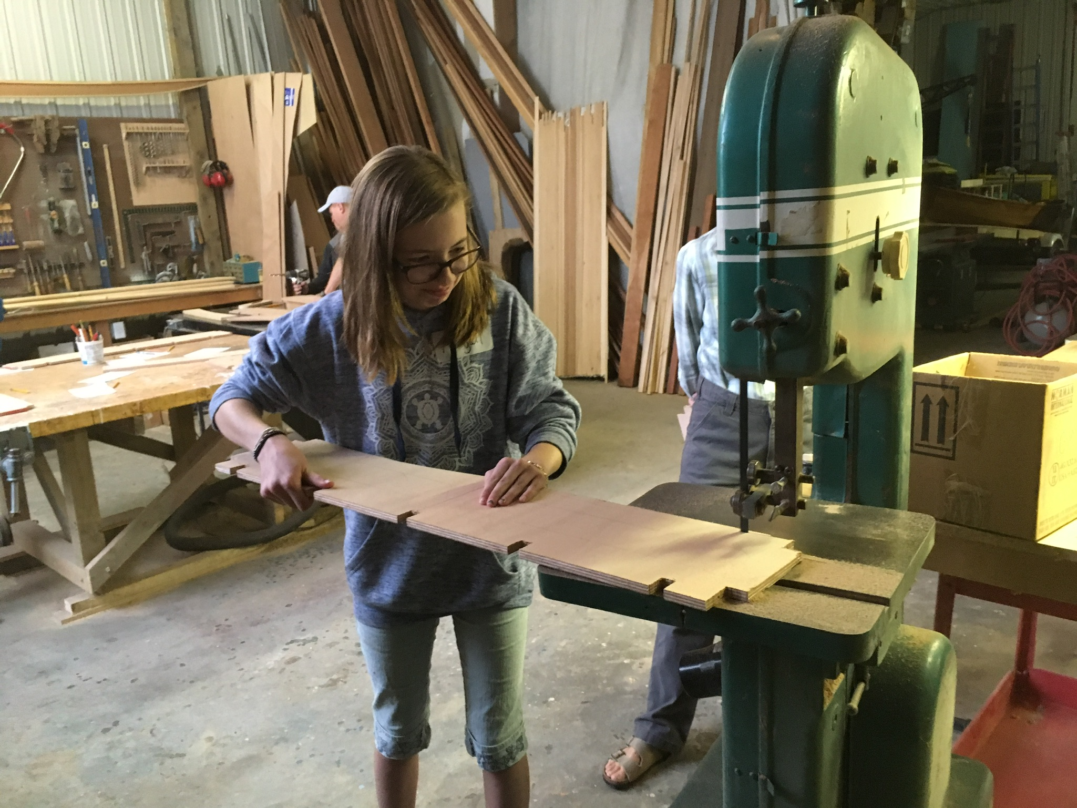
Pre-make the parts

Slide 4
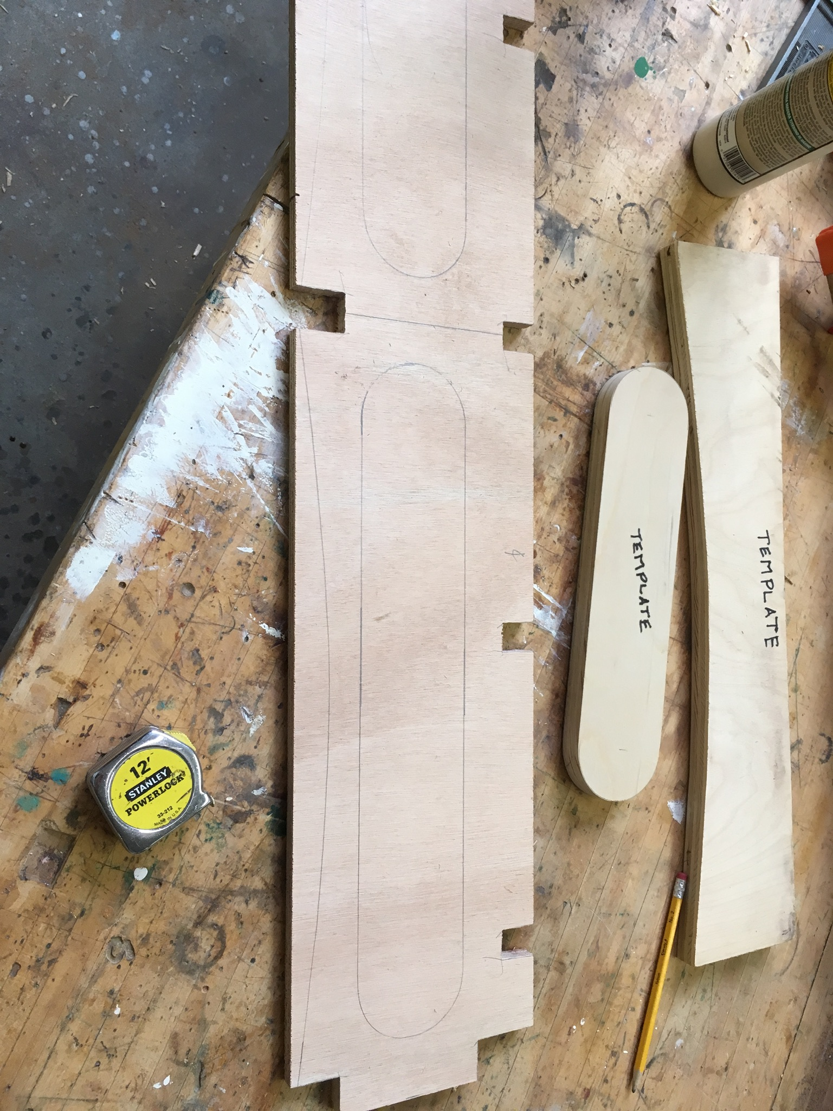
Templates make layout fast

Slide 5
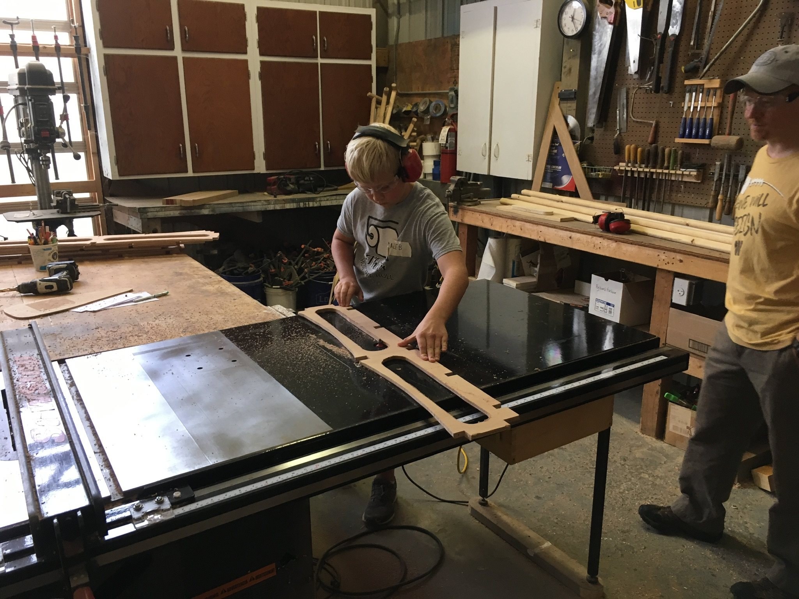
Once confident in the fit, frames can be lightened with venting

Slide 6
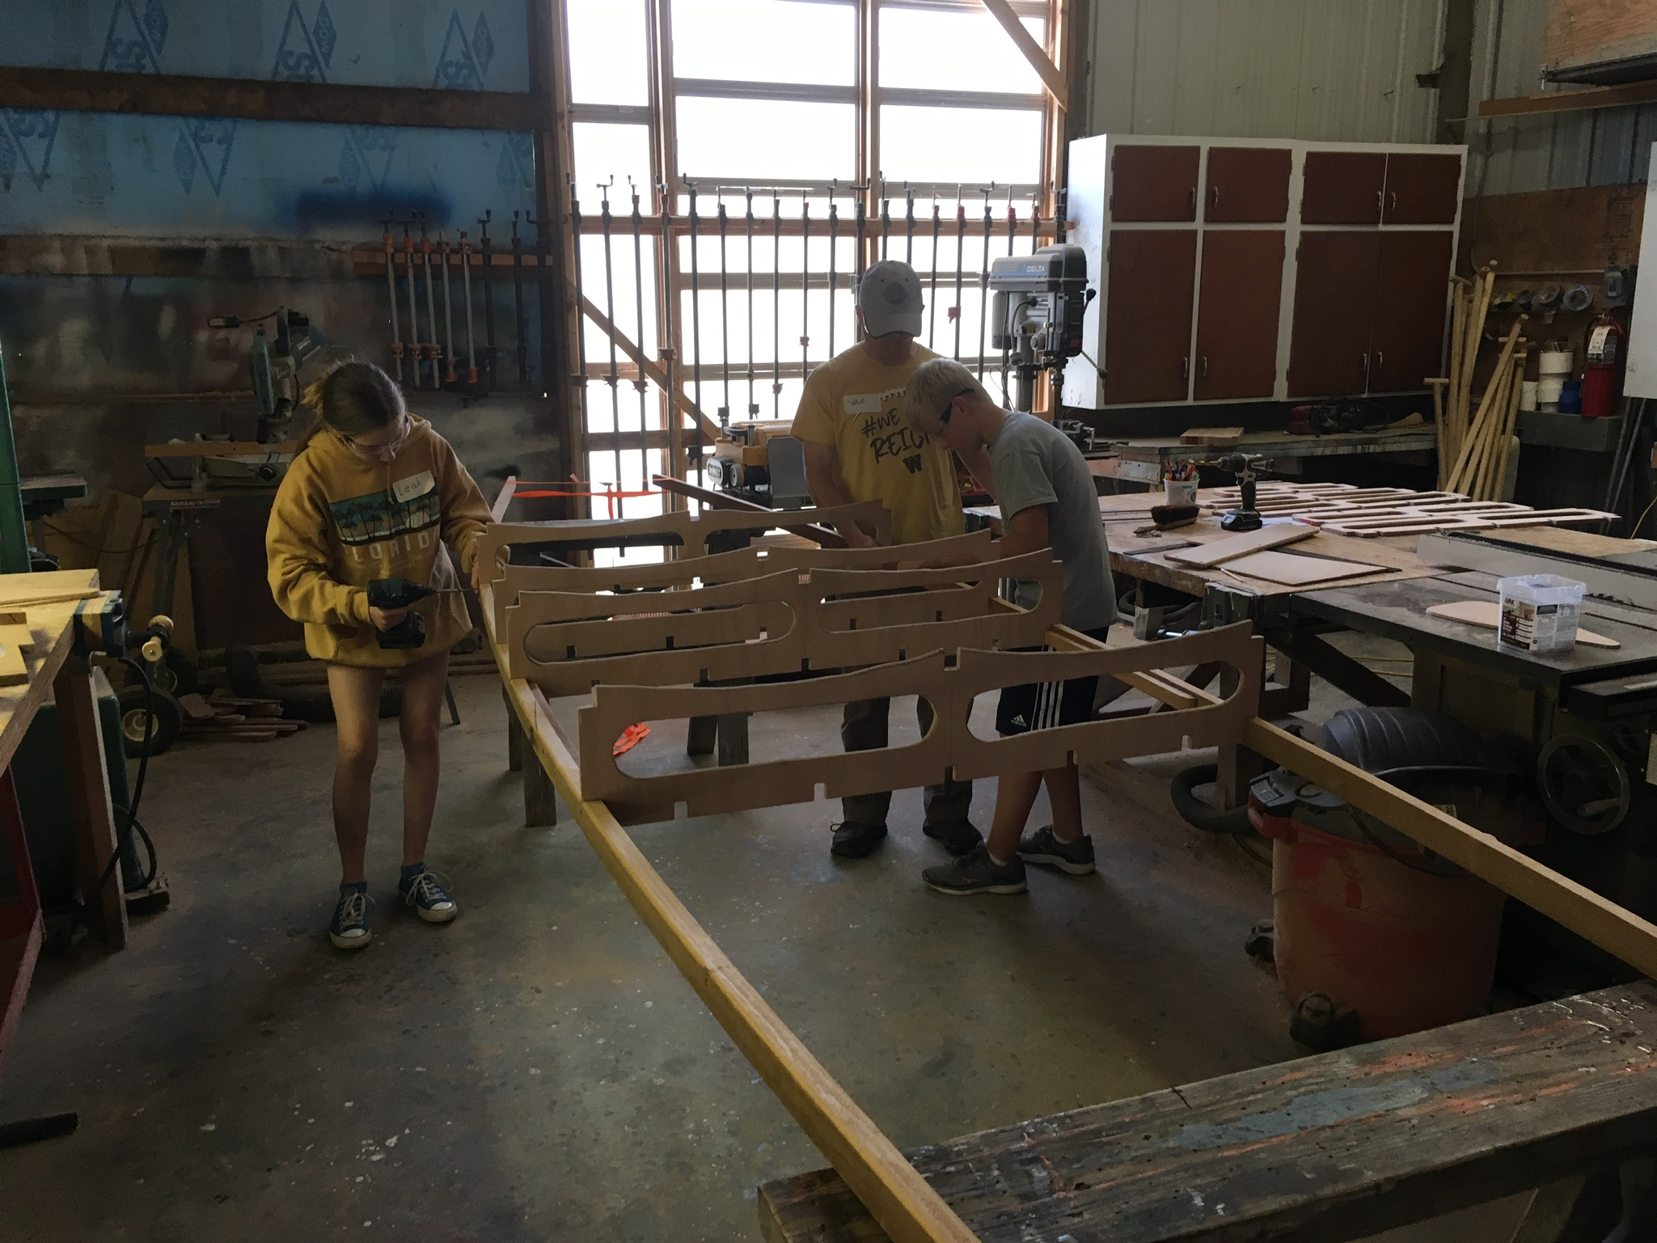
Final fitting upside down

Slide 7
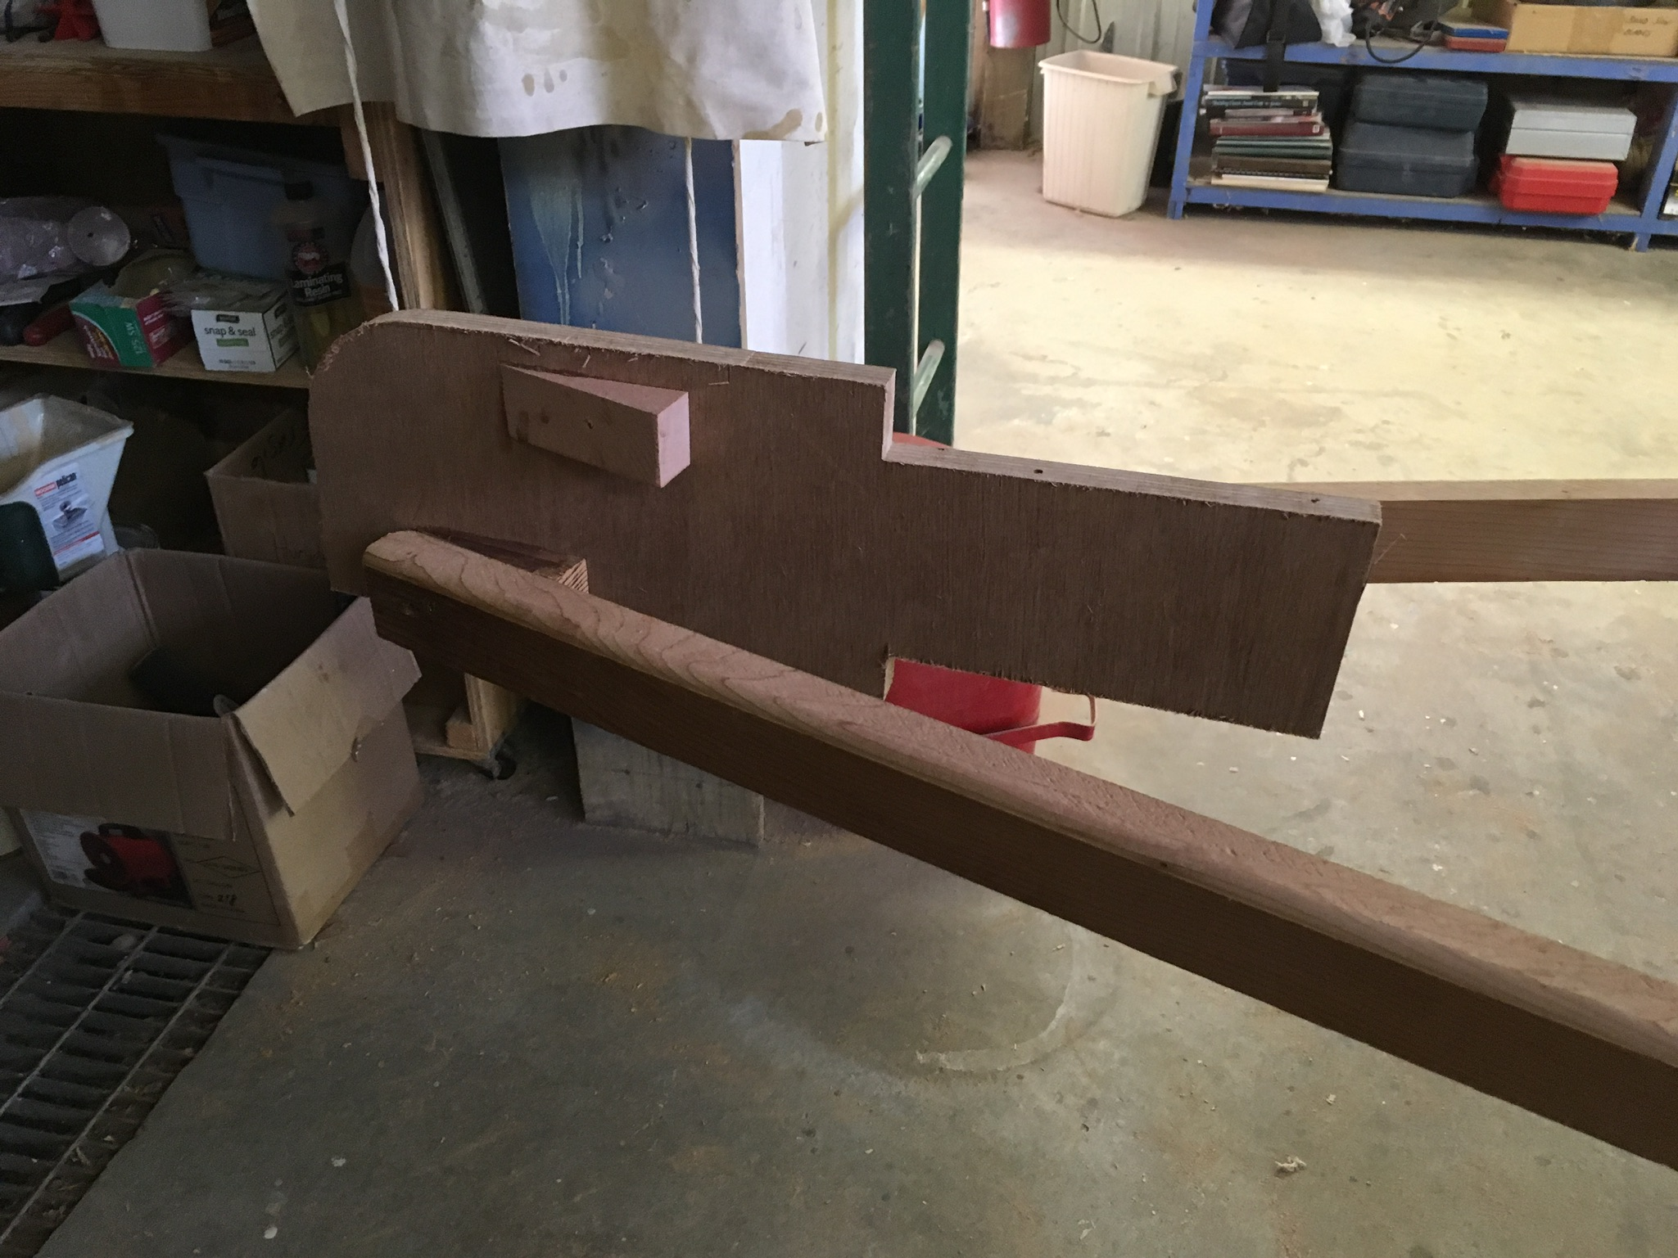
The Bow Piece

Slide 8
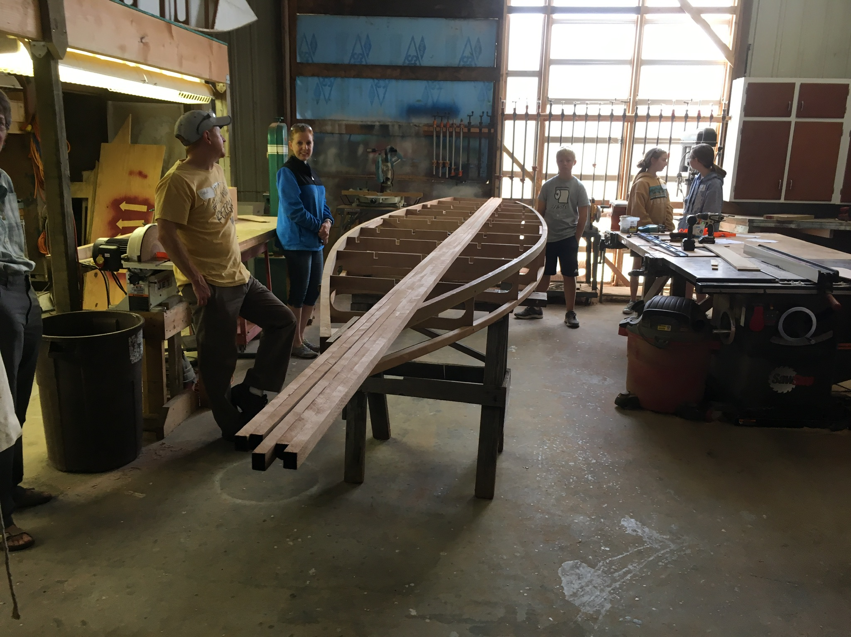
Chines and keel are installed, then right side up for the deck beams

Slide 9
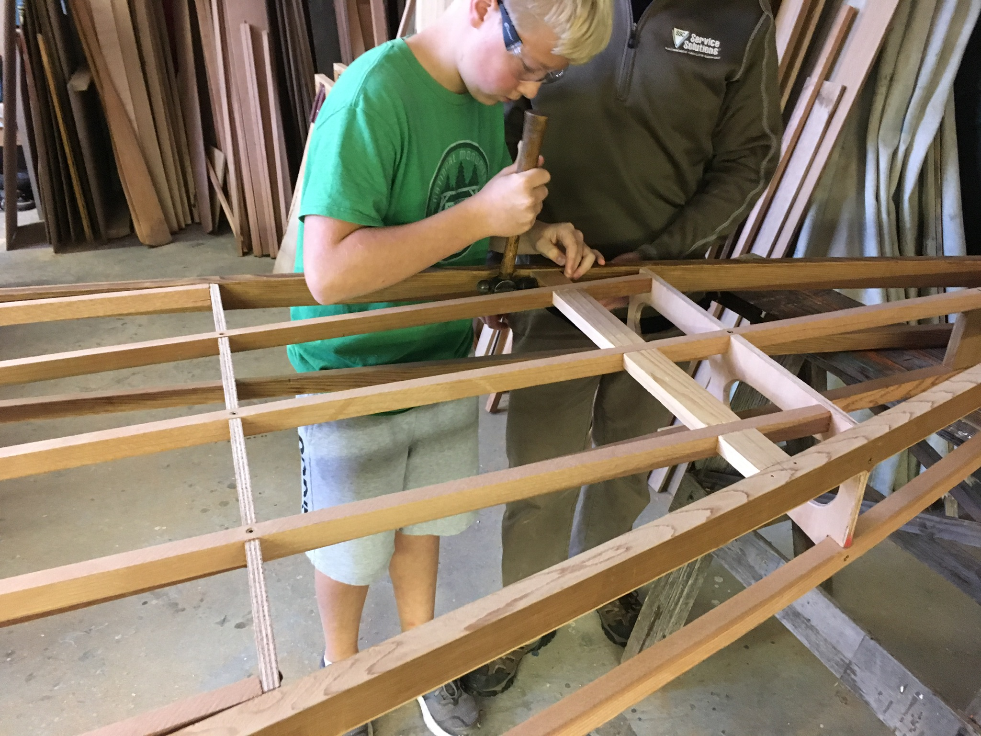
Installing support for deck seams

Slide 10
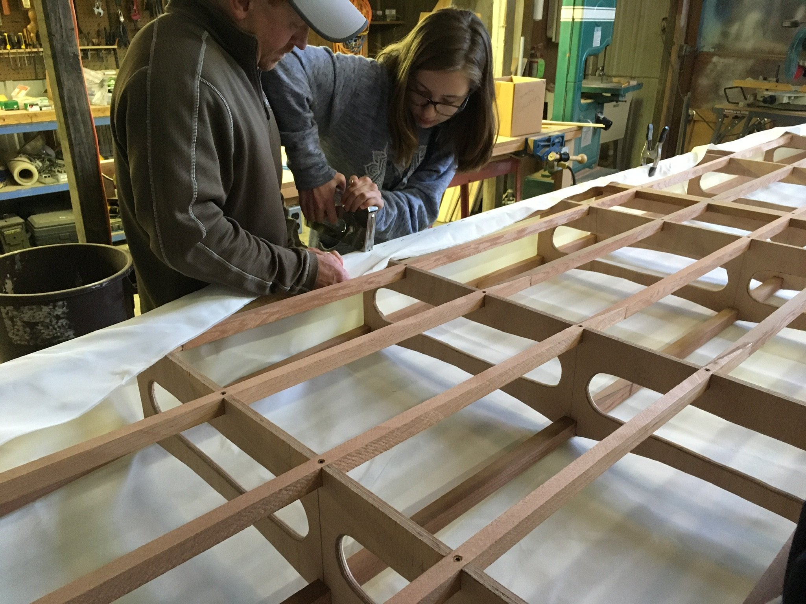
Staple skin to top of Gunwale

Slide 11
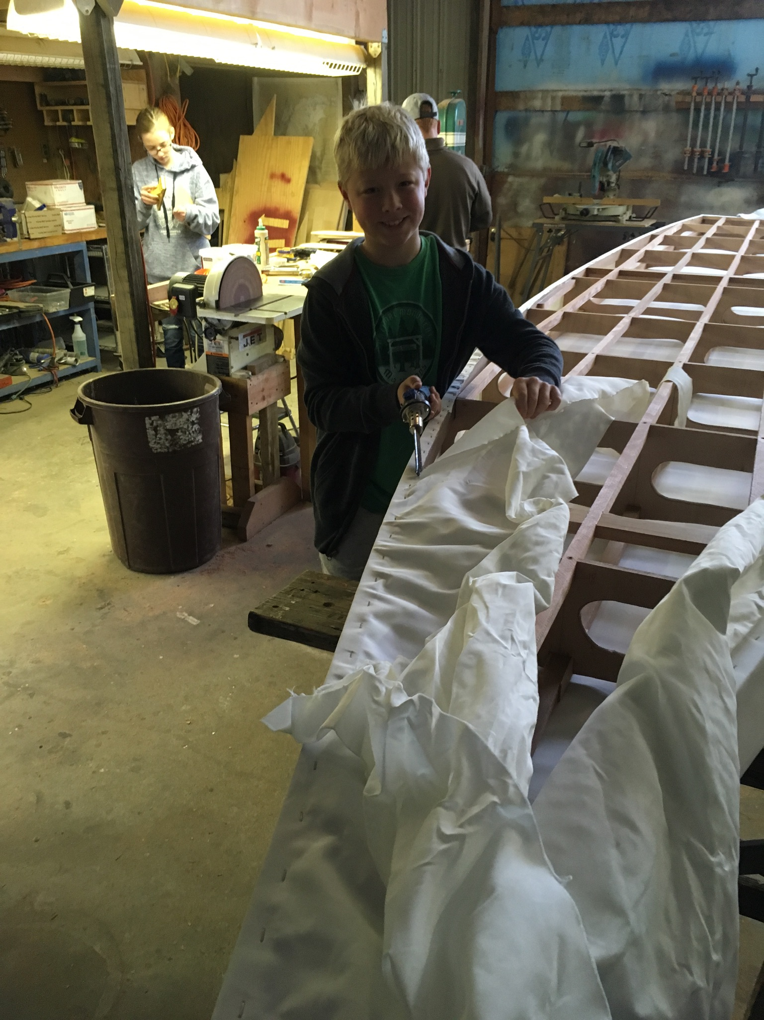
Trim the excess with a hot-knife

Slide 12
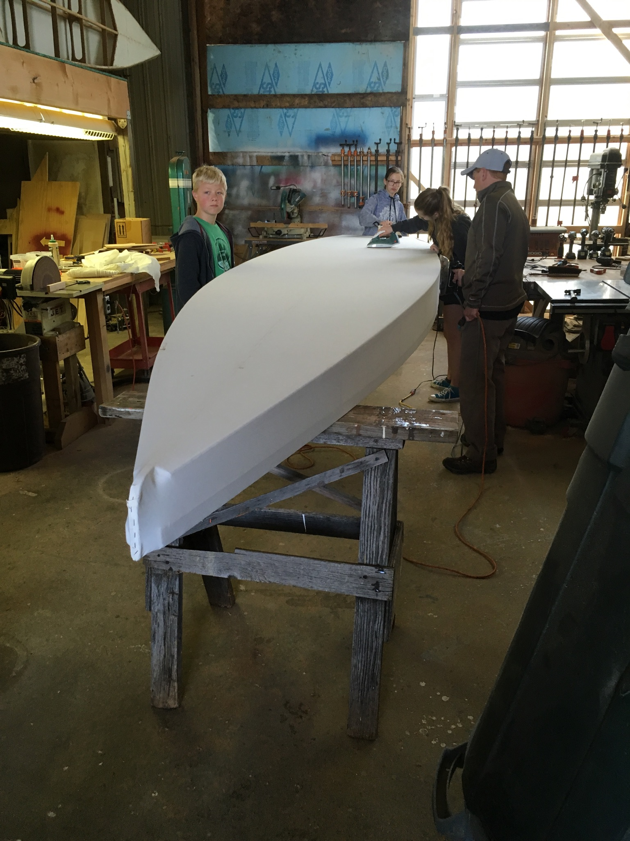
Hot irons shrink the cloth to perfection

Slide 13
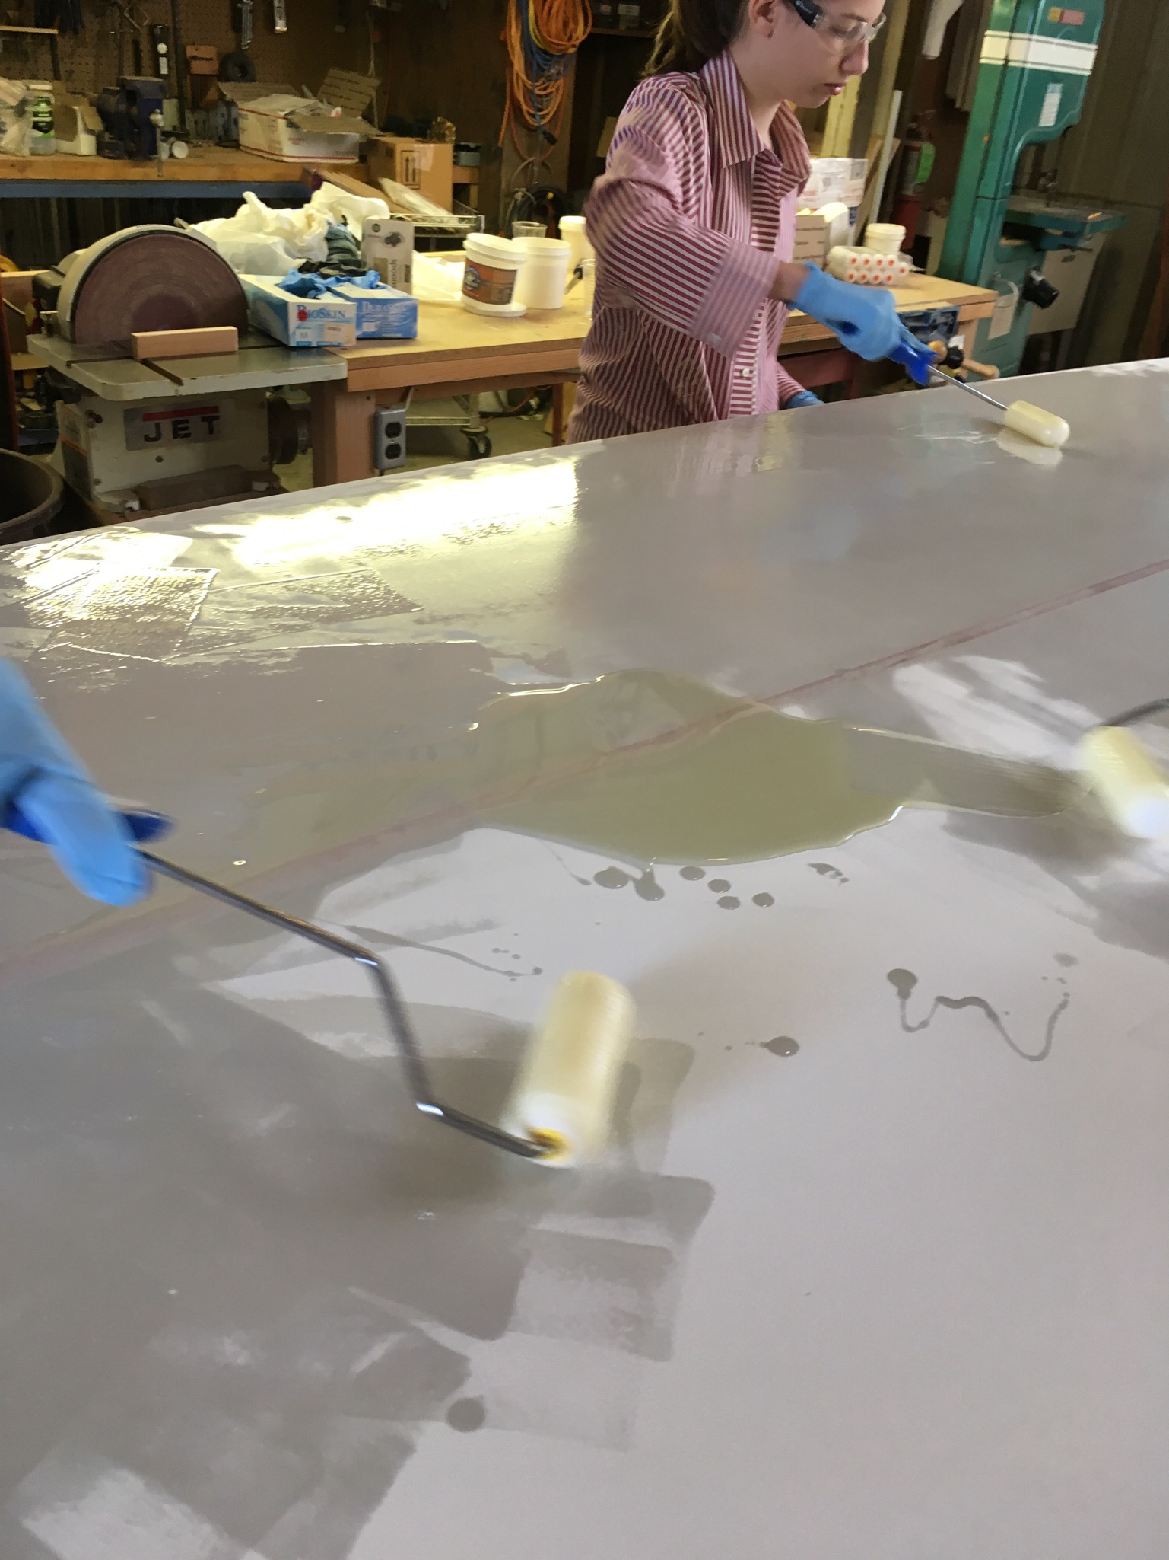
The fabric cover is coated

Slide 14
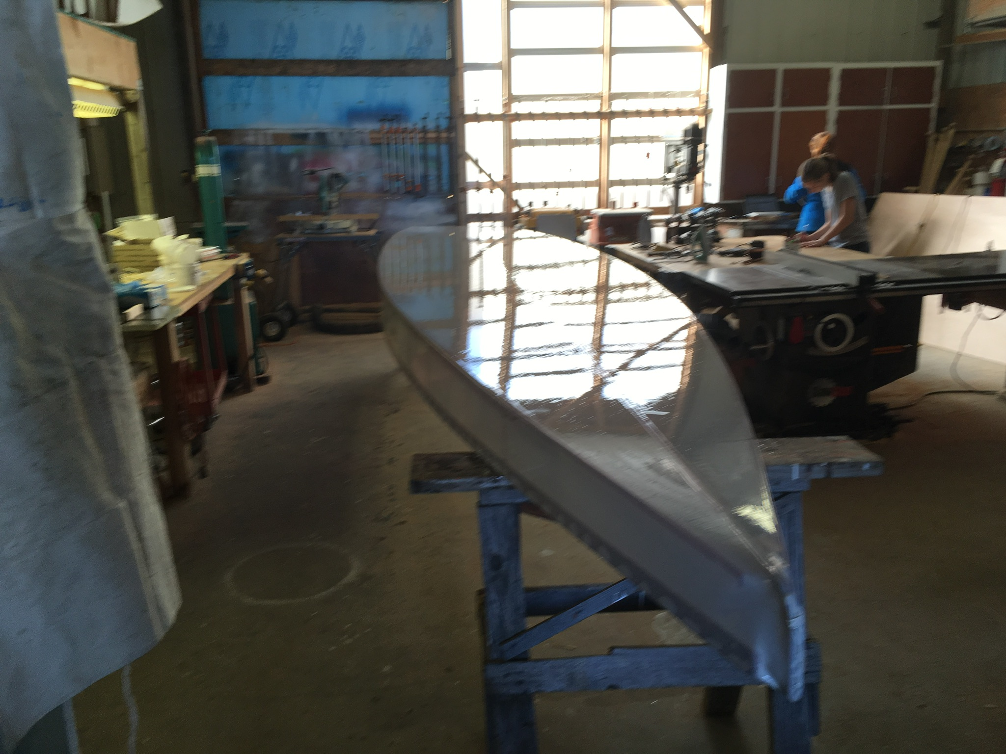
The coating cures overnight

Slide 15
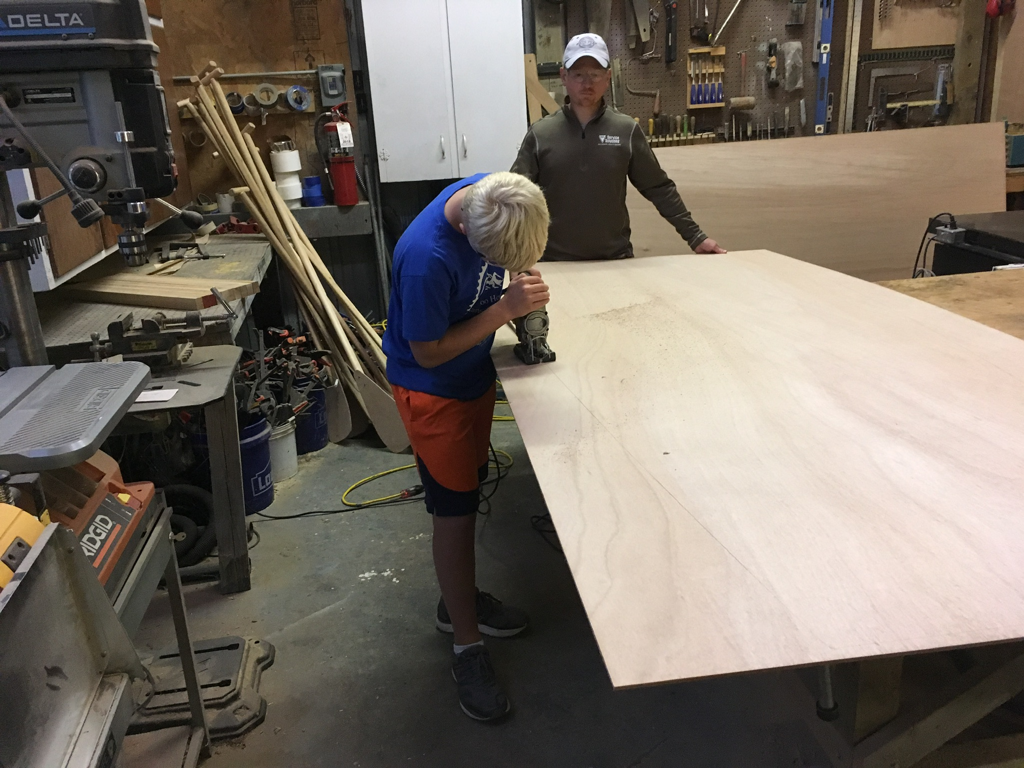
Rough cut the deck off the boat

Slide 16
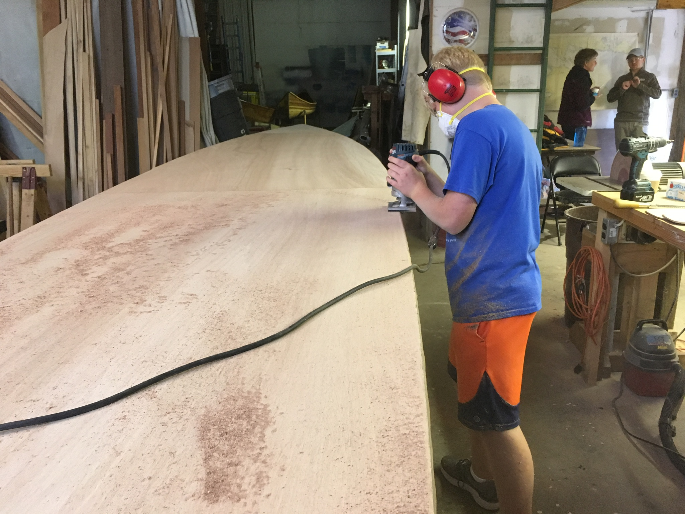
Router for a clean and perfect fit

Slide 17
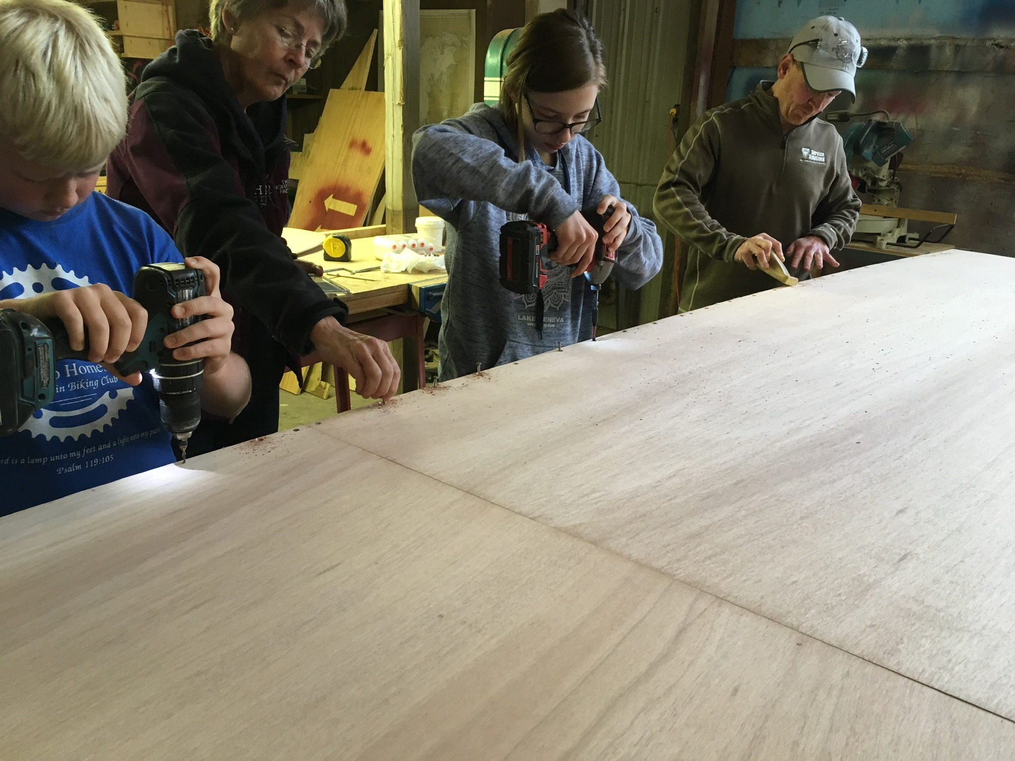
Final deck installation

Slide 18
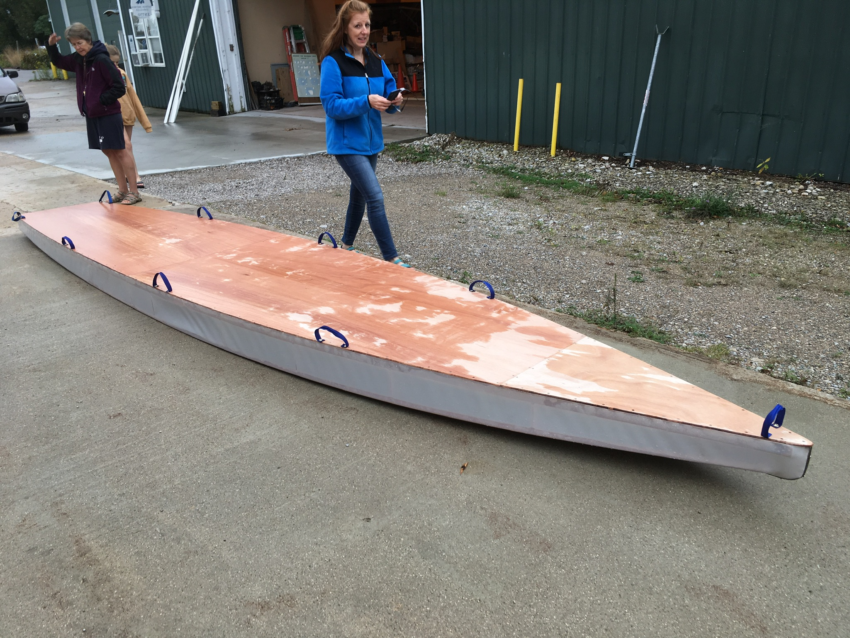
Install carrying handles

Slide 19
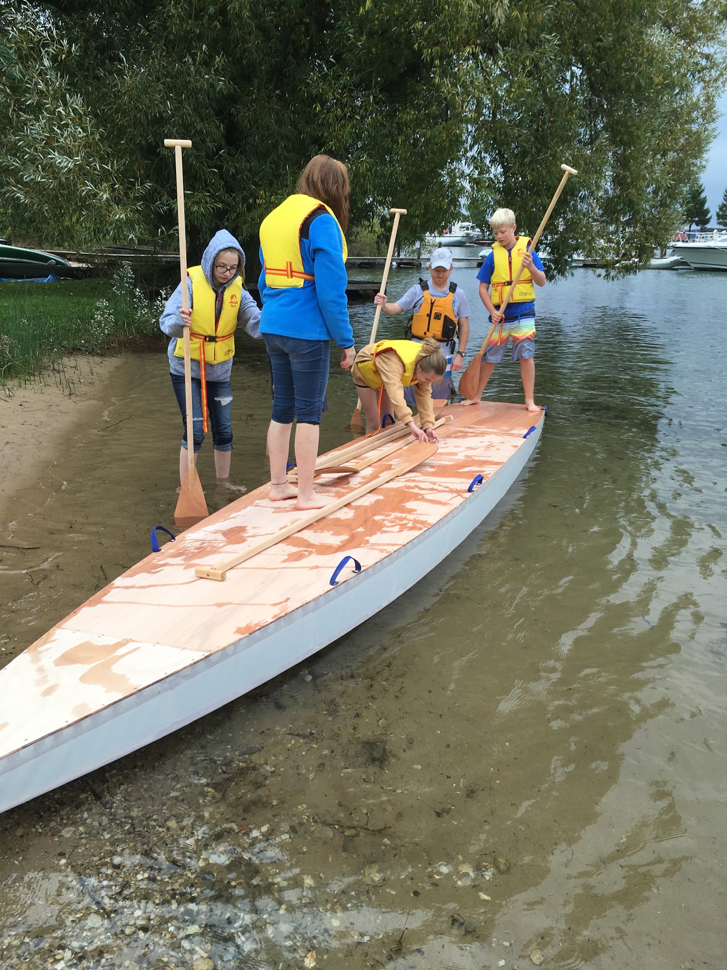
Make sure it doesn’t leak, get your life jackets and paddles

Slide 20
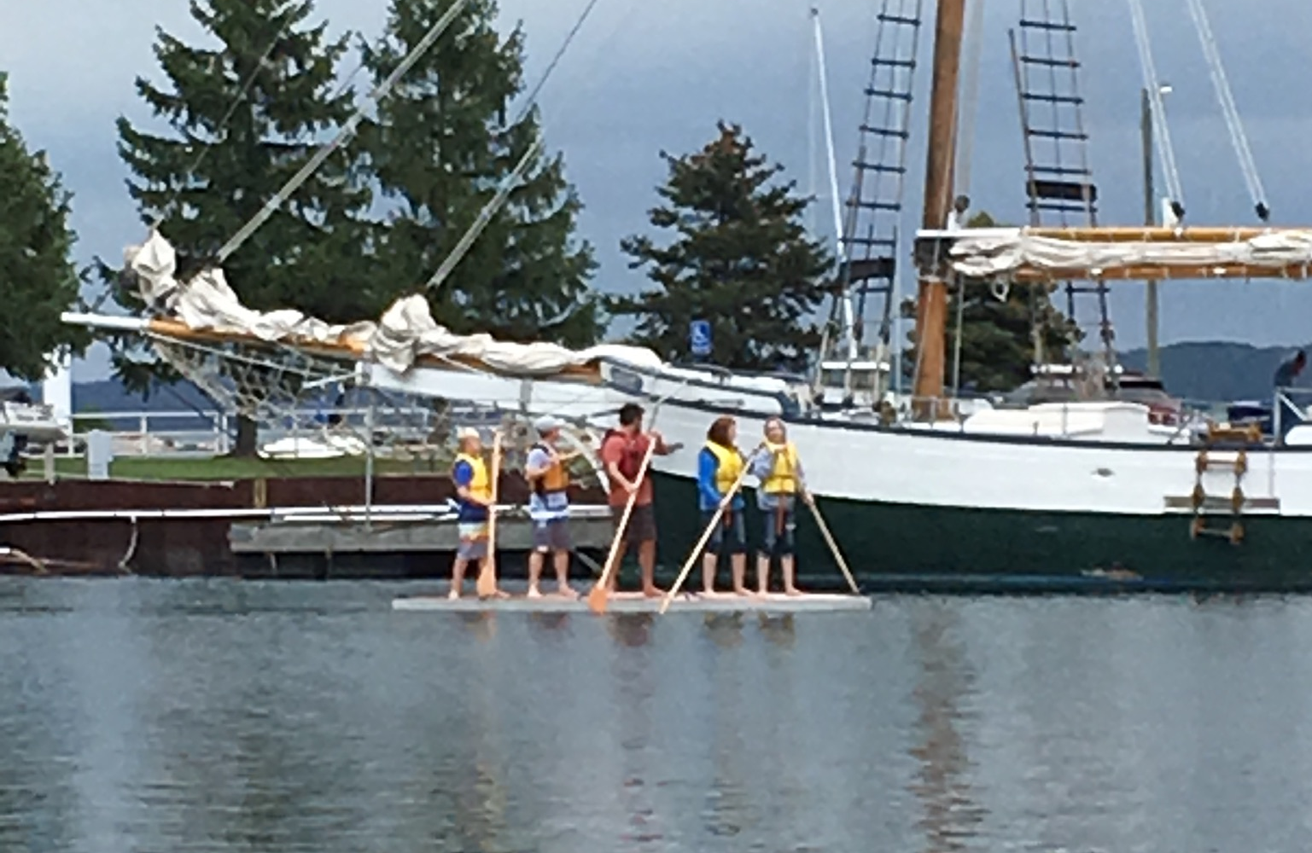
Go Paddle!

