Slide 1
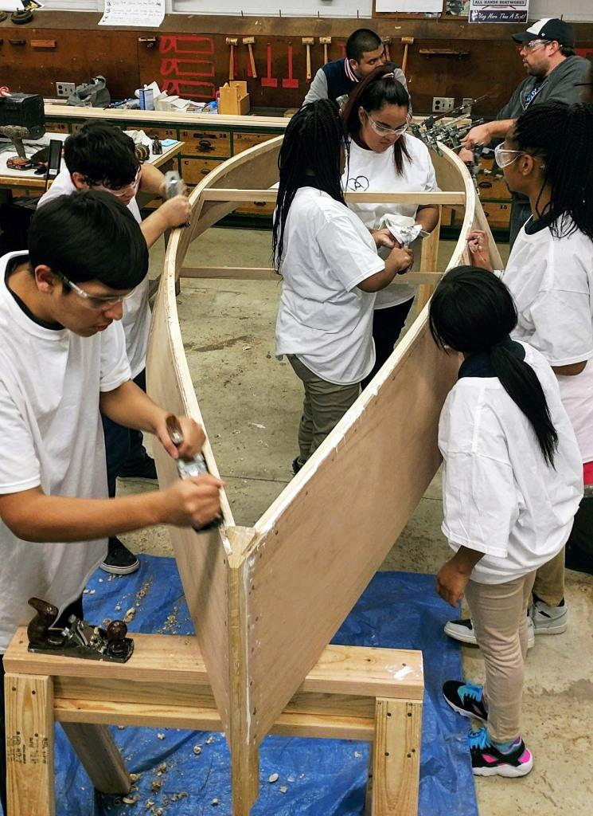
Bill Nimke, executive director

Slide 2
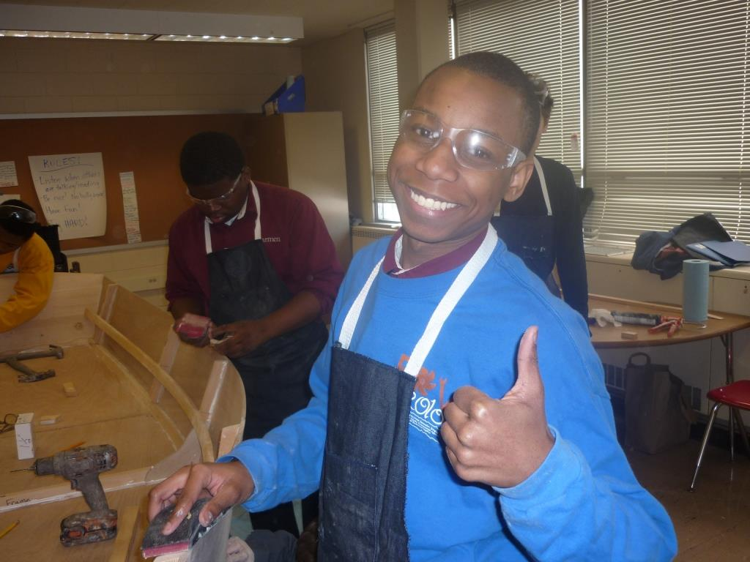
Building More Than A Boat !
Youth Development
Educational Success
Workforce Preparation
Community

Slide 3
Building More Than A Boat !
Why we exist
All Hands Boatworks, Inc., a Wisconsin 501(c)(3) organization, exists to build the skills, talents, resilience, and futures of Milwaukee-area youth through wooden boat building, work experiences, and on-water activities that foster the development of good character, educational success, and preparation for the world of work.

Slide 4
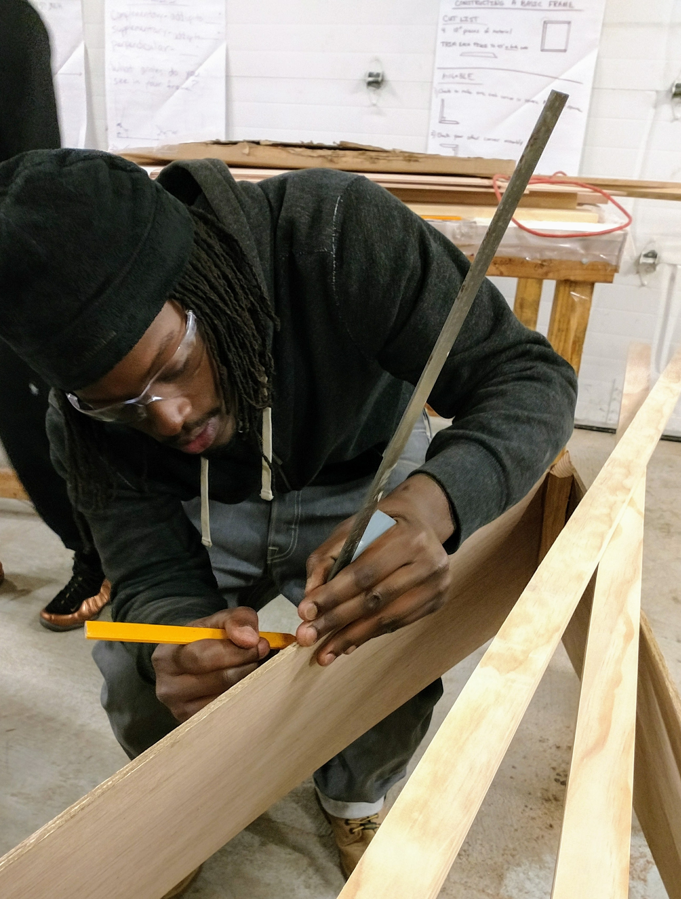
Building More Than A Boat !
Character
Craftsmanship

Slide 5
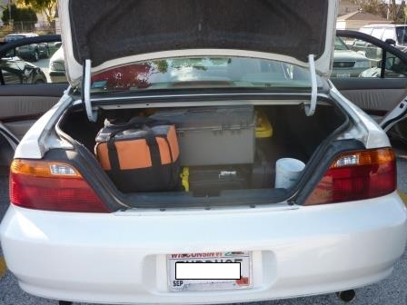
Building More Than A Boat !
Where we’ve come from . . .
2012 – 2013
3 Boatbuilding Projects
51 students

Slide 6
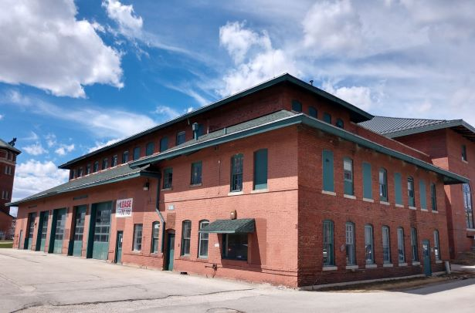
Building More Than A Boat !
Where we want to go . . .
As of September 2019
100+ Boatbuilding Projects
>2,500 students

Slide 7
Building More Than A Boat !
Audubon High School
Bay View Middle & High School
Bay View School Summer CLC
Brown Deer High School
Bruce Elementary School
Carmen High School*
Cass Street School CLC*
Children’s Hospital of Wisconsin
Cooper Elementary
Daniels-Mardak Boys & Girls Club*
Davis Boys & Girls Club
El Puente High School
Escuela Fratney*
Escuela Verde
Fernwood Montessori School*
Forest Home Elementary
Gaenslen Elementary School*
Girl Scouts of Southeast Wisconsin
Grant Elementary School
Greentree-Teutonia CLC
Kradwell School *
Lloyd Barbee Montessori School
Maryland Avenue Montessori*
Marquette University High School
Mary Ryan Boys & Girls Club*
Messmer Catholic Schools*
Milwaukee Christian Center (Youthbuild)
Milwaukee College Prep*
Milwaukee Environmental Sciences Academy
Nehemiah Project
Neu-Life Community Development*
New School for Community Service
Northern Ozaukee Middle School
Notre Dame Girls Middle School *
Pulaski High School
River Revitalization Foundation
Silver Spring Neighborhood Center
South Division H.S. CLC
St. Joan Antida High School
St. Joseph Boys & Girls Club
St. Rafael the Archangel School *
Washington High School
* Denotes a 2nd, 3rd, or 4th year program

Slide 8
Building More Than A Boat !
S.T.E.A.M.BOAT LEARNING (gr. 5-9)

Slide 9
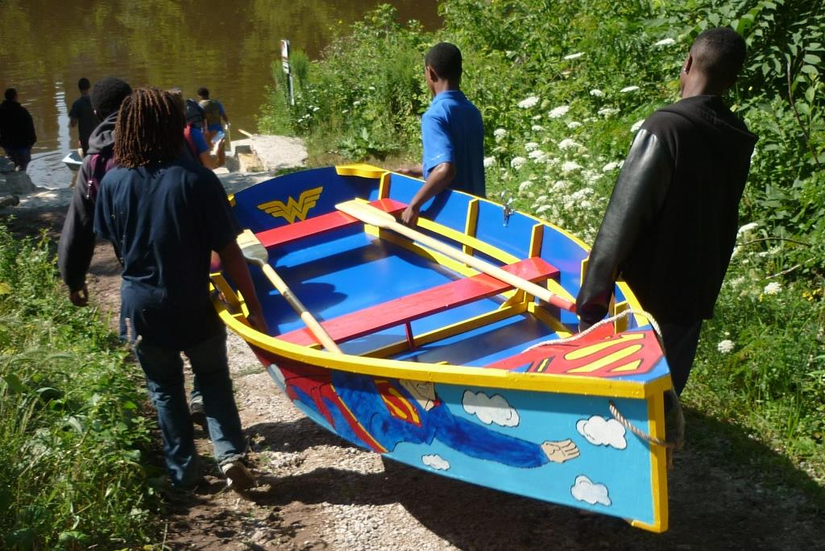
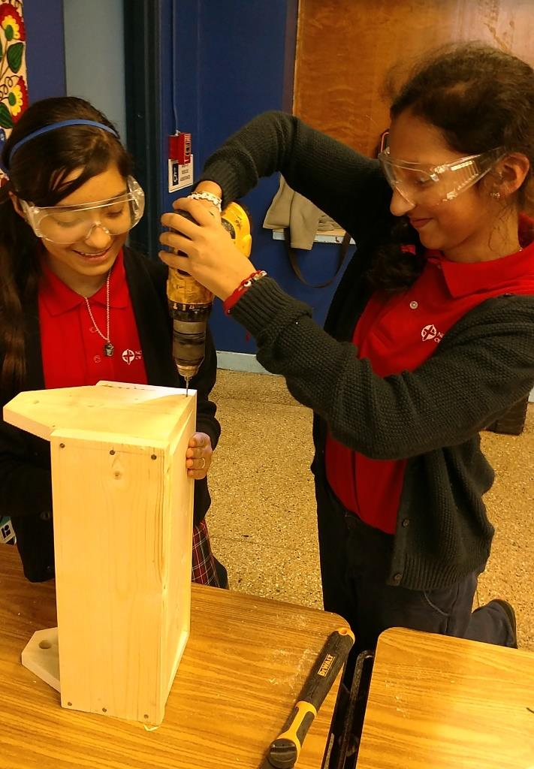
Building More Than A Boat !
Boat Building ^
Intro to
Woodworking >
< STEM

Slide 10
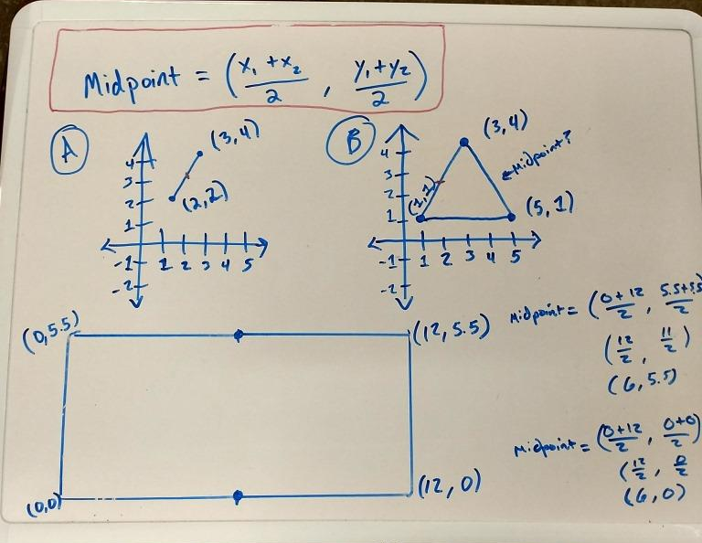
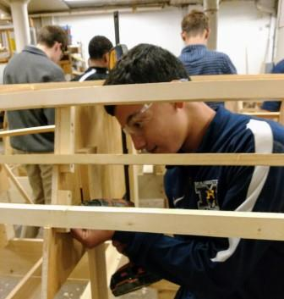
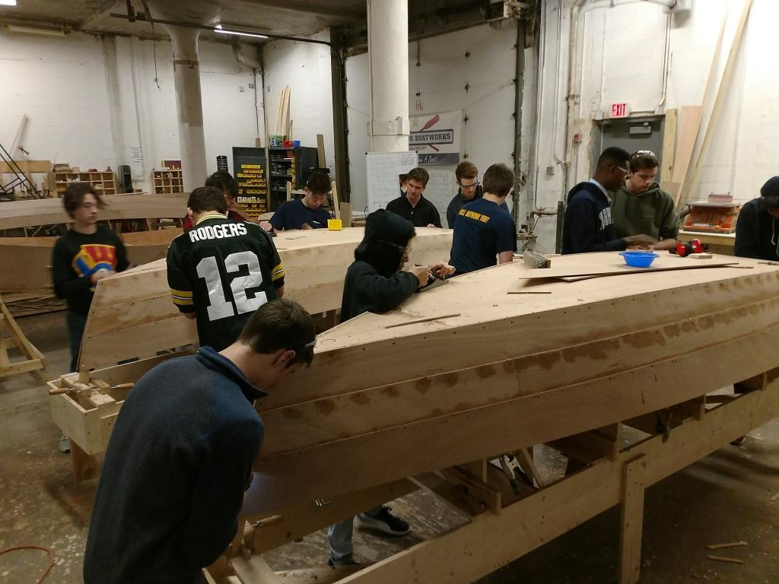
Building More Than A Boat !
In the Shop . . . Geometry of the Boat

Slide 11
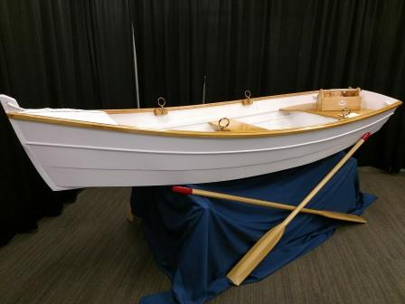
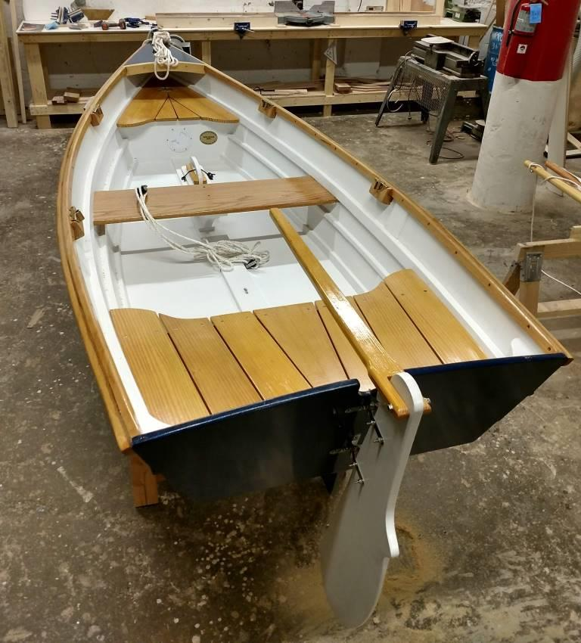
Building More Than A Boat !

Slide 12
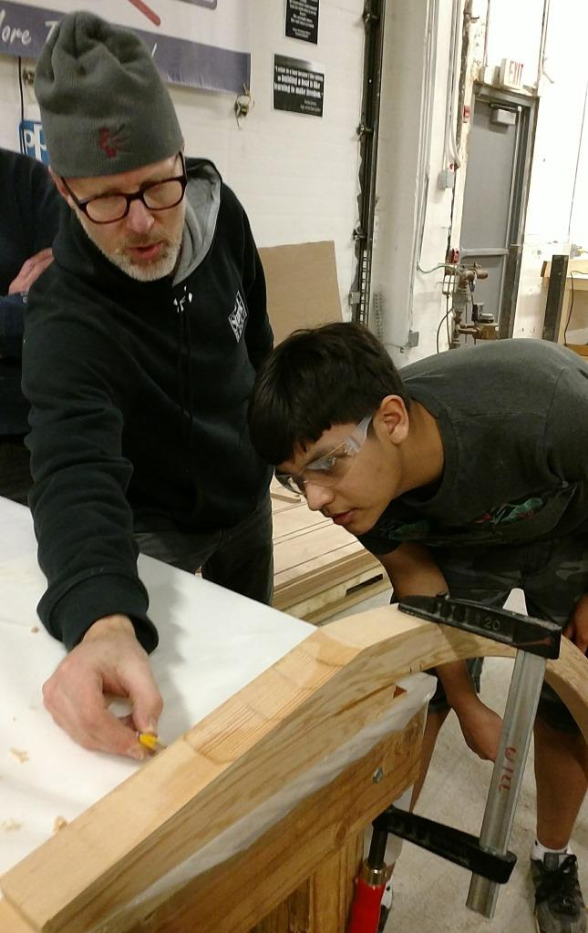
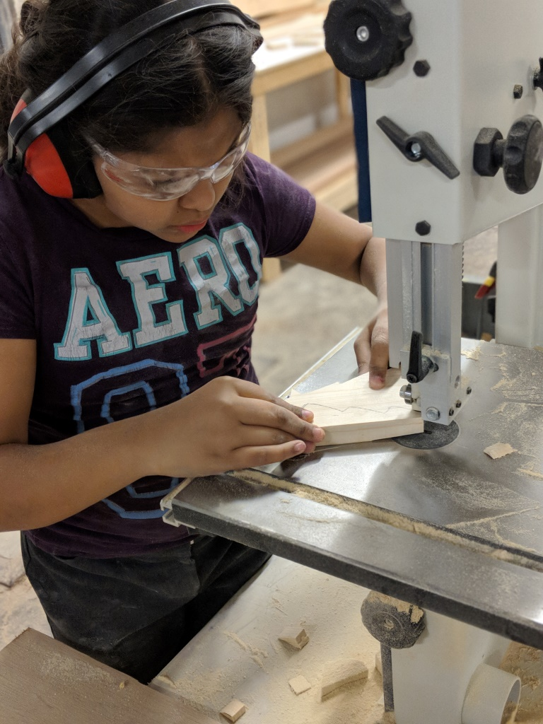
Building More Than A Boat !
R.A.F.T. (Real Apprenticeships for Teens)
and Summer Internships (gr. 9-12)

Slide 13
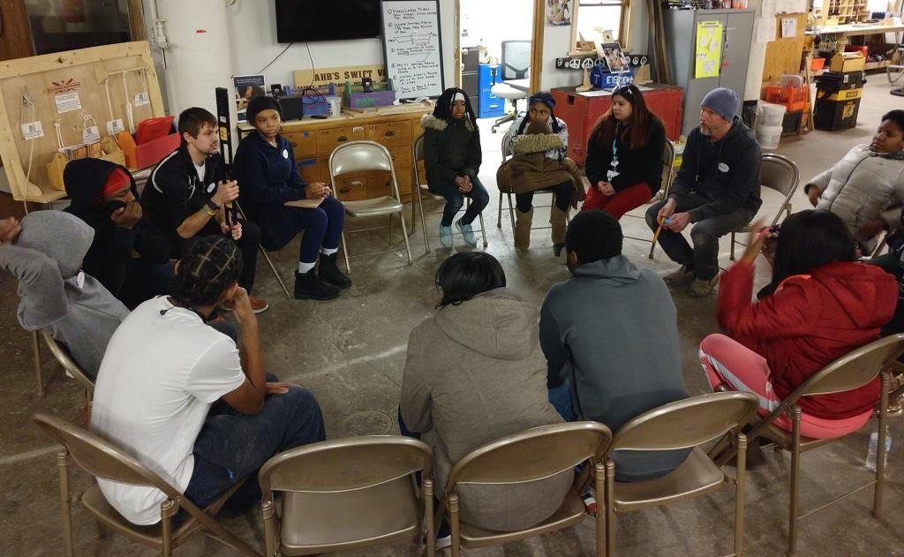
Building More Than A Boat !
R.A.F.T. (Real Apprenticeships for Teens)
and Children’s Hospital of Wisconsin
Trauma-informed practices in the shop

Slide 14
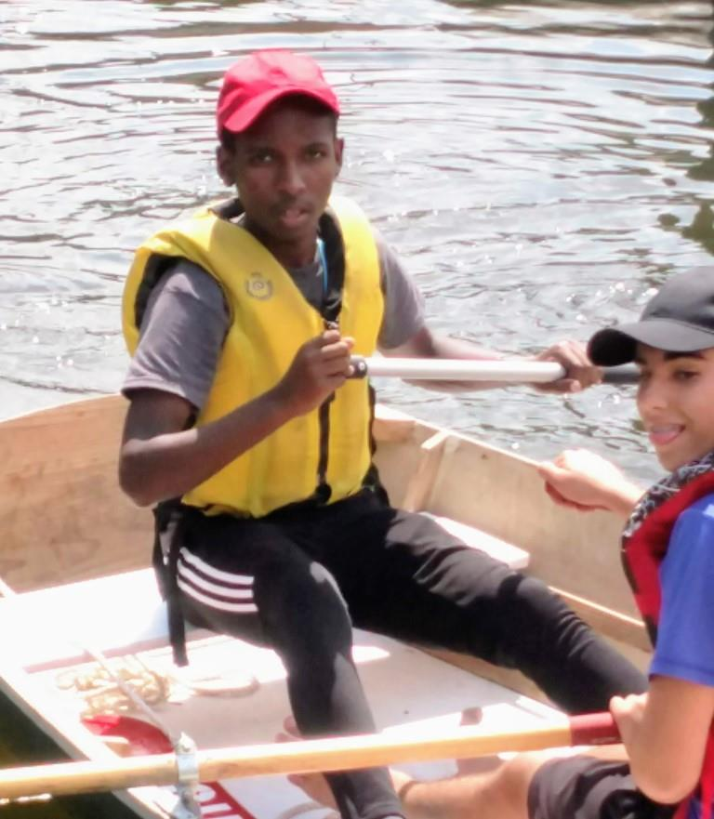
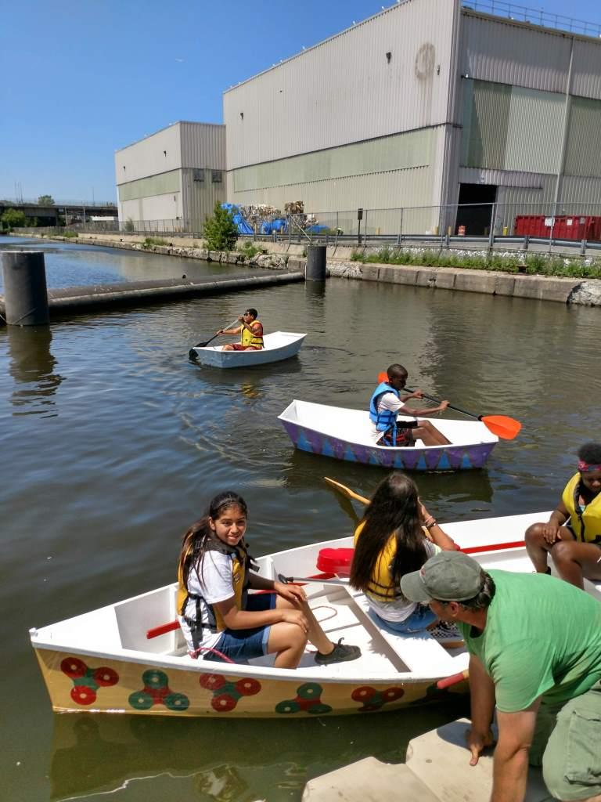
Building More Than A Boat !
Summer RiverVentures Camps . . .
In the heart of the City

Slide 15
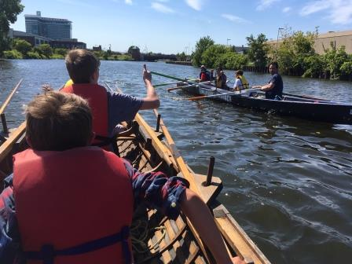
Building More Than A Boat !
Maritime Skills Summer Camp

Slide 16
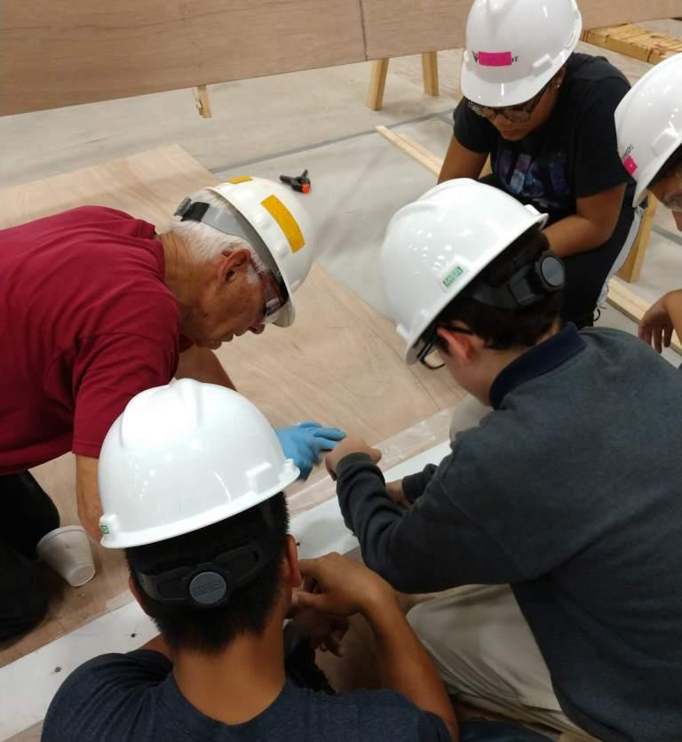
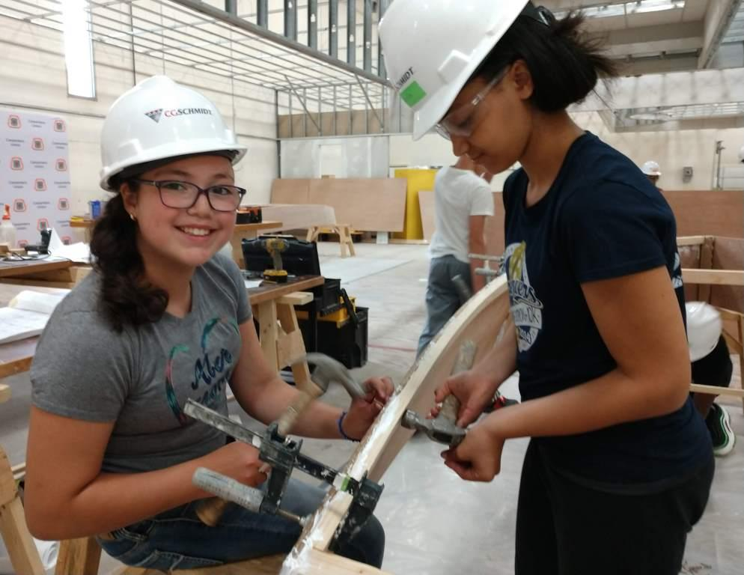
Building More Than A Boat !
Annual Builders Camp at the Carpenters Training Institute

Slide 17
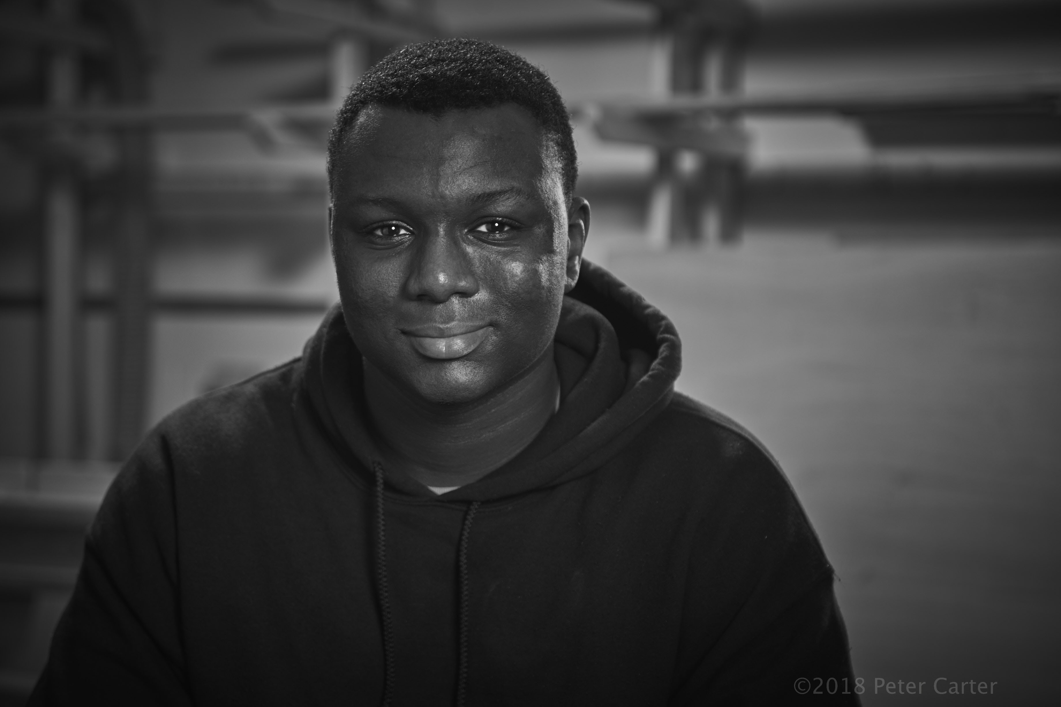
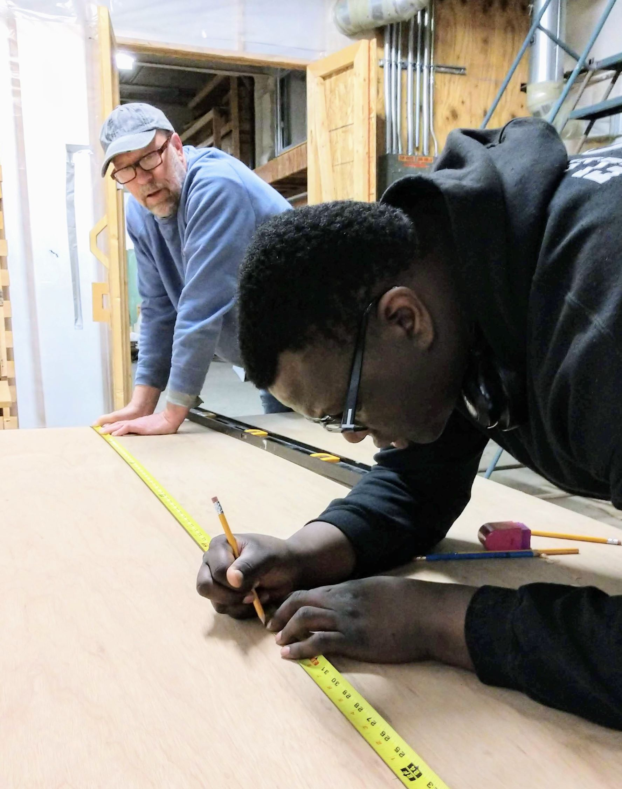
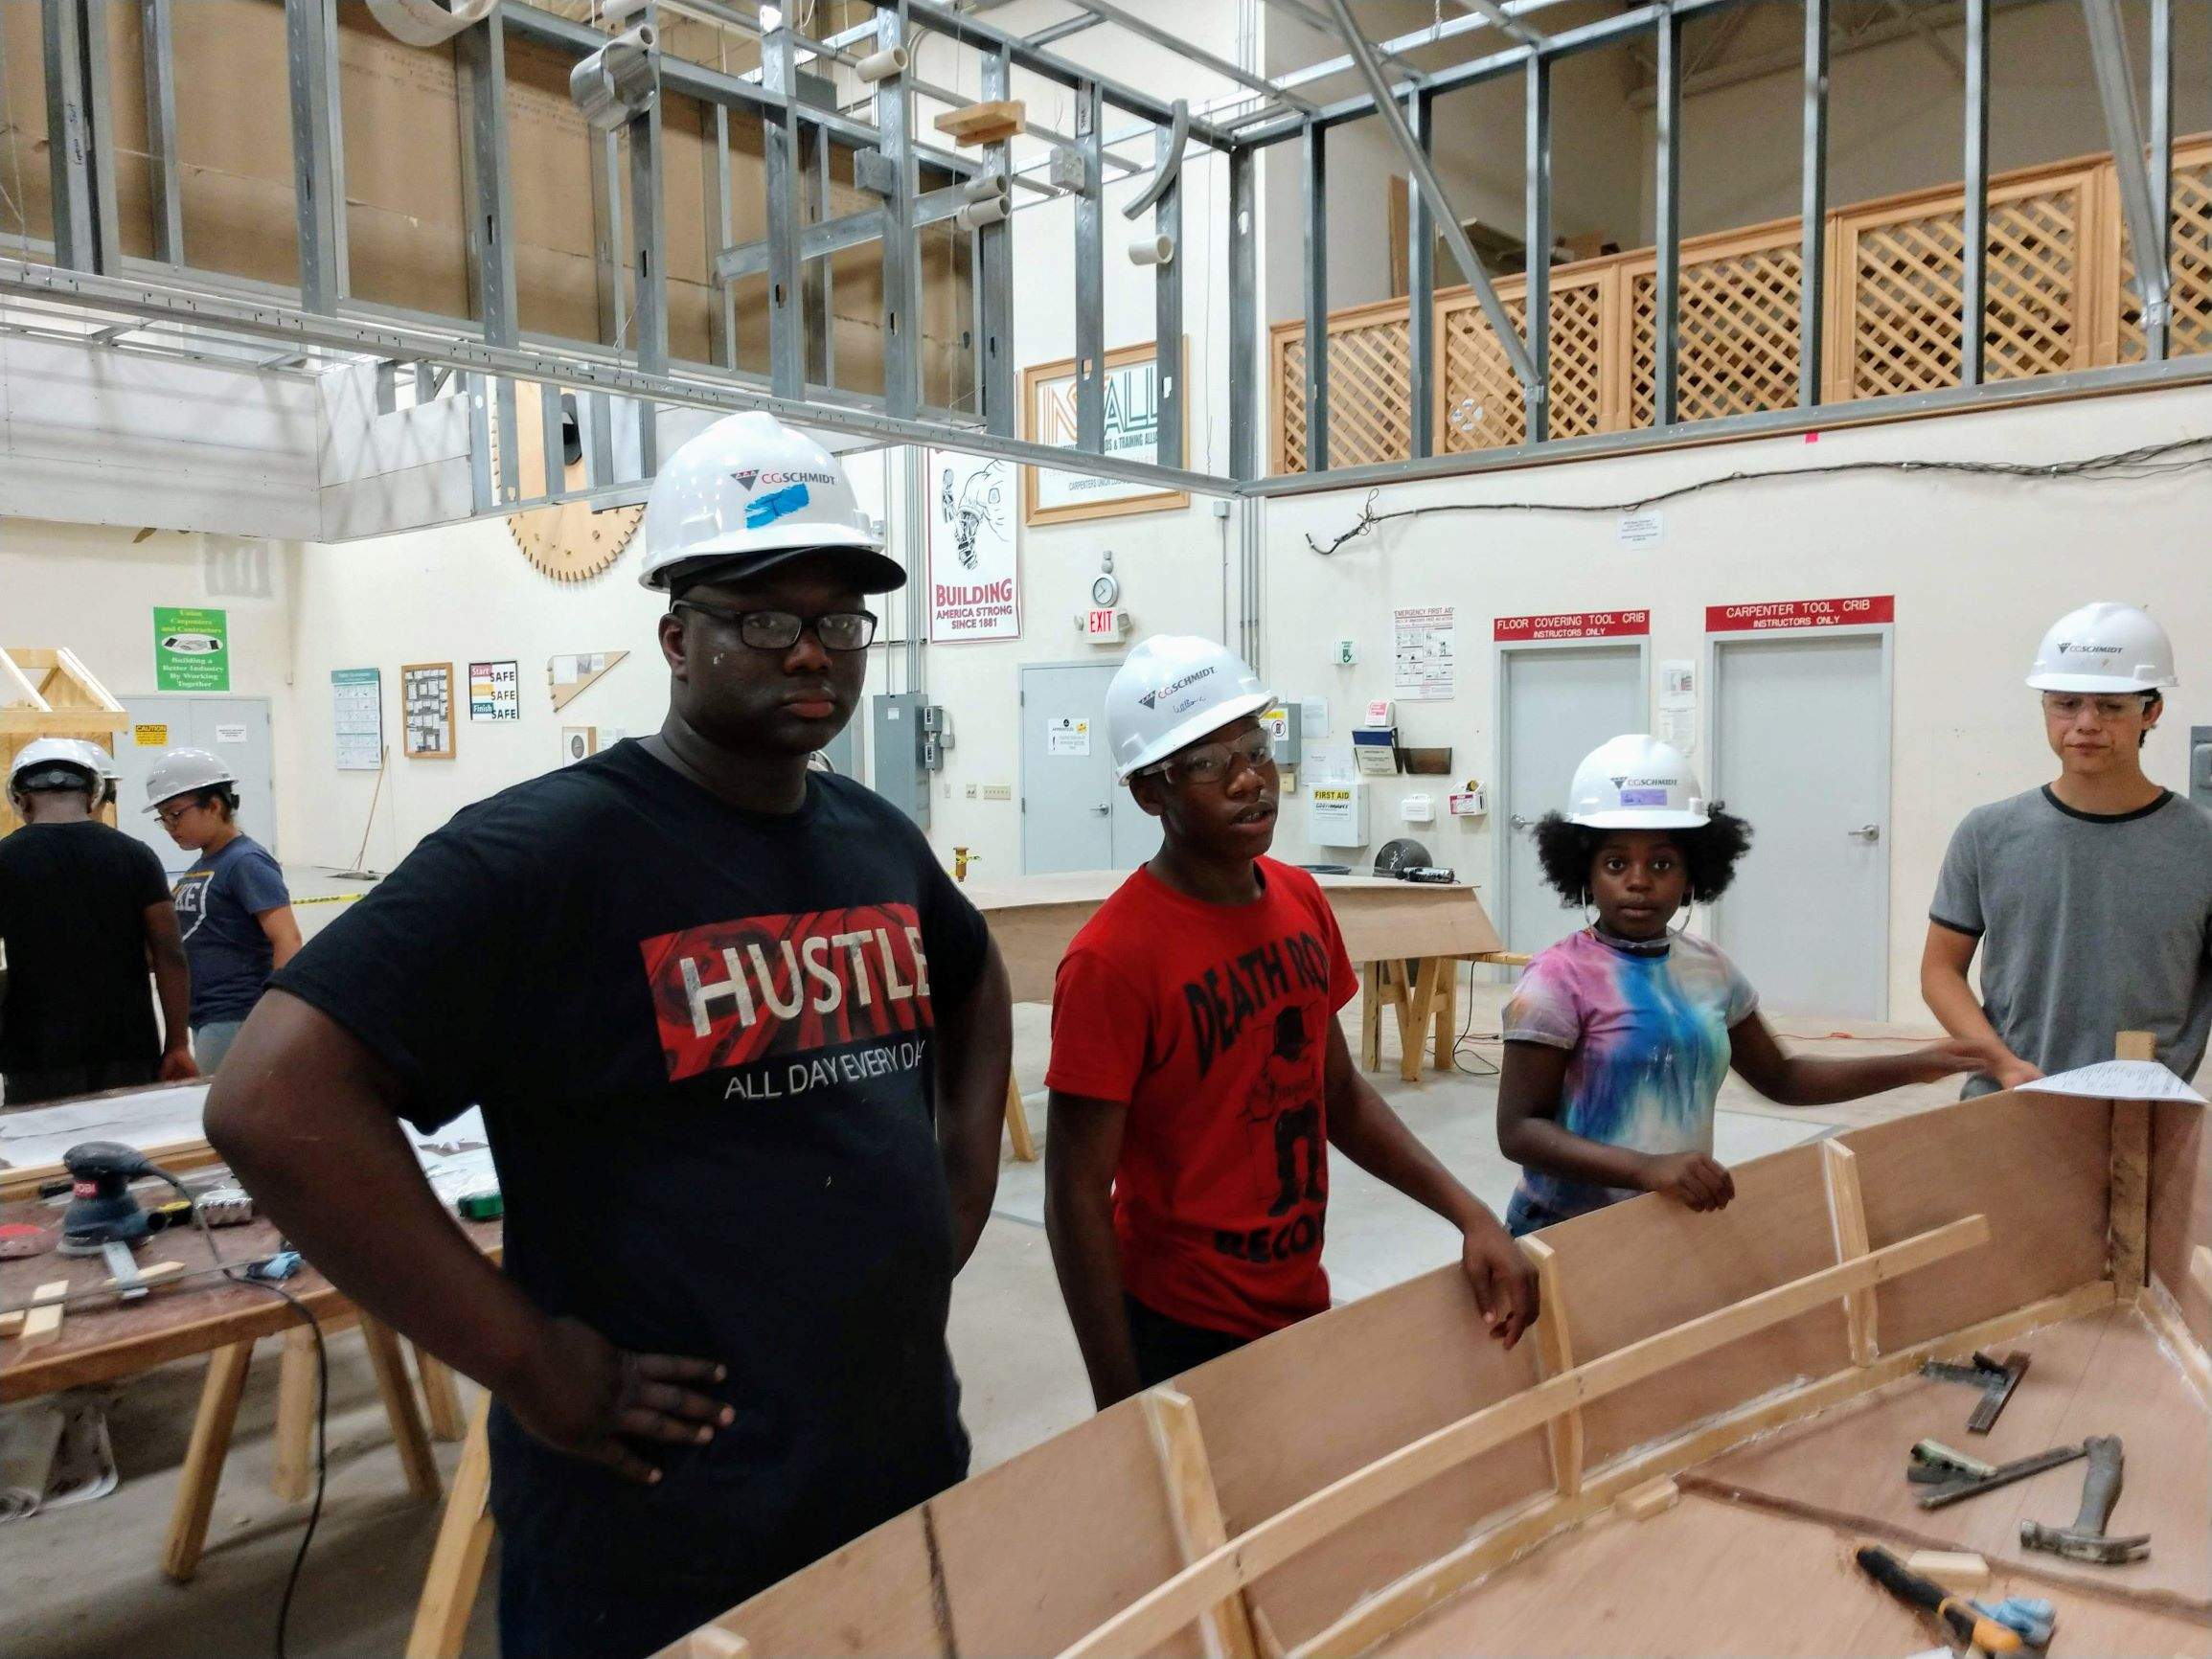
Building More Than A Boat !
ApprenticePREP (ages 18-22)

Slide 18
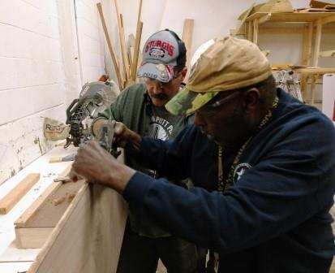
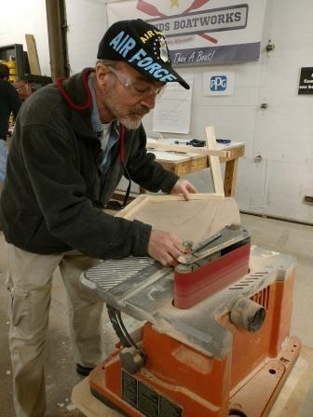
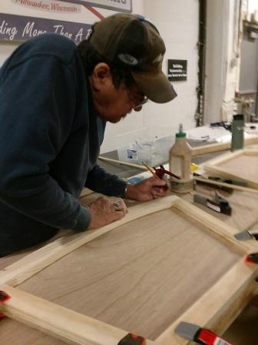
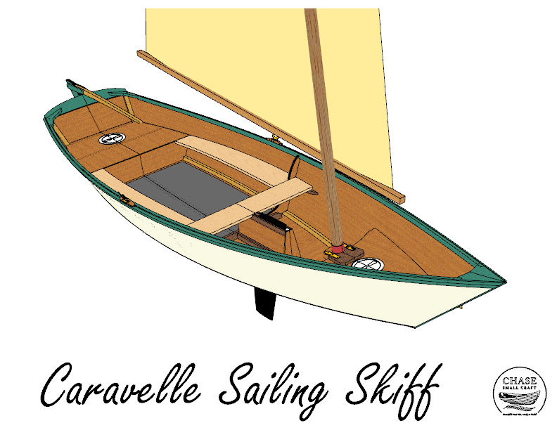
Building More Than A Boat !
Veterans Projects

Slide 19
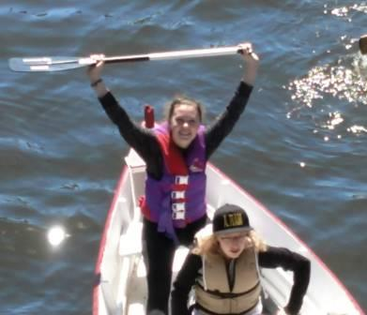
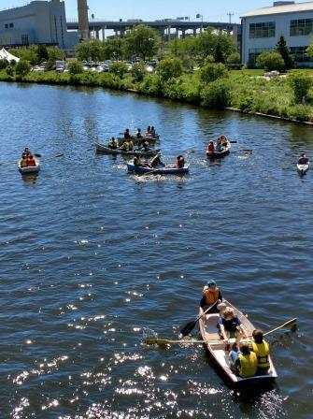
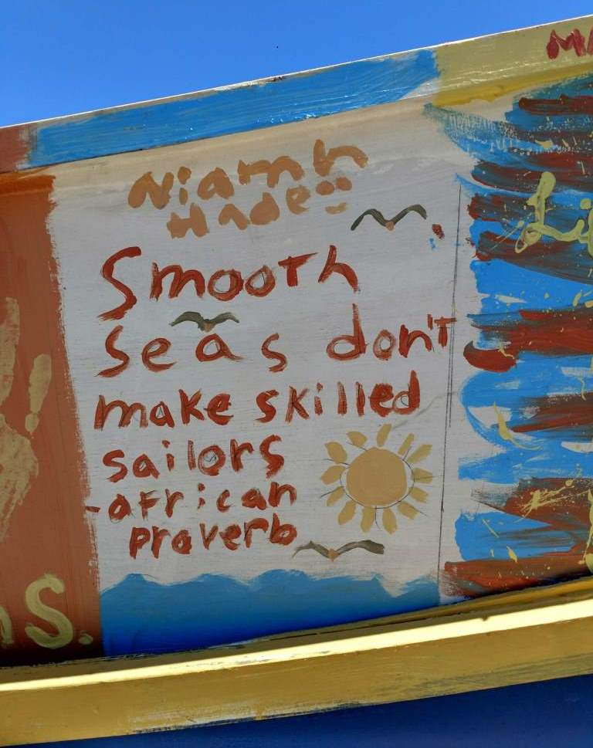
Building More Than A Boat !

Slide 20
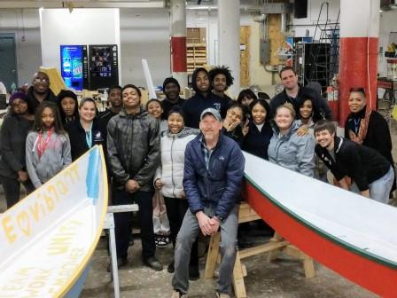
Building More Than A Boat !
www.allhandsboatworks.org William Nimke, President & Founder bill@allhandsboatworks.org 262-290-0228

