Slide 1
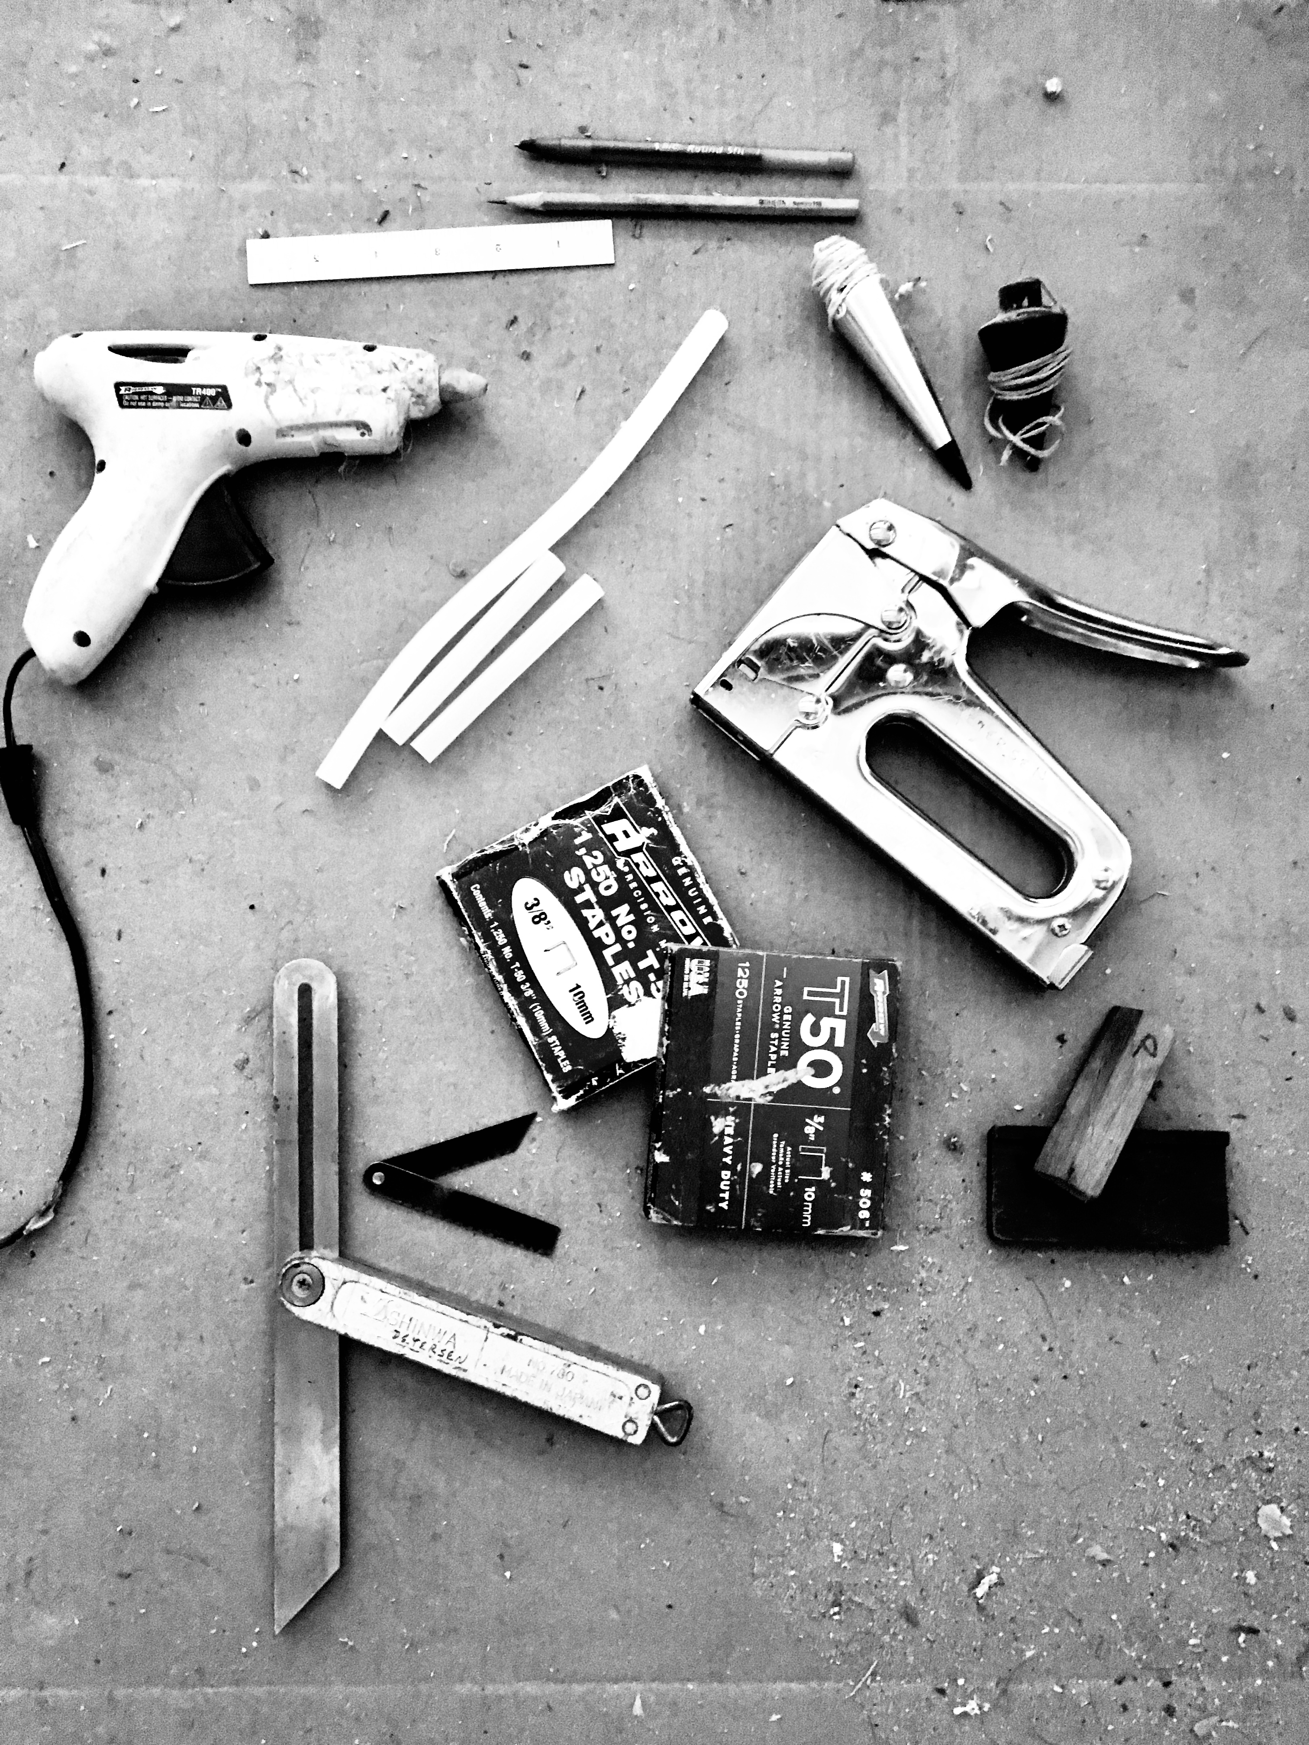
Making Patterns and Templates for Boat Parts
Building on previous presentations about spiling and lofting, here is a third way of defining and making a shape.
Inka Petersen
October, 2019

Slide 2
Nomenclature
template
pattern
spiling
lofting
scribing there is, often in-betweens or combinations of several techniques and different terms are used in different places to describe them.

Slide 3
Tools
pen / pencil
6” ruler
plumbob
glue gun w/ ammo
staple gun with ammo
bevel gauge
spiling block
not in the picture: mini square
good to have: box cutter, chisel, block plane, mini rabbet plane

Slide 4
Simple Common Applications
a true rectangle you can just measure: Length, Width, Thickness - all corners and edges are cut at a right angle (90º) no pattern necessary
A trapezoidal panel requires more work. You could measure all sides and angles and reconstruct the trapezoid that way in the shop. cumbersome!
better to make a template!

Slide 5
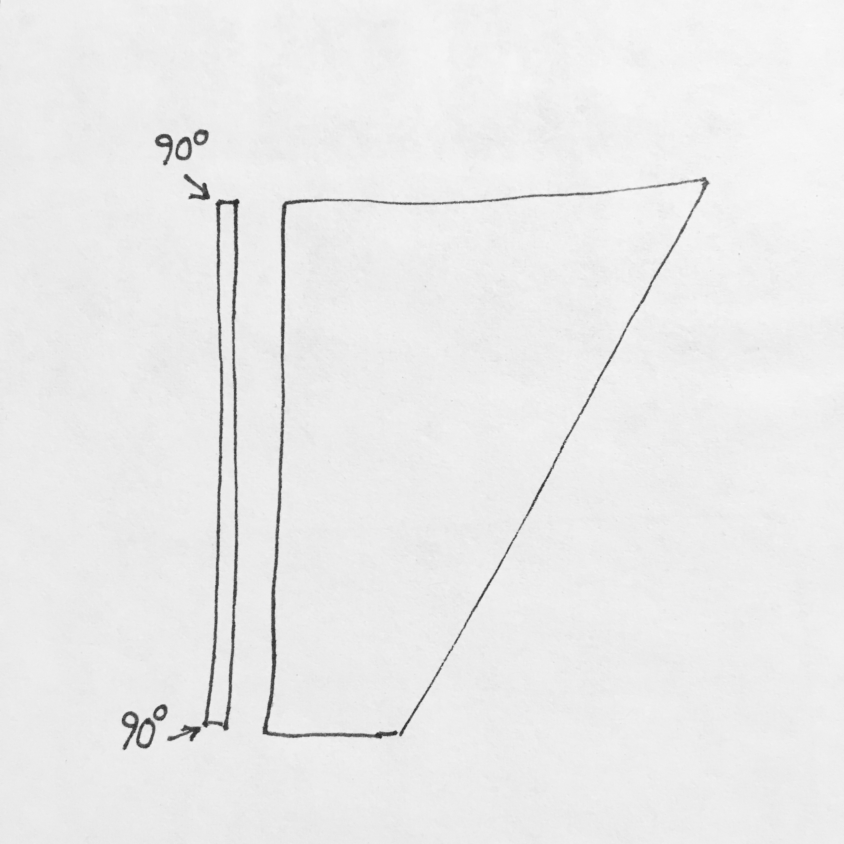
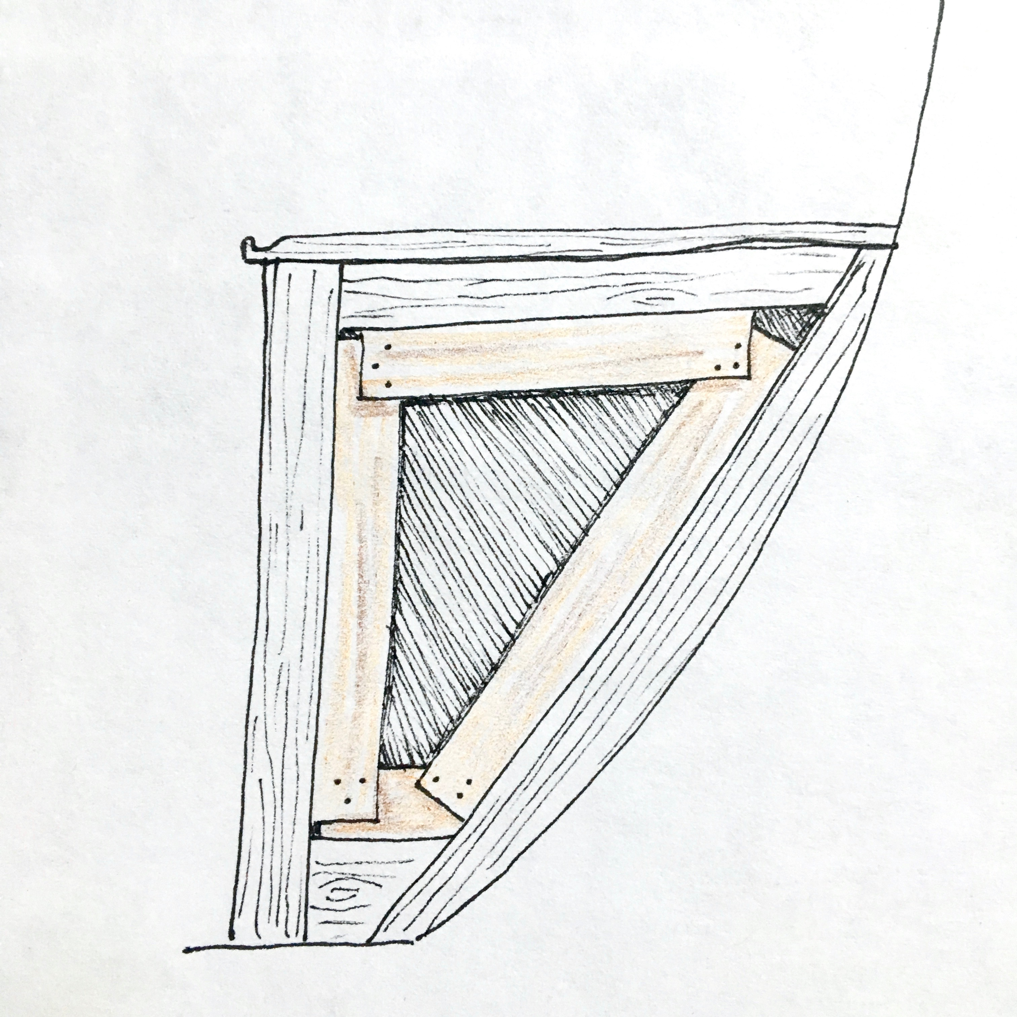
1 Trapezoid
X1
The trapezoidal panel is flat, so the thickness is of no concern, it doesn’t change throughout the piece.
All the edges are cut at a right angle, so we are basically working in 2 dimensions.
All sides are straight, no curves.
By fitting strips of doorskin into the opening, we copy its shape and then can transfer it to our piece of wood in the shop. Continuing the straight edges will bring us to the exact corner points, so there is no need to fit the ply exactly to the corners.
X2

Slide 6
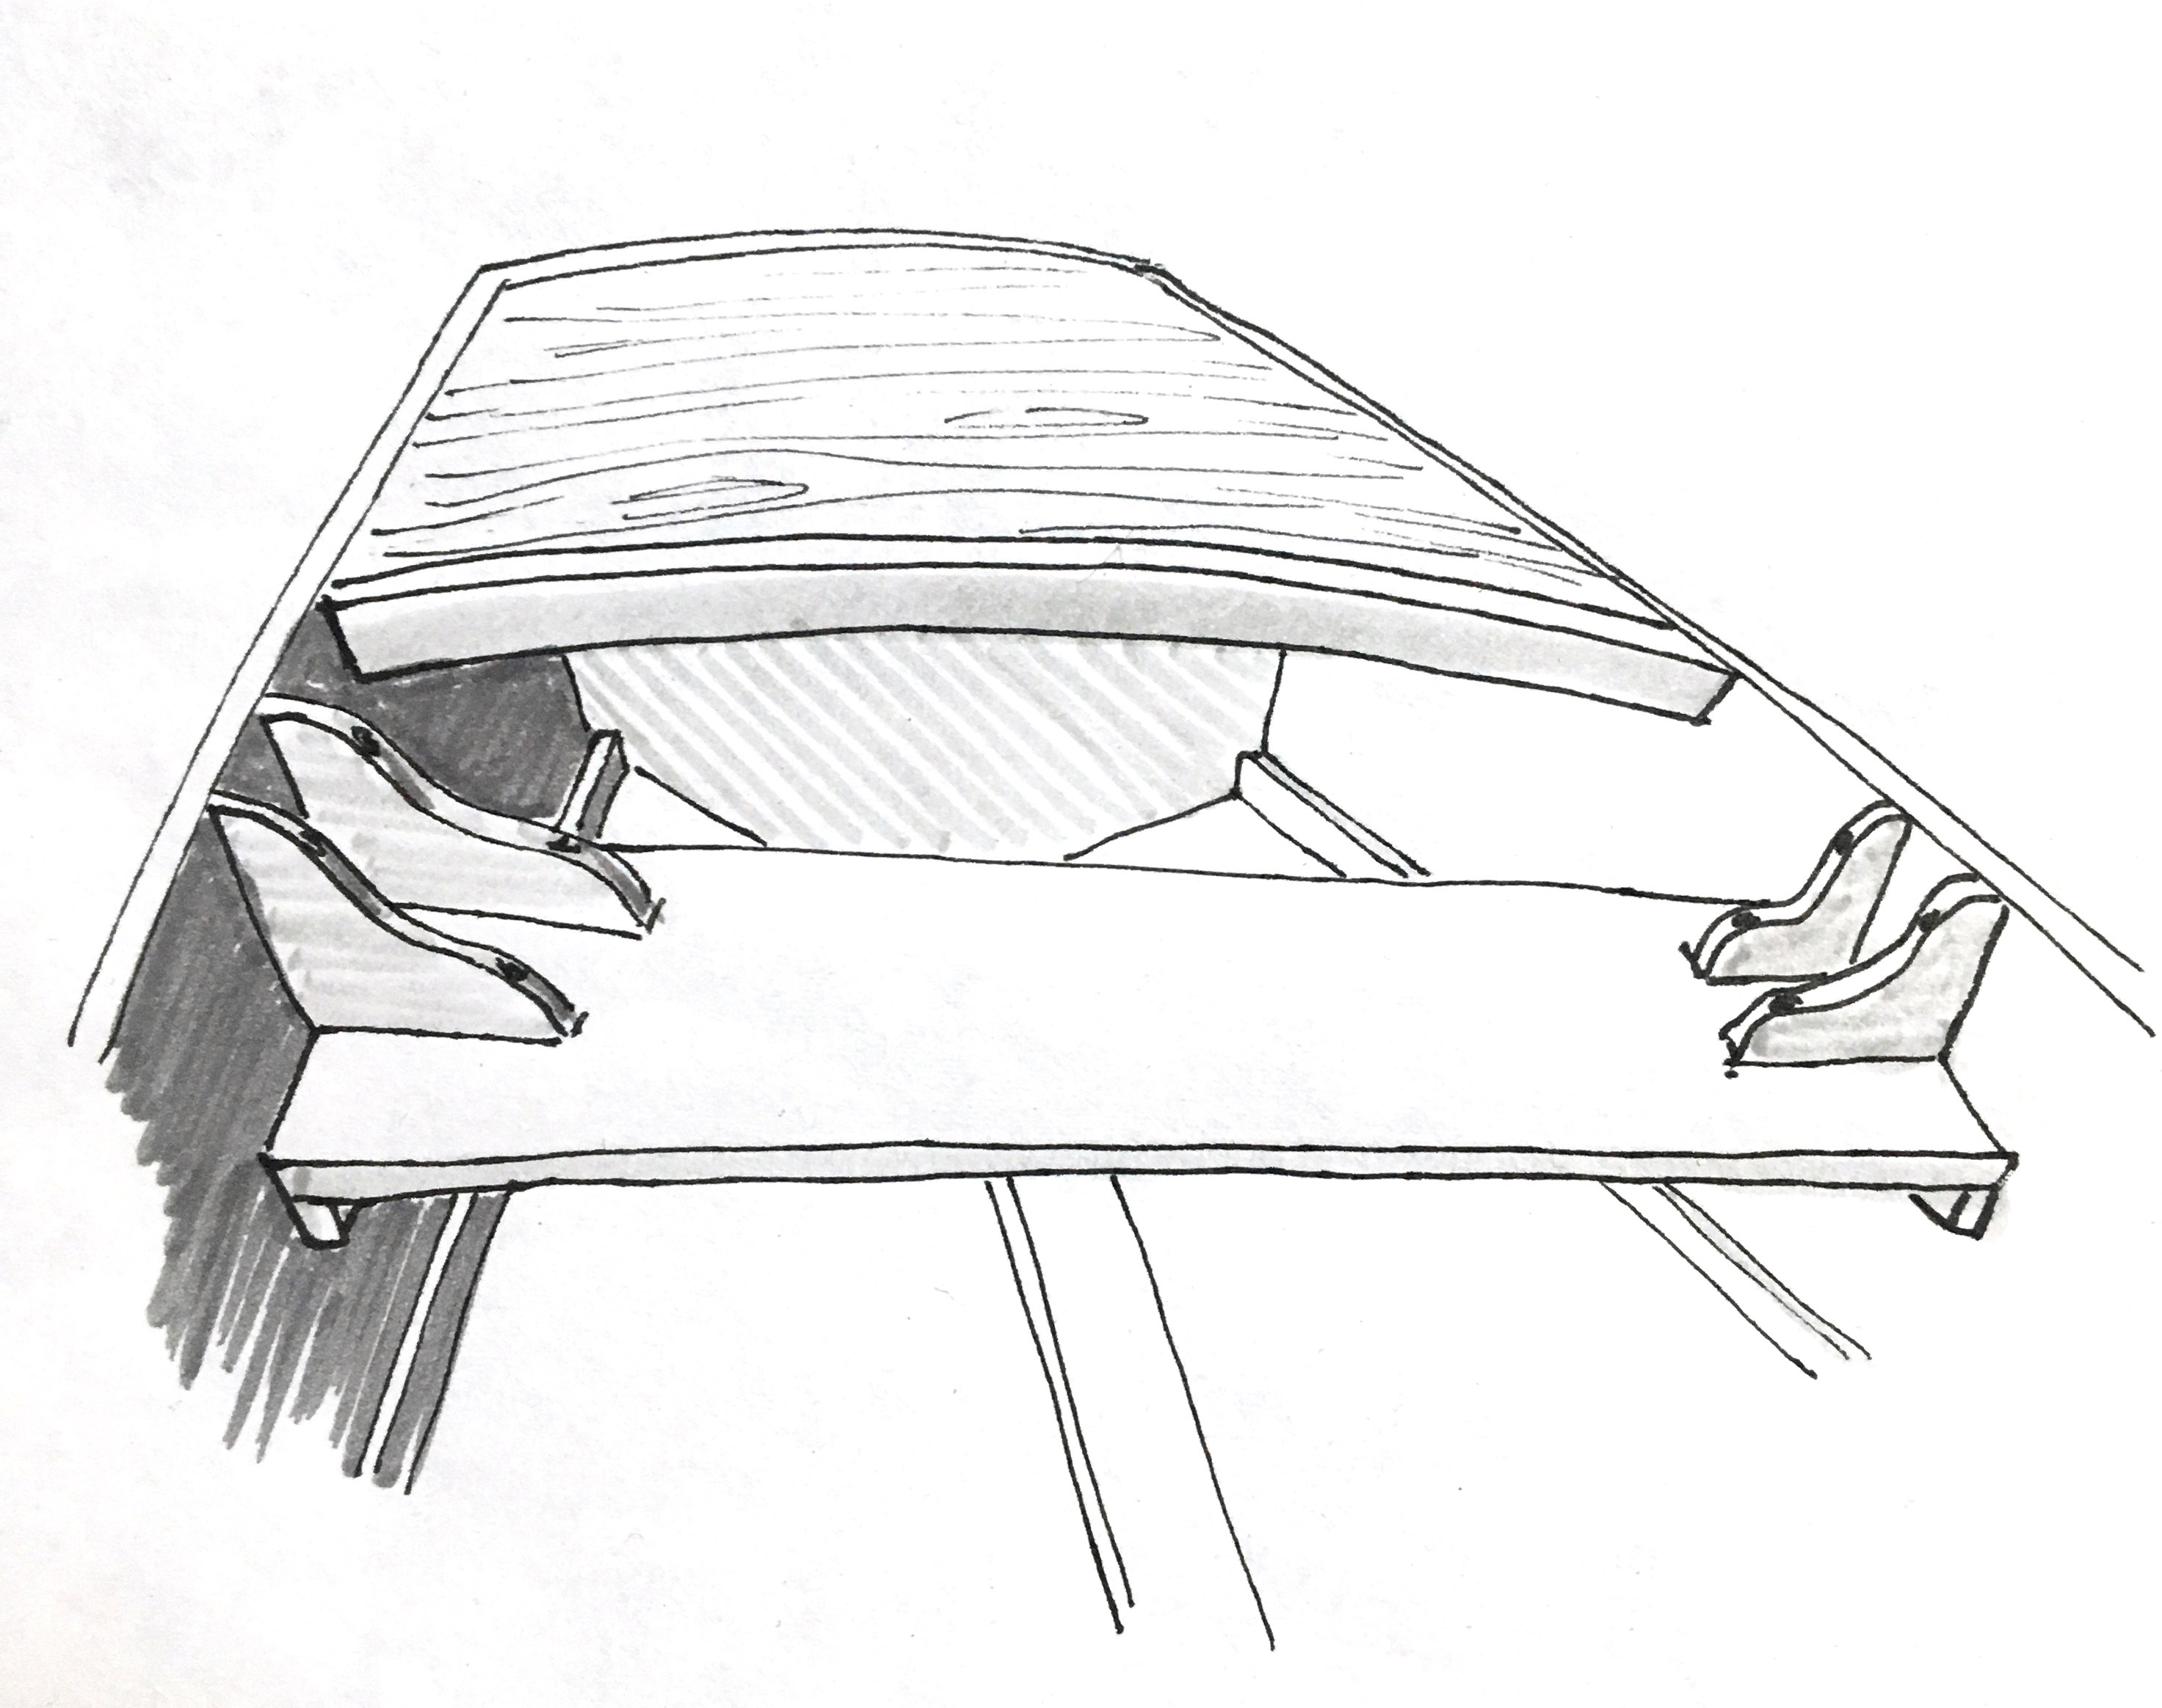
2 Small Boat Thwart/Seat
This shape is also trapezoidal, maybe with a slight curve to the shorter ends. The front and back edges are parallel, but of different length, and the side edges are cut at a bevel. Again we are only concerned with 2 of the 3 Dimensions.
6d

Slide 7
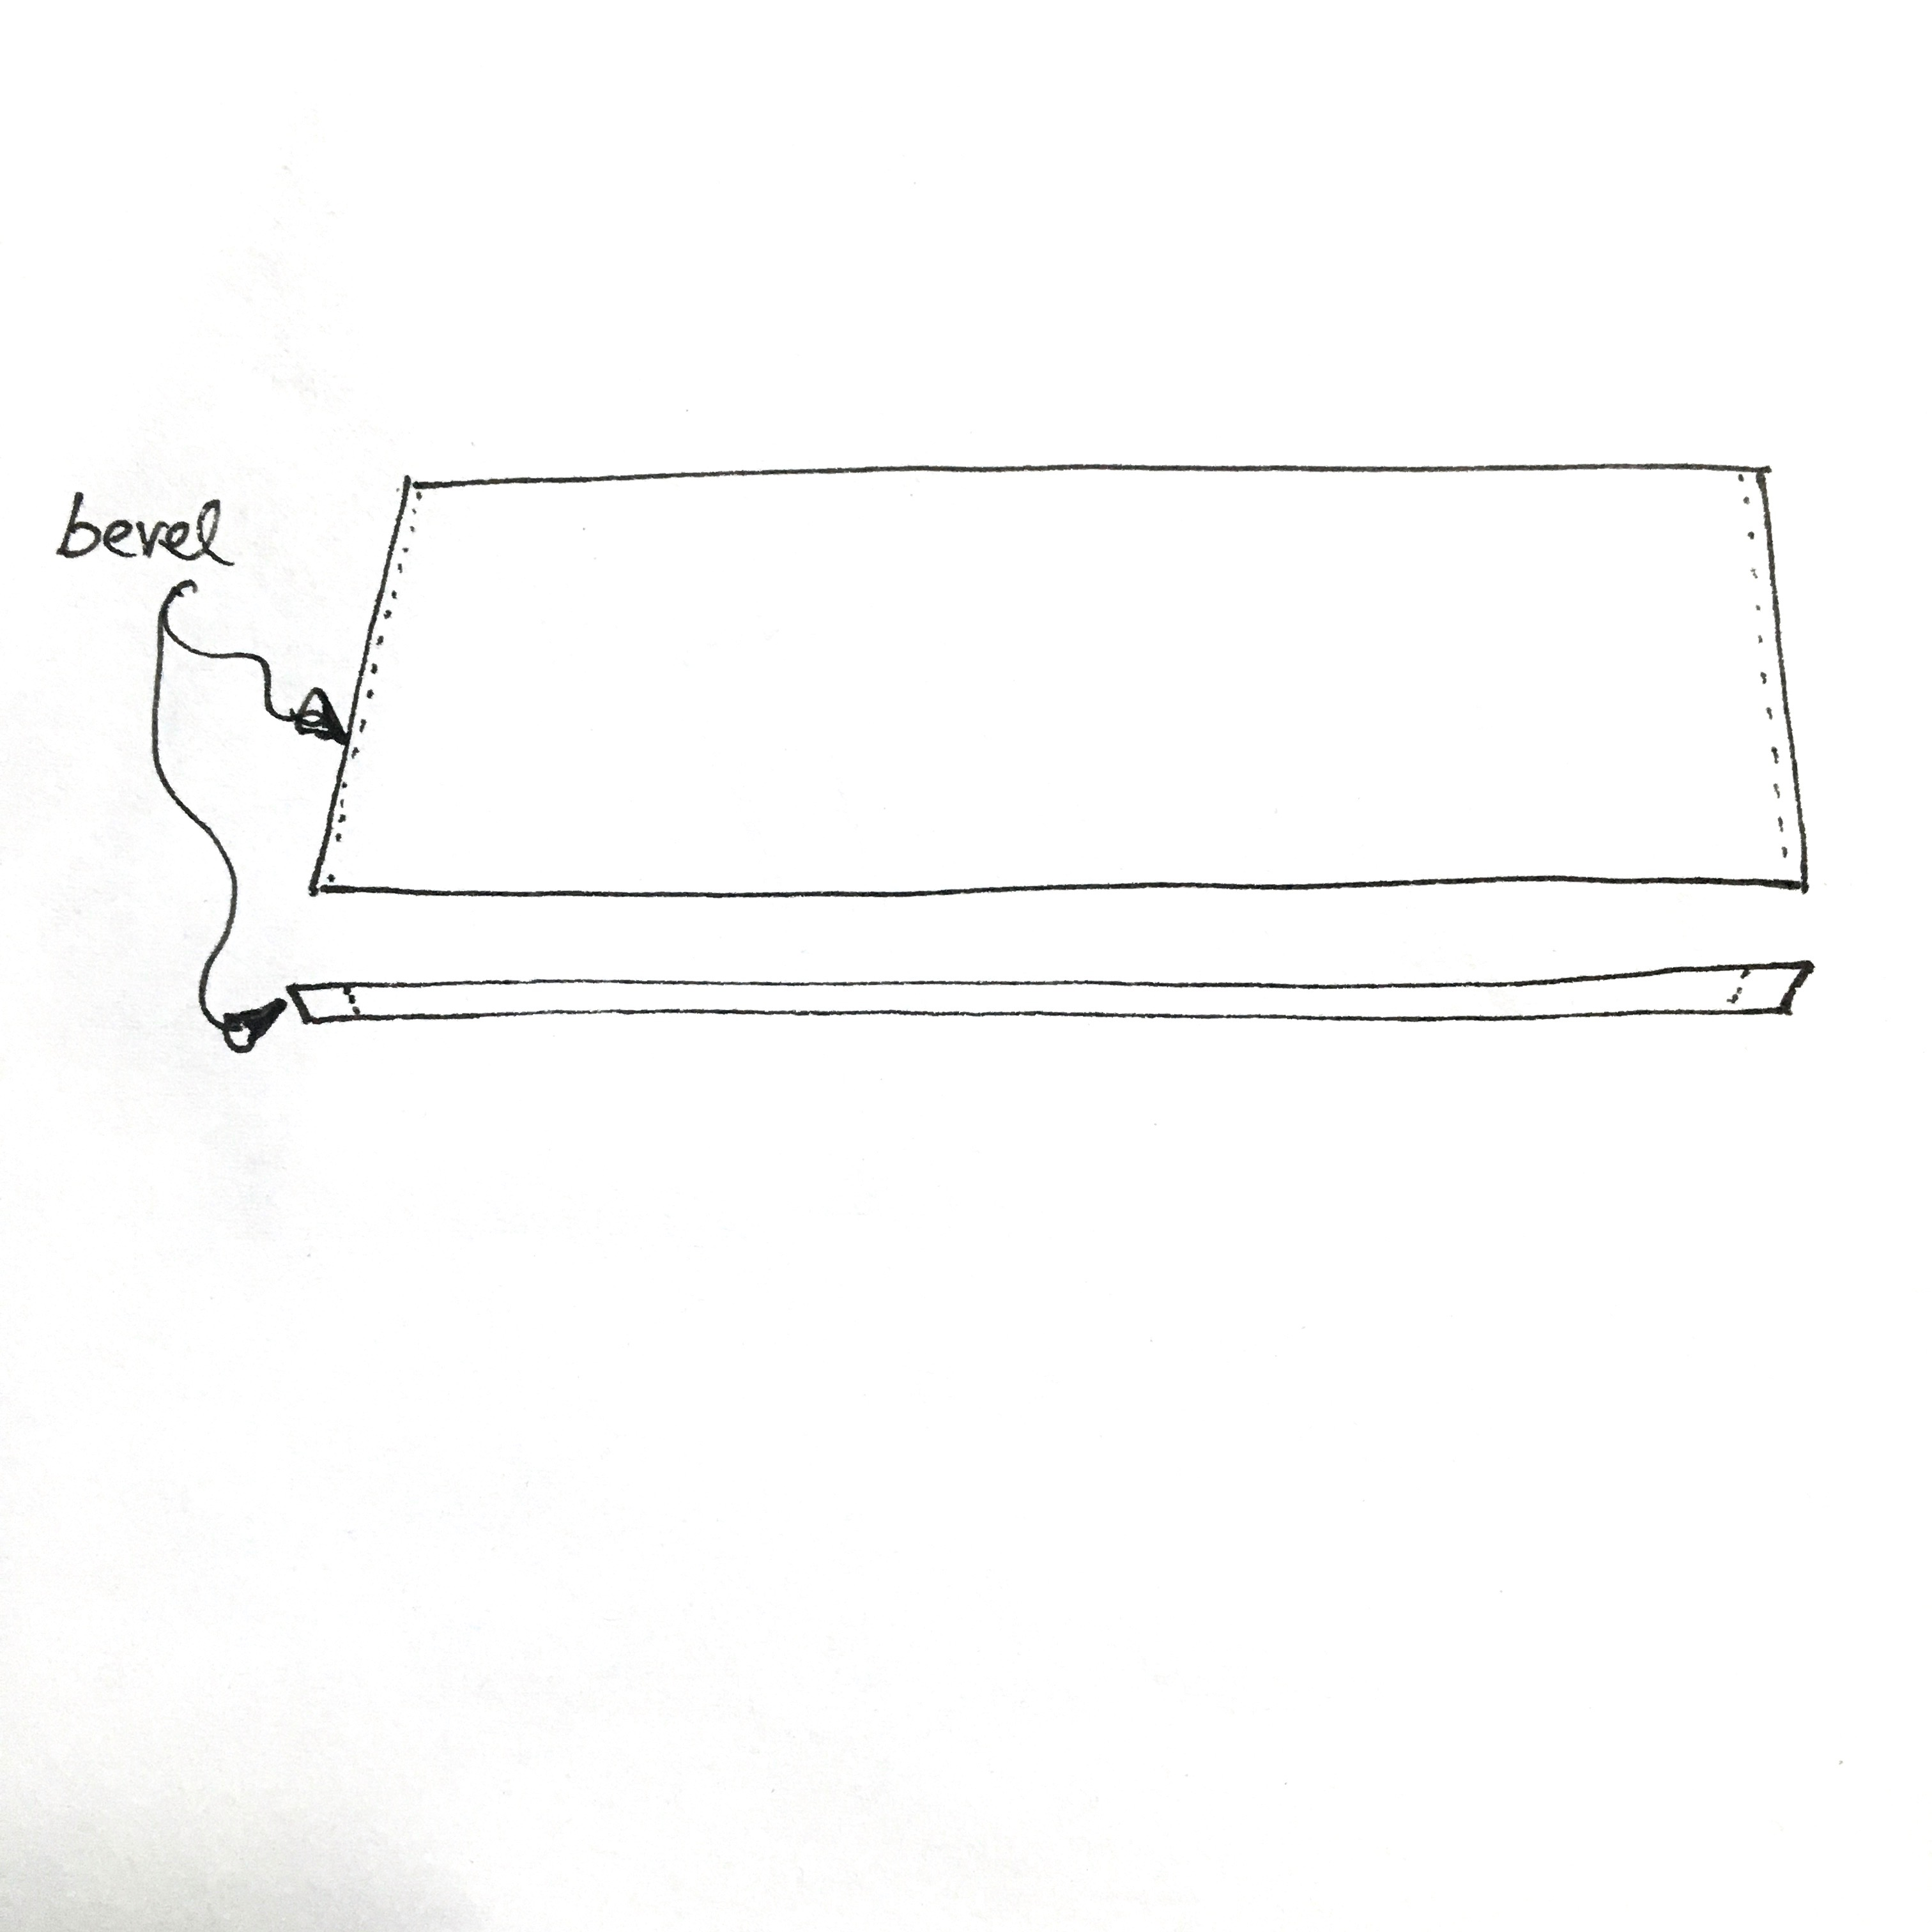
2c

Slide 8
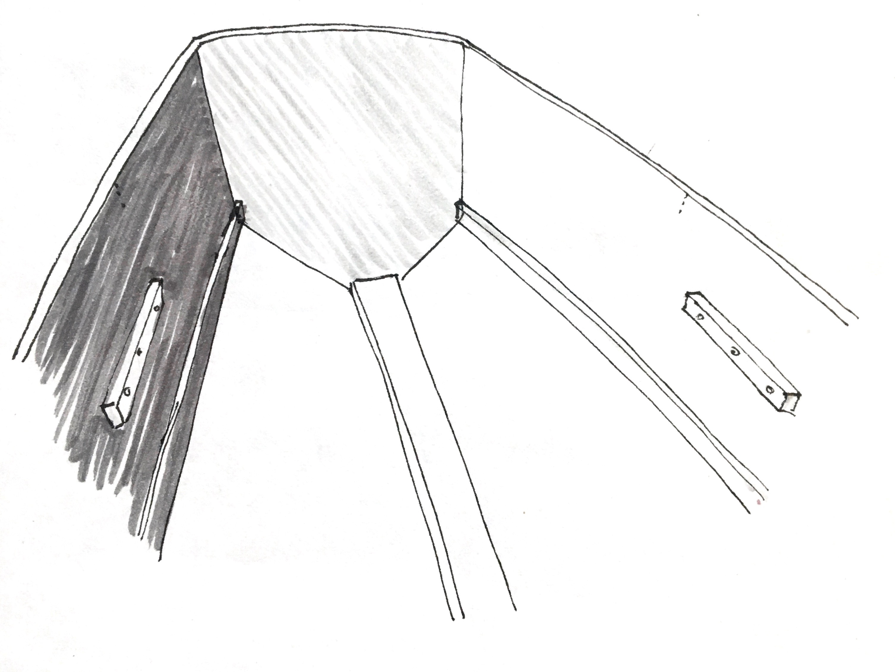
1

Slide 9
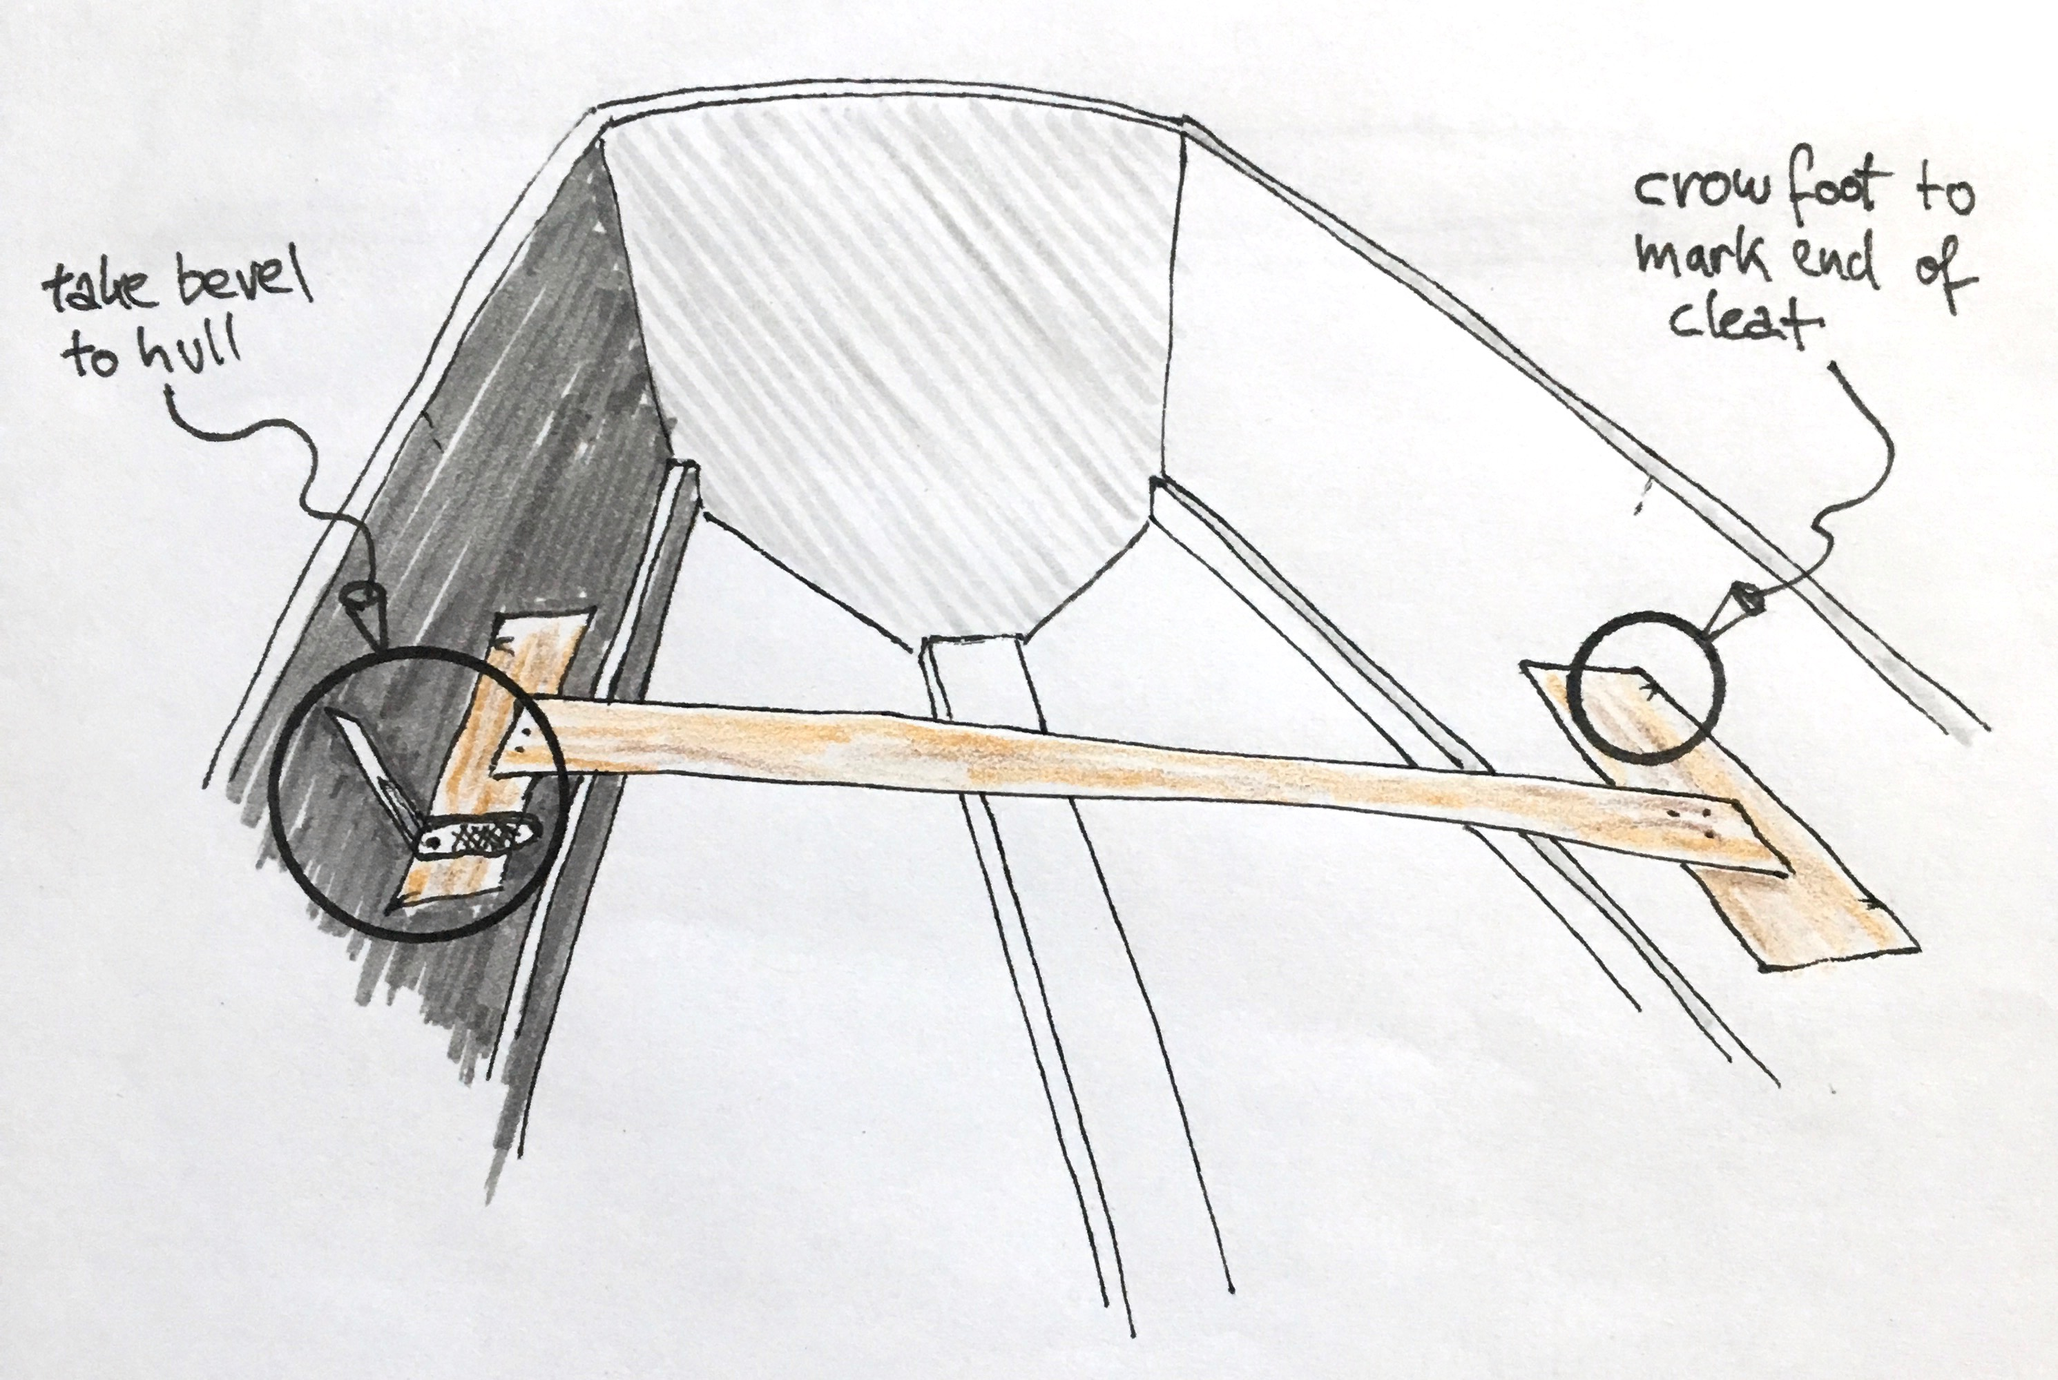
2

Slide 10
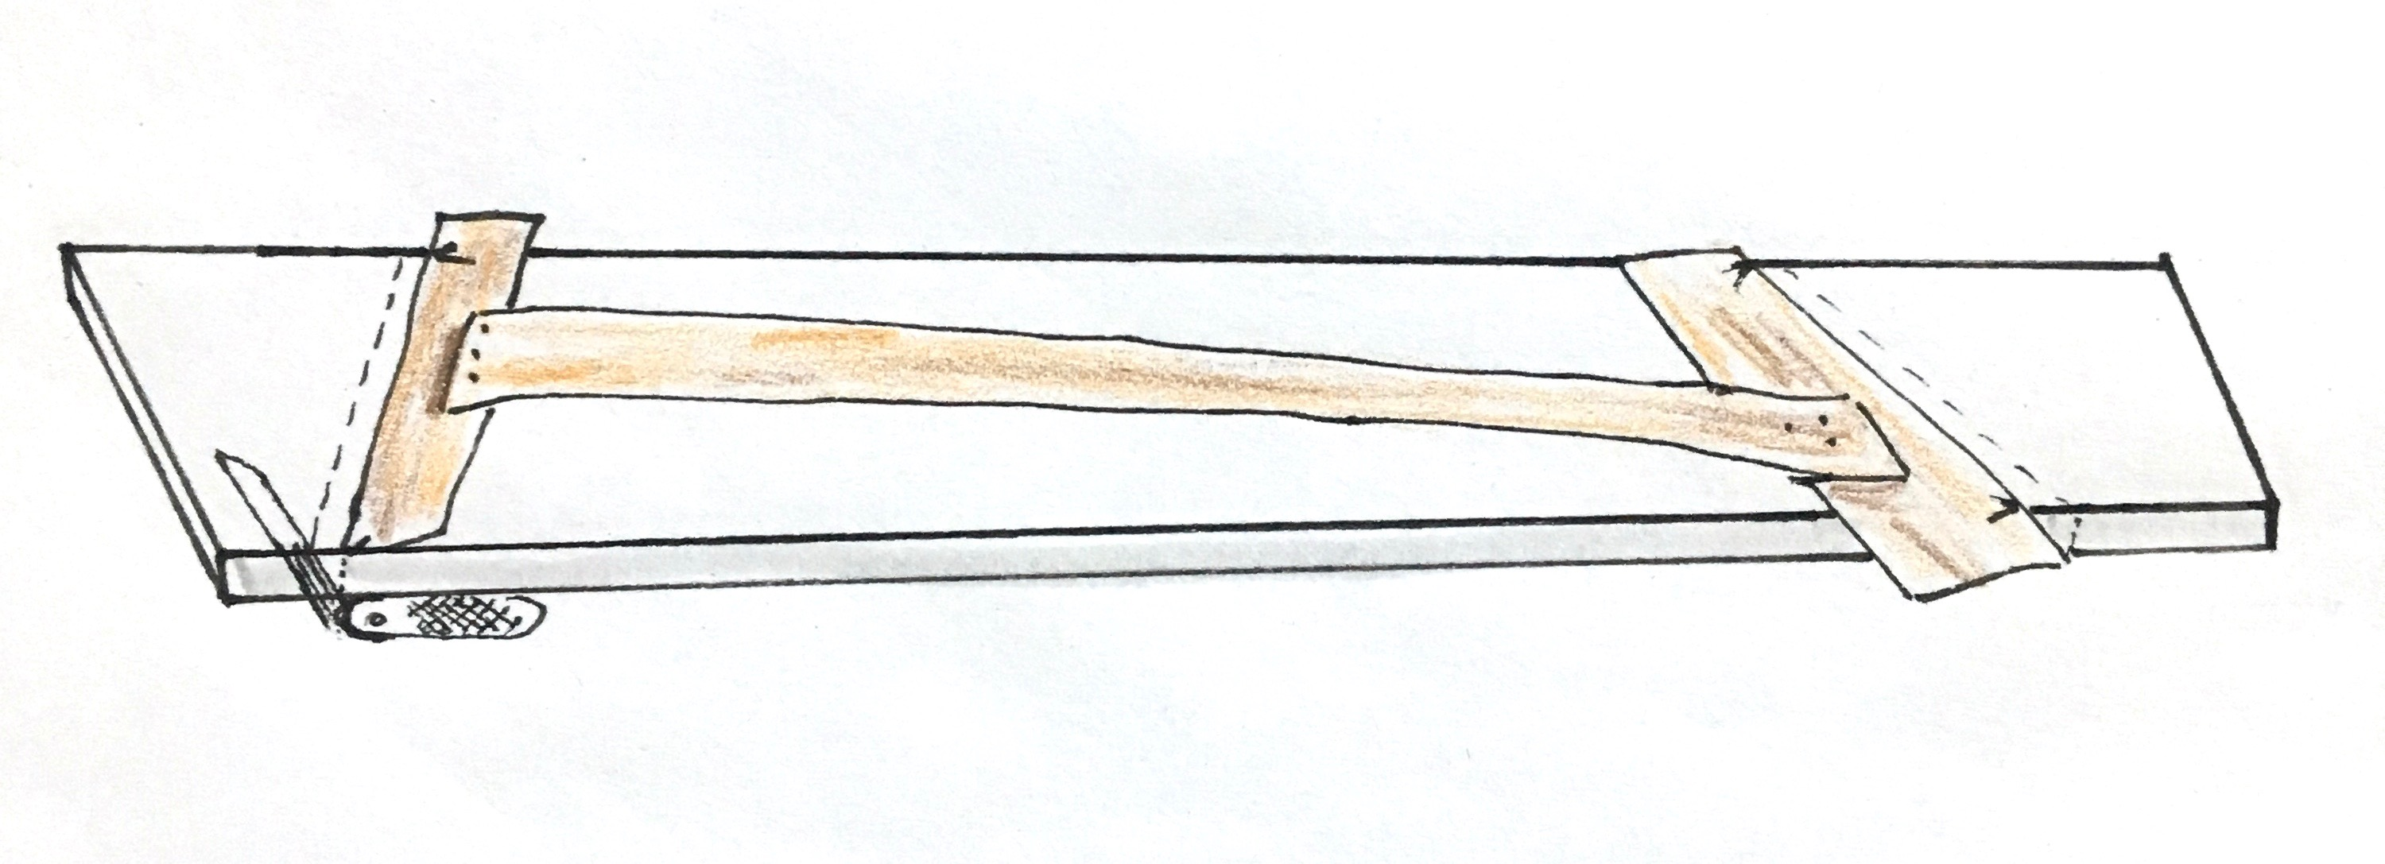
Because the template was taken directly on the cleat that will hold up the thwart, it shows us the dimensions of the underside.
Since the hull is opening out toward up, the top of the thwart is longer than the bottom.
To account for the bevel gain, you strike a square line from the template to the underside of the work piece, and scribe the bevel from there. The new line will be drawn parallel to the one you made when tracing the template.

Slide 11
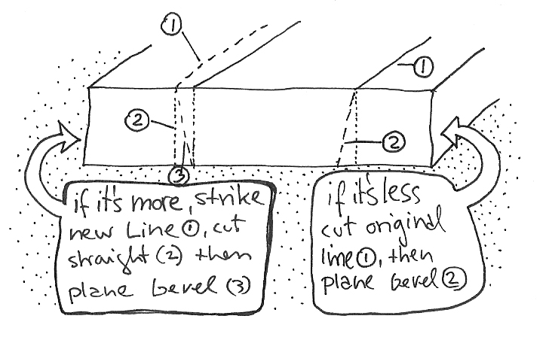

Slide 12
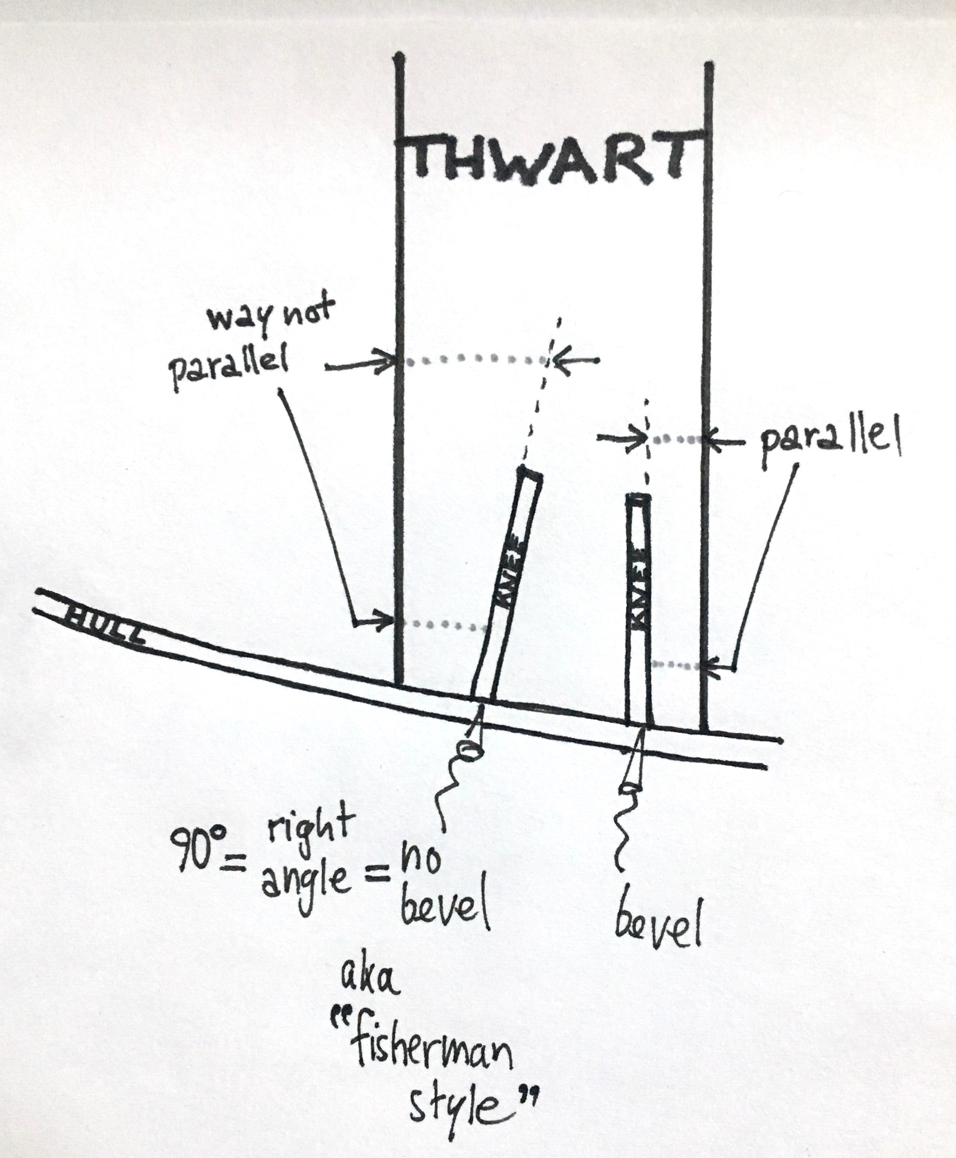
3 Knee
The simple way of making a knee, some call it "fisherman style", is to take the bevel between thwart and hull, cut that angle and the pretty curvy shape (which of course has a purpose!) square, and fasten it as it lays, disregarding the positioning. 2-D
Adding the 3rd dimension, the side that lays against the hull gets the appropriate bevel so the knee can be installed parallel to the thwart, perpendicular to the keel (CL of vessel).

Slide 13
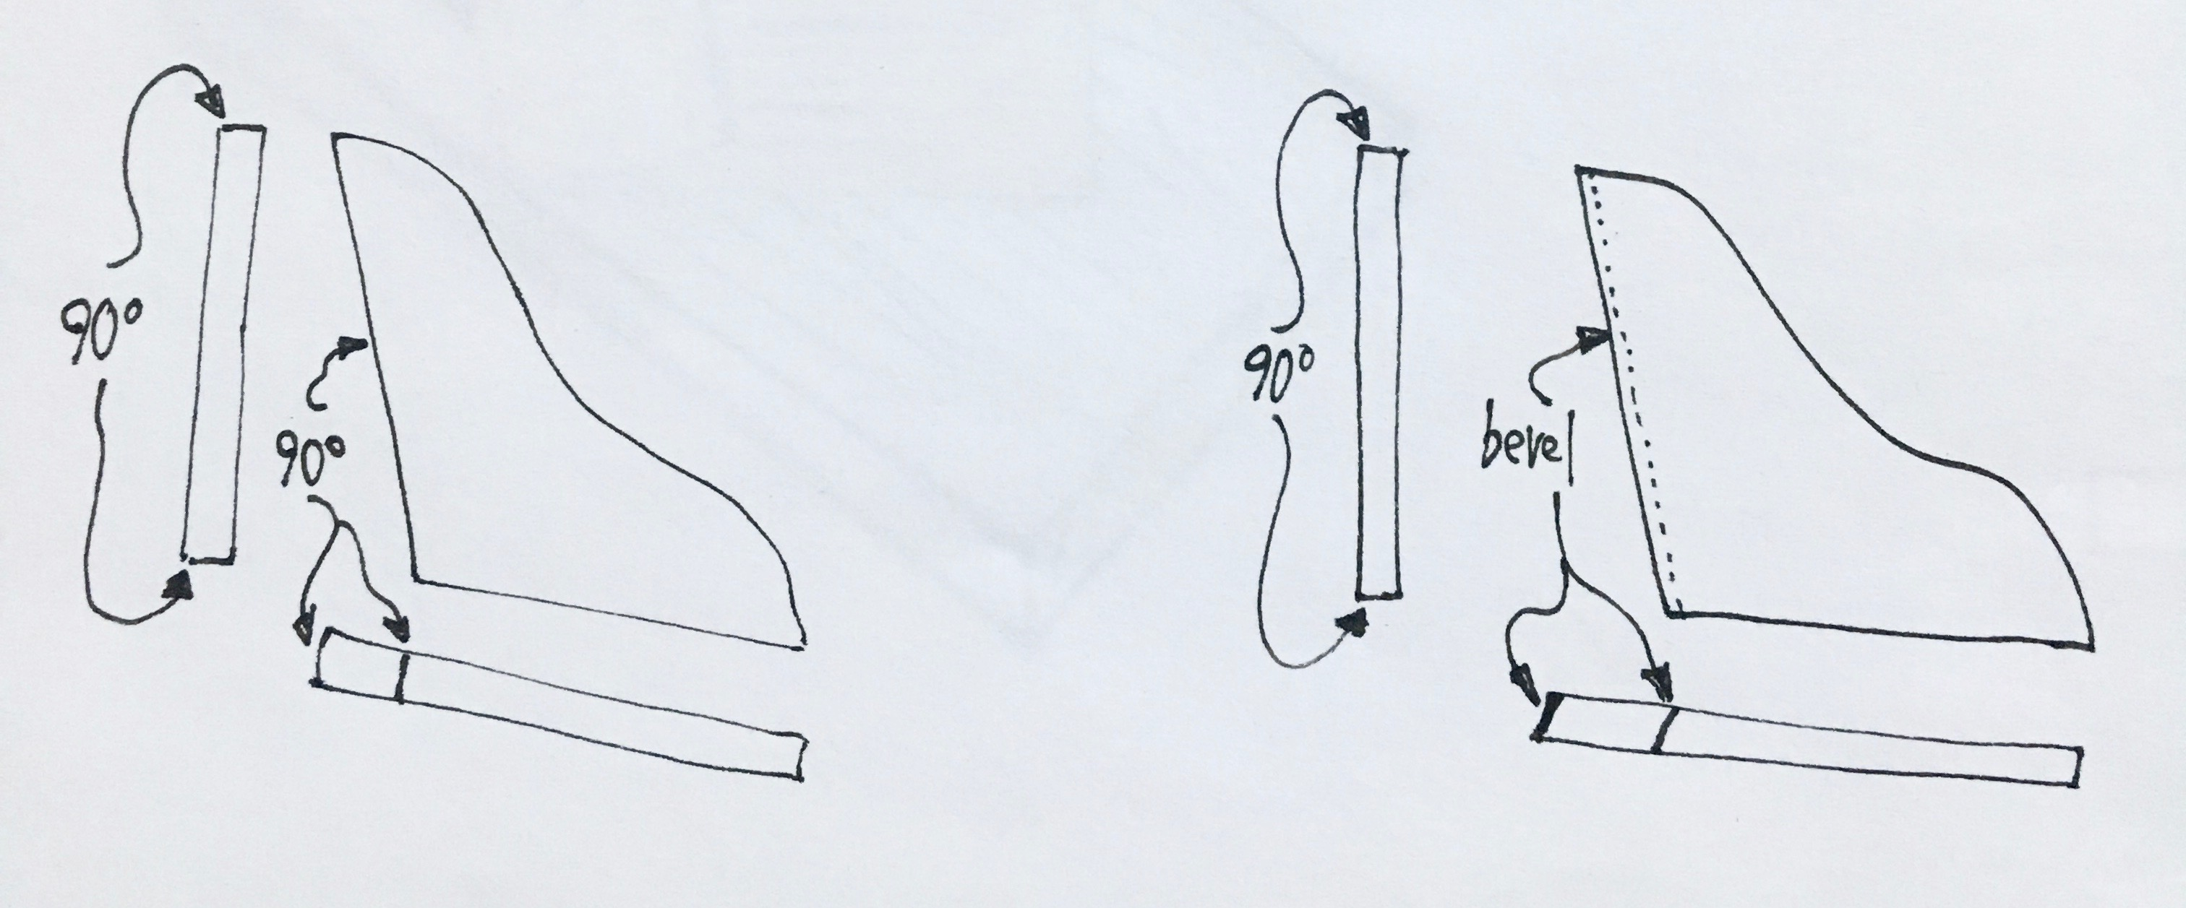
6f

Slide 14
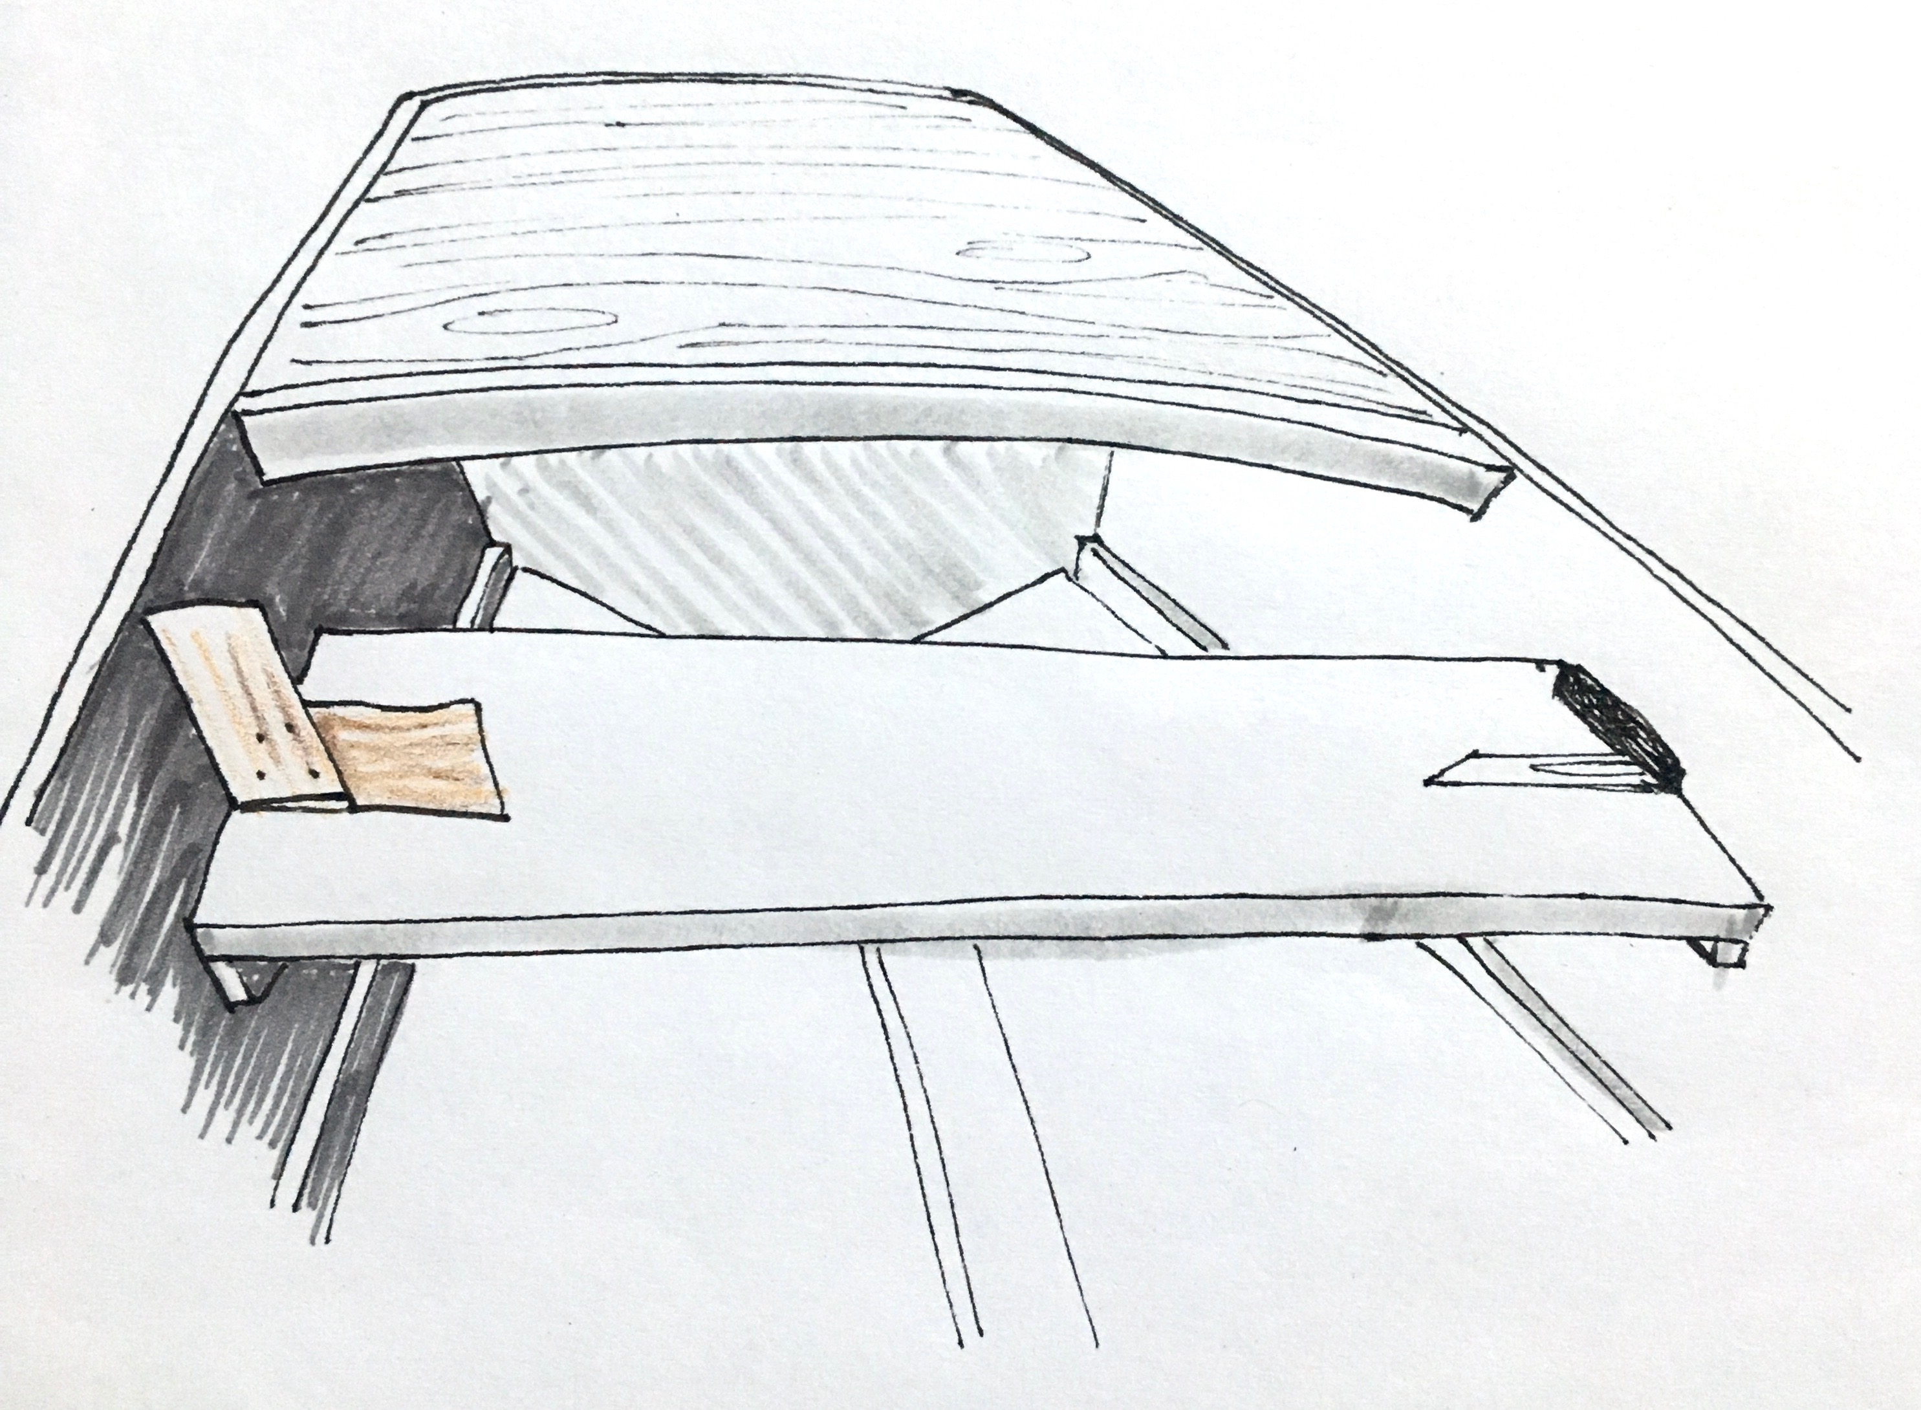
6

Slide 15
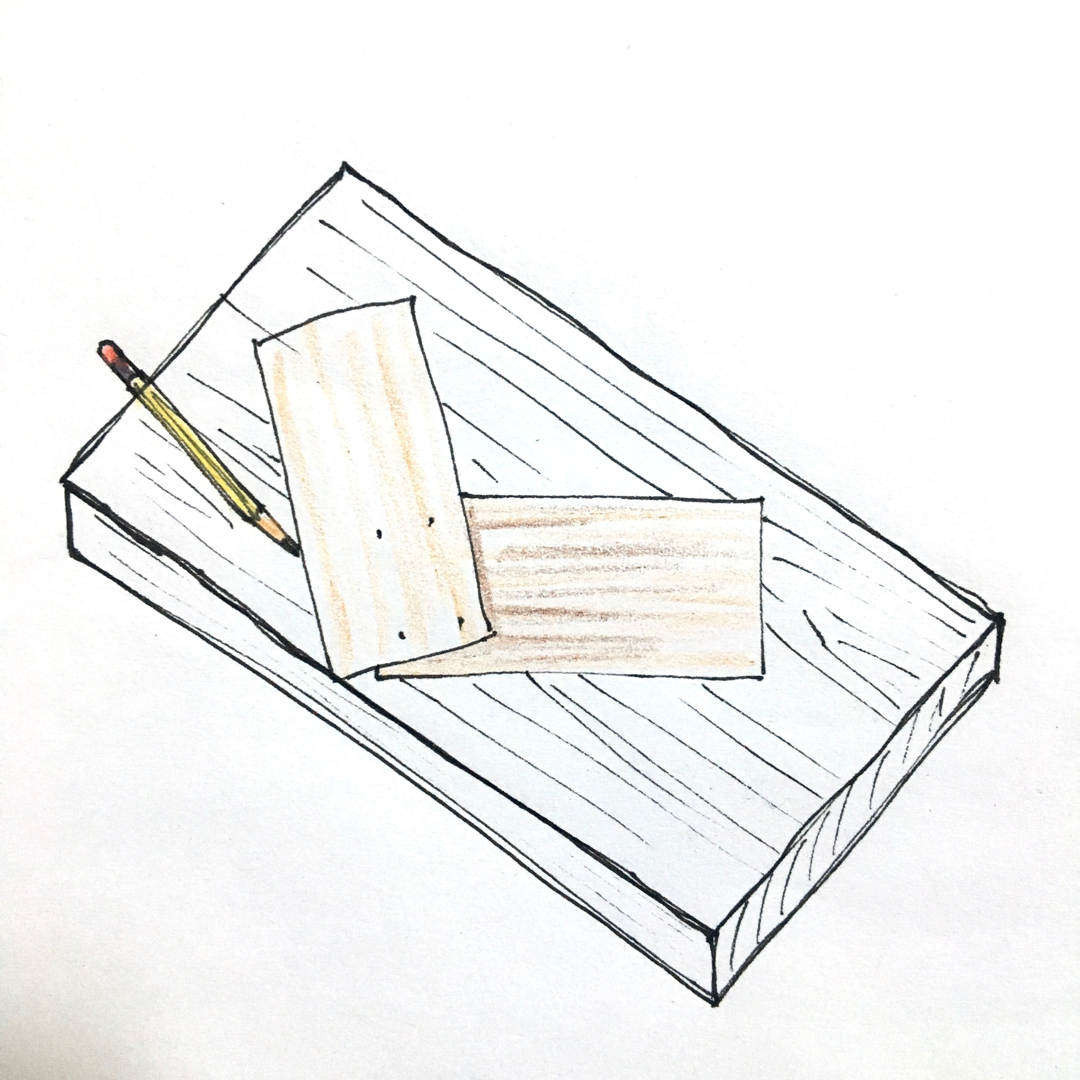
6b

Slide 16
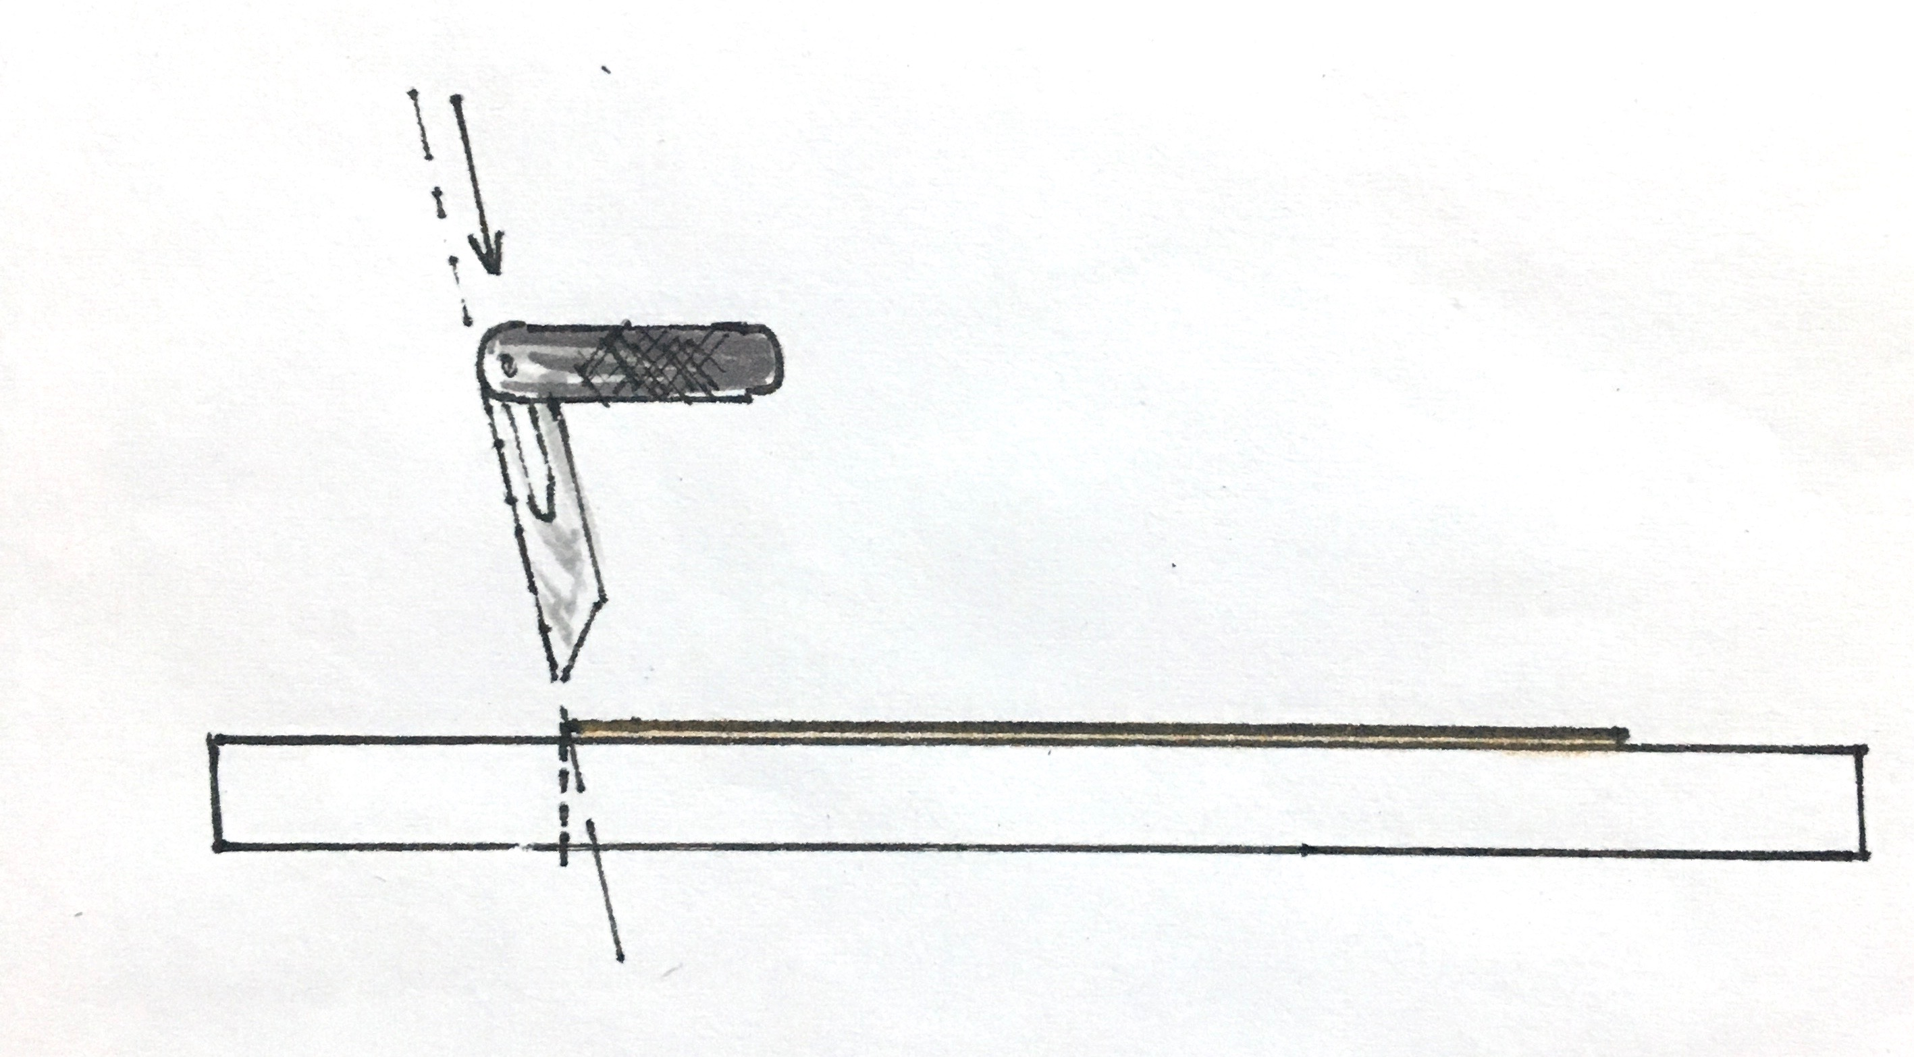
6e

Slide 17
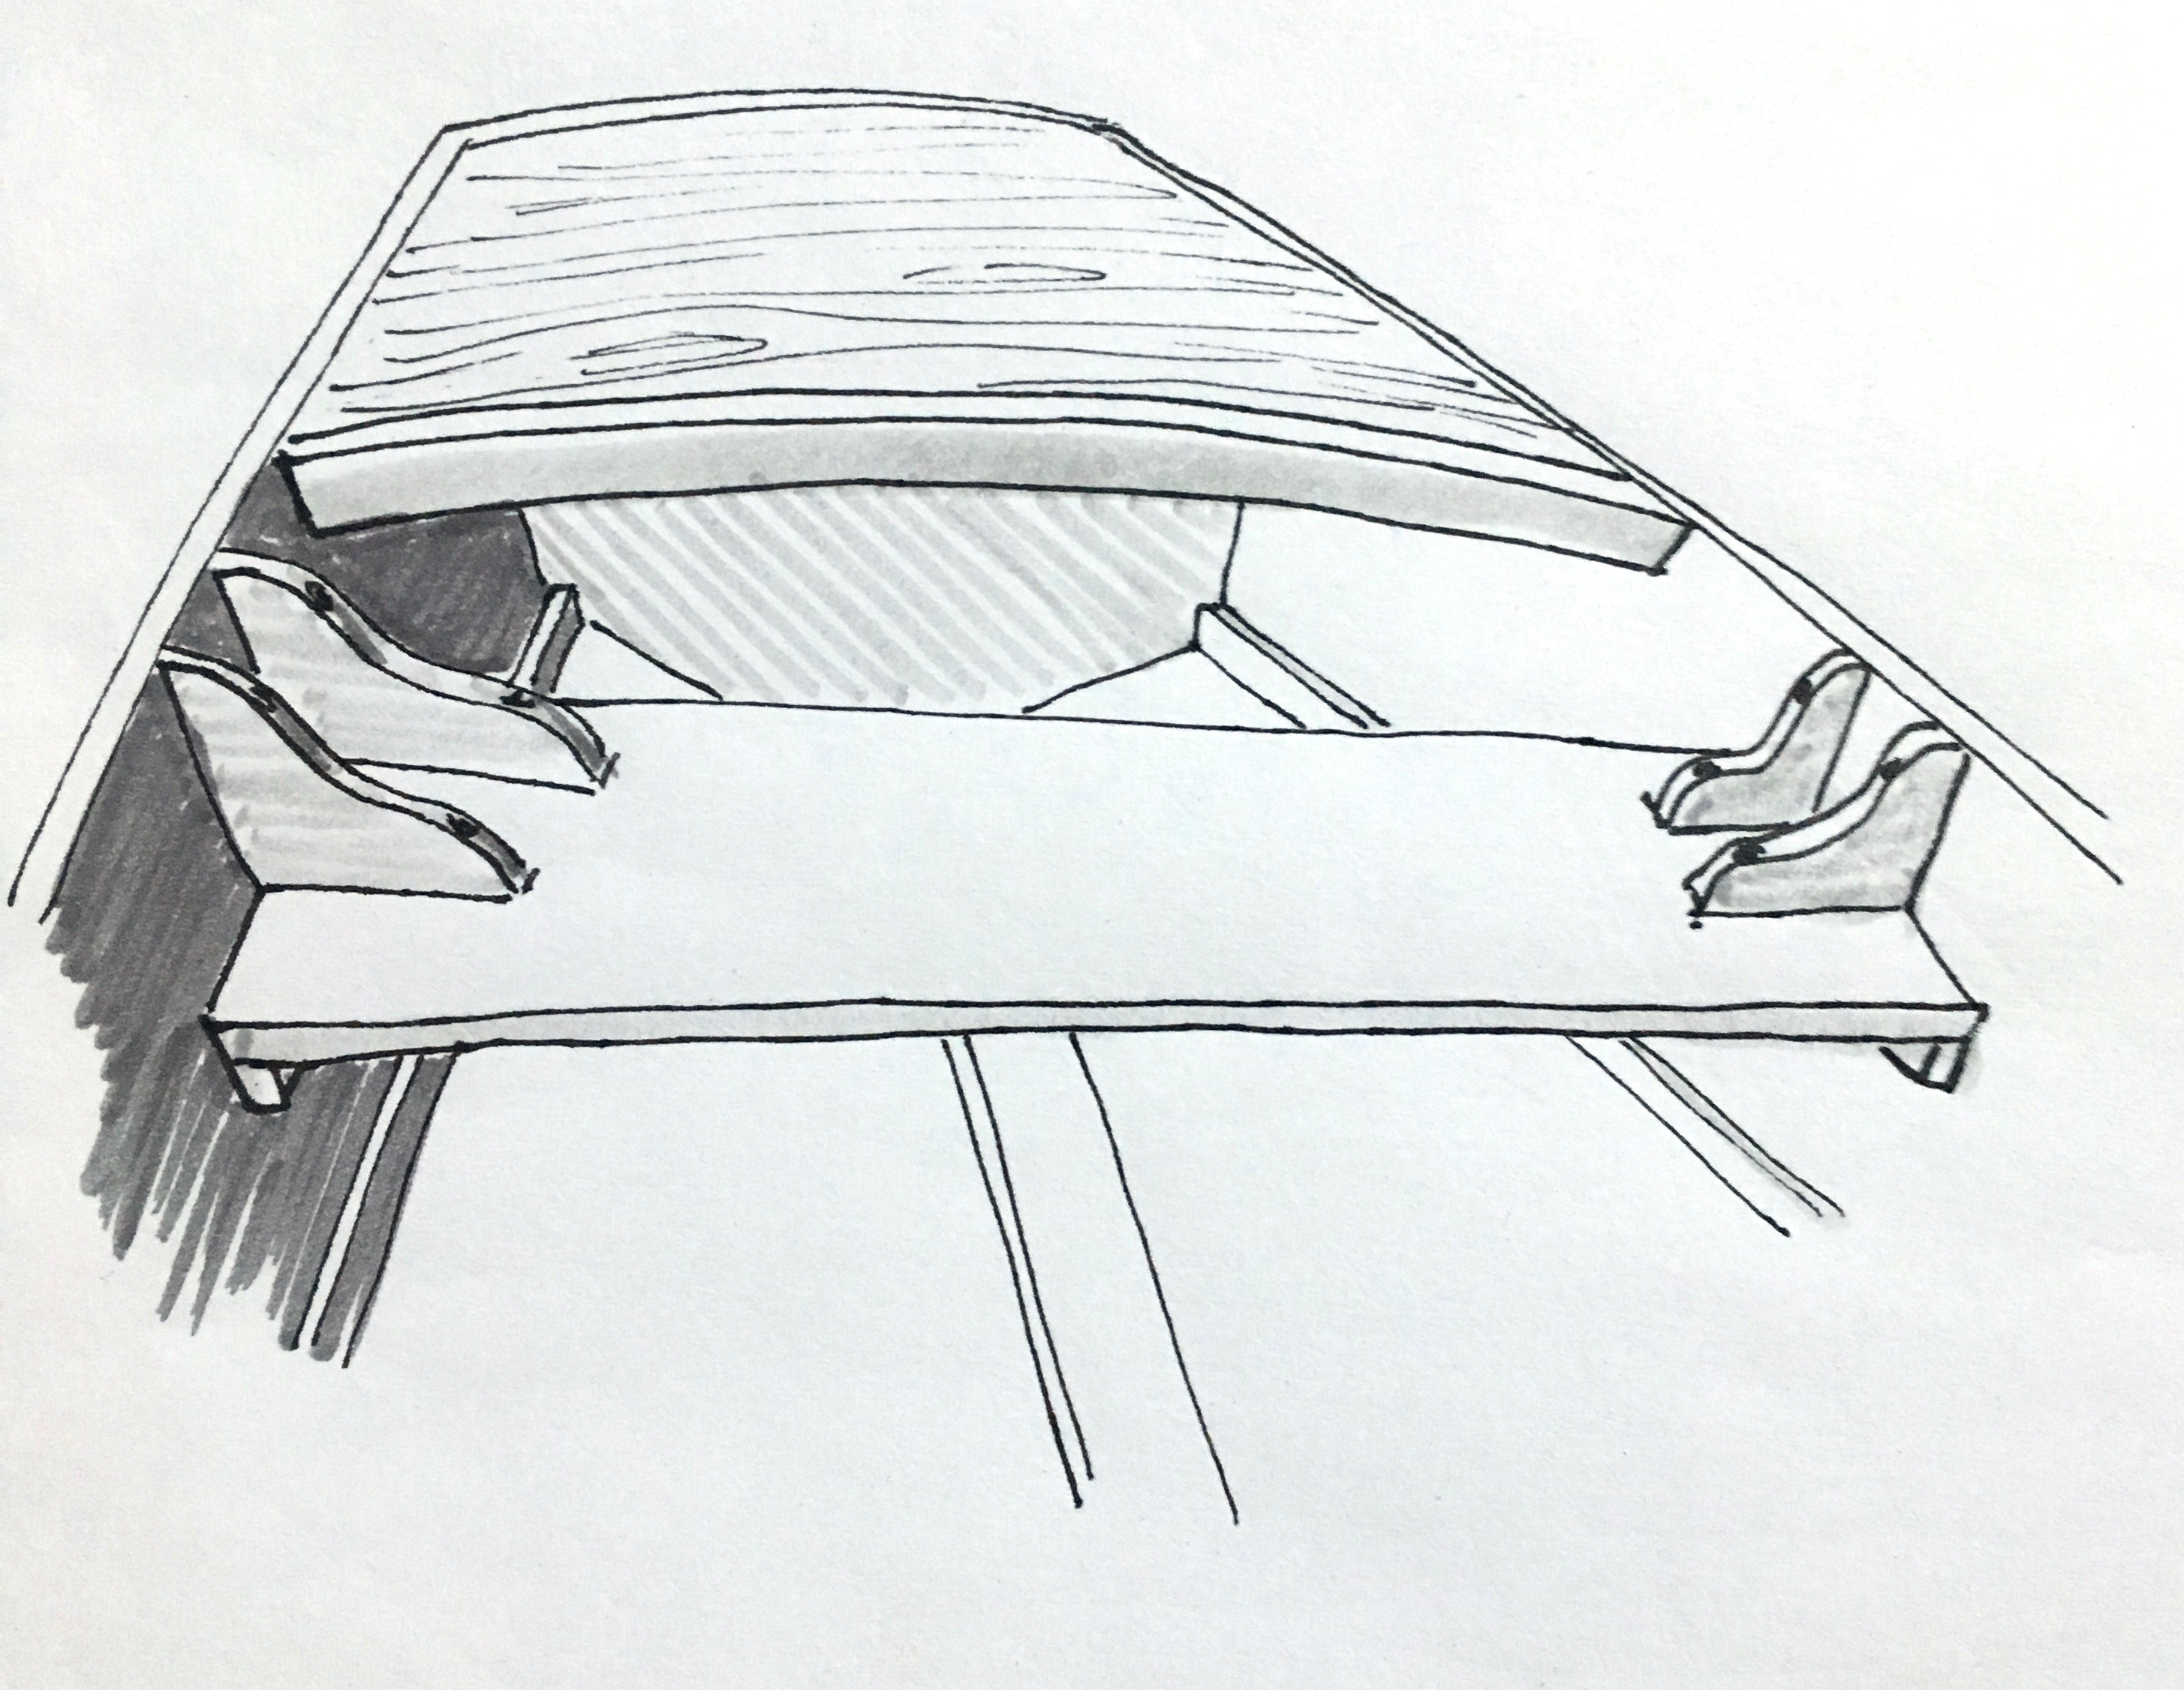
4 Deck Beam
This deck beam has a two different bevels on the ends, following the shape of the hull as it grows wider towards the top and narrower towards the bow. It also has a camber which means we have to use a bigger piece of wood to cut it out of than what it will be in the end.
6g

Slide 18
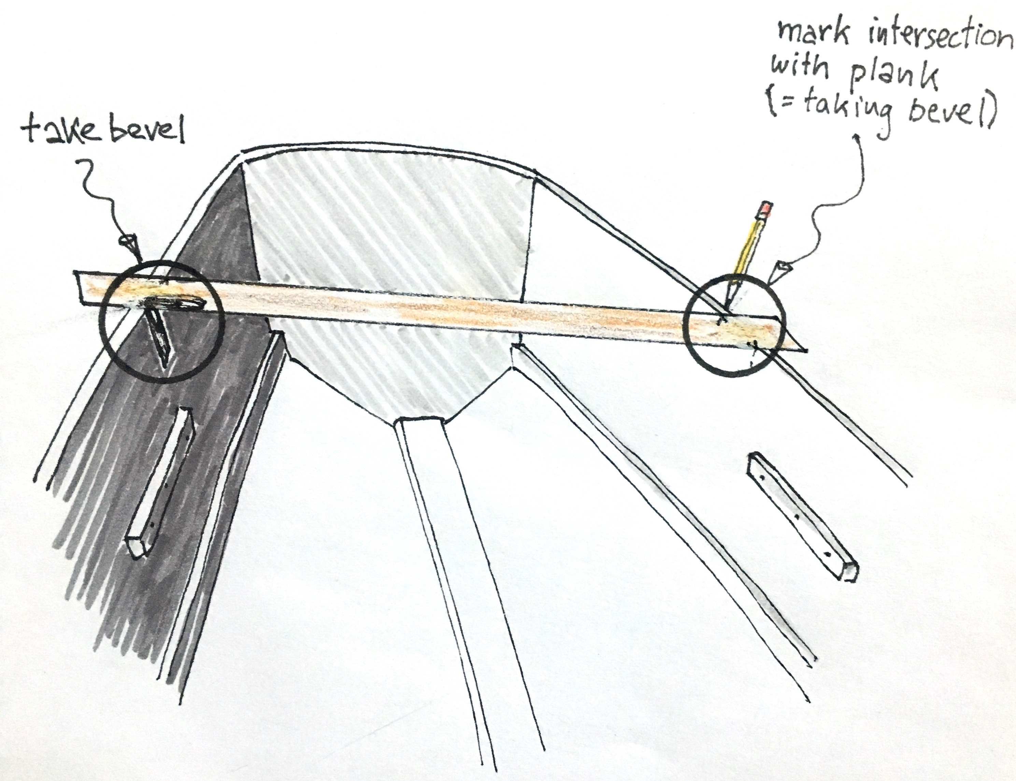
3

Slide 19
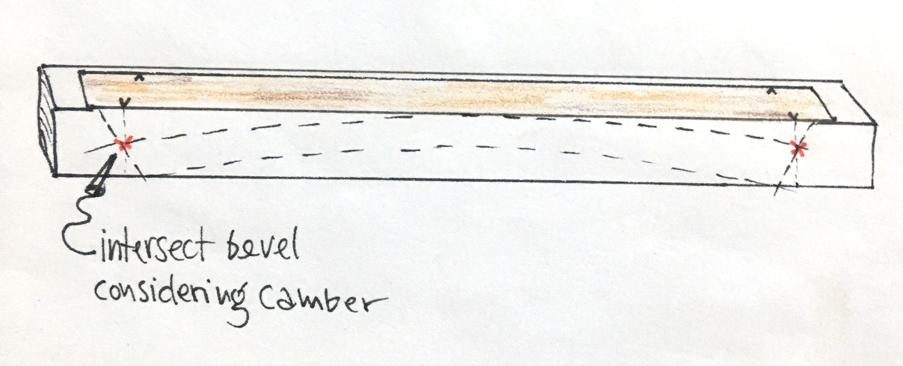
3b

Slide 20
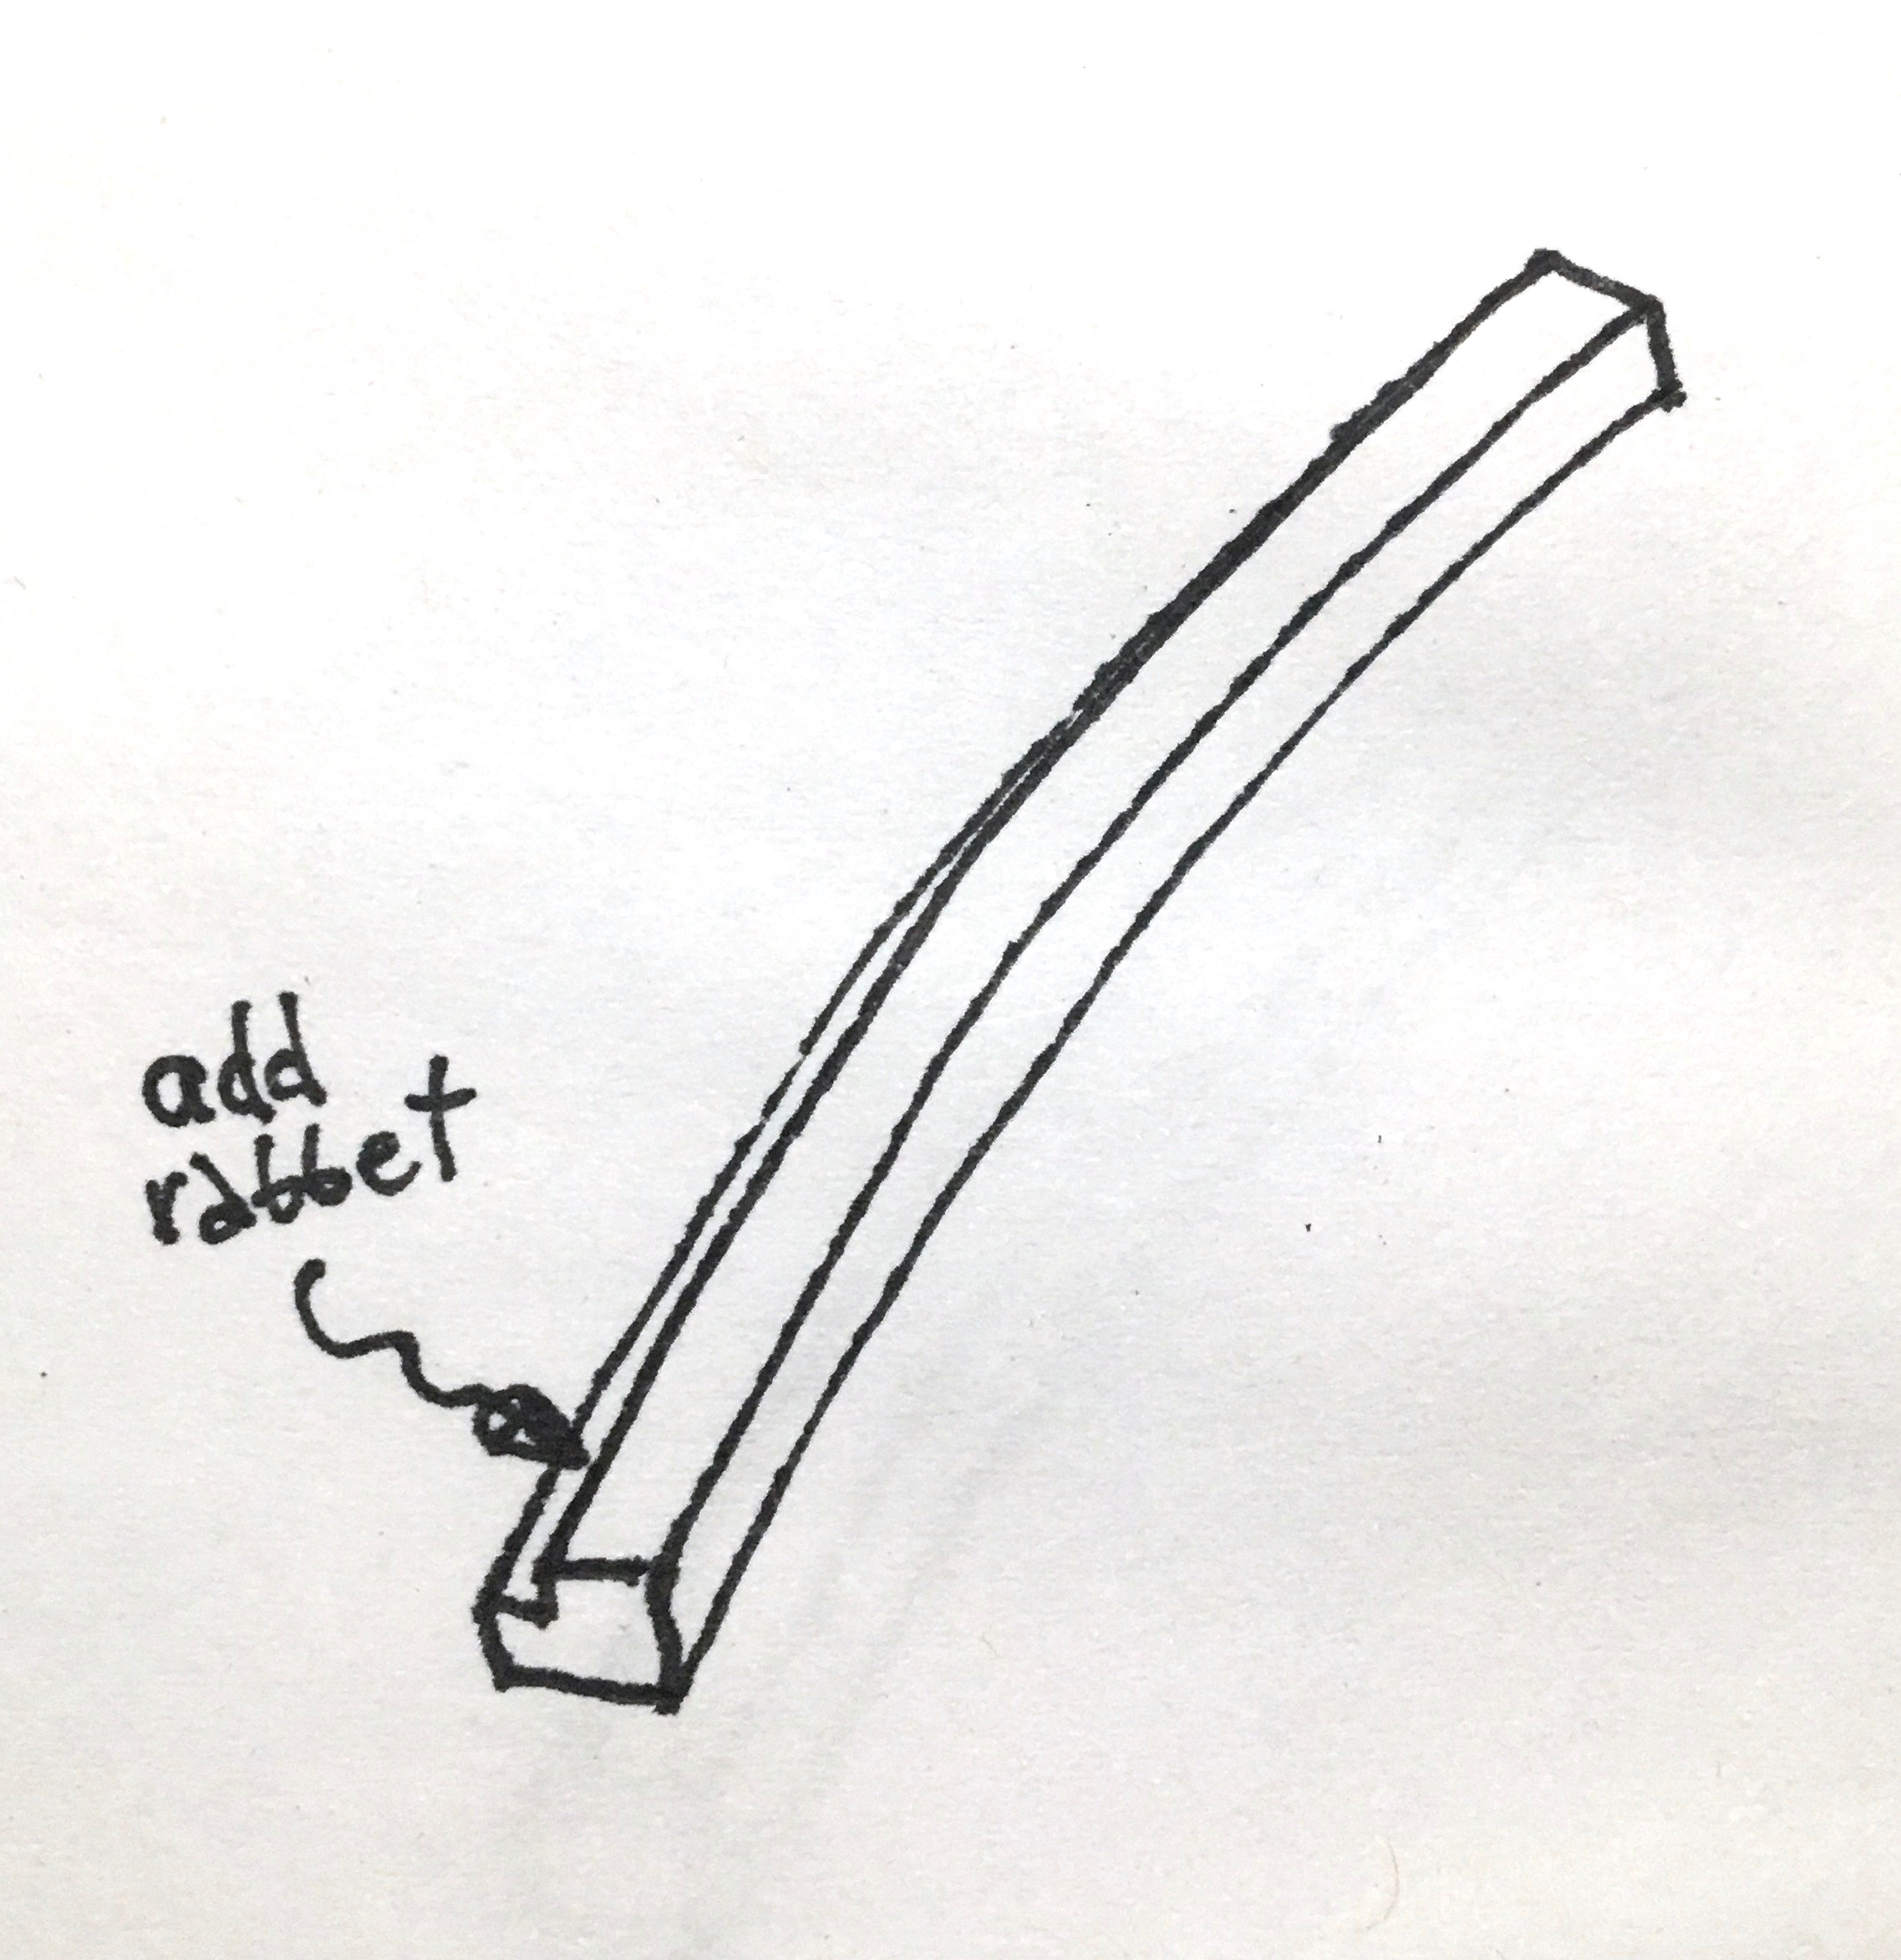

Slide 21
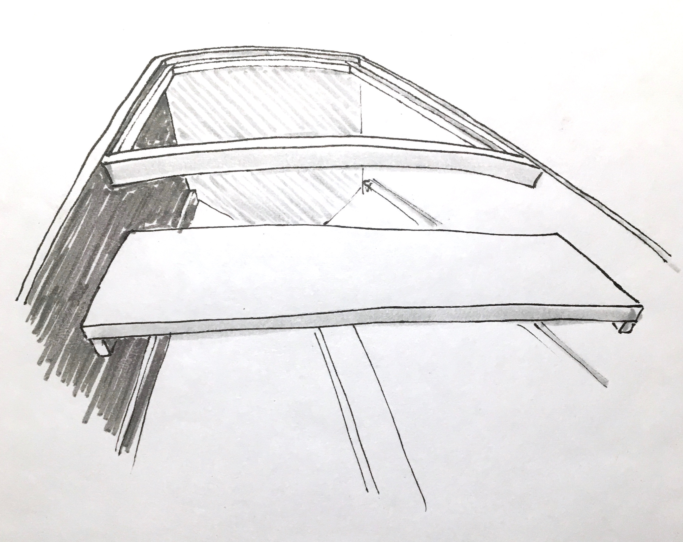

Slide 22
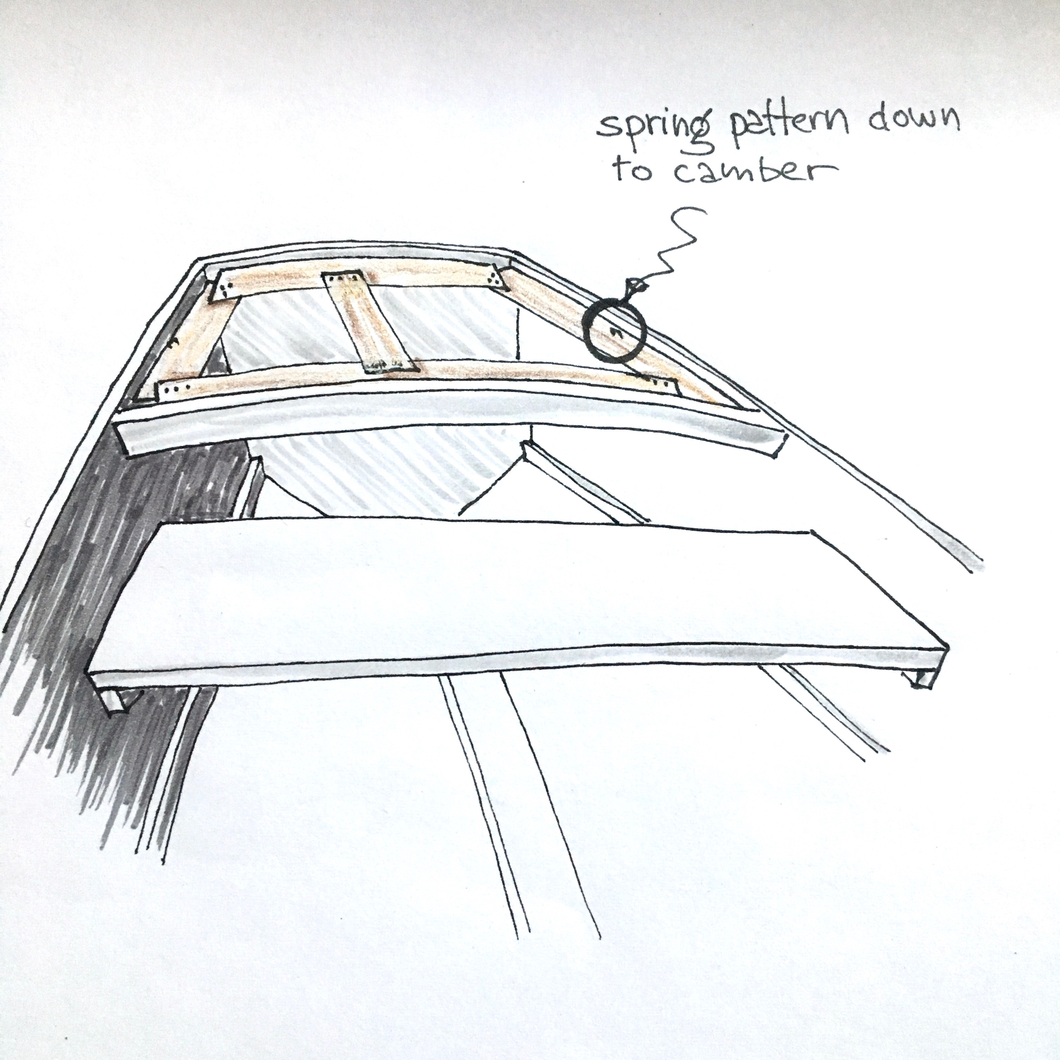
5

Slide 23
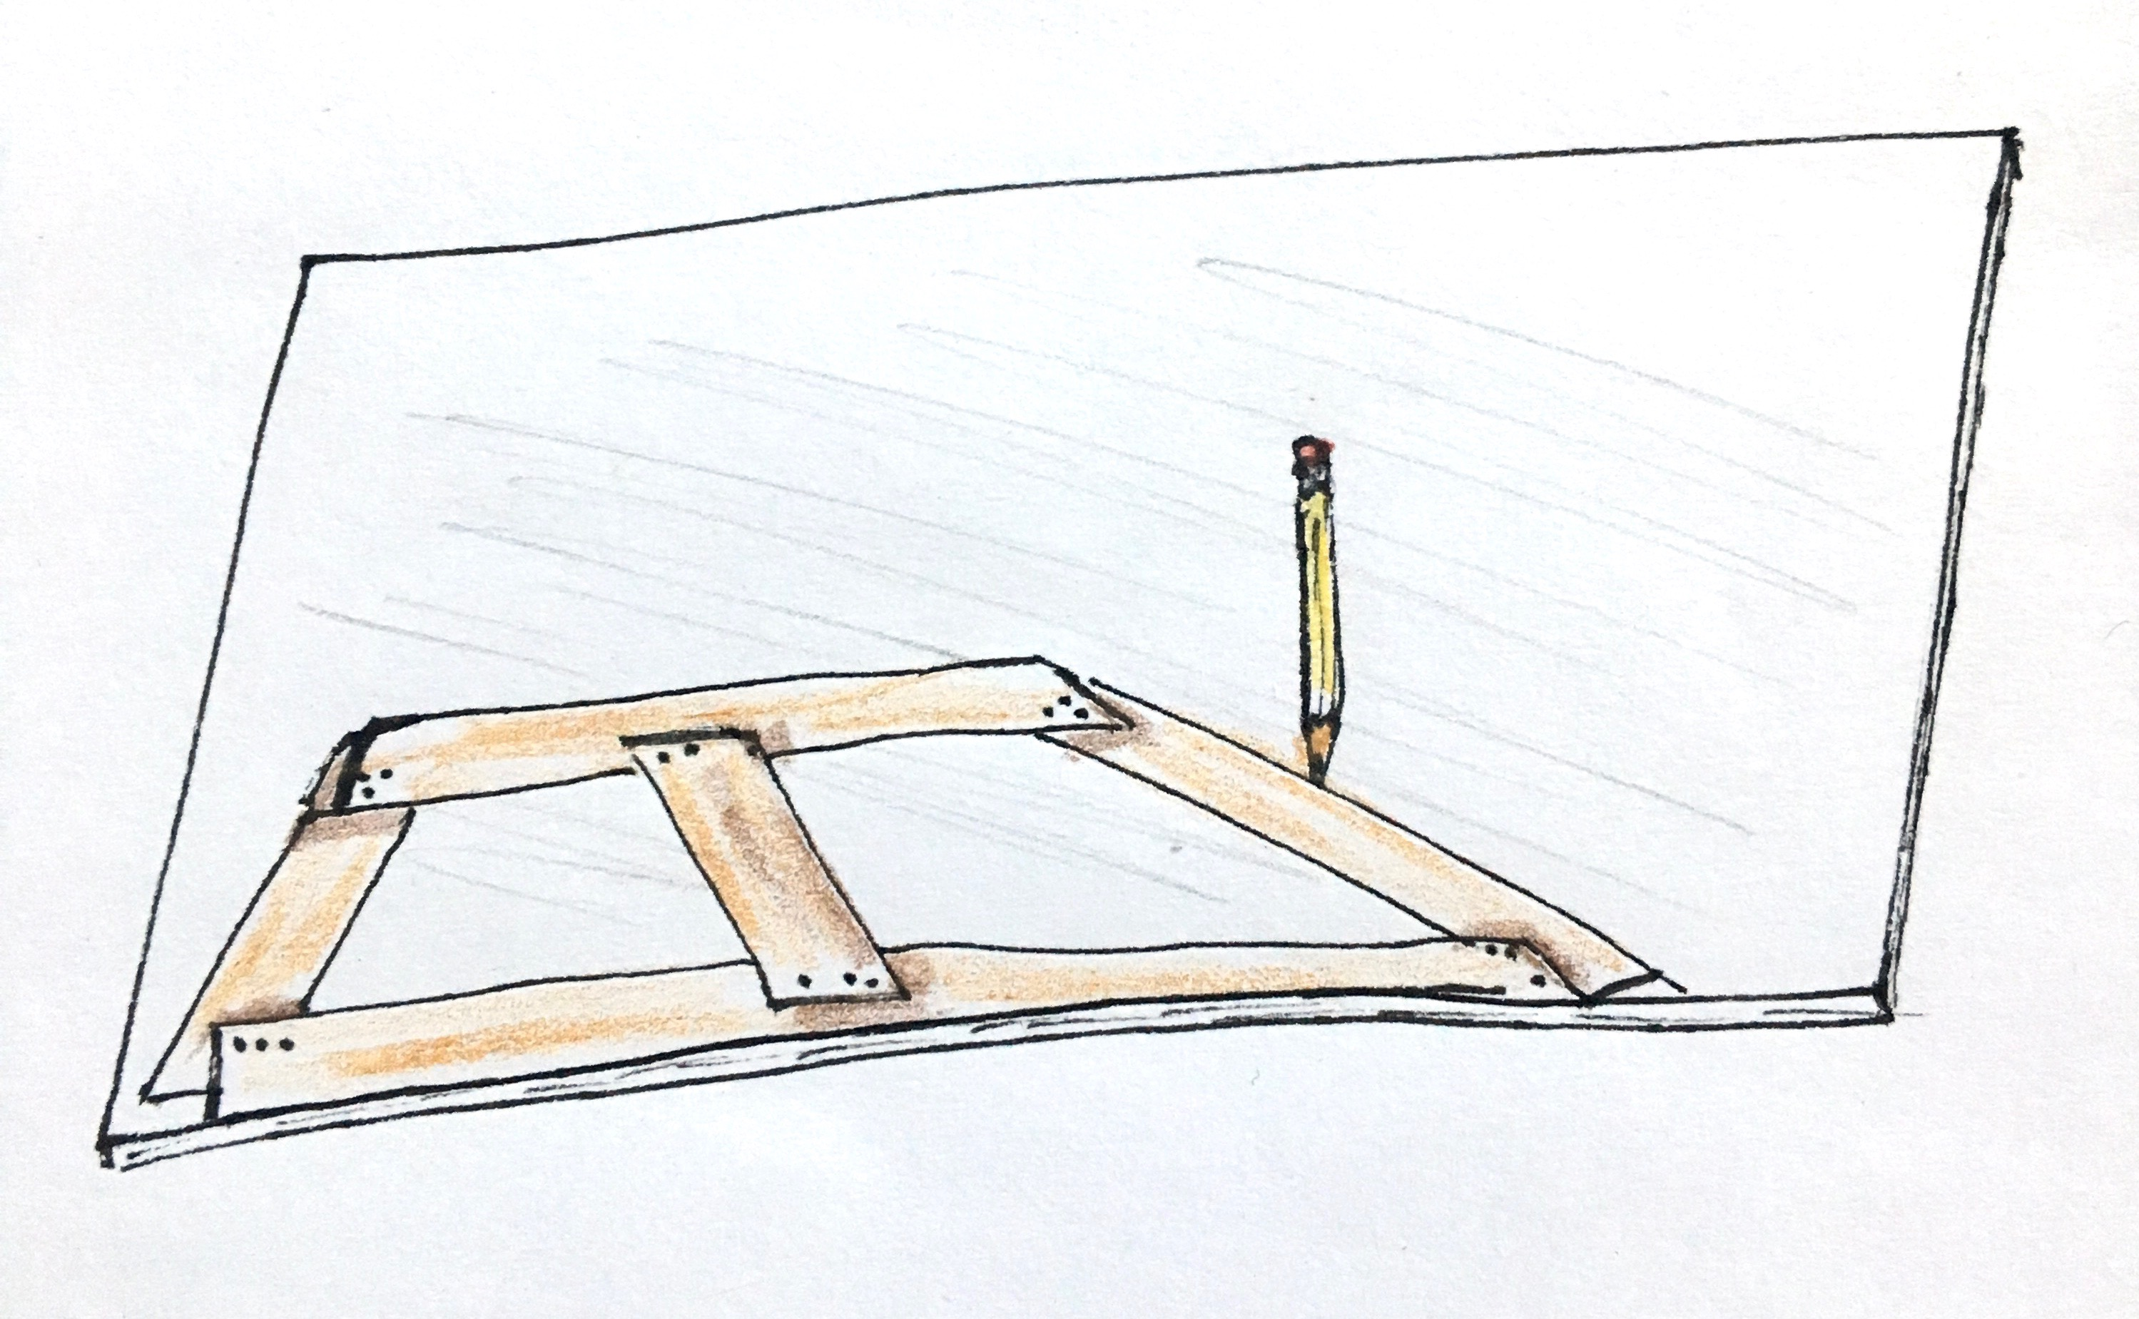
5b

Slide 24
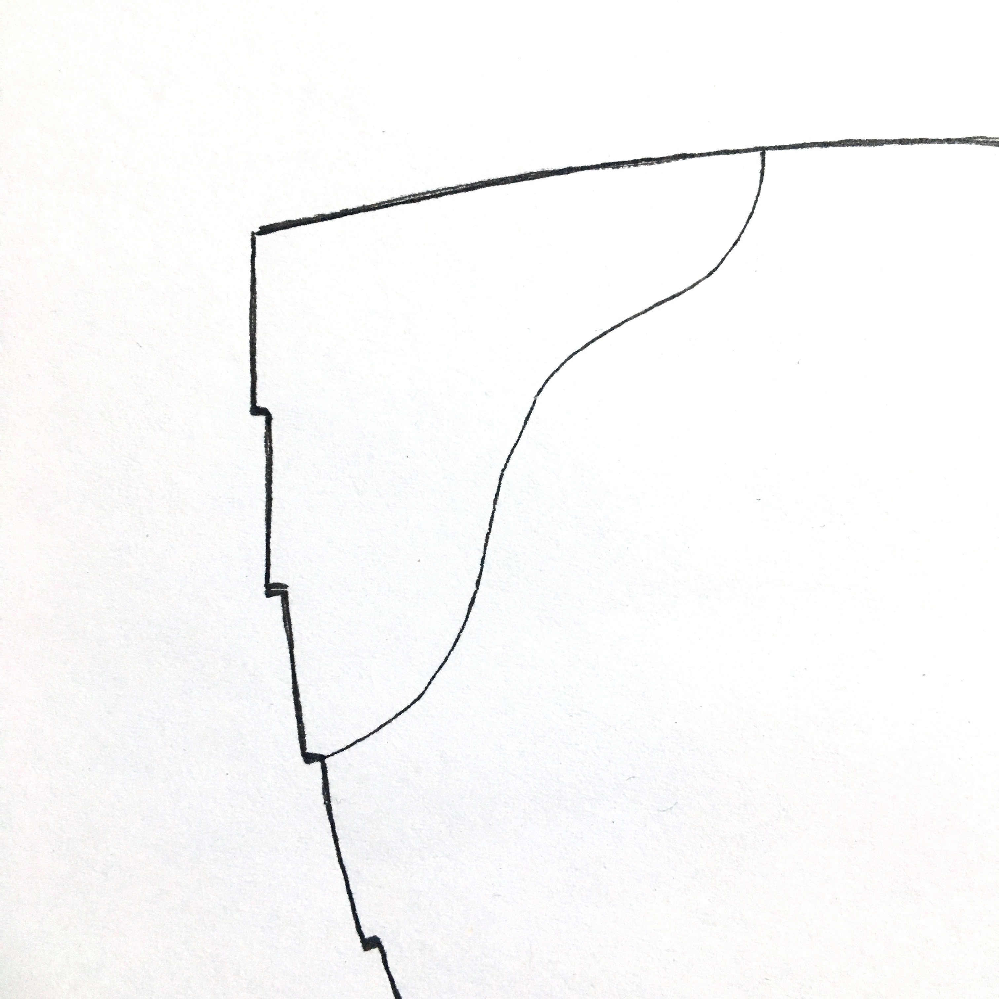
More Complicated Combinations
for example: Lapstrake knee

Slide 25
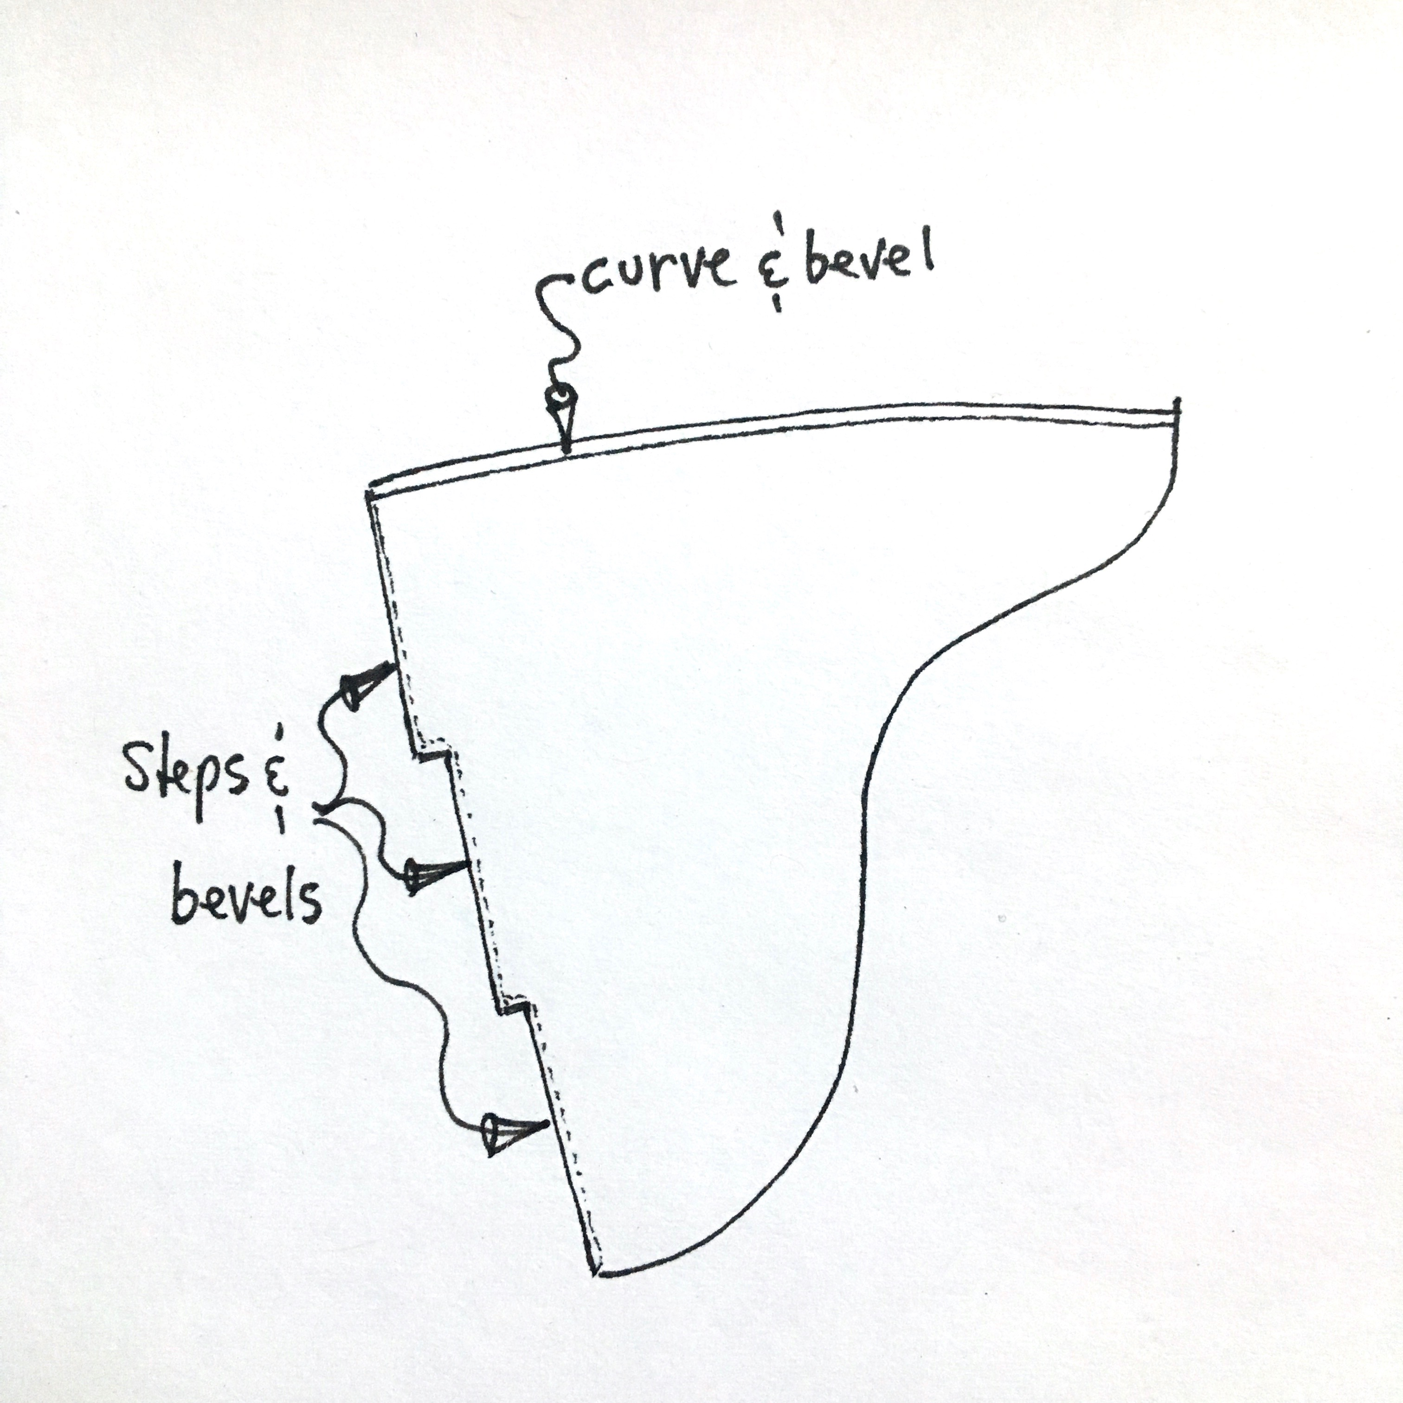

Slide 26
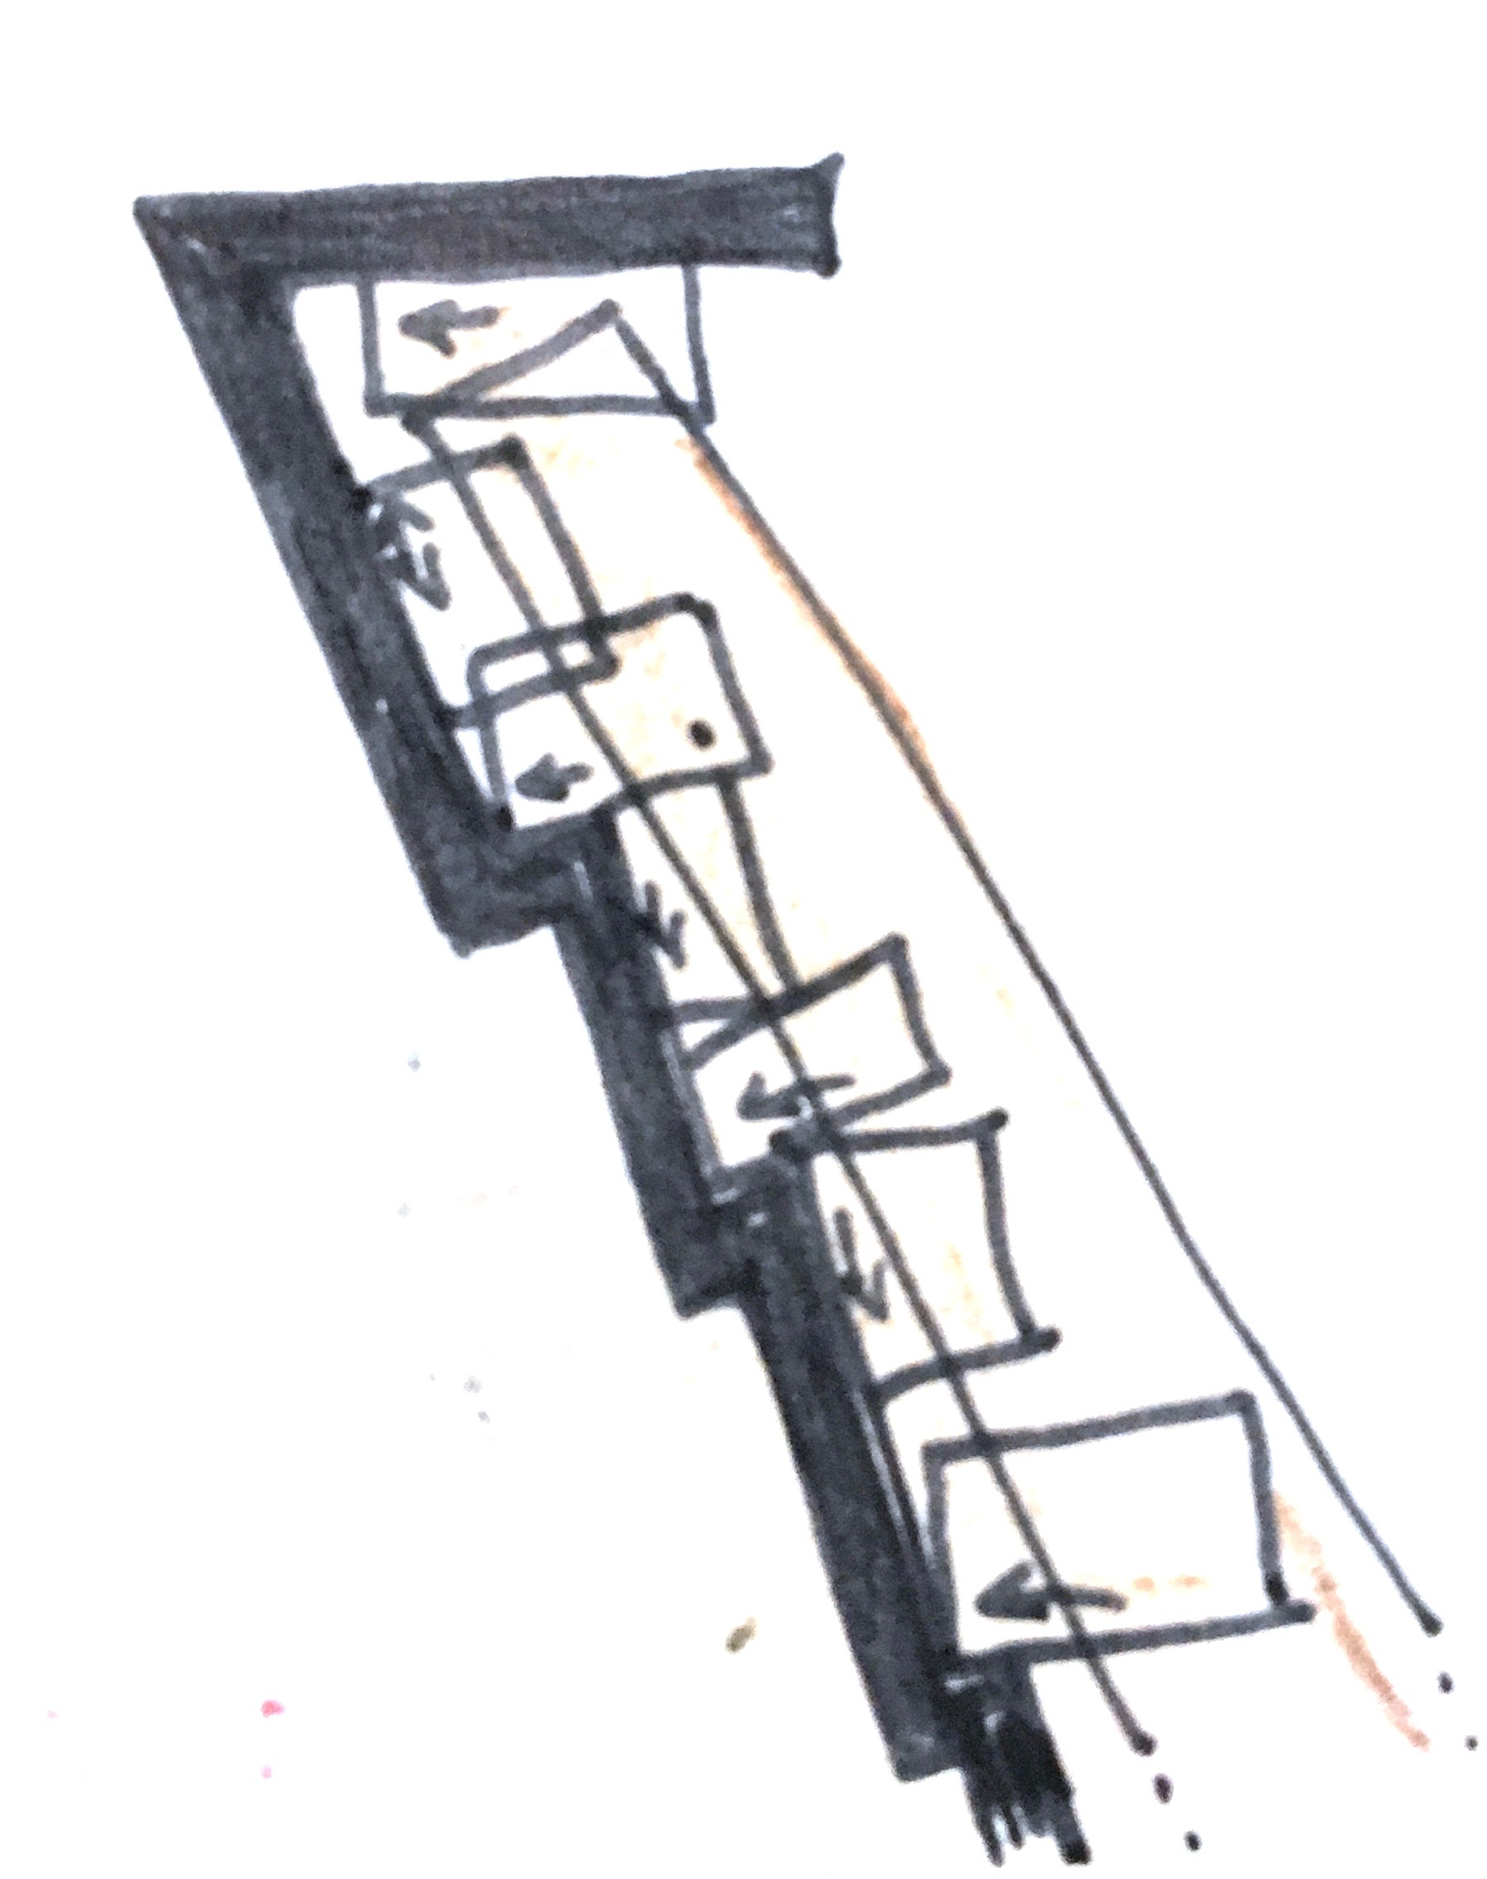

Slide 27
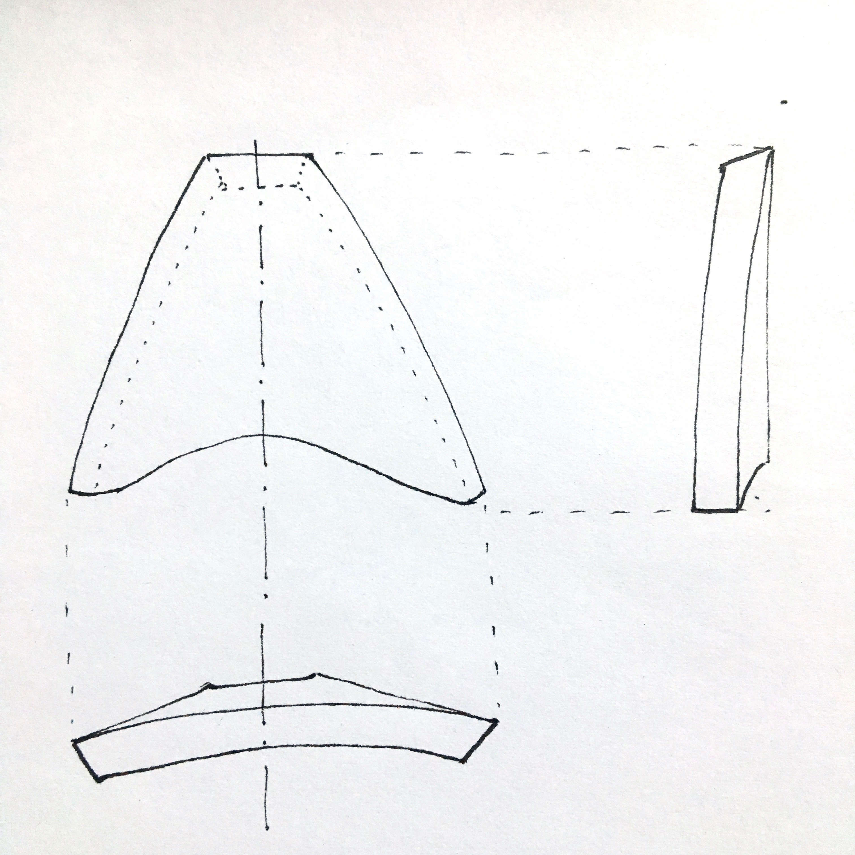
More Complicated Combinations
for example: Breast Hook

Slide 28
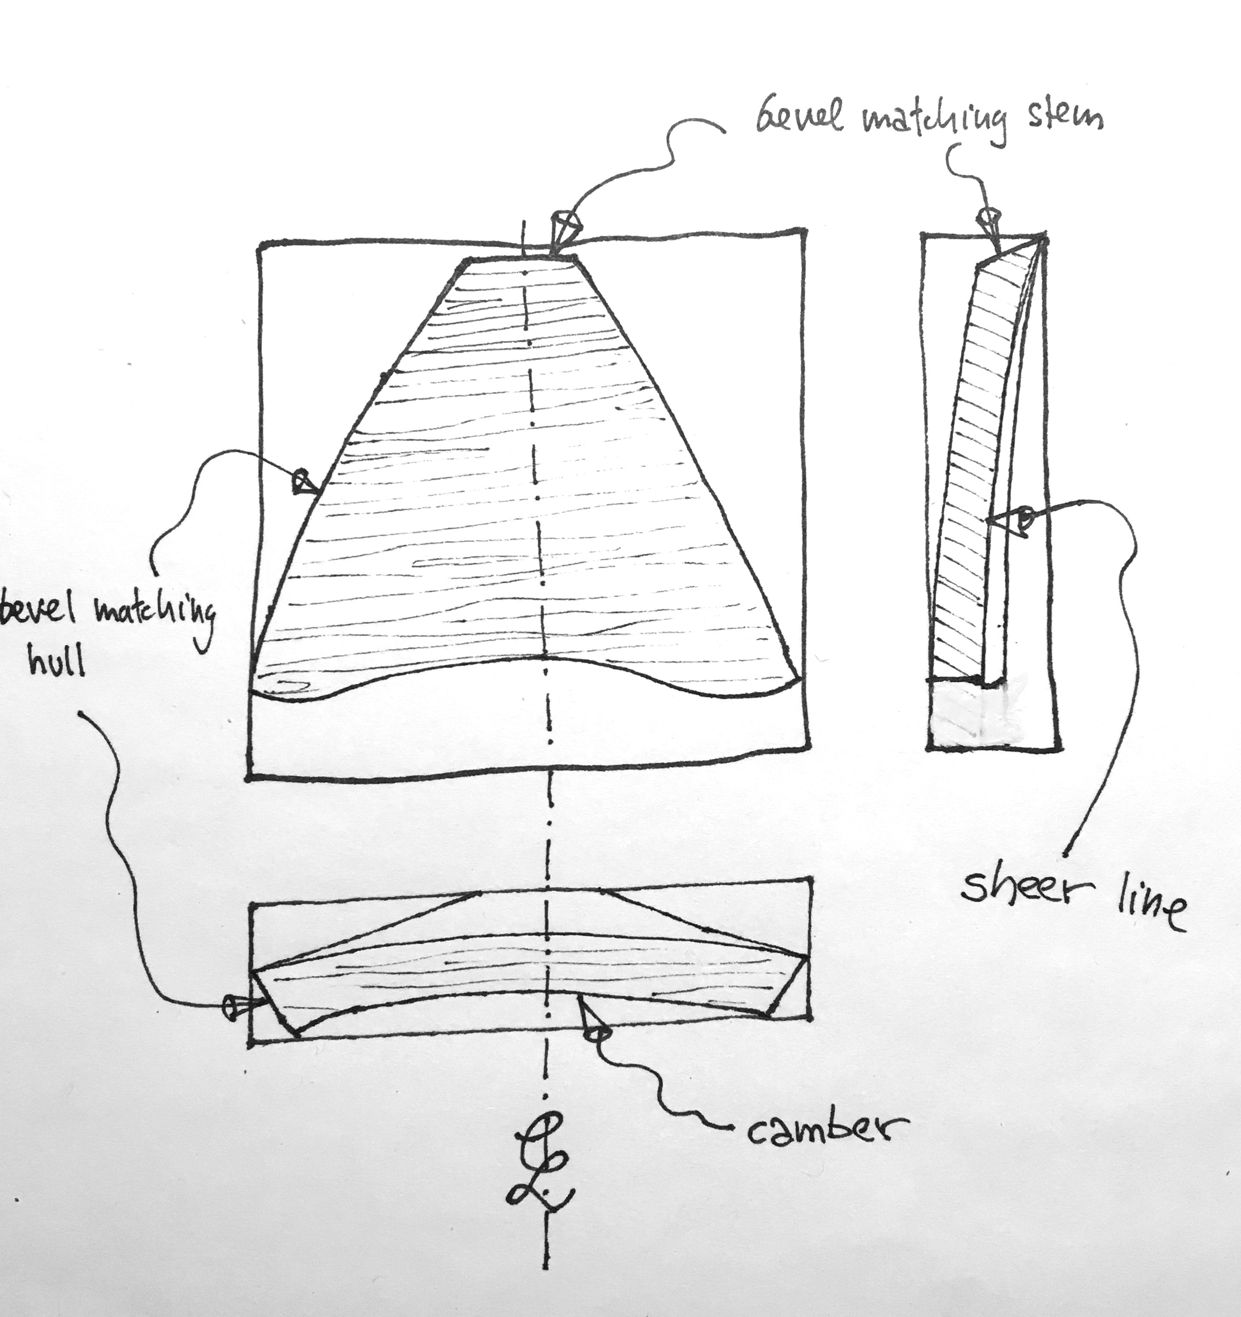

Slide 29
Things to consider
for accuracy
gussets/no gussets
transcribing pattern to material
pencil/pen thickness, size check by feeling
to be able to fit the piece into the right spot again
always have a datum (reference line, line-up crawfoot markson template and boat, centerline, plumb line)
mark your templates appropriately: up, forward, Port, Starboard, CL sometimes also vessel name/type, type of wood, and other important things like 1/2”quarter round or 1/4” chamfer

Slide 30
Saving Time
is a full pattern necessary? (a point can be defined by two straight lines, a straight line can be defined by two points)
a small variation in bevel can be adjusted with a blockplane when dry fitting
outside curves /edges can be accurately faired in place after installation

Slide 31
Tips and tricks
When a boat is not laying on its lines, a digital level or even your iPhone will work when a water level and a plumbob won't. If the boats vertical for example is at 89.7º and the waterline at 0.3º you can use that as the datum for all your templates. In the shop you will still work with 0º and 90º

Slide 32
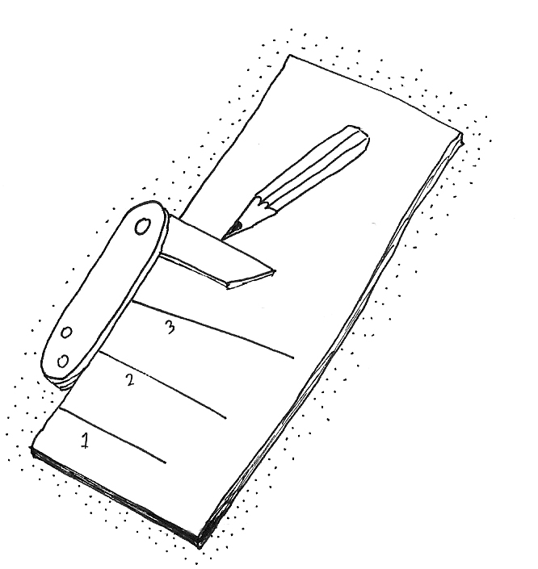
Tips and Tricks: Bevels
For a rolling bevel take a reading every 2º to 3º and spring a batten to connect the points
make your own mini bevel gauge to easily measure and transfer bevels.
also have a mini square to see if you might be able to avoid dealing with bevels altogether.
sometimes its fastest to just mark the bevel onto your template right at the spot it was taken. sometimes you mark the spot (number, letter, anything you can recognize and place again later) and transfer the bevel to another piece of doorskin. For longevity and documentation, you can use a bevel board to convert your physical bevel into the number of degrees and write it down that way. For actual working this would add a step that then would need to get reversed and presents TWO possibilities of inaccuracy.

Slide 33
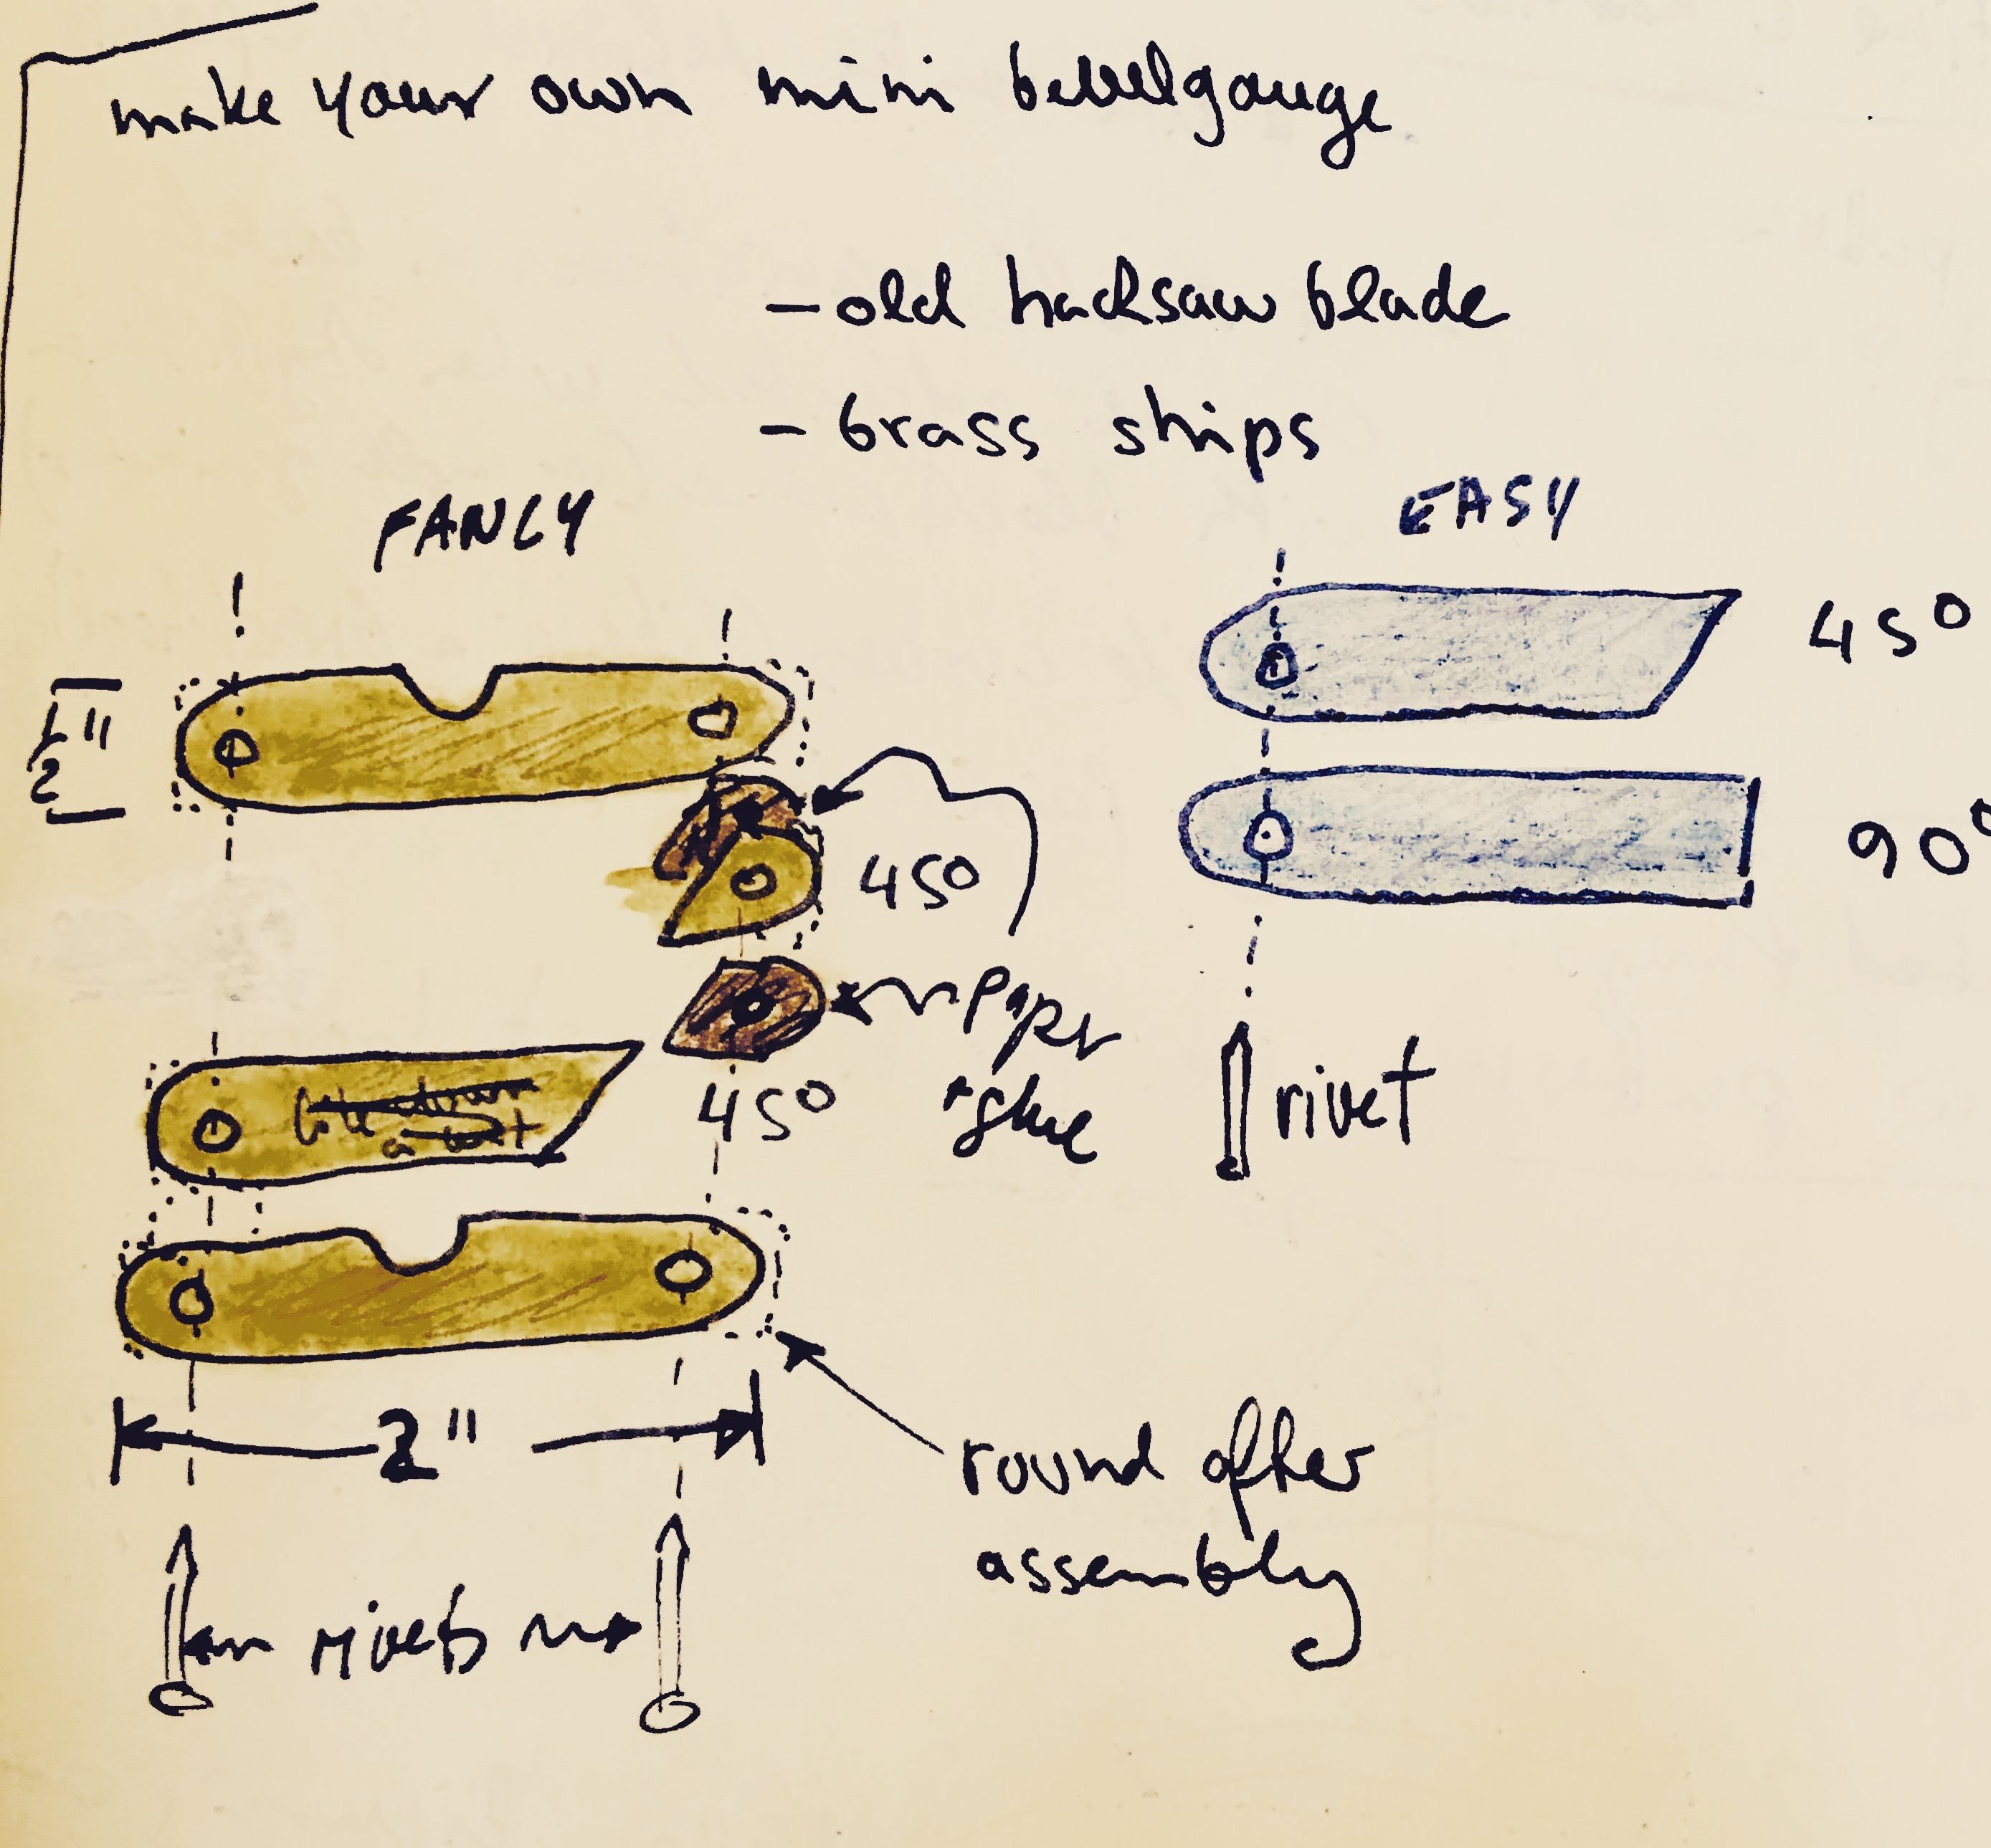

Slide 34
Now lets try some of this!
Thank you to all my teachers, friends and mentors and the women and men who keep encouraging me to share my knowledge and make these presentations.

