Slide 1
Organizational Development
101
Jake Beattie
Betsy Davis
Adam Green
Rebecca Hopfinger
October 2019

Slide 2


Slide 3
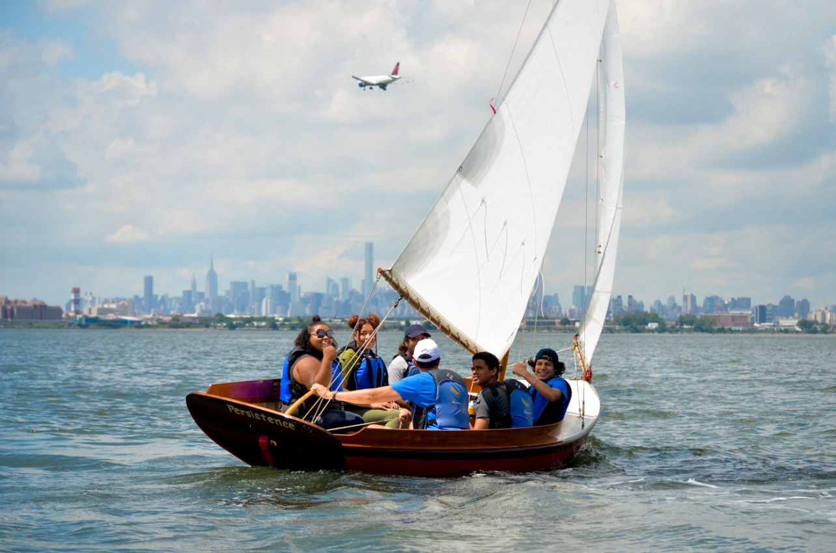
Mission:
Rocking the Boat empowers young people from the South Bronx to develop self-confidence, set ambitious goals, and gain the skills necessary to achieve them. Students work together to build wooden boats, learn to row and sail, and restore local urban waterways, revitalizing their community while creating better lives for themselves. At Rocking the Boat, kids don’t just build boats, boats build kids.

Slide 4
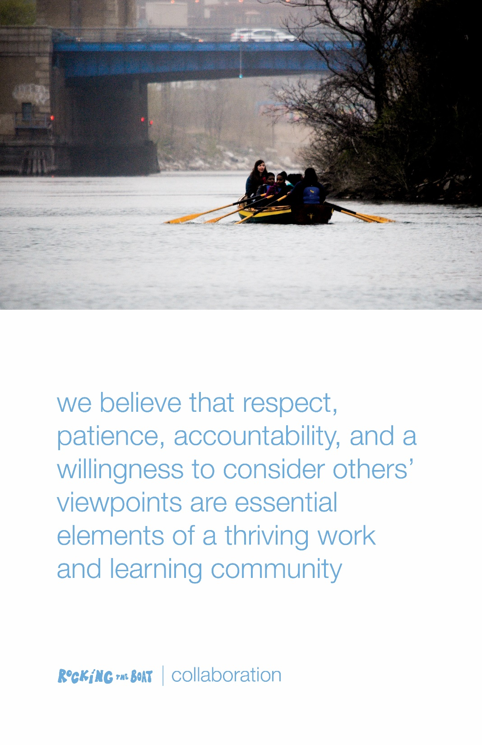

Slide 5
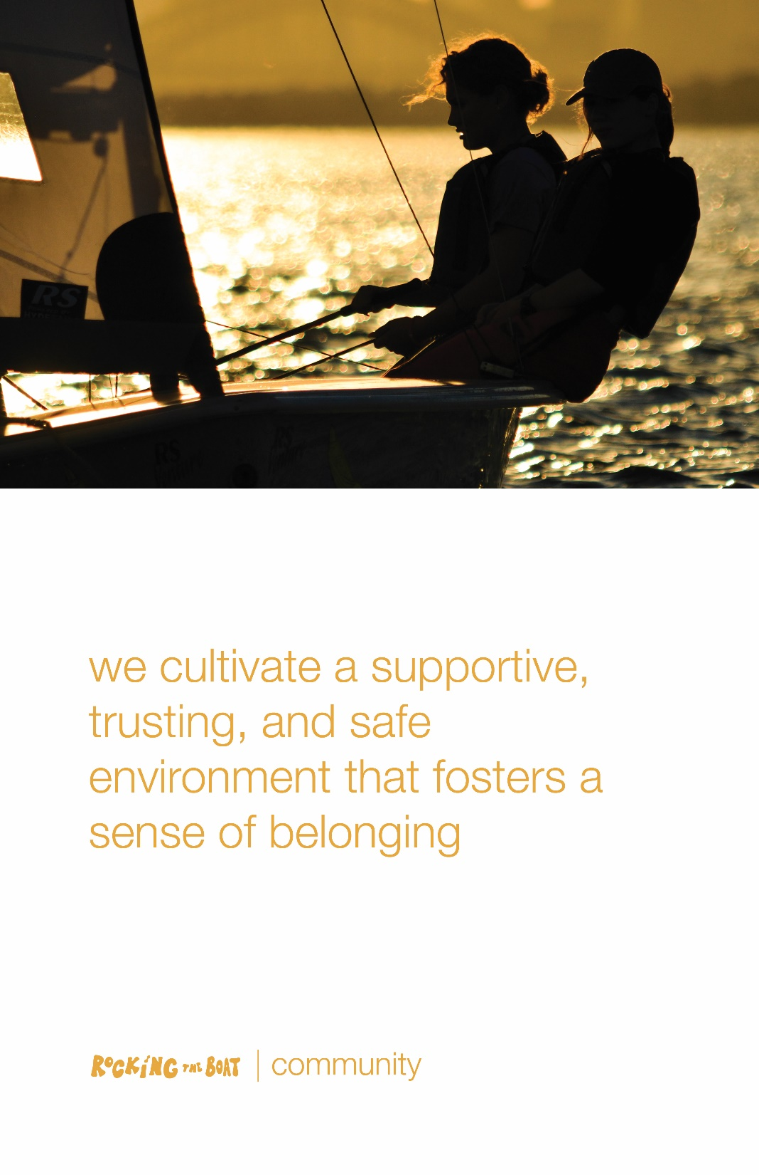

Slide 6
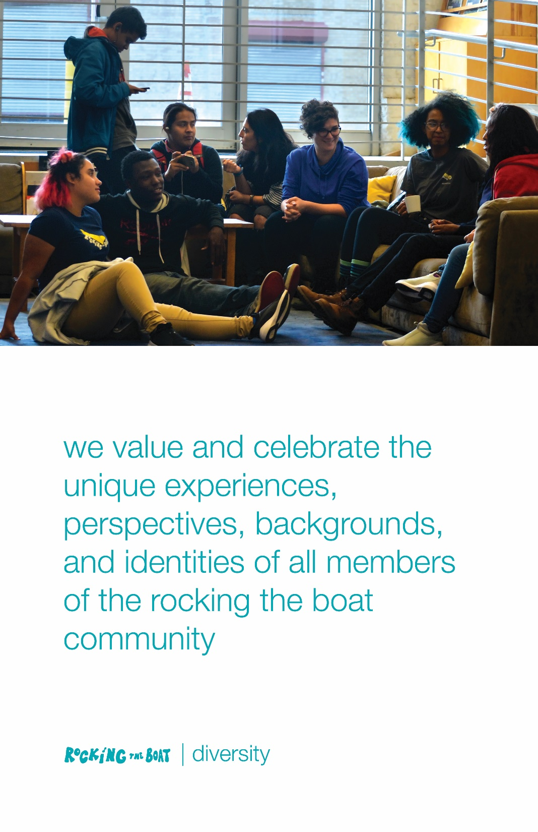

Slide 7
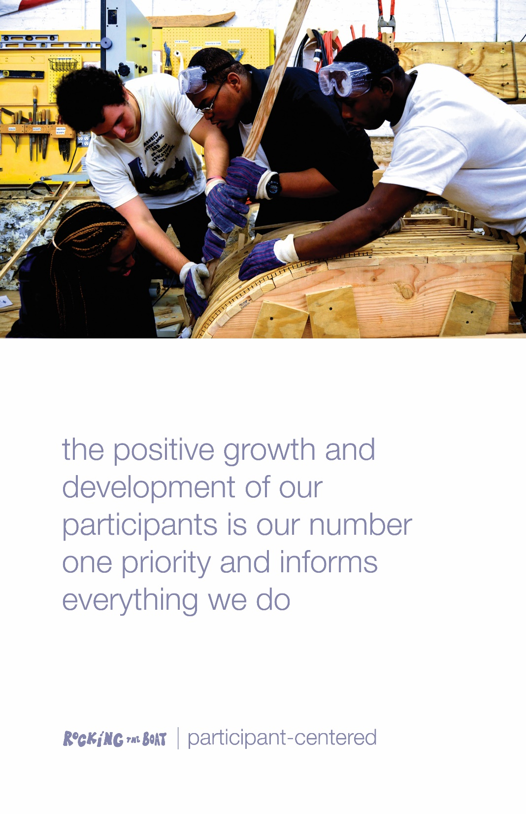

Slide 8
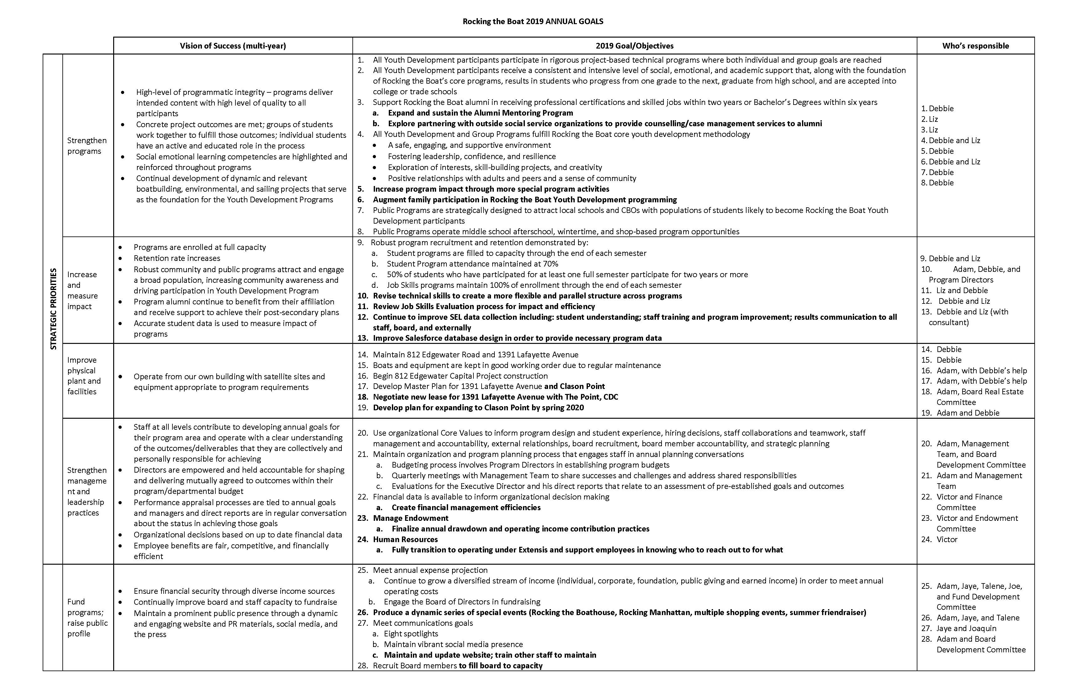

Slide 9
Budgeting and Fundraising
NW Maritime- An Example

Slide 10
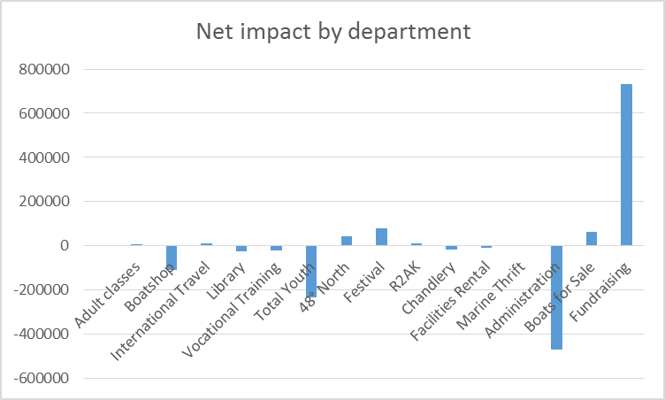

Slide 11
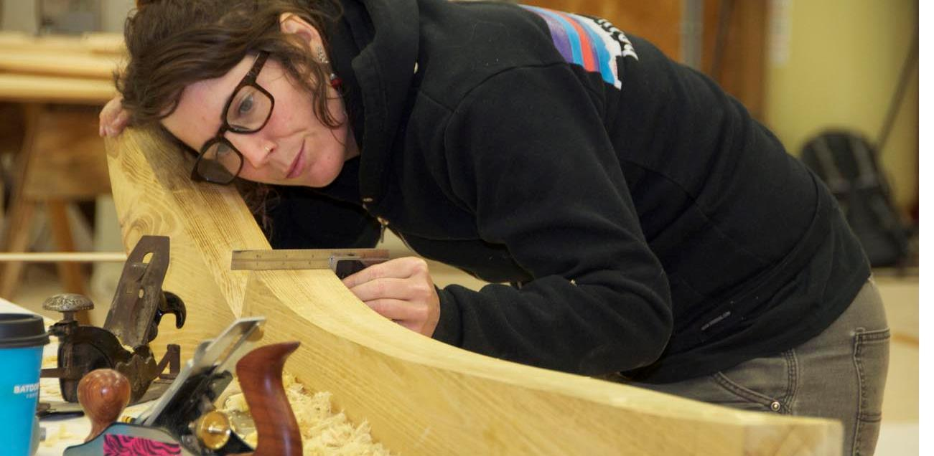


Notes:
For 38 years, the Northwest School of Wooden Boatbuilding has taught craftsmanship, through boatbuilding.

Slide 12

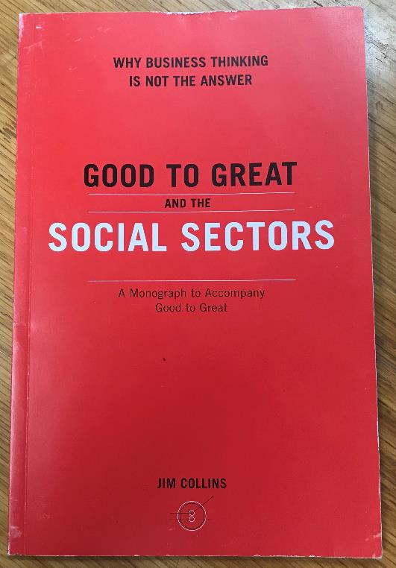
STAFF & VOLUNTEERS
“Getting the right people on the bus…”
“Great companies focused on getting and hanging on to the right people in the first place – those who are productively neurotic, those who are self-motivated and self-disciplined, those who wake up every day, compulsively driven to do the best they can because it is simply part of their DNA.”
Notes:
And launched the careers of over 1,600 graduates, primarily into maritime and construction trades.

Slide 13
STAFF & VOLUNTEERS
“Lack of resources is no excuse for lack of rigor – it makes selectivity all the more vital…”
“The more selective the process, the more attractive a position becomes, even if volunteer or low pay.”
“In the social sectors, where getting the wrong people off the bus can be more difficult than in a business, early assessment mechanisms turn out to be more important than hiring mechanisms. There is no perfect interviewing technique, no ideal hiring method; even the best executives make hiring mistakes. You can only know for certain about a person by working with that person.”
Notes:
And launched the careers of over 1,600 graduates, primarily into maritime and construction trades.

Slide 14

STAFF & VOLUNTEERS
Training
Job descriptions / clear goals
Handbook of Policies
Provide specific feedback on work
Appreciation / impact of efforts
Safety (background checks)
HR Resources
Food brings people together !
Notes:
And launched the careers of over 1,600 graduates, primarily into maritime and construction trades.

Slide 15
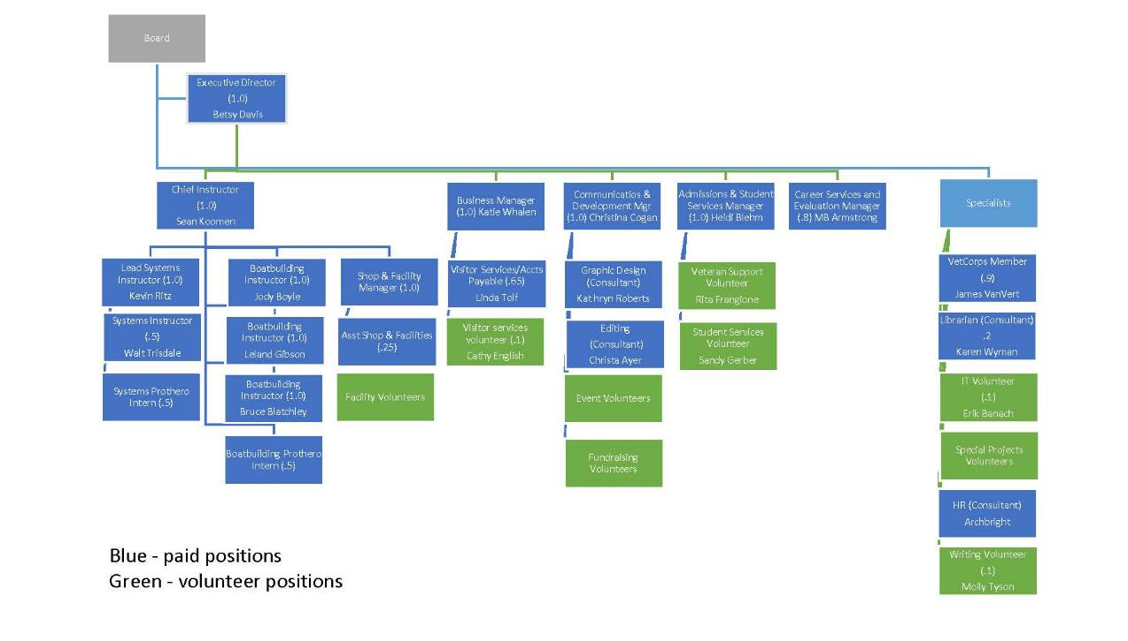
STAFF & VOLUNTEERS
Volunteers are part of the team !
Notes:
And launched the careers of over 1,600 graduates, primarily into maritime and construction trades.

Slide 16
STAFF & VOLUNTEERS
“Purity of mission … has the power to ignite passion and commitment.
The right people can often attract money, but money by itself can never attract the right people. Money is a commodity; talent is not. Time and talent can often compensate for lack of money, but money cannot ever compensate for lack of the right people.
Notes:
And launched the careers of over 1,600 graduates, primarily into maritime and construction trades.

Slide 17
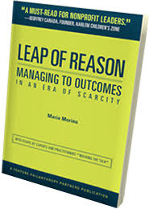
Great Resource
Leap of Reason by Mario Marino

