Slide 1
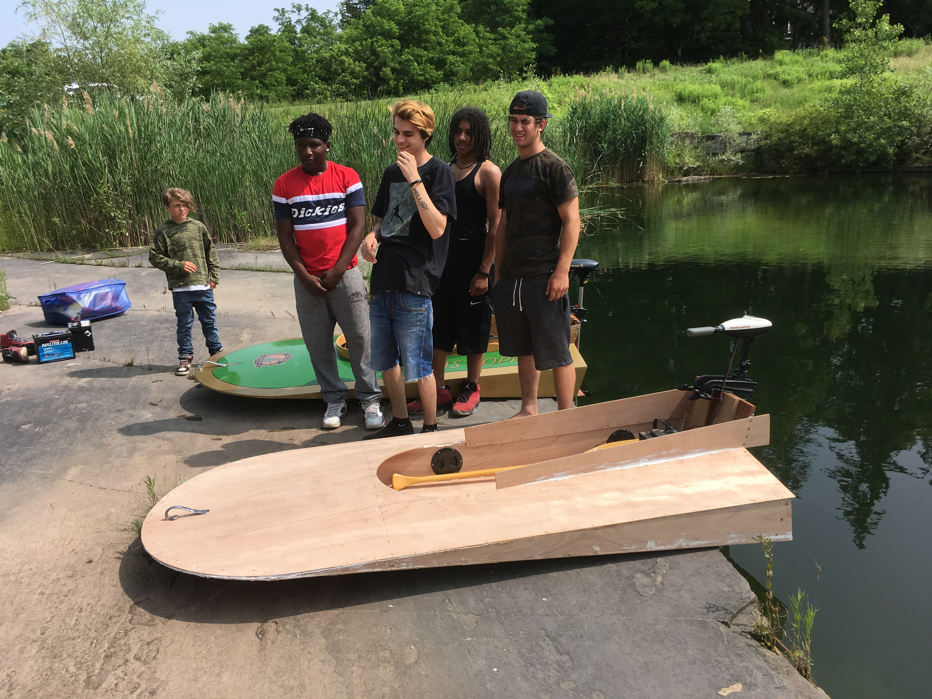
SeaFleas get thumbs off phones
Malcolm Black, President
Kids & Classics Boatshops Museum
October 11, 2019

Slide 2
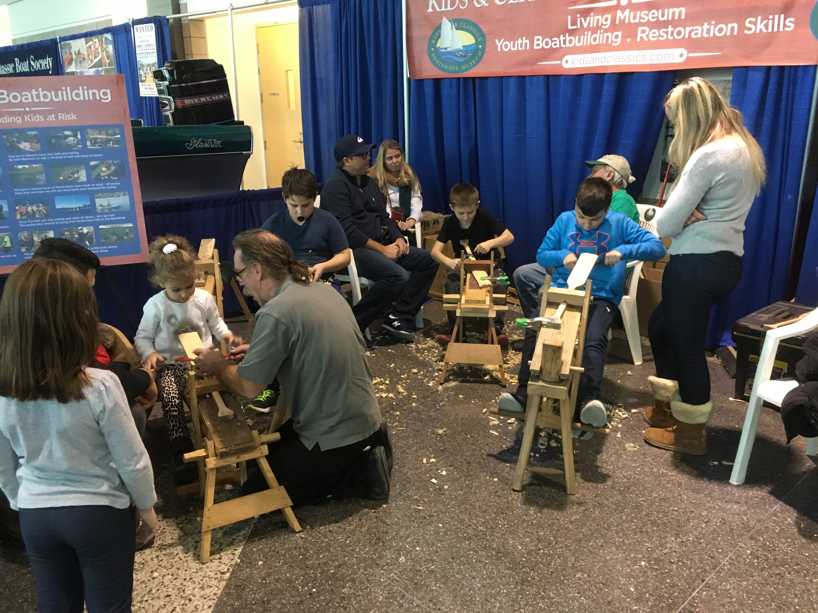
K&C Youth tool skills – step 1
“paddle carving” activity shows the use of a spokeshave to create a miniature paddle. Kids will spend hours at this activity.

Slide 3
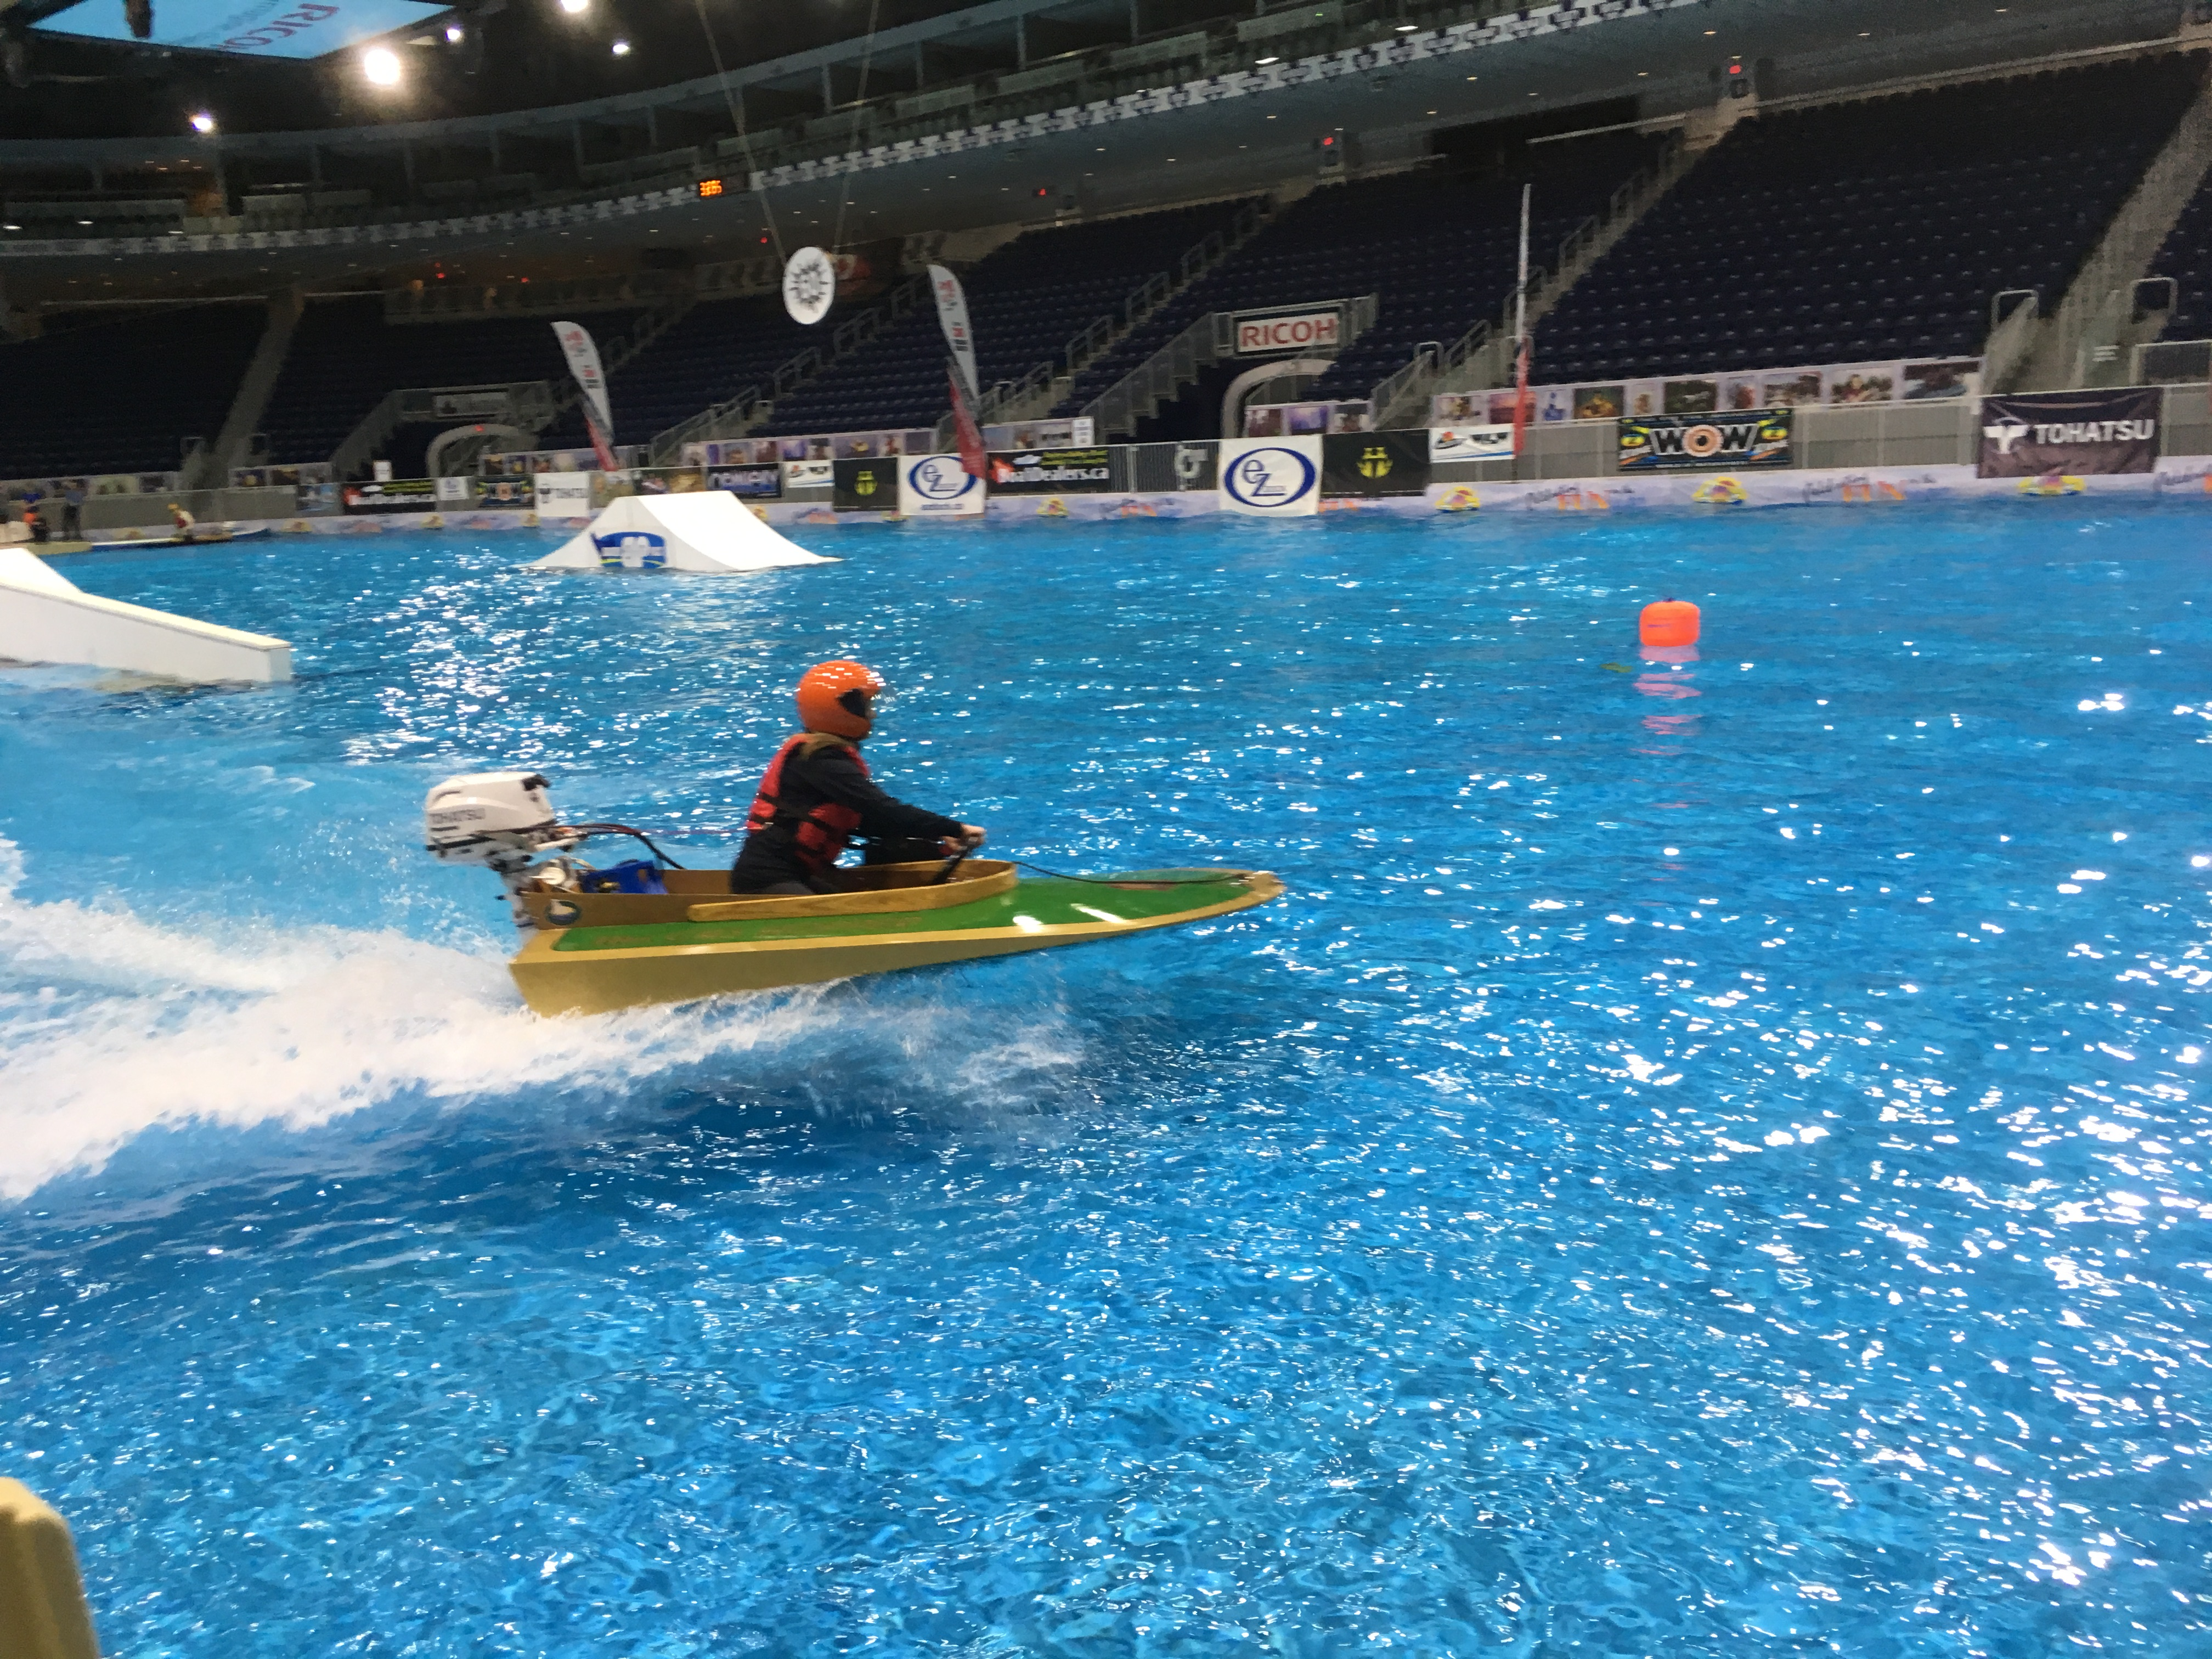
World Championship Indoor SeaFlea Races!
Held at Toronto Boat Show in January on World’s Largest Indoor Lake.

Slide 4
K&C Youth tool skills – step 2 – the SeaFlea Races Show
This event at the Toronto Boat Show every January has resulted in sea flea kits sales – usually by grandparents.
We also take this combination of paddle carving, seaflea show and kit sales to ACBS events with the same results.
Our belief is that this is a scalable programme

Slide 5
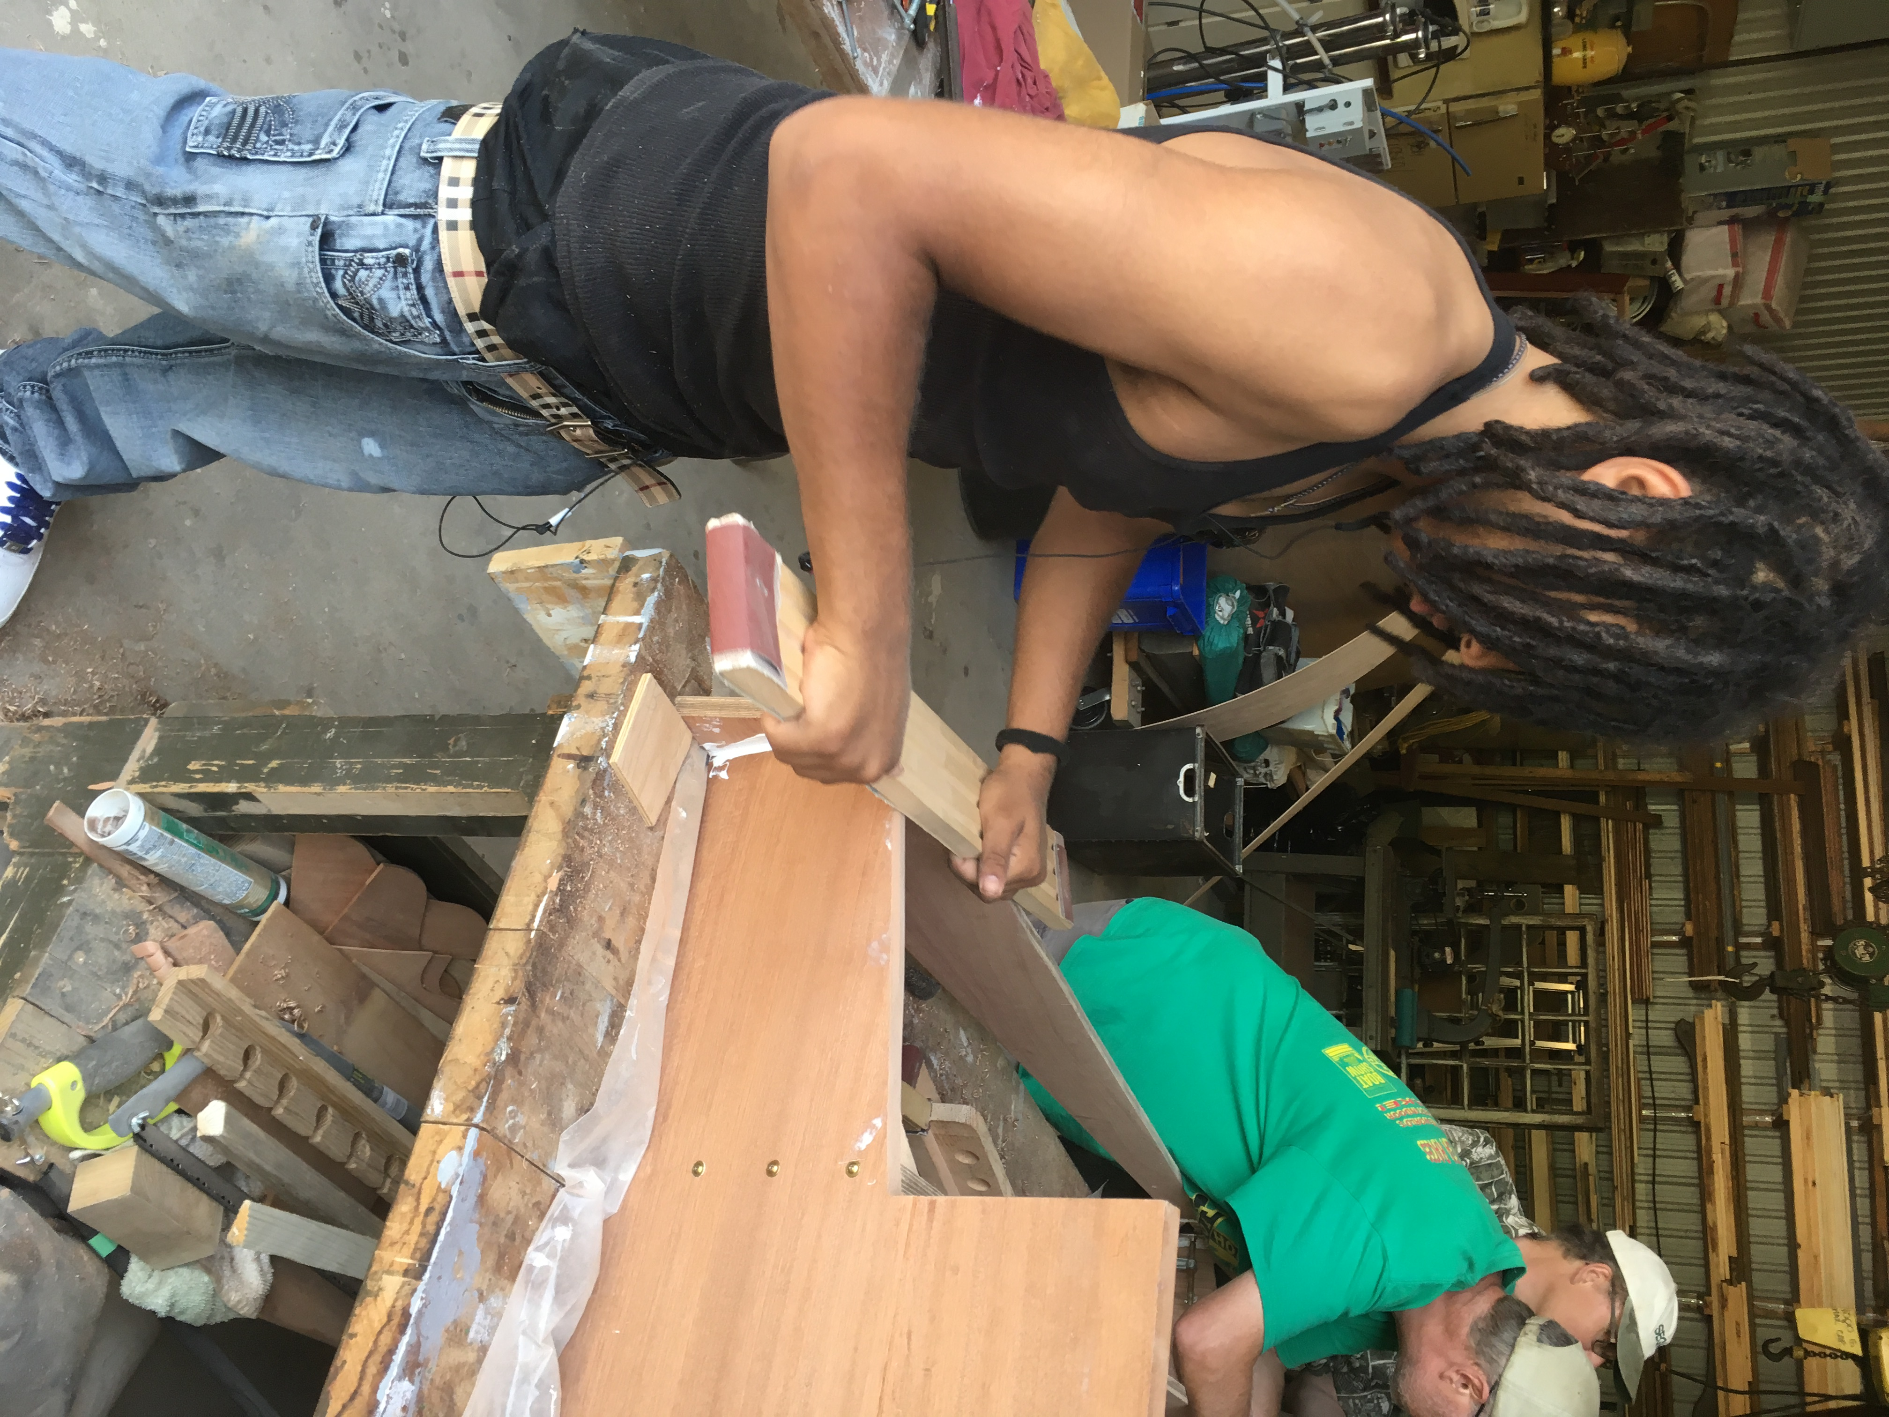
K&C Youth tool skills – step 3
Kids-at-risk SeaFlea building for self-esteem rescue.

