Slide 1
Insurance & Risk Management
Thomas Freyer AVP, CIC, CRIS
Haylor, Freyer & Coon Inc.
tfreyer@haylor.com
(315) 703-1339

Slide 2
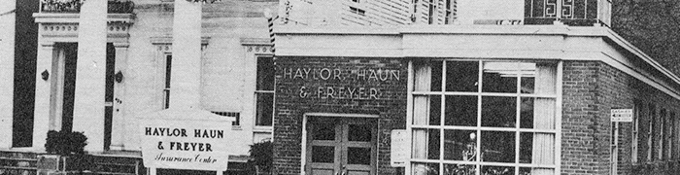
History
Haylor, Freyer & Coon was founded in 1928 by Burnett (Barney) E. Haylor and James McLusky as a local four-person insurance agency. From these humble beginnings, Haylor has grown steadily into a national agency. Today, we are a top 100 independently owned insurance agency in the United States with a reputation as a proven leader. A lot has changed in the more than nine decades we’ve been in business, but our core principles remain the same. We are dedicated to the well-being of our employees, and to providing insurance and risk management solutions with distinctive and exceptional service. HF&C continues to be a proven leader in the insurance industry, with approximately 180 employees and 6 corporate offices. ISO 9001 certified by the International Standards Organization and an ESOP (Employee Stock Ownership Plan).

Slide 3
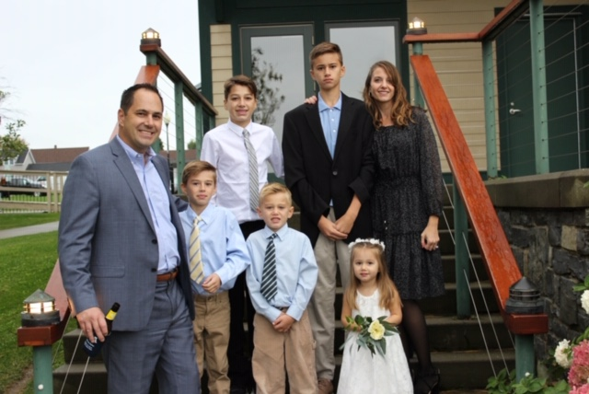

Slide 4
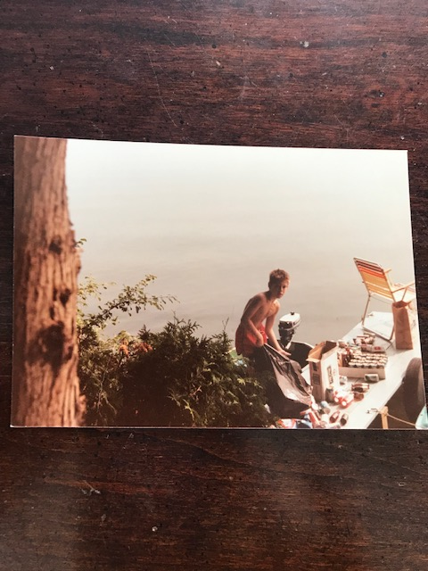

Slide 5
Legal Disclaimer
Your use of this PowerPoint presentation is subject to the following terms and conditions. By viewing this presentation you acknowledge that you have read and accept the terms and conditions. The materials have been prepared by Thomas Freyer of Haylor, Freyer & Coon Inc. for informational purposes only and are not to be considered as insurance advice. Your use of the material in this presentation is at your own risk. HF&C is not responsible for any errors or omissions in the content of this video presentation or for damages arising from the reliance on materials addressed in this presentation.

Slide 6
“Wherever one finds summer resorts, inland lakes or harbor facilities, there are also marinas and boat and yacht sales and service agencies. The insurance requirements of these operations are unusual. While marine insurance is the oldest form of insurance, it is also one of the least understood”
Coverage Applicable, The Rough Notes Co Inc. / 2006

Slide 7
Insurance & Risk Management Discussion
1-Commercial Insurance Coverage
2-Importance of Active Risk Management
3-Steps of the Risk Management Process
4-Applying Risk Management to your Organization
5-Overview of the Insurance Marketplace

Slide 8
Commercial Insurance Coverage
Property, Boiler & Machinery & Business Income + Extra Expense
General Liability/ A&M / Liquor Liability / Employee Benefits Liability
Protection & Indemnity
Auto
Marina Operators Legal Liability- Care, Custody & Control
Owned Boats “Hull Coverage”
Inland Marine & Fine Arts
Umbrella / Bumbershoot
Crime
Pollution
Employment Practice Liability, Cyber Liability & D&O
Worker Compensation & Disability

Slide 9
Property Insurance
Property Insurance: “First Party” insurance of real and personal property against physical loss or damage, not to be confused with property damage liability insurance. This is covered by a named “Premise” aka a listed location on a policy.
Examples of Property include:
Buildings: Includes the structure itself as well as inside and outside fixtures, permanently installed machinery and equipment and equipment used to service the building.
Business Personal Property (BPP): Includes furniture and fixtures, machinery and equipment, stock and other personal property owned by the insured and used in the business.
The scope of property coverage may be broadened, limited or modified through the use of several endorsements. Examples include ordinance of law, debris removal, earthquake and flood.

Slide 10
Property Insurance Terminology
Coinsurance Clause: In property insurance, a condition of the policy requiring the insured to maintain insurance at least equal to a stipulated percentage of value in order to collect partial losses in full. If the insurance is less than the minimum required, a penalty is applied to the amount of loss based on a proportionate formula of the amount of insurance carried divided by the amount of loss required to be carried. Usually see 80%, 90% or 100% co-insurance listed.
Agreed Value Clause: A condition of a policy of a policy stating that the insurer agrees to waive the coinsurance requirement in consideration of the insured maintaining insurance for the scheduled item.

Slide 11
Co-Insurance Loss Scenario
A business has their building limit insured at only $45,000
The RC value of the building at the time of loss is $100,000
The coinsurance percentage is 90%
The limit of insurance should be at least $100,000 x 90% = $90,000
Because the amount of insurance purchased is only 50% of the amount required ($45,000/$90,000), coverage is afforded for only 50% of the repair cost:
The cost to repair the covered damage is $20,000
50% of the repair cost is 20,000 x .50 is $10,000
The deductible is $500

Slide 12
Property Insurance Terminology
Replacement Cost: Protection which pays the costs to restore or replace damaged or destroyed property without deduction for depreciation. Typically want to see RC on buildings and BPP. Actual Cash Value can be used on older properties but that does become more subjective as depreciation is utilized when settling a claim.
Blanket Coverage: A single amount of insurance covering several items…example: one amount to cover two buildings or one building and it’s contents.
Blanket Limit :
Building 1- $1M / BPP $500K Building 2- $500K / BPP $250K
Option 1: Blanket Building Limit of $1.5M
Blanket BPP of $750K
Option 2: Building and BPP Limits of $2.25M

Slide 13
Property Insurance Perils
Property policies can differ in terms of the perils (cause of loss) that are covered and or excluded.
Basic, Broad and Special Forms are examples of commercial property forms that could be utilized. Special Form is the broadest form available of the three.
Some examples of perils that are typically covered on a basic property form are Fire/Lighting, Smoke, Explosion, Windstorm, Vandalism, Sprinkler Leakage, Riot & Civil Commotion, Sinkhole Collapse and Volcanic Action.
Flood and Earthquake are normally excluded on every property form but can be bought back.

Slide 14
Boiler & Machinery / aka Equipment Breakdown
B&M has three separate parts: Damage from an accident to covered items, damage to the other property of the insured caused by accident to the items covered and loss of income due to damage to the items covered and/or damage to other insured property. The items covered consist of boilers and other heating devices. Most machinery and equipment, including electronic devices can also be included.

Slide 15
Business Income & Extra Expense
A time element coverage which pays for loss of earnings or income when business operations are interrupted, curtailed or suspended due to a property loss as a result of an insured cause of loss. It also includes reimbursement for continuing expenses.
This can dramatically affect a retail organization that has ticket sales, events, that would be interrupted should they encounter a covered loss like a fire.
Need to examine the set limit every two-years at minimum by doing a business income worksheet. This will allow you can have a BI/EE limit that works for your organization based upon the period of restoration.

Slide 17
General Liability Insurance & A&M
A form of insurance sold to businesses to indemnify the business for third party liability claims due to negligence which resulted in bodily injury or property damage to another party. Coverages can include premise and operations liability for onsite and jobsite accidents and products liability claims for products that injure third parties. Most businesses carry general liability insurance with $1M occurrence/$2M aggregate.
Abuse & Molestation (A&M) and Liquor Liability can be added by endorsement or with a separate policy.
Abuse and Molestation: Physical and sexual abuse insurance is insurance coverage that protects against losses related to lawsuits arising from claims of physical and/or sexual abuse. This abuse can include molestation, physical blows, inappropriate touching, and more.

Slide 18
Liquor Liability Insurance
Liquor Liability: Coverage where the basis of legal liability is dram shop, liquor control, or alcoholic beverage law. The laws vary, but most provide that the owner of an establishment which serves alcoholic beverages is liable for injury or damage caused by an intoxicated person if it can be established that the liquor licensee caused or contributed to the intoxication of the person.
Liquor liability coverage fills the gap created by the exclusion in general liability policies applying to businesses directly involved in the sale, distribution, manufacturing or serving of alcoholic beverages.
Limit: $1M occurrence and you can schedule an umbrella to follow

Slide 19
Employee Benefits Liability
This coverage addresses the requirements of businesses to provide their employees with information about the benefits available to them ie. Medical, Dental, Life, 401K. This form provides coverage for damages that result from an employer not fulfilling the notification requirements and the employee being denied access to promised benefits.

Slide 20
Protection and Indemnity
Protection & Indemnity coverage provides bodily injury and property damage liability protection for accidents arising from the ownership and operation of a vessel. It is written in conjunction with Hull Coverage. It includes liability coverage for loss of life or personal injury to guests, to swimmers and to the general public and to employees, including a hired captain and crew.
Limit: $1M occurrence and you can schedule an umbrella to follow.

Slide 21
Auto
Auto Liability: Protection for loss incurred through legal liability for bodily injury and damage to property of others caused by accidents arising out of ownership, maintenance or use of an automobile.
Exposures: Company owned vehicles, trailers and hired and non-owned use with rentals or employee owned vehicles.
Auto Liability Limits $1M
PIP “No Fault”
Comprehensive / Collision
Uninsured and Underinsured Motorist

Slide 22
Auto
The challenges impacting the commercial auto segment are the following:
1-Continuining shortage of experienced, skilled commercial drivers
2-Distracted driving
3-Impaired driving
4-An increasing number of aggressive drivers
5-More vehicles on the road and more miles driven
6-Unprecedented jury awards

Slide 23
Marina Operators Legal Liability
Marina operators legal liability is comparable to garagekeepers legal liability insurance for parties having custody of customers boats. This wet marine form protects shipyards, marinas and others who service boats to the extent of their legal liability for such property in their custody.
If boats are being sold you could need “Boat Dealers Coverage Form” which could include dealer’s truth and lending , boat dealer’s errors and omissions, false pretense coverage as well as title recovery expense.

Slide 24
Owned Boats “Hull coverage”
Pertains to boats be utilized on water that are also covered for physical damage. This coverage includes the hull, machinery, fittings and other onboard equipment necessary for the safe operation and maintenance of the boat.

Slide 25
Inland Marine
Inland Marine is the insurance of property that is in the course of transportation or is of such a nature that can be easily transported.
Examples: Construction Equipment, Forklifts, Large Wedding Tent, or specialty equipment that has considerable value and could be mobilized from different locations.

Slide 26
Fine Arts
Fine Arts coverage insures specified works of art, including paintings against risks of direct physical loss or damage. Coverage applies on premise, off premise and in transit. An exclusion for breakage is common but it can be bought back for a premium surcharge.
Ex: High value items on display that could be moved throughout different locations.

Slide 27
Umbrella / Bumbershoot
Bumbershoot liability coverage is designed for businesses whose principal exposure is ocean marine and involves the operation of vessels and use of docks. This is a specialized form of umbrella liability insurance. Bumbershoot coverage includes protection & indemnity, collision & salvage charges, and other legal and contractual liability (including employers liability under admiralty laws or longshore act), automobile liability & coverage for other hazards associated with general liability insurance.

Slide 28
Crime
“Employee Theft” coverage is the insuring agreement that applies to employee theft losses involving money, securities and other property. It covers the unlawful taking of covered insured property by employees.
Theft of money and securities on and off premise
Fund transfer fraud coverage
Forgery or alteration coverage
Computer fraud coverage
Inside the premise robbery or safe burglary

Slide 29
Pollution Liability Coverage
The commercial general liability(CGL) policy attempts to exclude virtually all types of pollution except for that is caused by fire. The CGL can be endorsed to buy back some or all of the excluded pollution coverage or a separate pollution coverage form can be purchased to provide insurance protection for varying degrees of pollution coverage. Several versions are available to limit coverage to specified locations or projects.
Where a pollution policy could be advisable:
Dock Gas Sales, Oil or Gas Tank Storage on premise.

Slide 30
Employment Practice Liability
Employment related practice coverage is available for the legal costs to defend claims against sexual harassment, wrongful termination, discrimination and some can include coverage for wage discrepancies and claims from third parties. Most policies can offer a range of limits from $100K per claim up to several million in limits.

Slide 31
Cyber Liability
Data breaches exposed 4.1 billion records in the first six months of 2019 alone.
A special form or separate commercial insurance policy created to protect businesses against cyber (internet) risks, such as hackers and other breaches of computer system security.
Cyber liability policies typically include various property and crime coverages. They also cover certain costs, such as notification expenses. Loss or Damage to Electronic Data - Many policies cover losses caused by damage, theft, disruption or corruption of your electronic data.

Slide 32
Directors & Officers
D&O liability coverage insures corporate directors and officers against claims , usually brought by stockholders, alleging loss due to mismanagement. Also covers the corporation for expenses incurred in defending lawsuits arising from alleged wrongful acts of officers or directors.
Limit: $1M occurrence

Slide 33
Worker Compensation
By law, employers are required to provide coverage for on the job injuries sustained by their employees through a worker compensation policy. Boat, yacht and marina operations with paid employees are not exempt from this requirement. These operations are also usually subject to the Longshoreman and Harbor Workers Compensation Act and the policy must be endorsed to cover the obligations created and imposed on the employer by this act.

Slide 34
Disability
Disability insurance is a form of health insurance which provides benefits in the form of income (usually weekly or monthly) to employees disabled by sickness or accident not related to employment.
Some states like NY require businesses to carry policies with minimum limits should their employees get injured outside work.

Slide 35
Risk Management
Risk Management: “Process of managing uncertainty of exposures that affect an organization’s assets and financial statements using five steps: identification, analysis, control, financing and administration.
The focus of the process if two –fold:
1- Protect the assets of the organization (Property & Human Resources)
2- Protect the financial statements of the organization

Slide 36
Importance of Risk Management
Risk management is the process of identifying possible risks, problems or disasters before they happen. This allows business owners to set up procedures to avoid the risk, minimize its impact, or at the very least help cope with its impact.
Risk is the main cause of uncertainty in any organization. Thus, companies increasingly focus more on identifying risks and managing them before they even affect the business. The ability to manage risk will help companies act more confidently on future business decisions. Their knowledge of the risks they are facing will give them various options on how to deal with potential problems.

Slide 37
Accident Prevention (Form of RM)
All the ways and means used to avoid the occurrence of an accident or to reduce its consequences if it does not occur, such as the control of personal performance, machine performance and physical environment, including the training needed to reduce the number of accidents and cost of accidental injuries. Accident prevention is one of the less publicized functions of risk managers and insurers.

Slide 38
Five Steps of the Risk Management Process
1- Risk Identification
2- Risk Analysis
3- Risk Control
4- Risk Financing
5- Risk Administration

Slide 39
Risk Identification
Risk Identification: The process of identifying and examining exposures of an organization. Identification is the most important step of the risk management process because an exposure and or risk must be identified before it can be effectively analyzed, controlled or financed.
Four logical classifications of exposures: Property, Human Resources, Liability and Net Income.

Slide 40
Risk Identification
Methods of Exposure Identification
Insurance Policy Review
Physical Inspections
Compliance Review
Procedures and Policies review
Contract Review
Experts
Financial Statement Analysis

Slide 41
Risk Analysis
Risk Analysis: The assessment of the potential impact of various exposures of an organization.
Qualitative Analysis: the “What” analysis This is used to identity and assess those loss exposures that can’t be easily measured by traditional statistical or financial methods and to understand their impact on the organization’s ultimate risks and performance.
Identification methods should be used to analyze those qualitative risks that could have a potentially harmful impact on the organization.

Slide 42
Risk Analysis
Quantitative Analysis- the “How Much” analysis: attempts to accurately measure risks by using acceptable traditional methodologies which calculate relative values.
Examples- Loss projection or forecasts
Business Income/Extra Expense Worksheet

Slide 43
Risk Control
Any Conscious action or inaction to minimize at the optimal cost , the probability , frequency, severity or unpredictability of loss.
Five techniques of Pre- Loss Risk Control
1- Avoidance
2- Prevention
3- Reduction (Pre-loss and post-loss)
4- Segregation/Separation
5- Transfer (Contractual, physical or both)

Slide 44
Risk Financing
The acquisition of internal and external funds to pay losses at the most favorable cost.
1- Retain the loss: pay with internal funds
2- Non-insurance contractual transfer of control or responsibility for an exposure.
3- Utilize Insurance: equitable financing of risks, from one entity to another, in exchange for payment

Slide 45
Risk Administration
Implementation: Developing a written and measurable risk management plan with your team. Start by establishing monthly or quarterly goals in terms of what your are trying to accomplish.
Monitoring: Examine and evaluate the results of your risk management actions and plans.

Slide 46
Application of Risk Management
Develop a Risk Management Committee within your organization.
Set some measurable goals in terms of what you are trying to accomplish as a committee throughout the year.
  Use the Five steps of the Risk Management process to help determine what are the most significant risks inside your organization.
  Then you can work to analysis, control, finance and those risks throughout the year.

Slide 47
Overview of Insurance Marketplace
Generalization
Renewal rate increases north of 4% for most lines.
More underwriting discipline and demand for cyber coverage.
Shrinking limits, increased retentions and coverage restrictions.
Liability
Hardening auto liability market is driving up rates for umbrella premium with insured’s with large fleet exposures.
Underwriter demand for more data is complicating the application process

Slide 48
Overview of Insurance Marketplace
Auto
Premiums continue to increase 5%-15%
Liability losses are out-pacing the rate increases
Property
Commercial property insurance rates are significantly higher this year
Underwriters are focused on profitability rather than market share or renewal retention rates.
Worker Compensation
Worker compensation rates are predicted to be flat or down about 5% for 2019 last quarter renewals and into 2020.

Slide 49
Overview of Insurance Marketplace
“While the status of the insurance marketplace varies from one line of coverage to another and the nature of the exposures being insured, the market is hardening for most lines and regions”
Overview from IRMI Insurance Market Report / Sept 2019
IRMI (International Risk Management Institute)

Slide 50
Questions ?

