Slide 1
Fundraising
101
October 2019

Slide 2
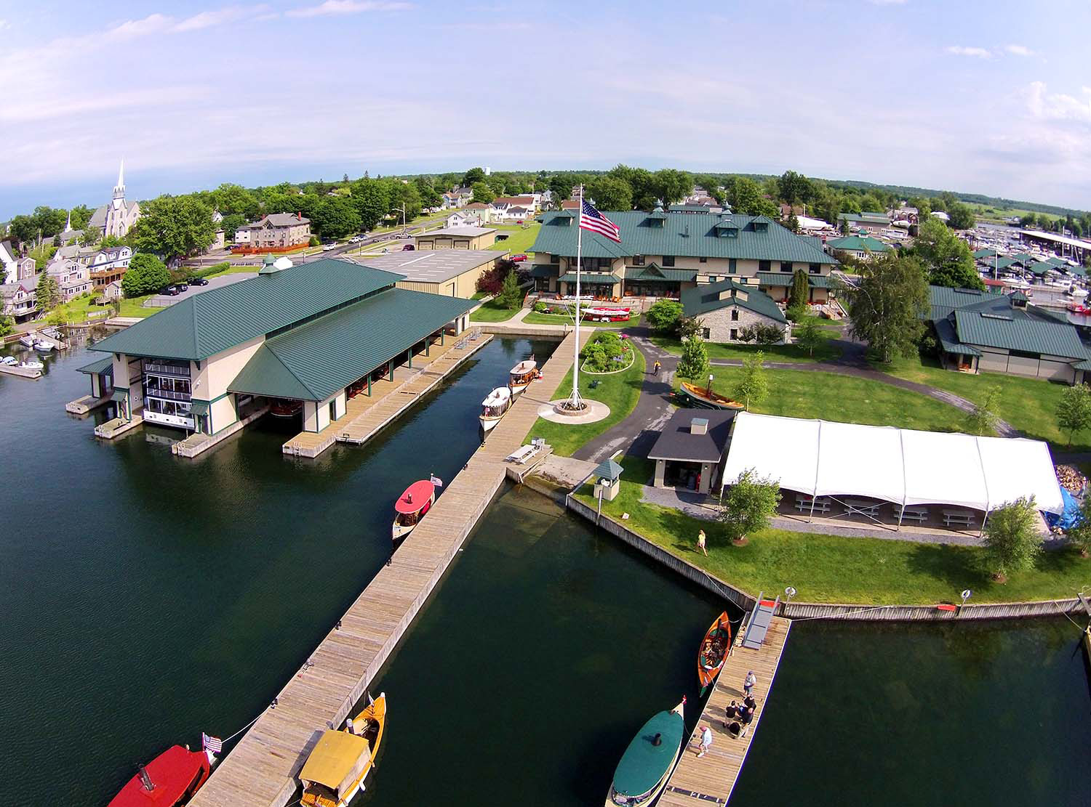
Founded in 1967
15 Permanent Employees
25+ Seasonal Employees
150+ Volunteers
$8.5 Million Endowment
The Antique Boat Museum collects, preserves, interprets and celebrates boats and related artifacts to advance public understanding of the importance of boating to the cultural history of North America and the St. Lawrence River in particular.

Slide 3
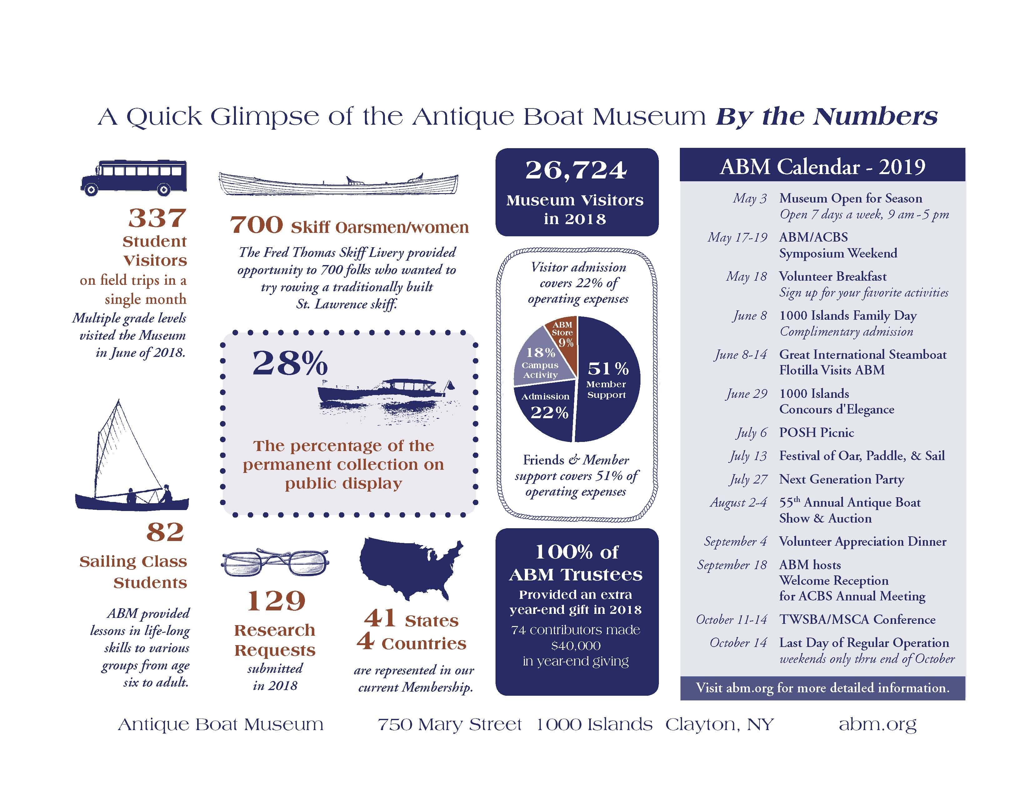
My advice to you:
Treat all people with RESPECT!
BE REAL…people can tell when you aren’t.
Be HONEST…no exceptions!
BUILD relationships…donors are real people too!
If you don’t know, ASK.
Nicole Paratore
Donor Relations Manager
15+ years Marketing & PR Experience
6+ years Fundraising Experience

Slide 4
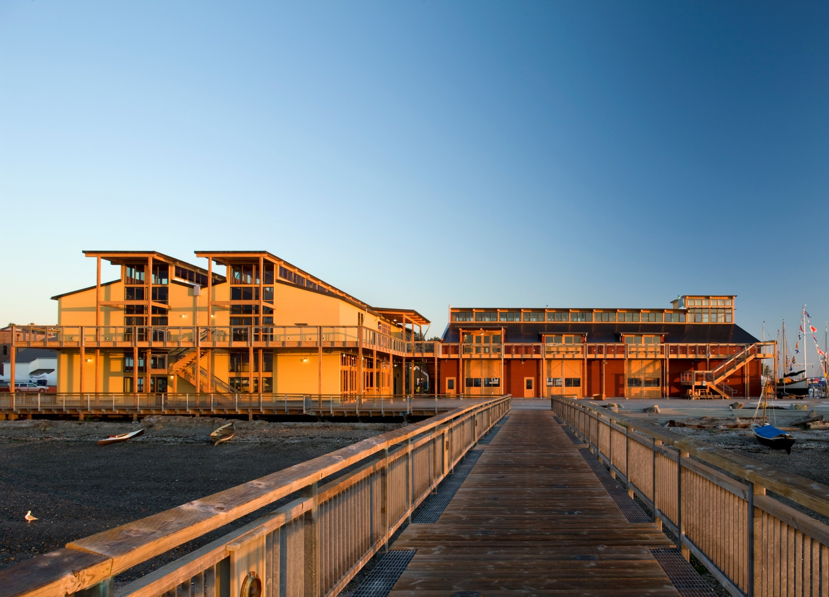






501 c-3 non-profit
Annual budget 2020
$4.3M
65% earned
35% contributed
100,000 annual visitors
2,200 students
44 Perm. employees
100+ peak season
900+ Volunteers
Notes:
I was supposed to be talking about Point Hudson
Point Hudson
Timeline slide
Money Slide
Breakwater
Wooden Boat Festival
Race to Alaska
Seventy48
School programs/vocational training

Slide 5
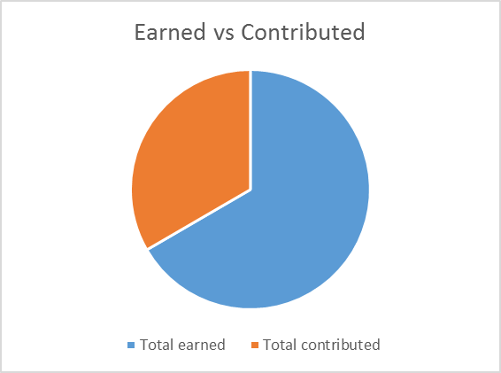
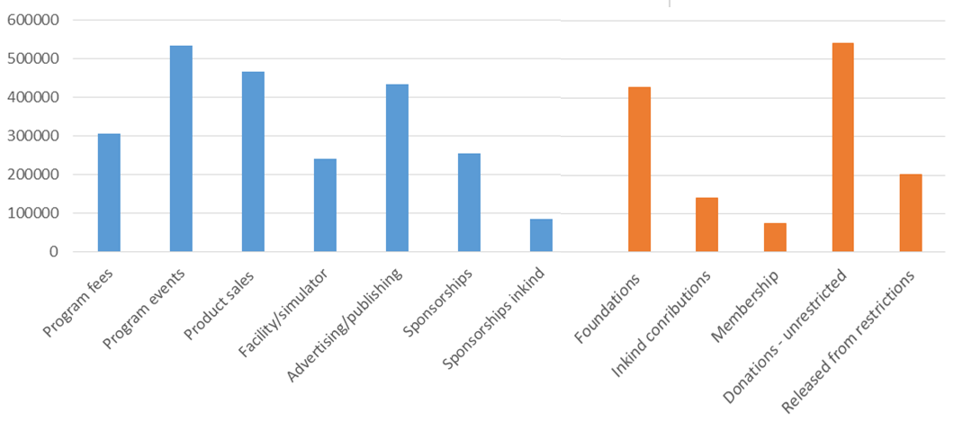
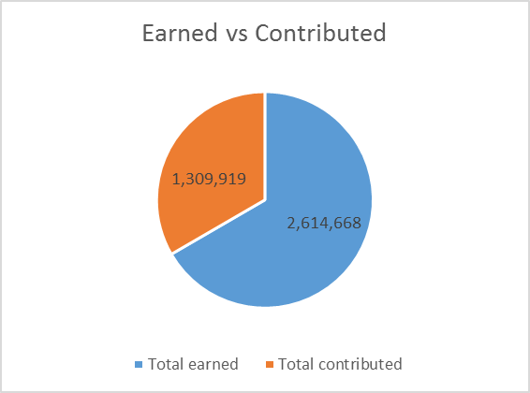

Slide 6
Fundraising
From
Foundations
Dave Bell
October 2019

Slide 7
Do the research:
Identify foundations that give to youth or other applicable programs in your area
Make sure foundation mission and current priorities are compatible with your organization
Pay attention to guidelines, criteria, geographic focus, selection process, limitations, and deadlines (at least one week early)
Identify past grantees: organizations, projects, amount
Identify officers and board members (any connections?)
Notes:
Know what you are doing!
Who are you teaching? Why are YOU there?
How will the students be assessed?- Standardized?, Grade in class, accuracy of the project?

Slide 8
Resources
Nonprofit Expert: https://www.nonprofitexpert.com/foundation-master-file/
Foundation Center Online: https://fconline.foundationcenter.org/
Libraries with foundation resources: https://candid.org/find-us
Individual foundation websites

Slide 9
Have your supporting documents in order:
Mission statement
501(c)(3) Tax-Exemption Status
Tax returns
Financial statements
Board members and affiliations
References, awards, etc.

Slide 10
The Grant Proposal
Identify a need in the community that aligns with a foundation priority (not your need)
Describe how you would address that need
Explain why your organization is the best one to address that need
Consider partnering with another organization
Prepare a detailed project budget, including project-related staff and overhead

Slide 11
The Grant Proposal
Plan to measure outcome or evaluate success
How will project be funded after grant expires (if applicable)
Make and cultivate personal contact(s) for the long term
Invite a representative to visit when clients are there
Have more than one idea to propose

