Slide 1

ERIE HIGH SCHOOL MARITIME PROGRAM
at the
Bayfront Maritime Center
Antique Boat Museum
Clayton NY
12 October, 2019

Slide 2
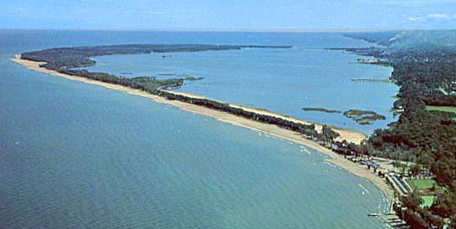
Presque Isle Peninsula Looking East

Slide 3
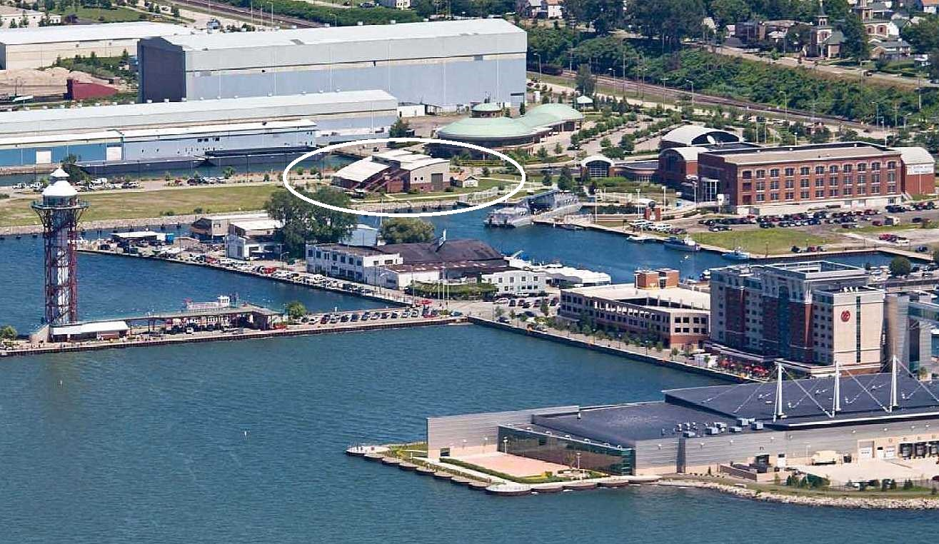
Maritime Campus
Bayfront Maritime Center, Schoolship Porcupine,
Erie Maritime Museum, Brig Niagara, Blasco Library, Donjon Shipbuilding, Intermodal Hub, Erie Water Works,
Erie Western PA Port Authority,
Notes:
Huge Potential – IN NOAA’S INVENTORY OF NATIONAL MARITIME SANCTUARYS

Slide 4
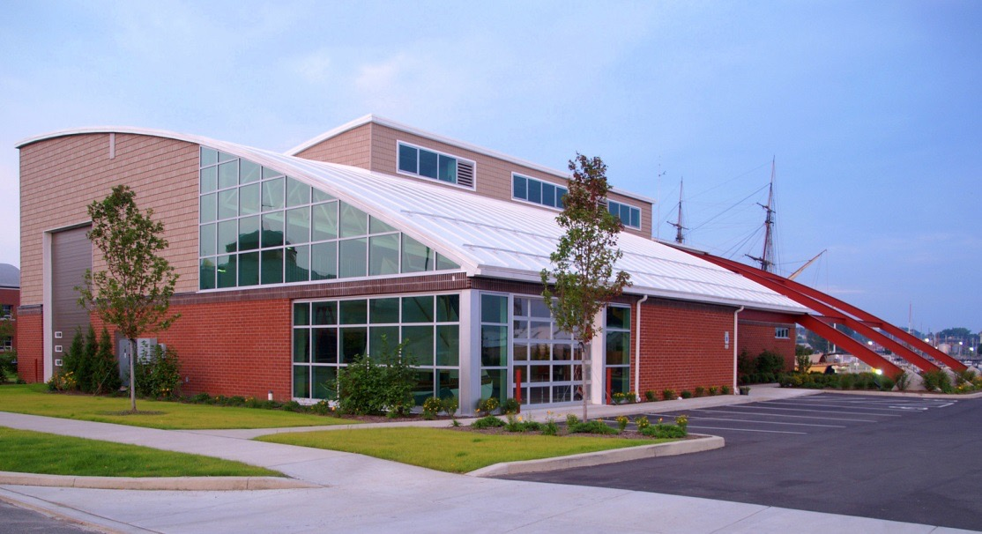
Erie Maritime Foundation’s Mission:
To design and implement hands-on, maritime themed, educational, vocational and recreational activities for the community in a universally accessible waterfront facility.
Erie Maritime Foundation
SINCE 1998

Slide 5
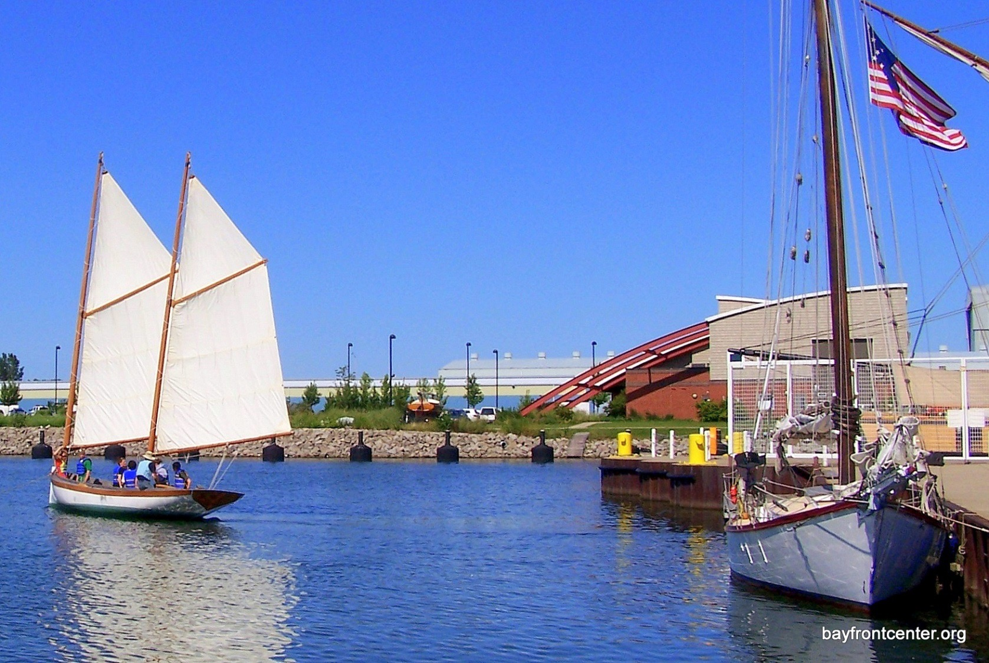
Historic replica of Erie’s fishing boat,
the Erie Boat.
Built by hundreds of students at BMC!

Slide 6
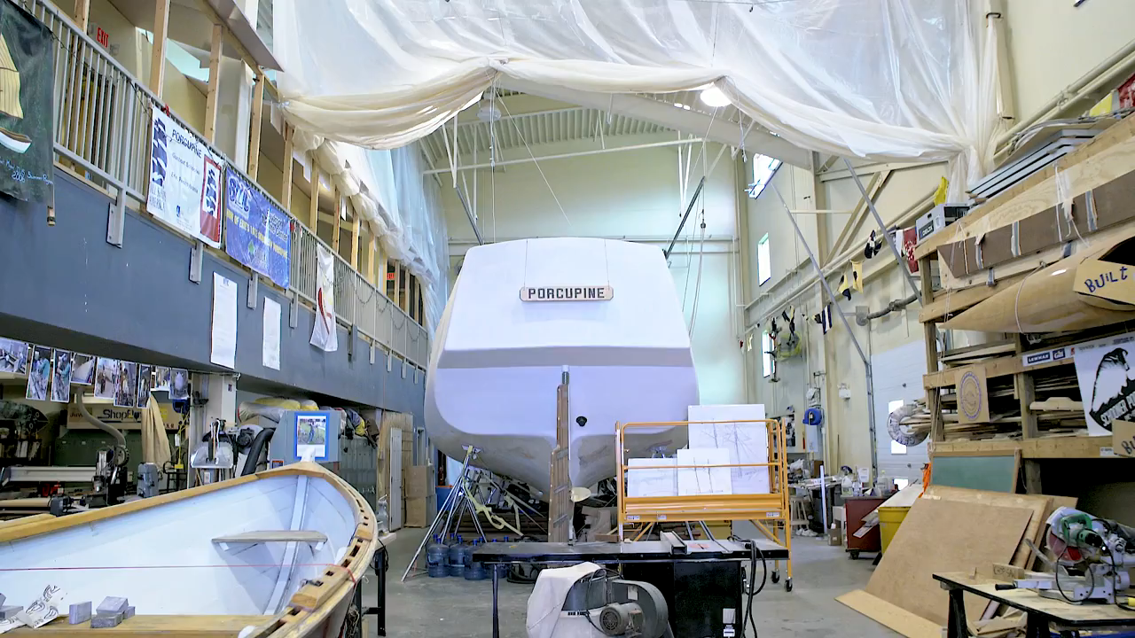

Slide 7
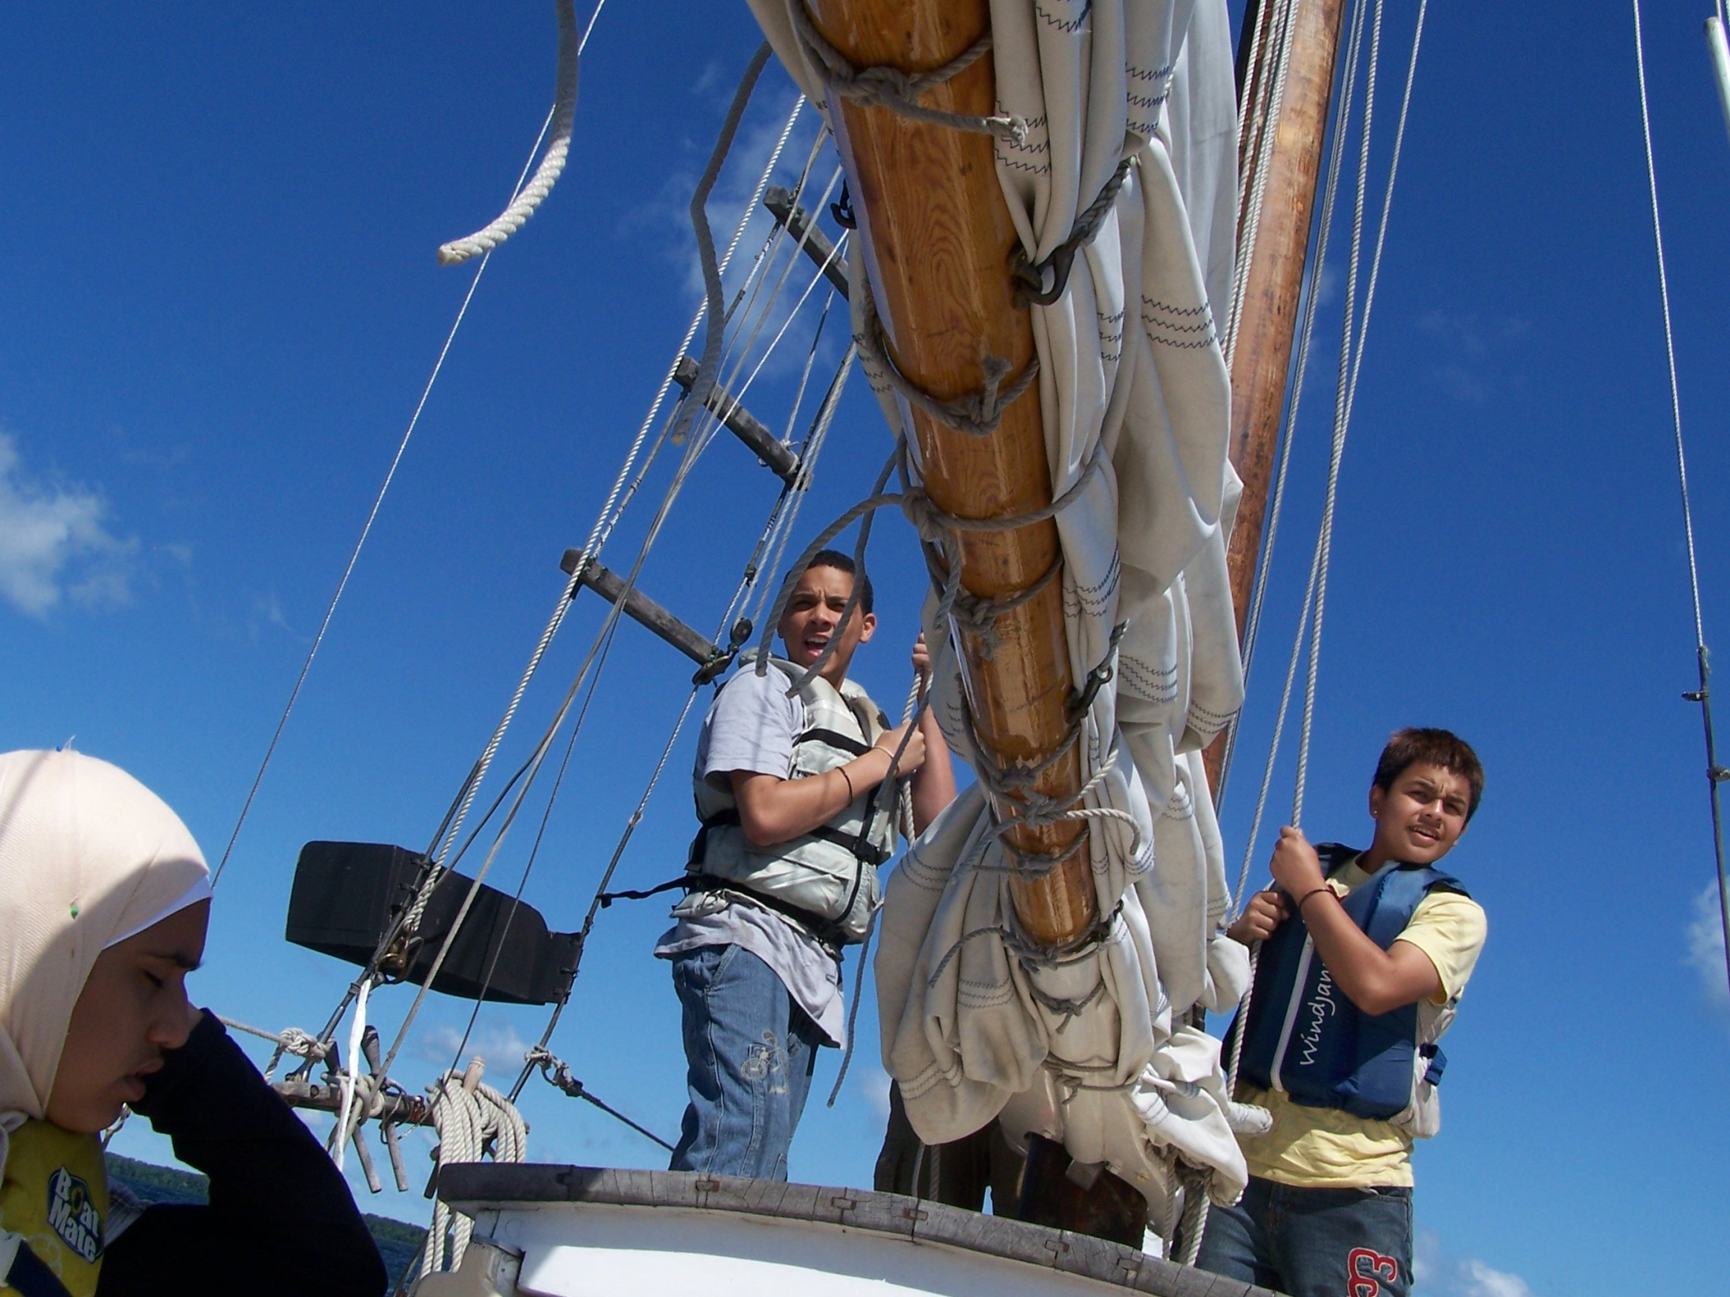
ADVENTURE

Slide 8


ERIE HIGH SCHOOL MARITIME PROGRAM
2018-2019
Inaugural Year

Slide 9
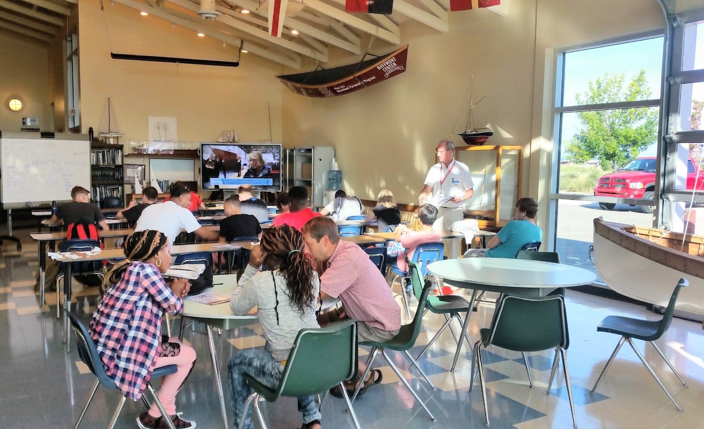
CLASS IN SESSION

Slide 10
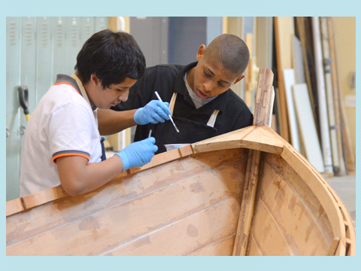
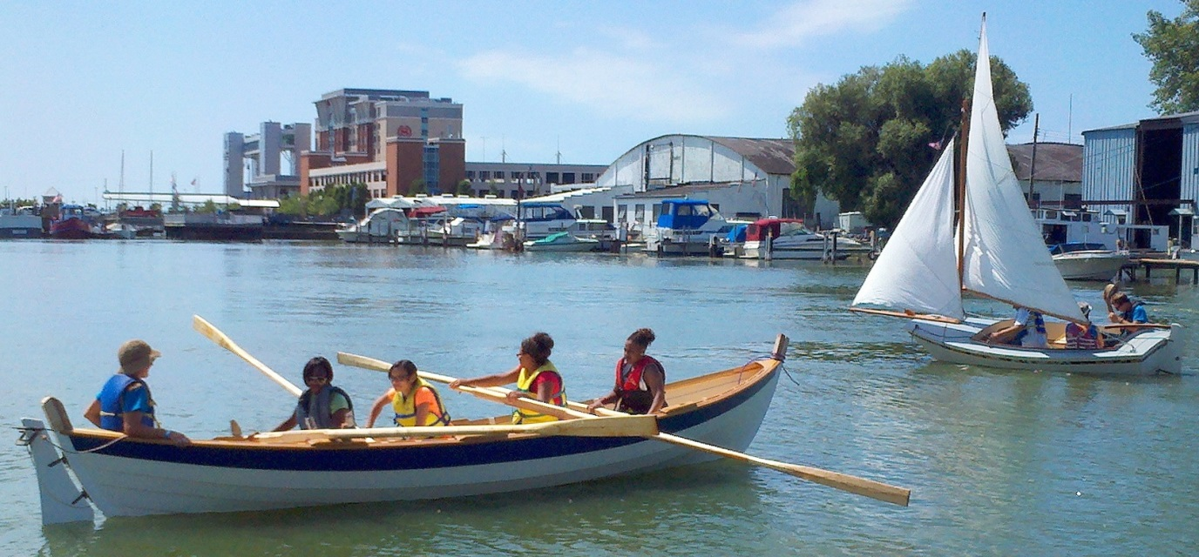
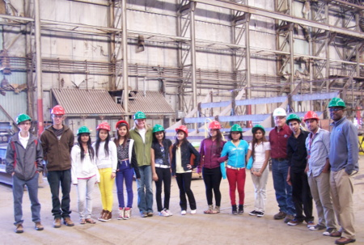
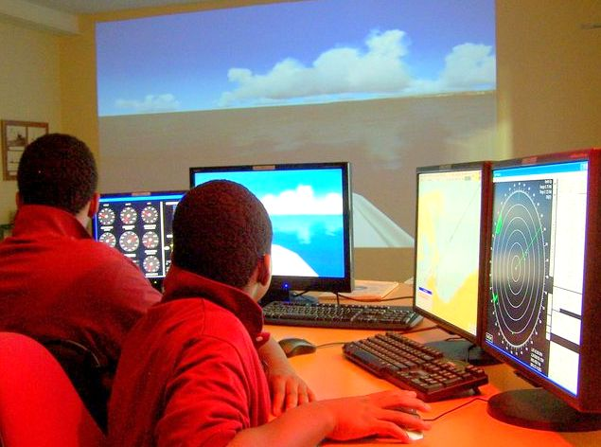
On the Water
In the Boatshop
Field Trips
Maritime Simulator

Slide 11
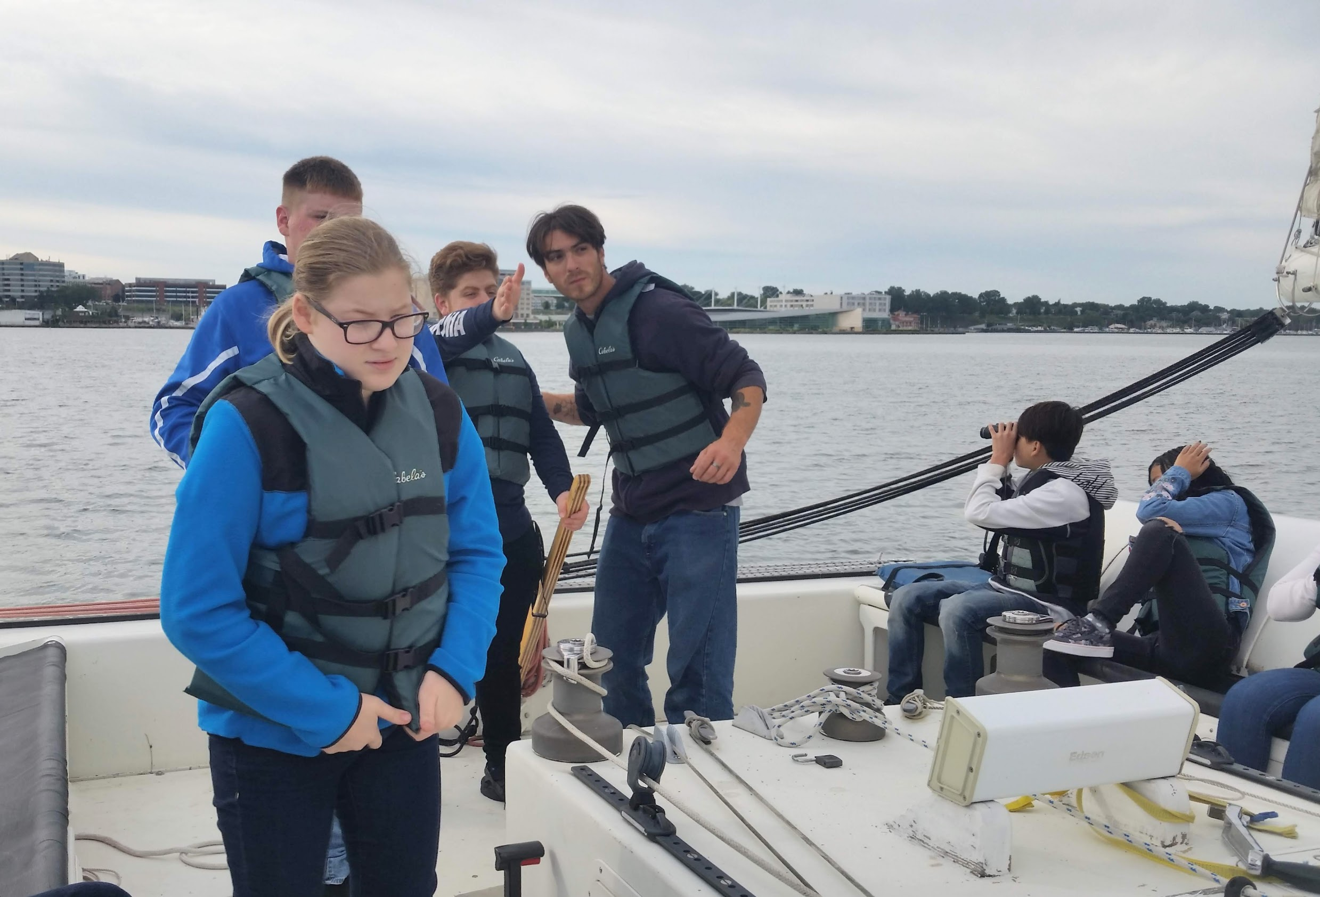
Learning to sail and boating safety in the on-the-water floating classroom.

Slide 12
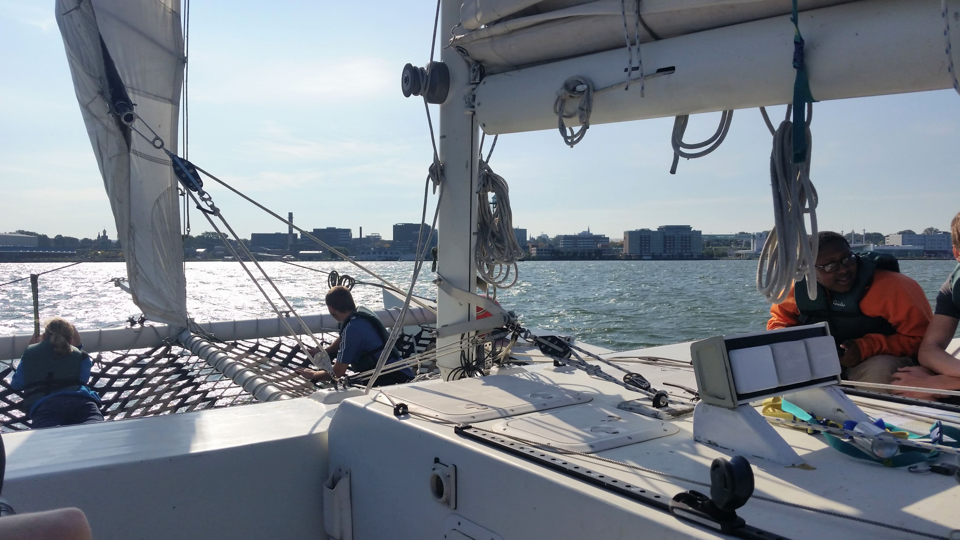

Slide 13
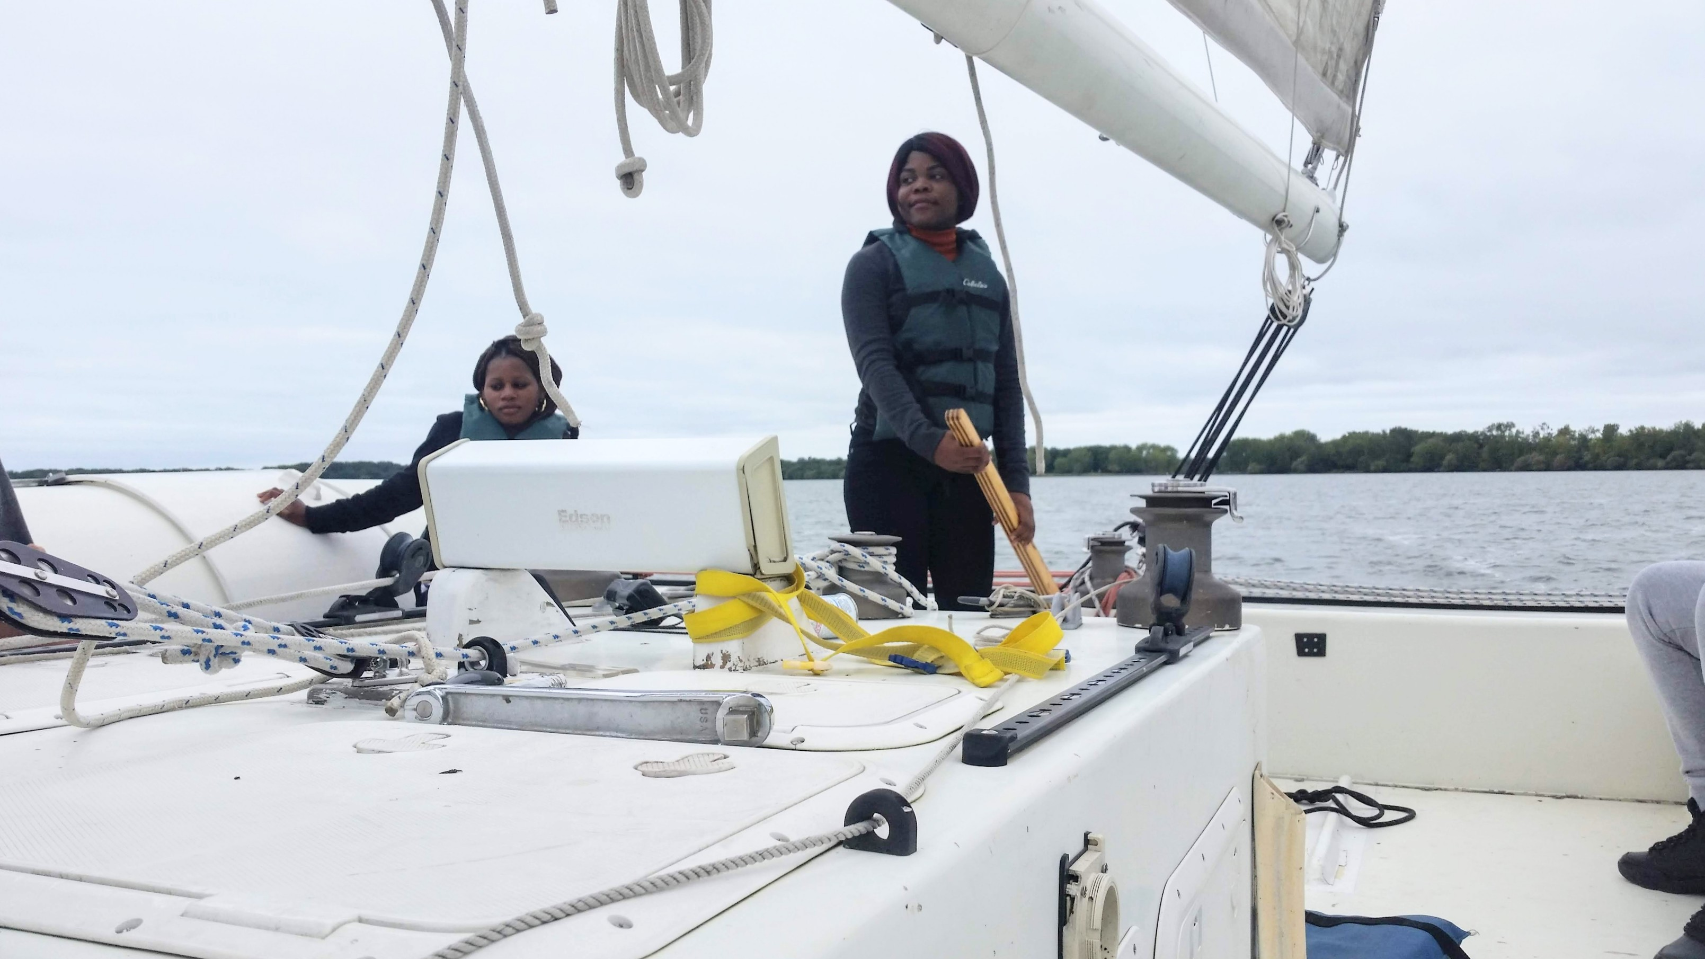

Slide 14
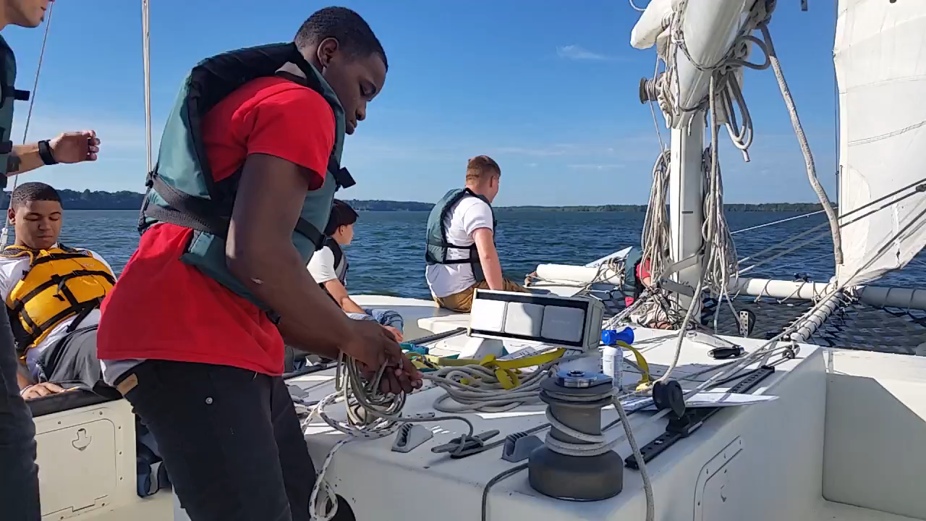

Slide 15
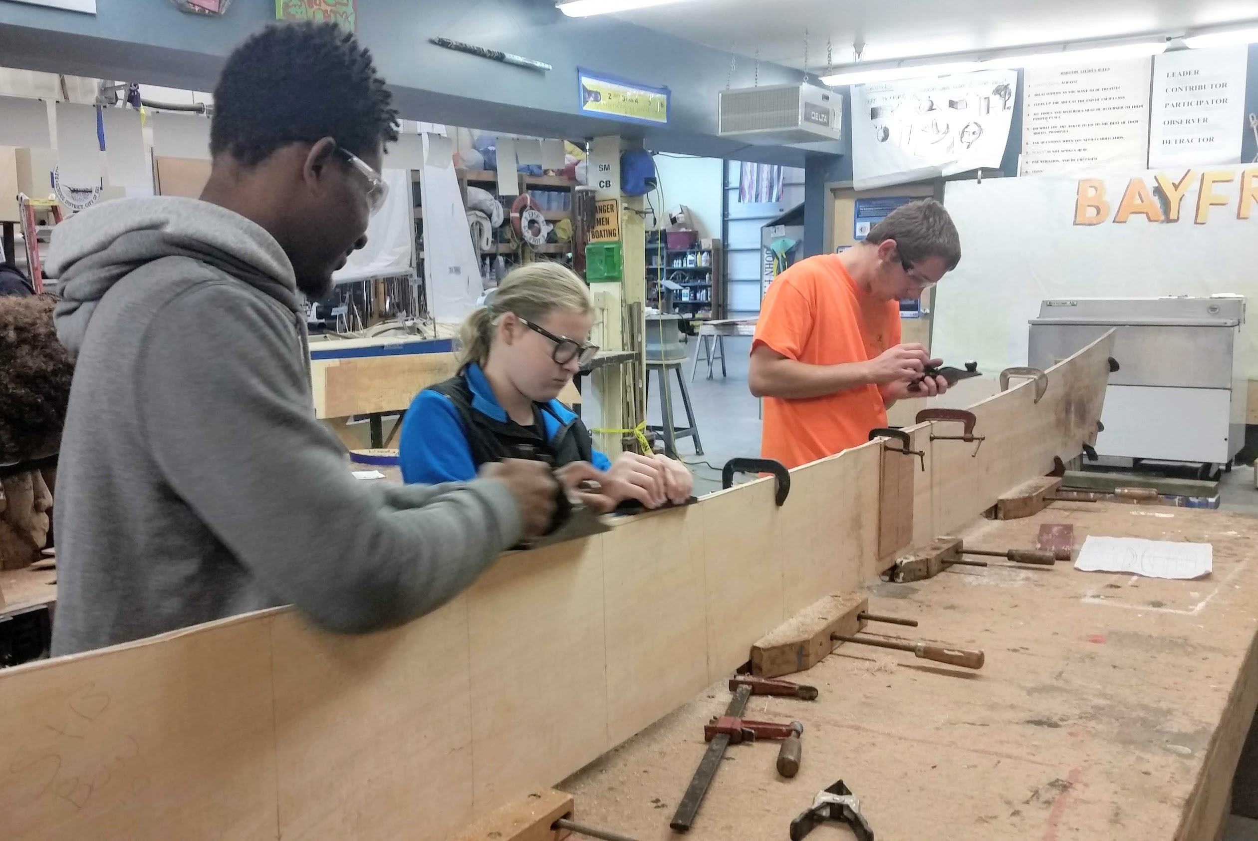
Boatbuilding in the BMC Boatshop

Slide 16
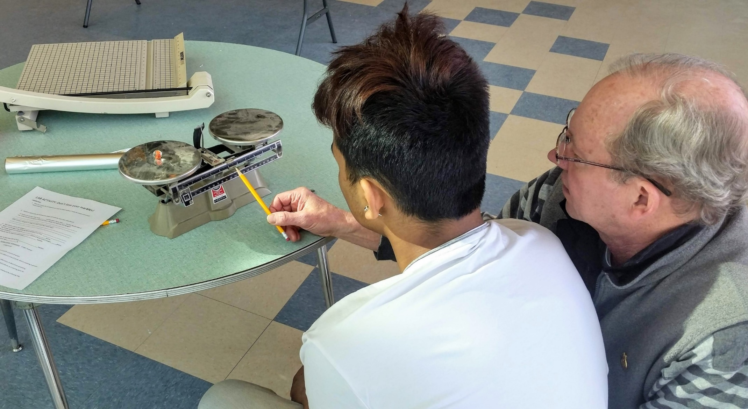
BUOYANCY and STABILITY LAB
- DESIGN – CONSTRUCTION – HYPOTHESIS – OBSERVATION- - EVALUATION - DOCUMENTATION

Slide 17
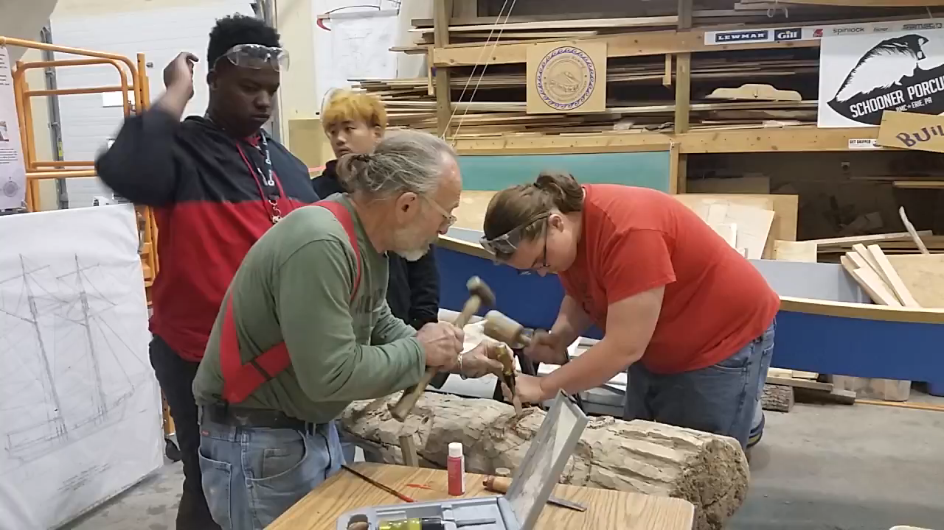

Slide 18
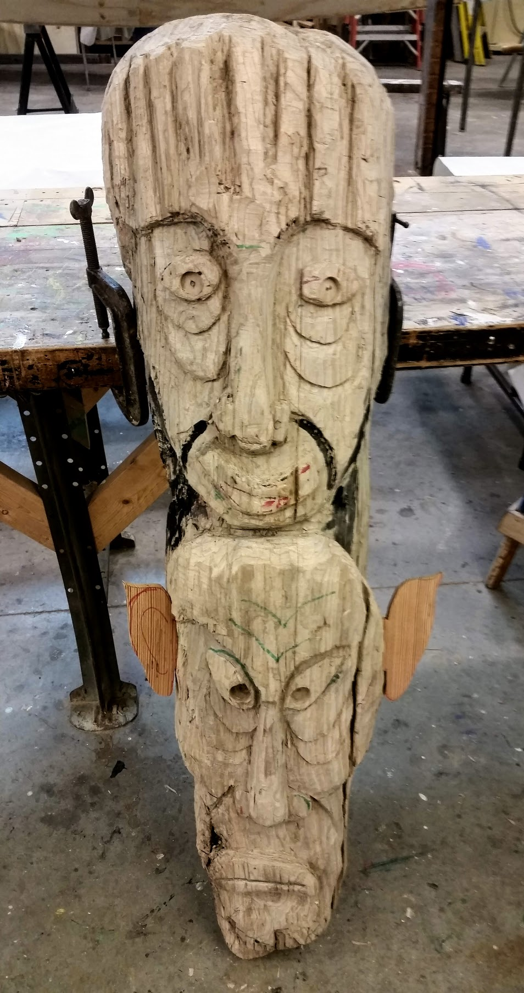
Carved by students with
guidance from
Mr. Ron Bayuzick, Artist-in-residence from Erie Arts and Culture.

Slide 19
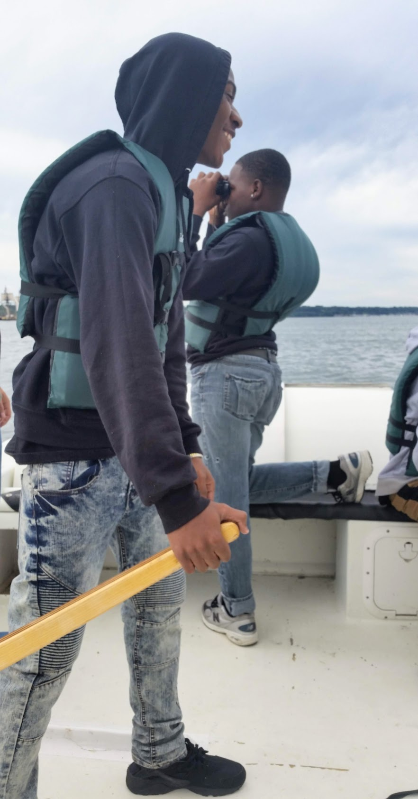
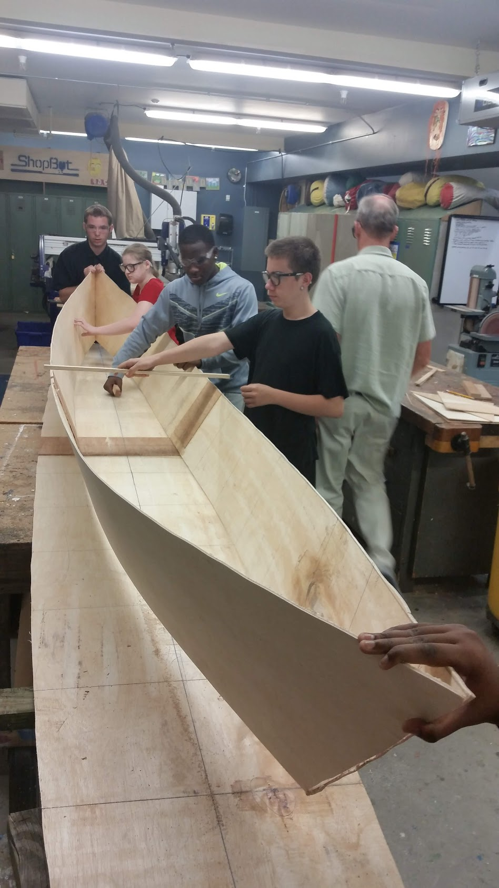
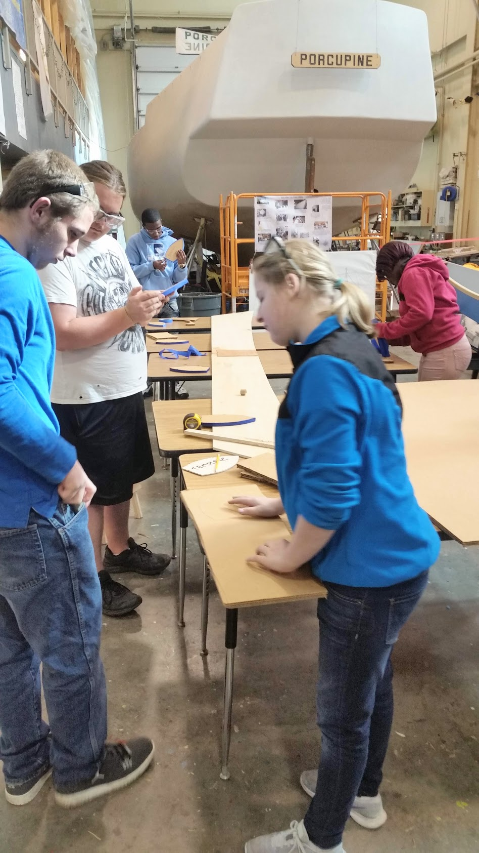

Slide 20
THE NEED
-Current 20% Shortage in Maritime Workforce
-USCG predicts shortage to increase to 30% in 10 years
-Maritime Career opportunities are widely diverse with
high pay, benefits, and pensions.

Slide 21
STARTING SALARY IS $75,000 A YEAR FOR 182 DAYS OF WORK
At the end of the free 30-month training program, students will be qualified to sit for a United States Coast Guard Third Assistant Engineer’s License exam, and will sail with AMO for a minimum of three years. Starting salary for a third assistant is approximately $75,000 a year for 182 days of work.
AMERICAN MARITIME OFFICERS UNION
http://www.amo-union.org/

Slide 22

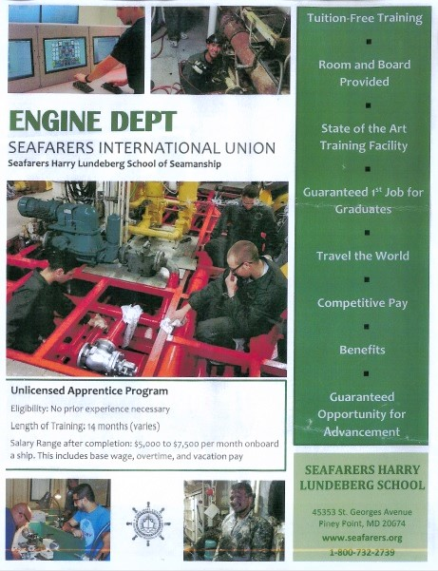

Slide 23
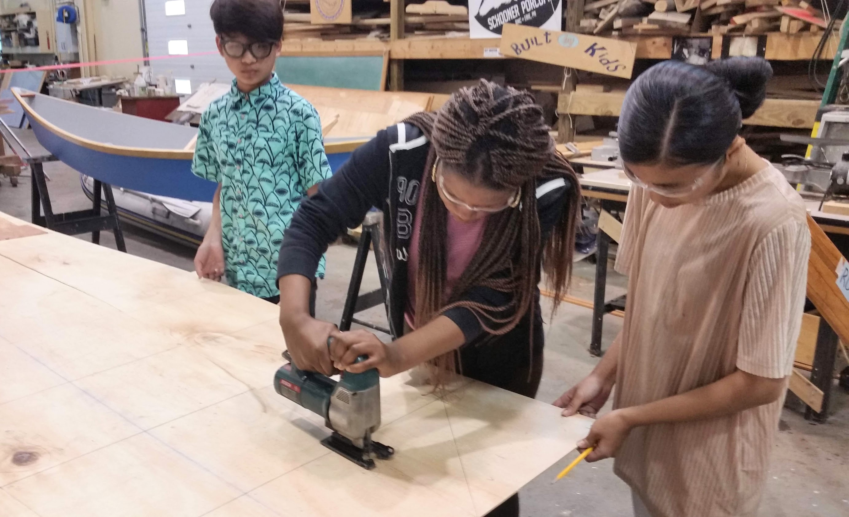
-Measuring
-Lofting
-Design
-Using Tools
-Teamwork
-Problem solving
-SAFETY!

Slide 24
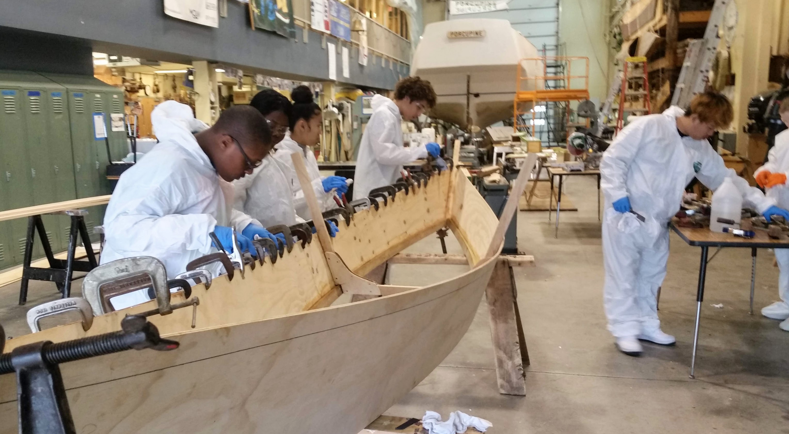


Slide 25
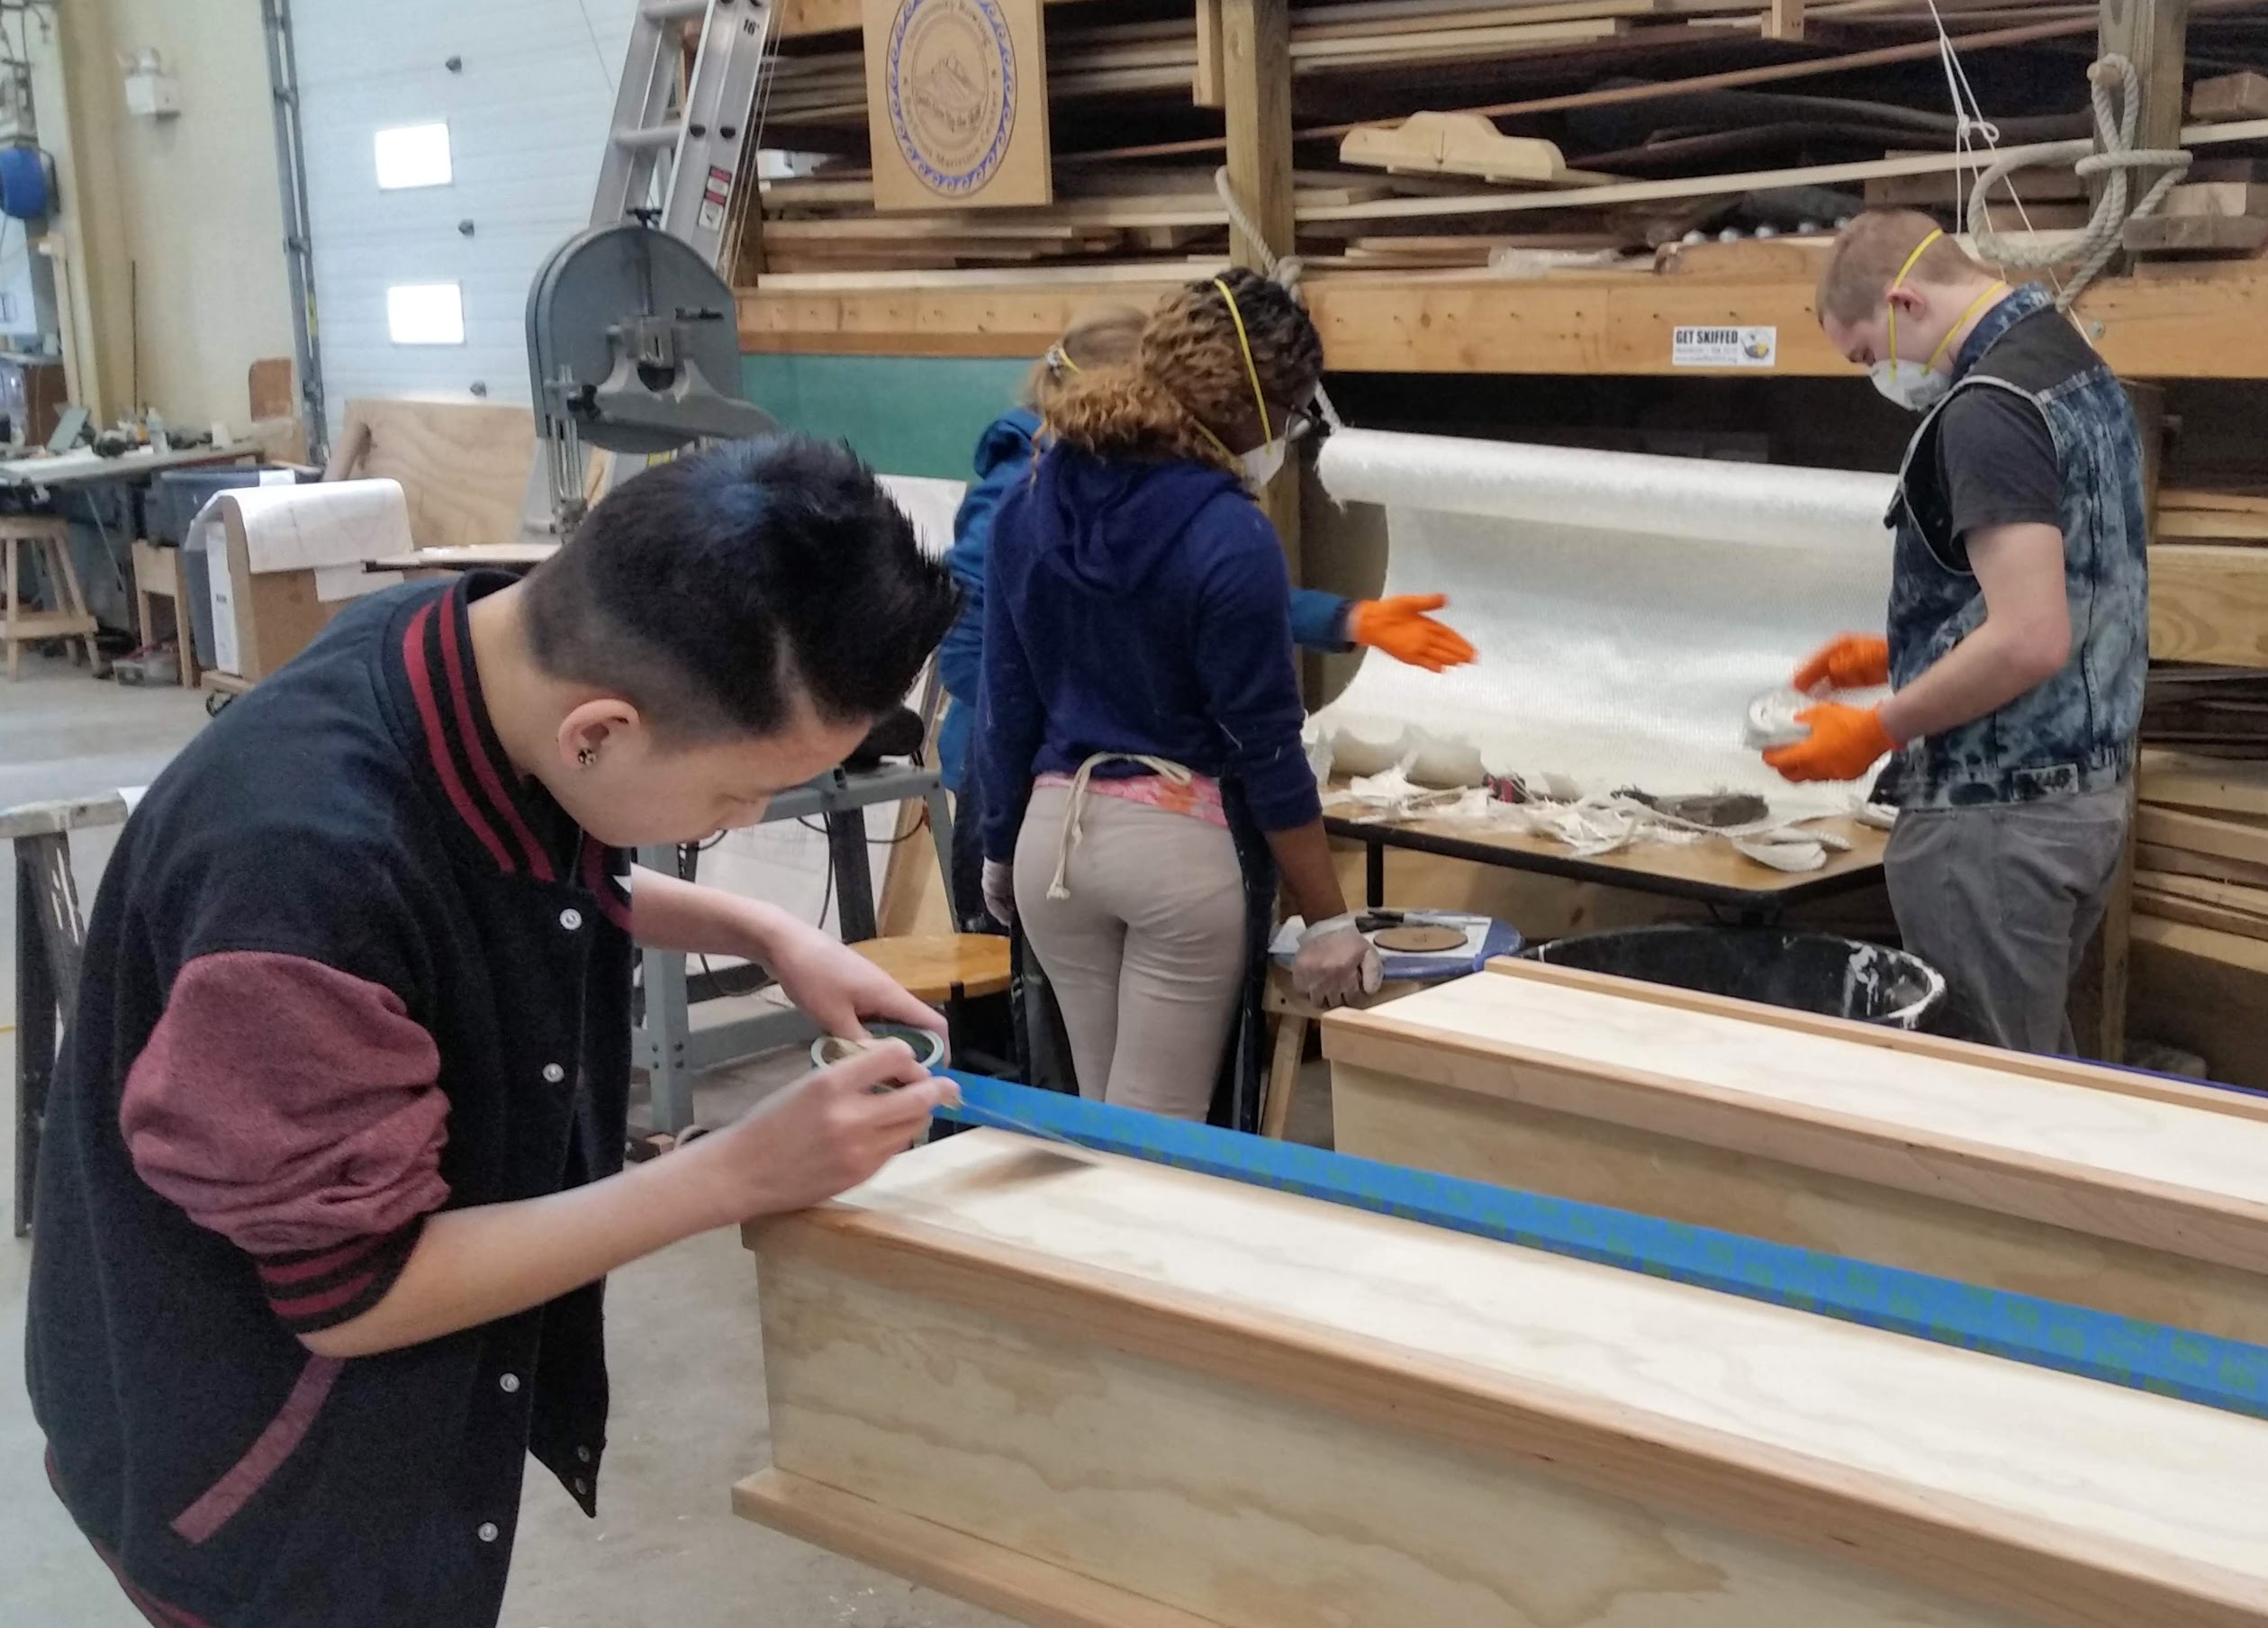

Slide 27
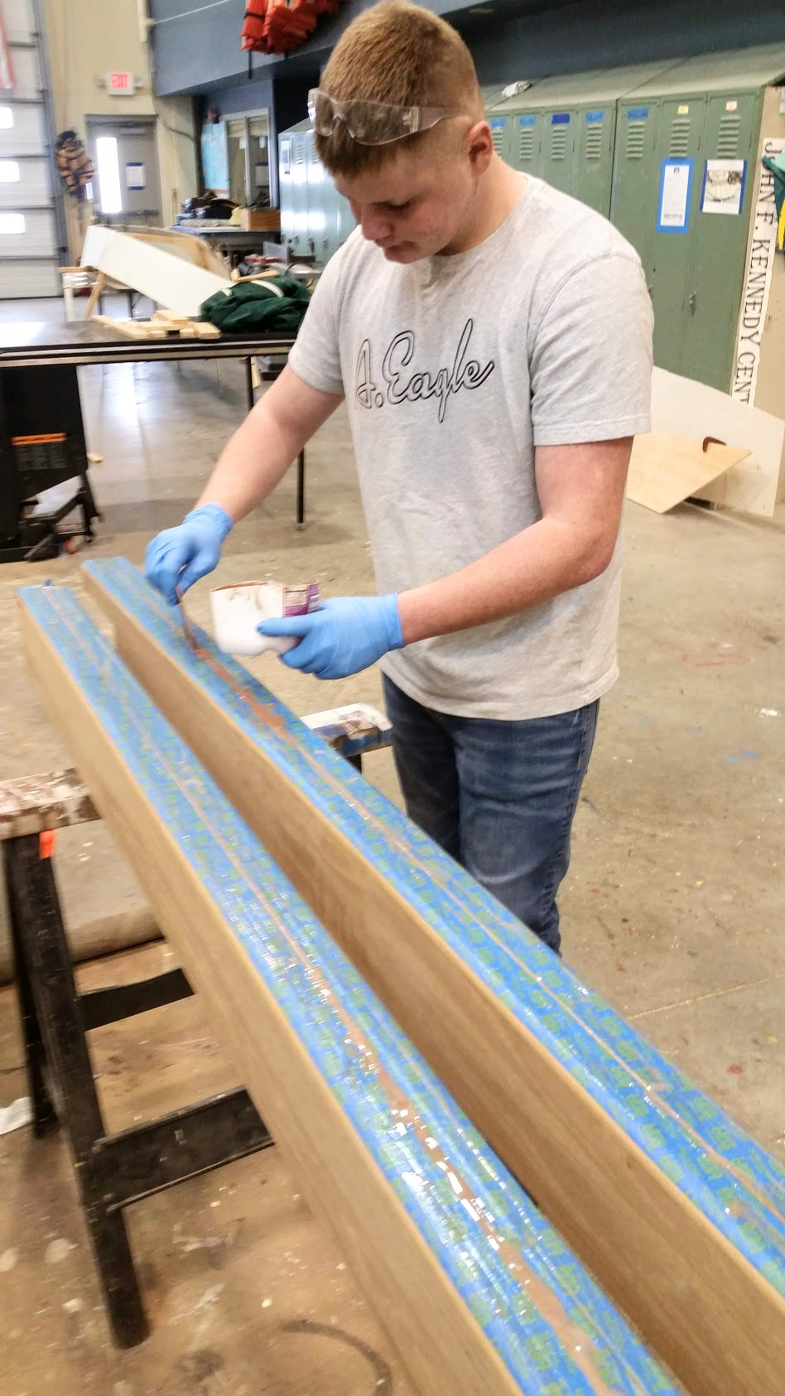
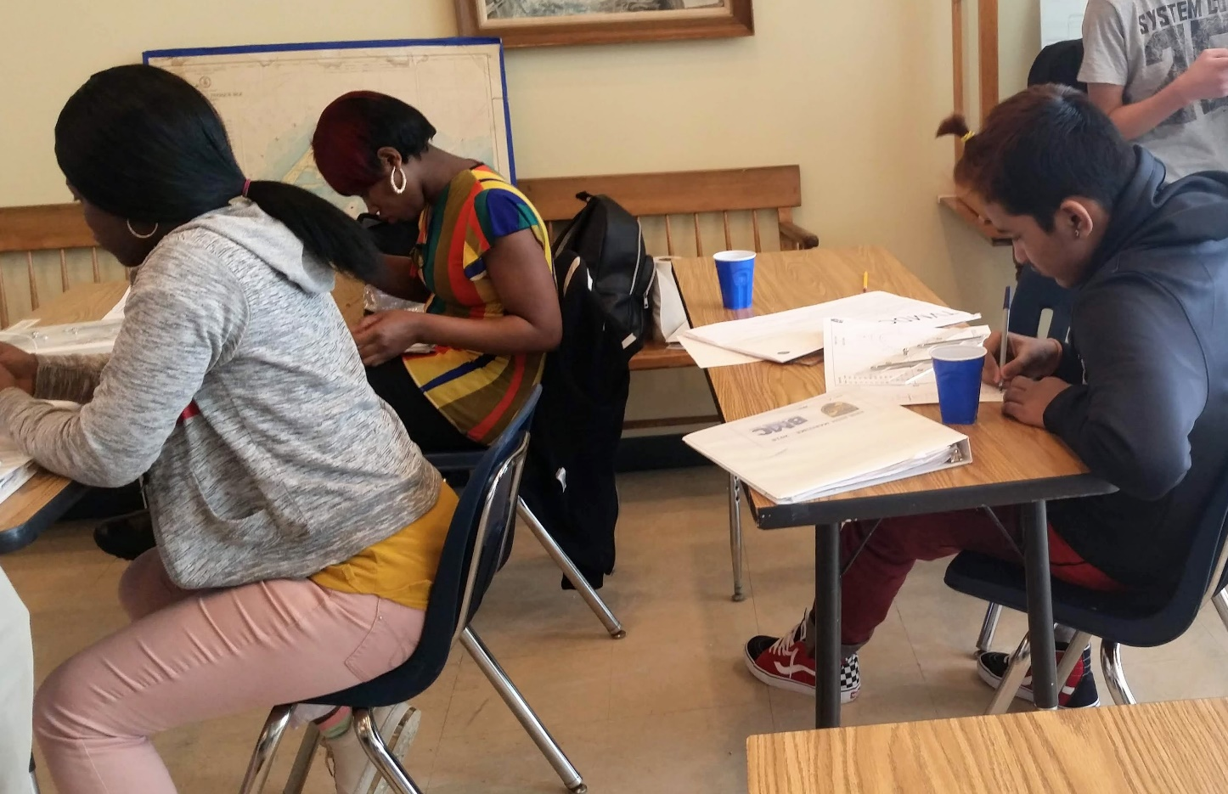
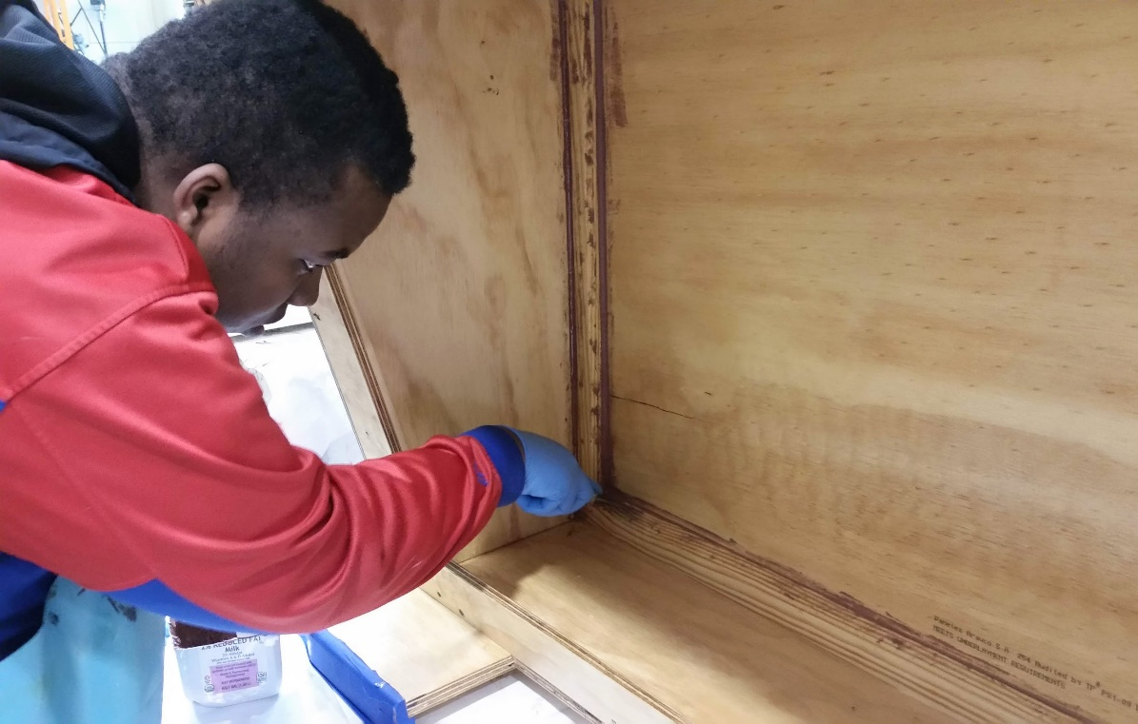
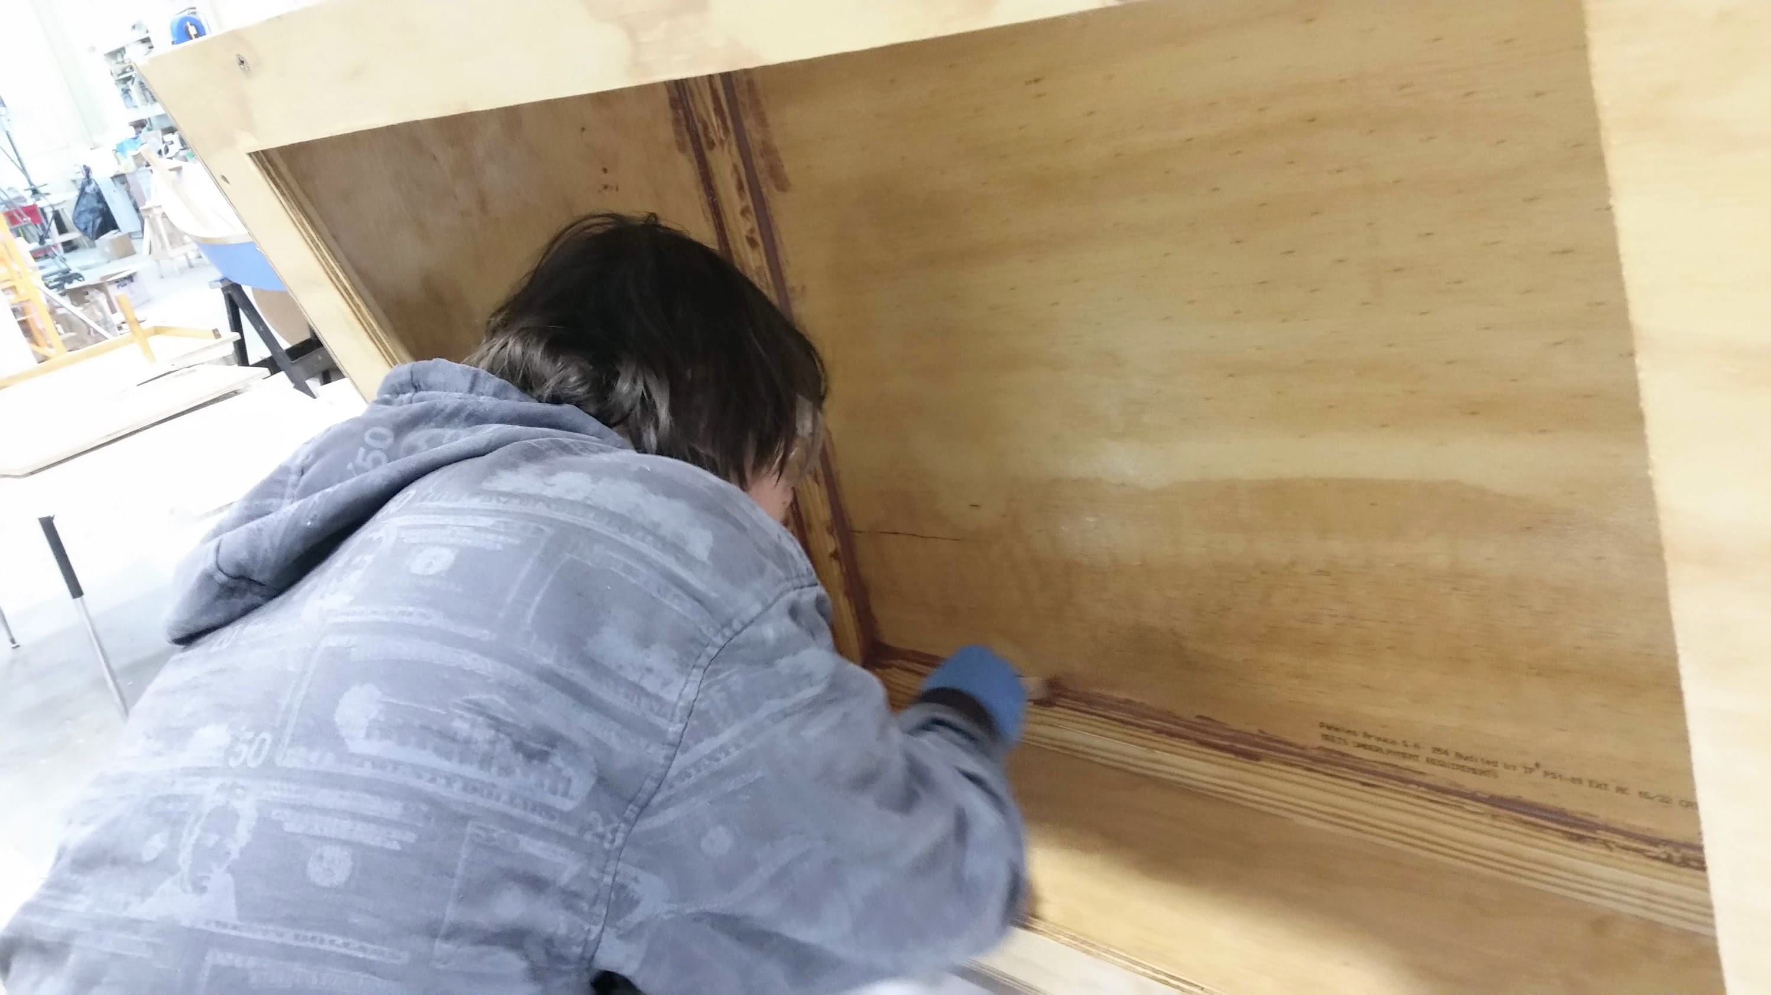
-NAVIGATION
-ARTS of the
SAILOR
-BOATBUILDING
-SAILING
-SAFE BOATING
-FIRST AID - CPR
-MARINE
TECHNOLOGY

Slide 28
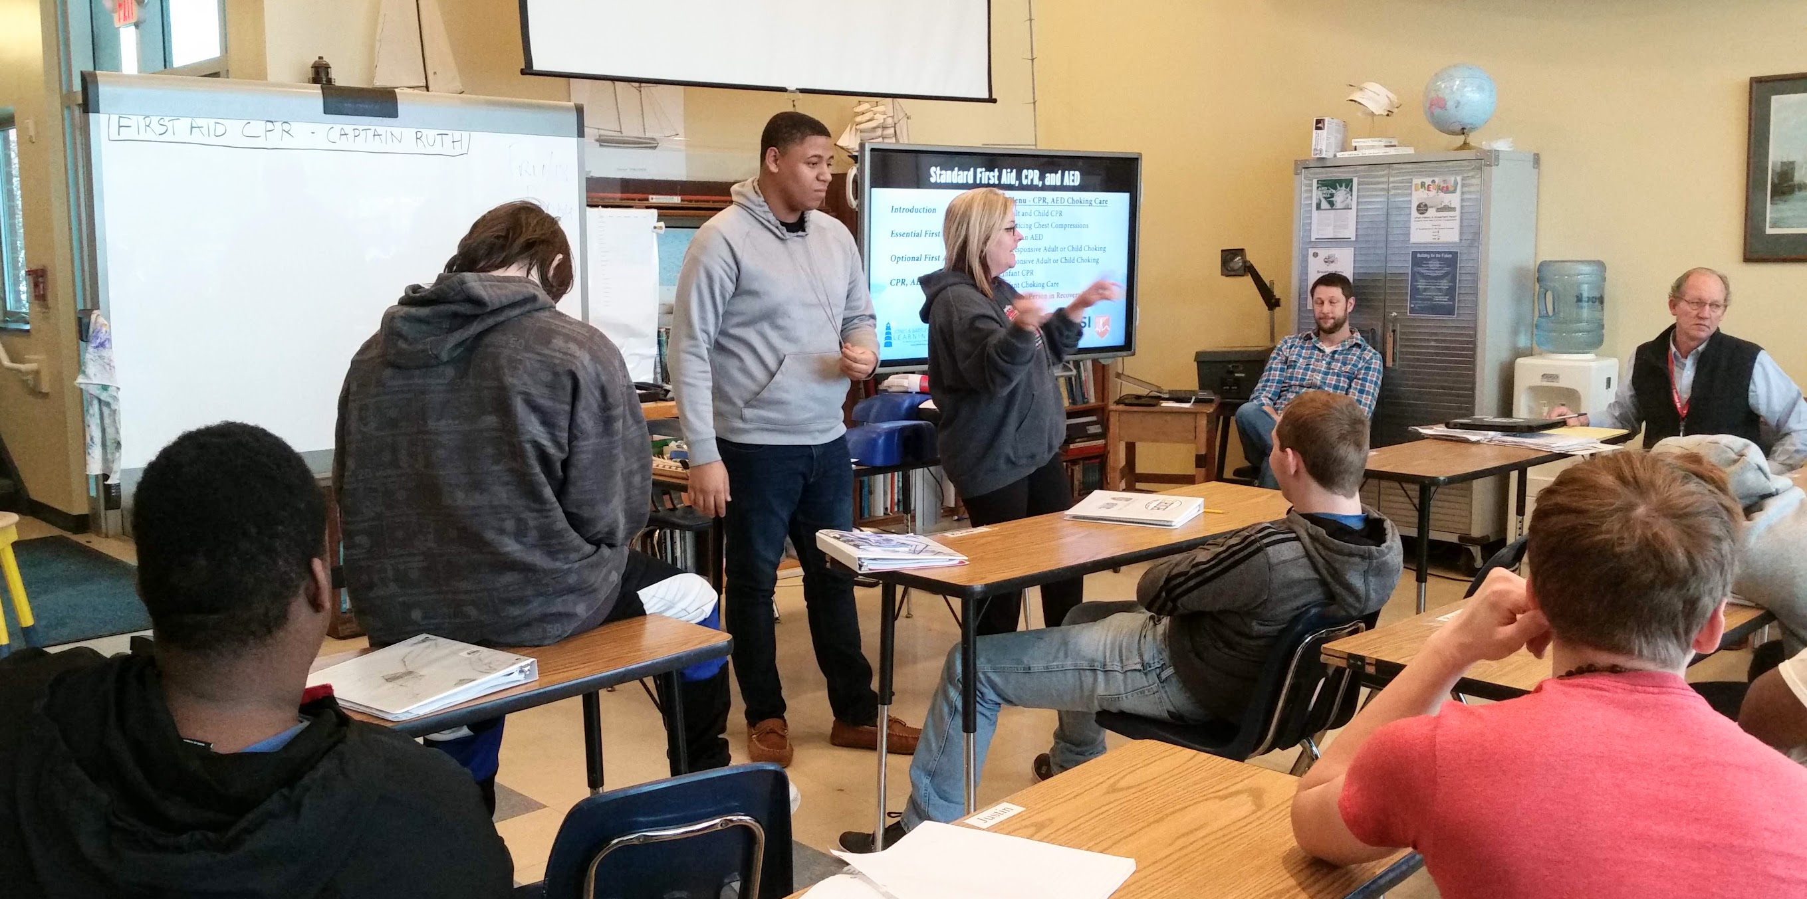
1
FIRST AID – CPR - AED CERTIFICATION

Slide 29
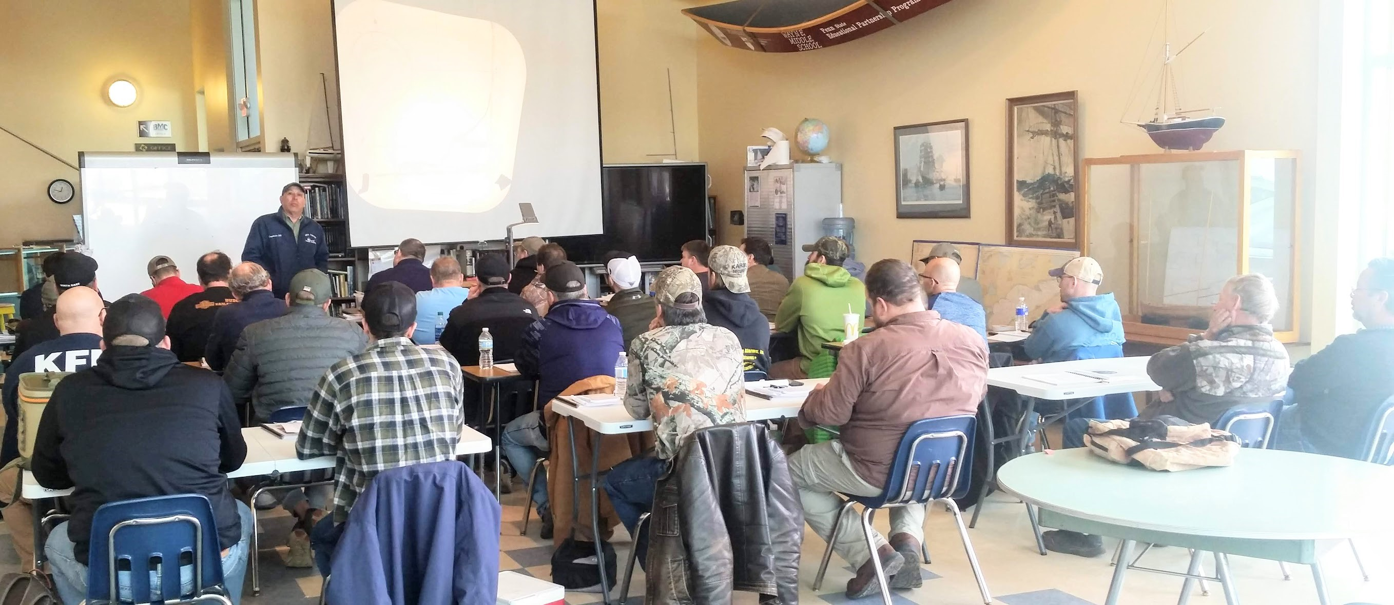
SEA TECH MARINE – DONJON - AUTISM SOCIETY
POWER SQUADRON - BLASCO PUBLIC LIBRARY – MARITIME MUSEUM
LAKESHORE TOWING - PIYC - PORT AUTHORITY – GANNON U -

Slide 30
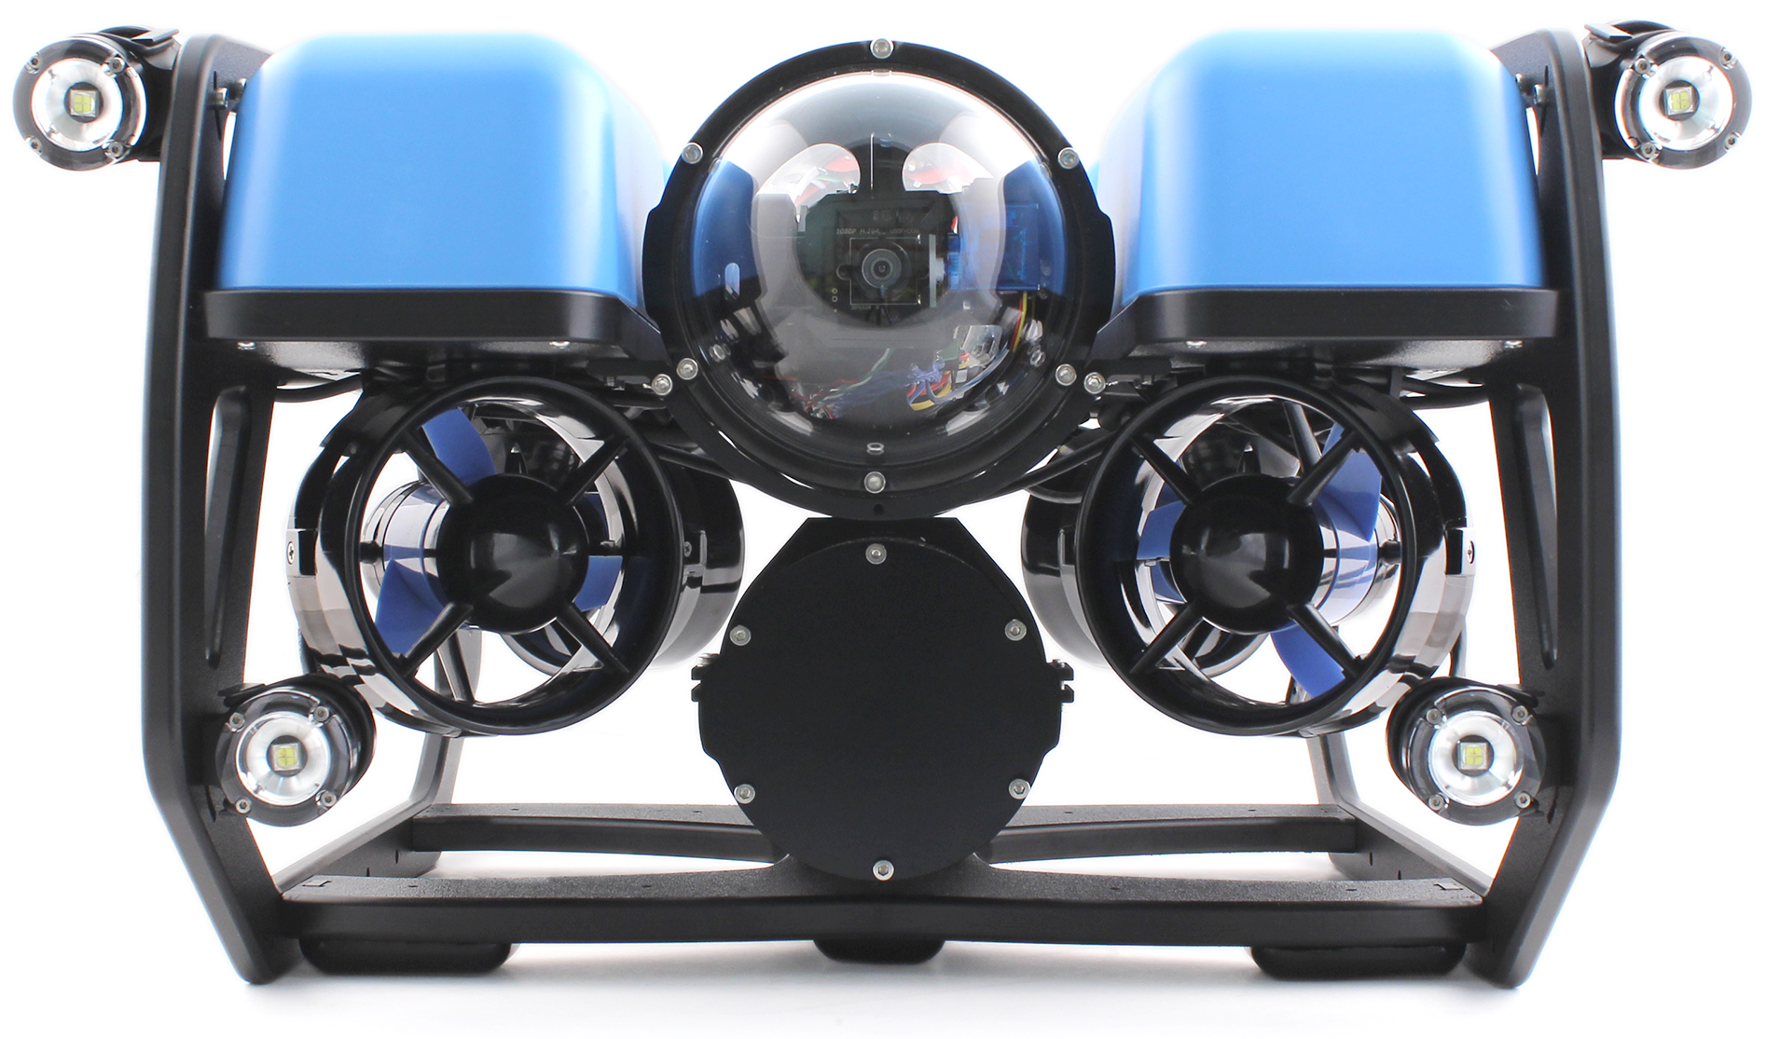
BLUEROV2 Hands-on STEM!
Building the BLUEROV2 underwater robot.

Slide 31
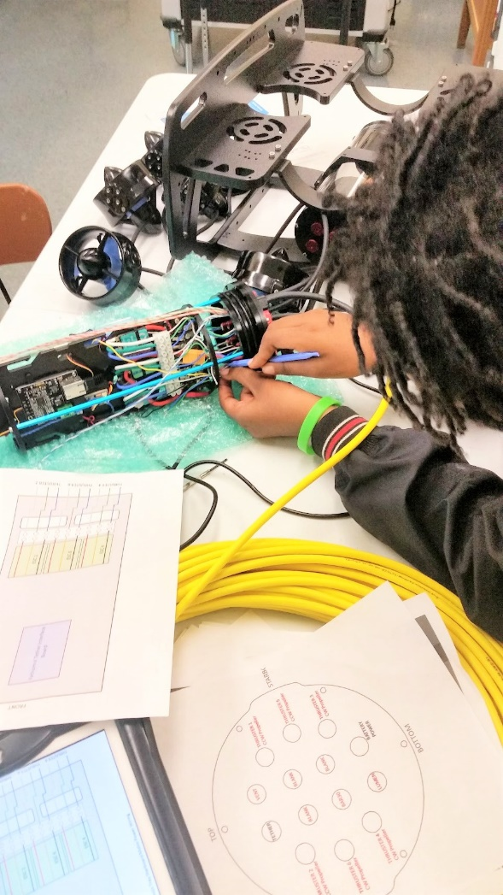
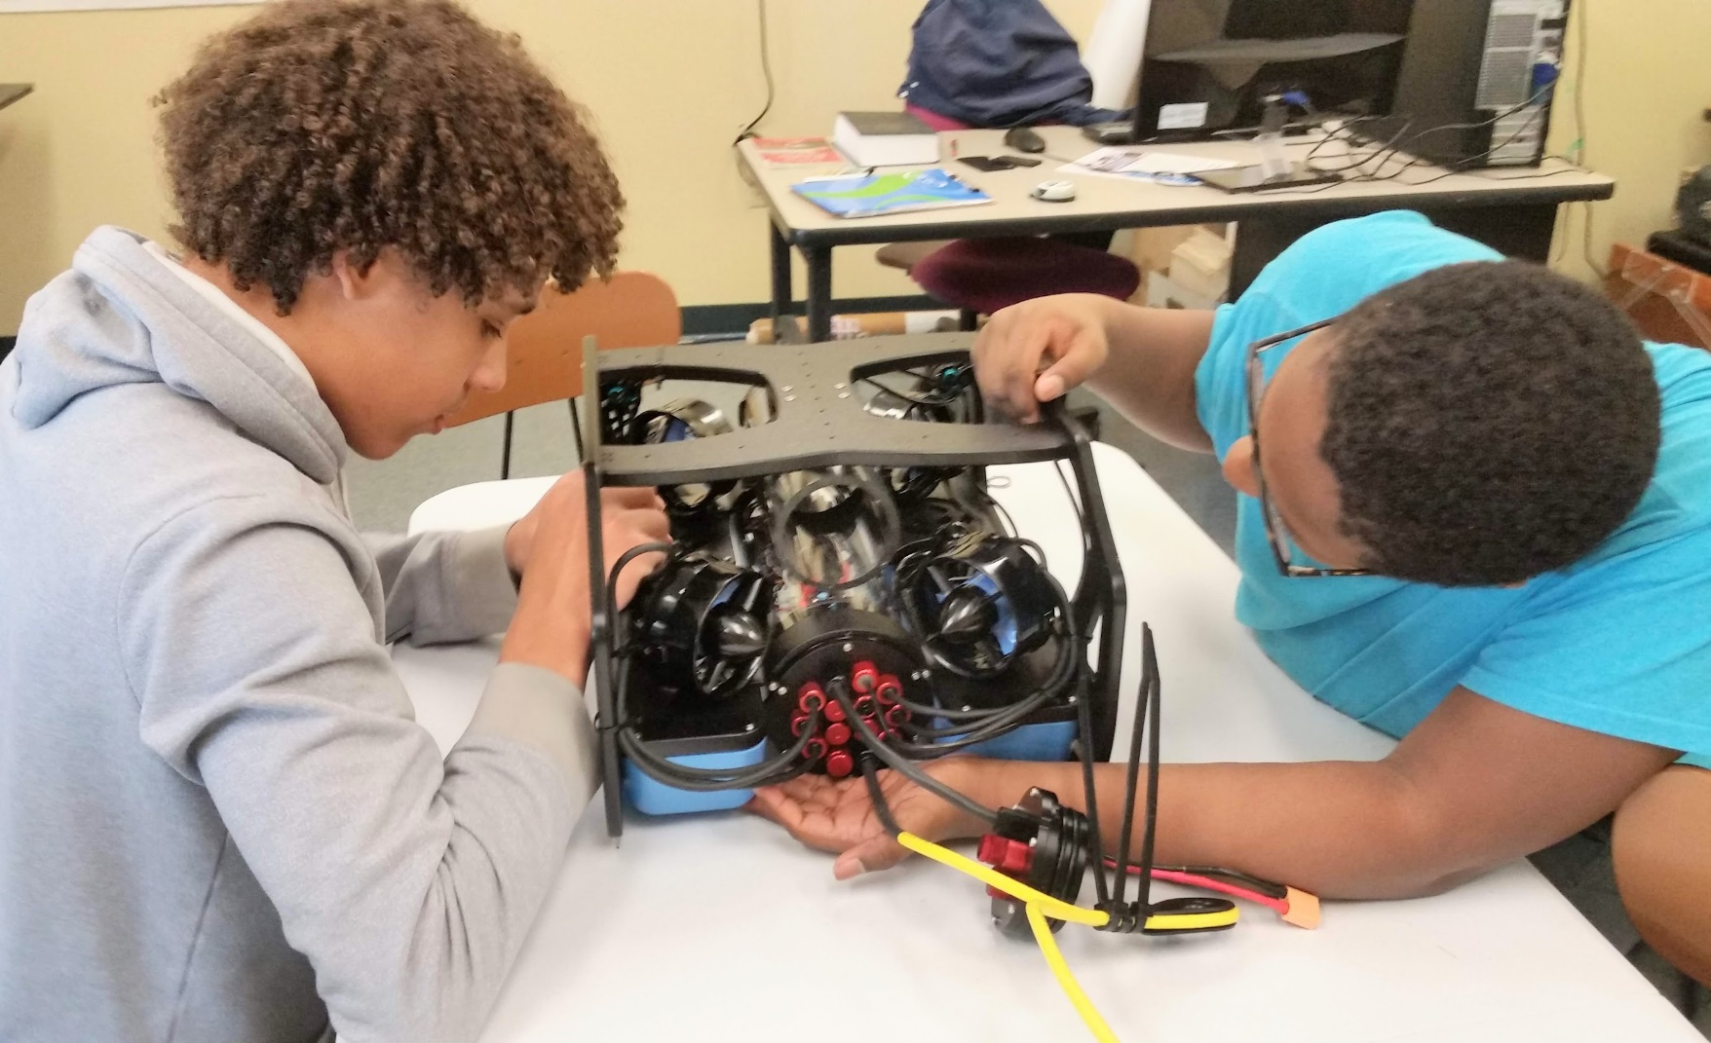
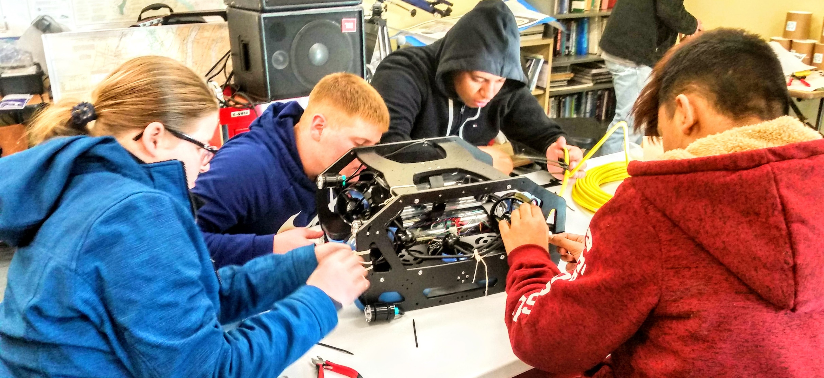

Slide 32
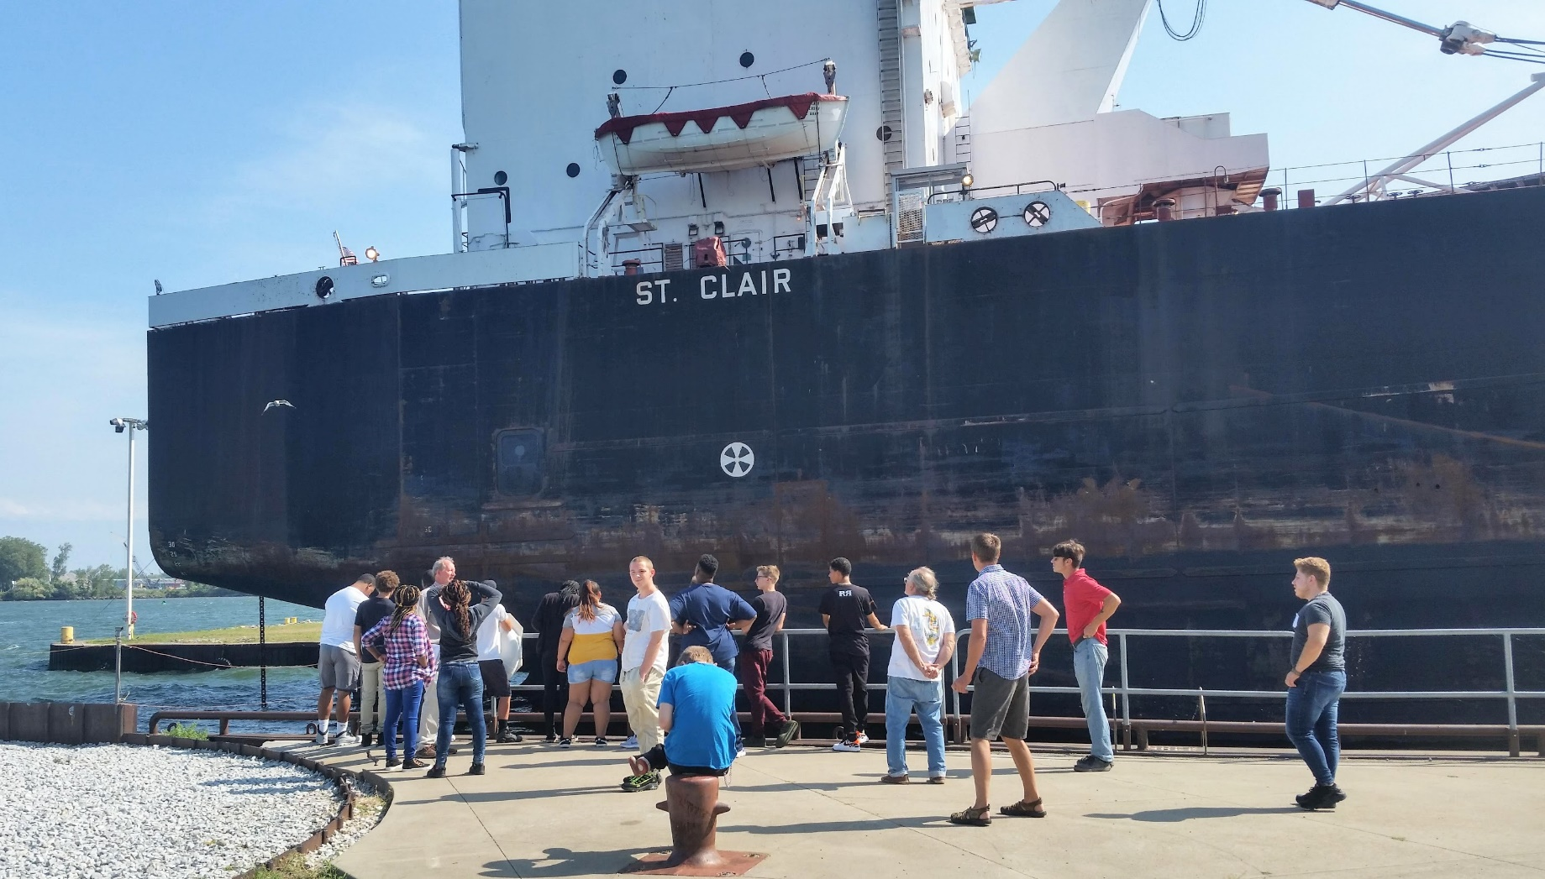
FIELD TRIP

Slide 33
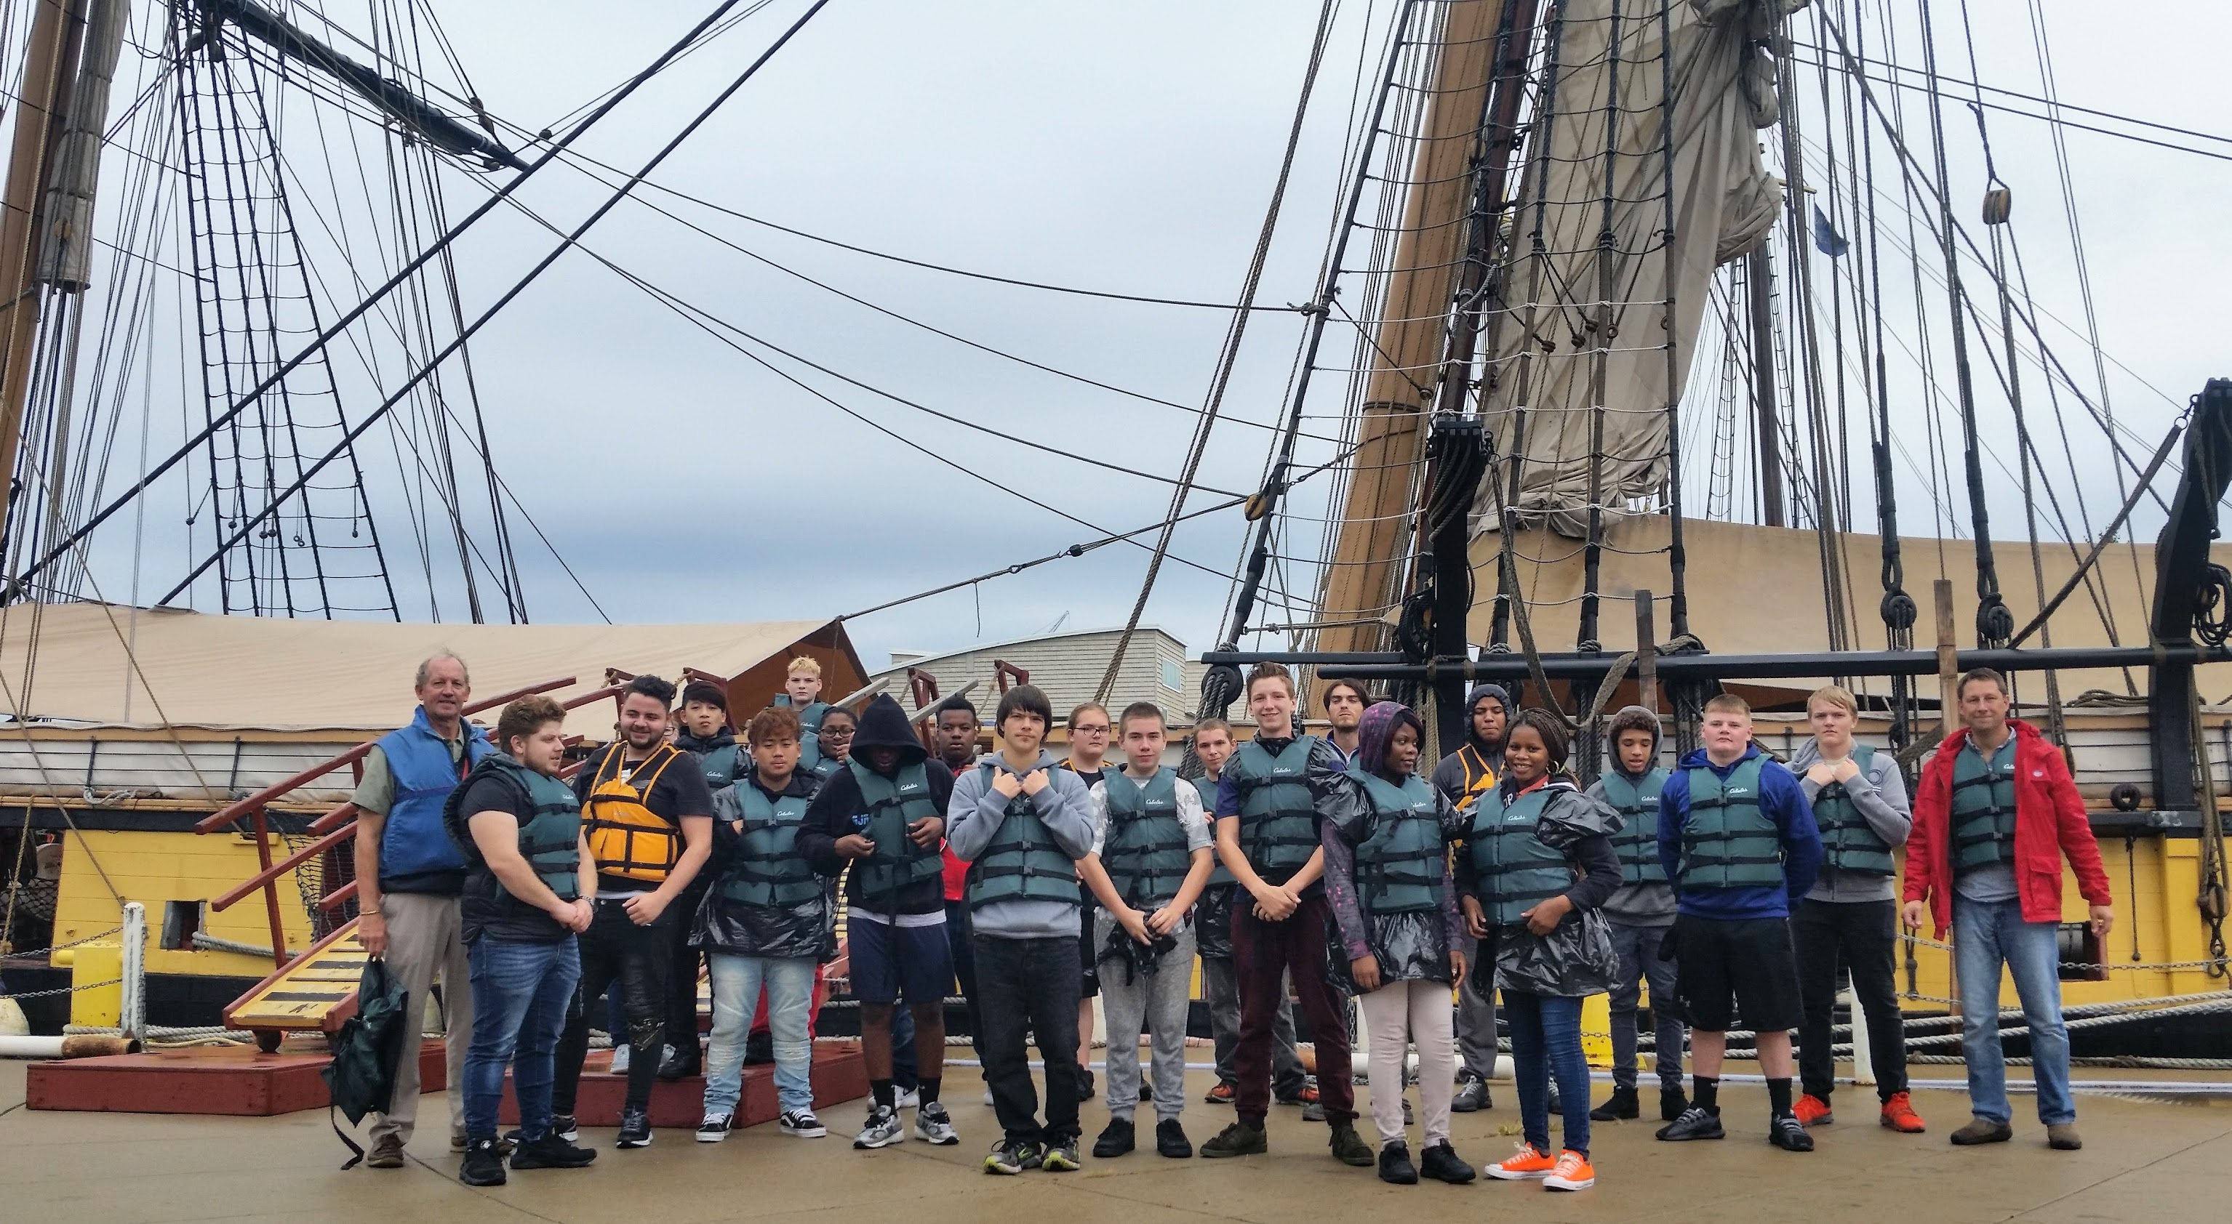

Slide 34
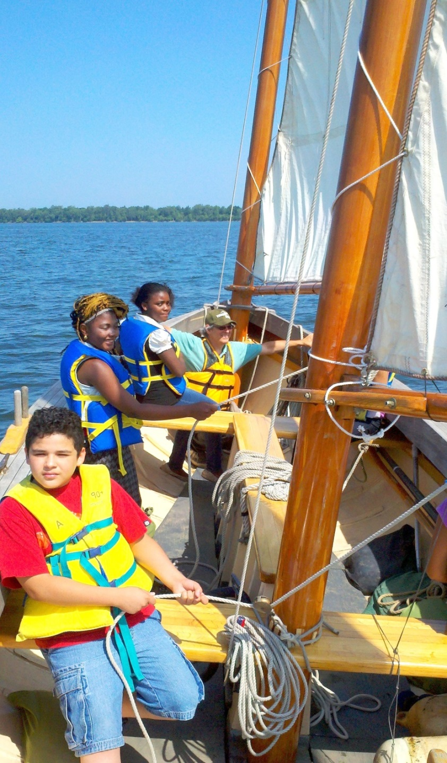
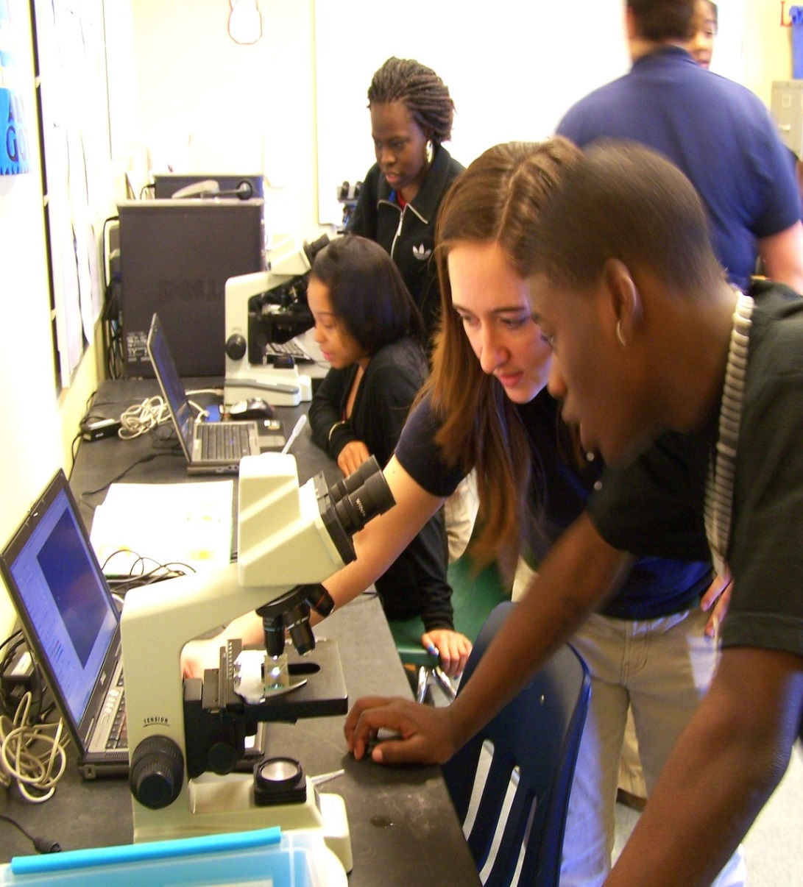
•Teamwork• Problem Solving •Positive Social Skills •Effective Communication •Responsibility •Perseverance •Critical Thinking •Creativity •Leadership •Safety

Slide 35
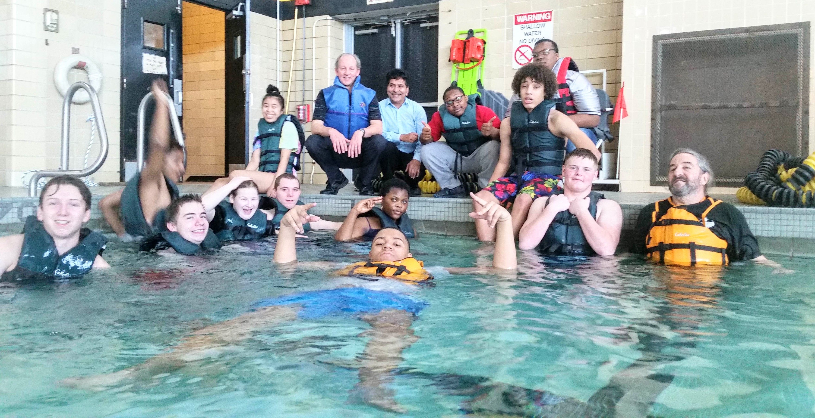
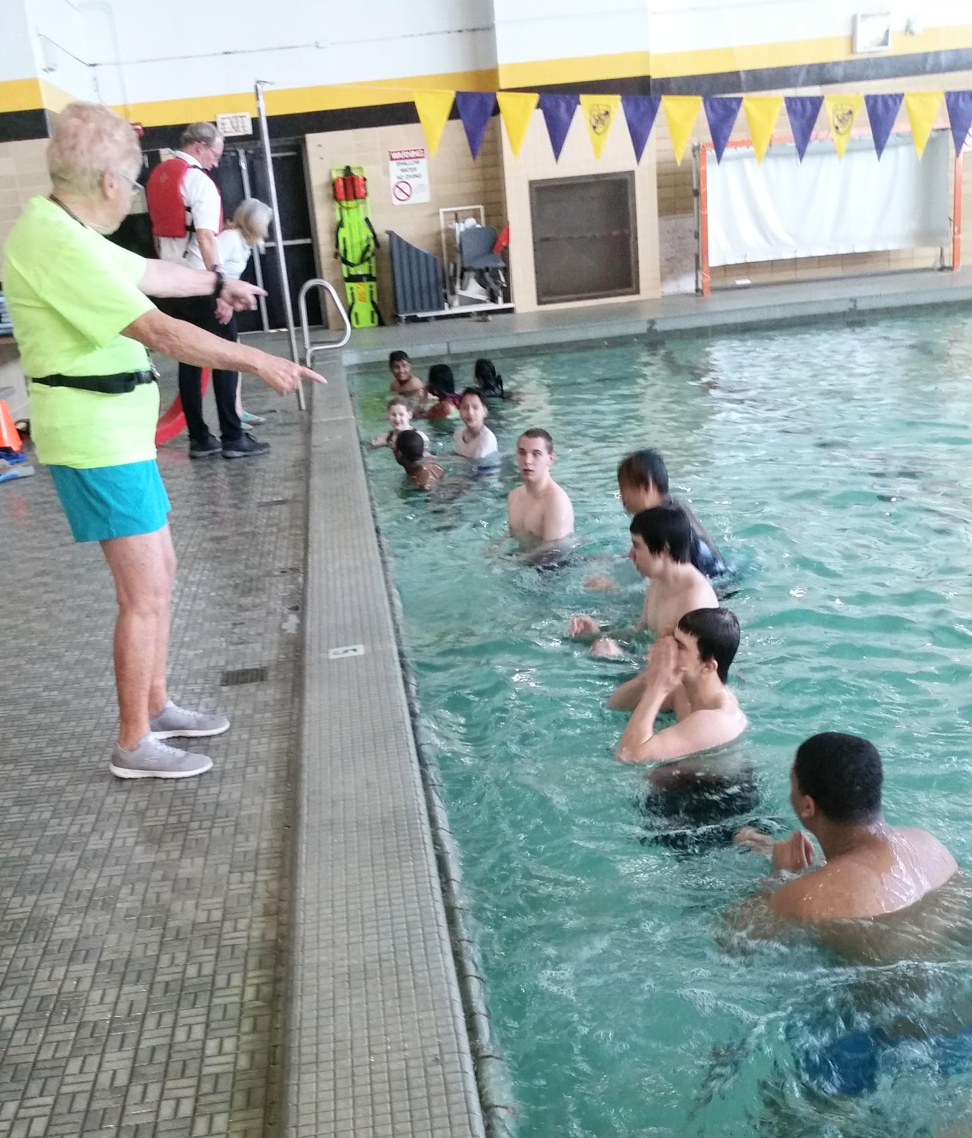
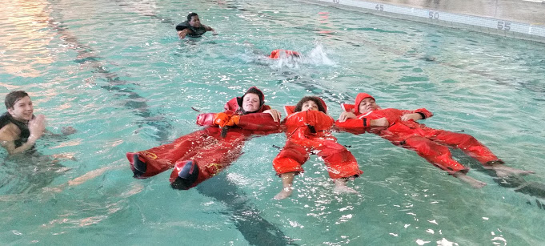
Water Safety and Swimming - Erie High Pool

Slide 36
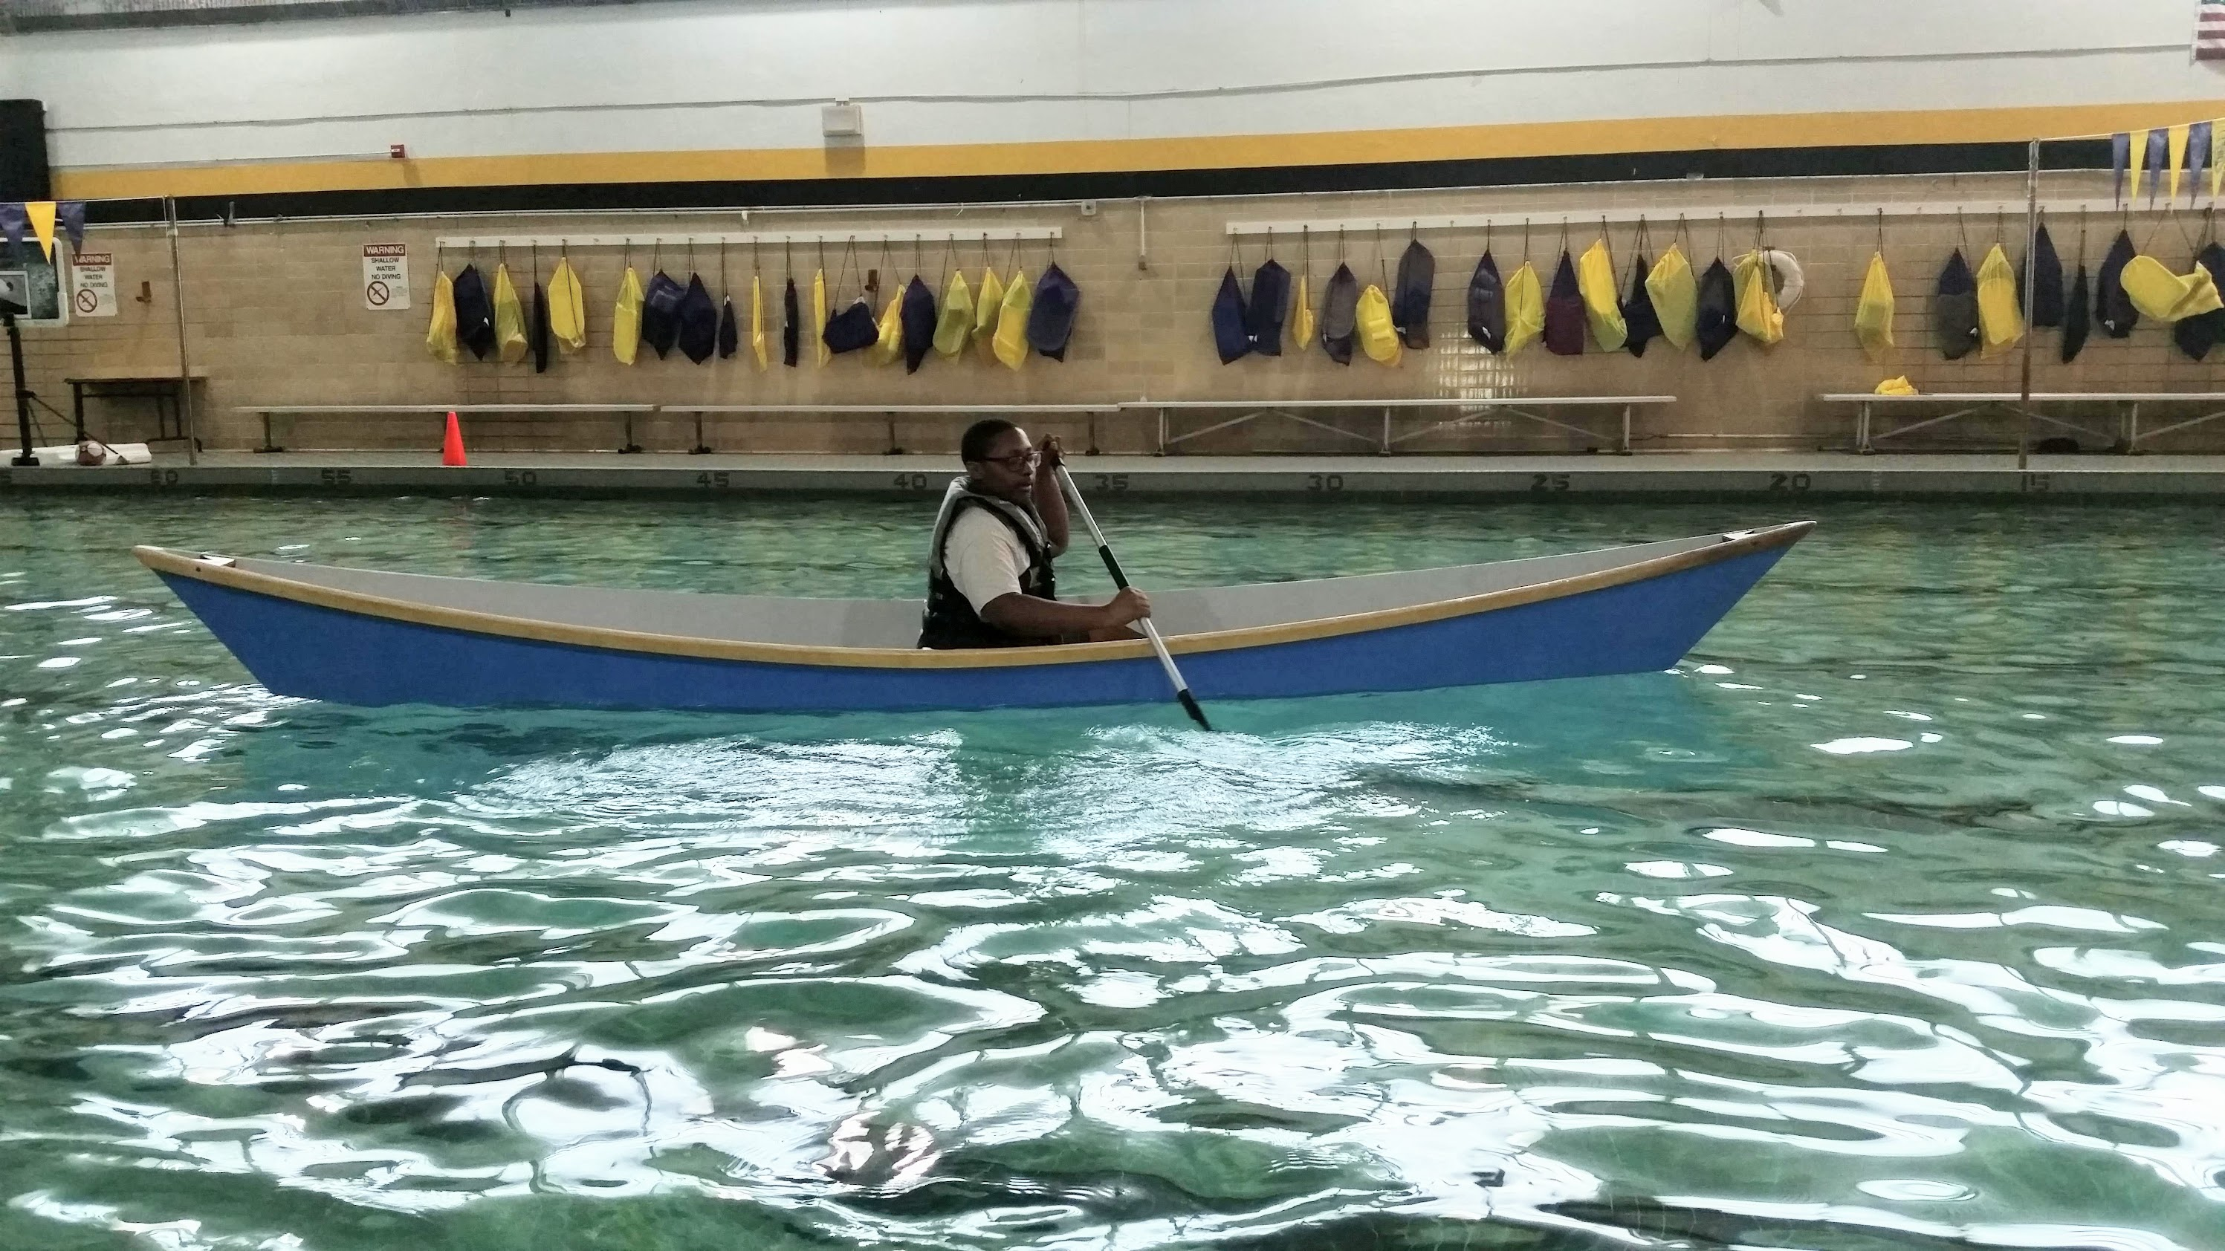
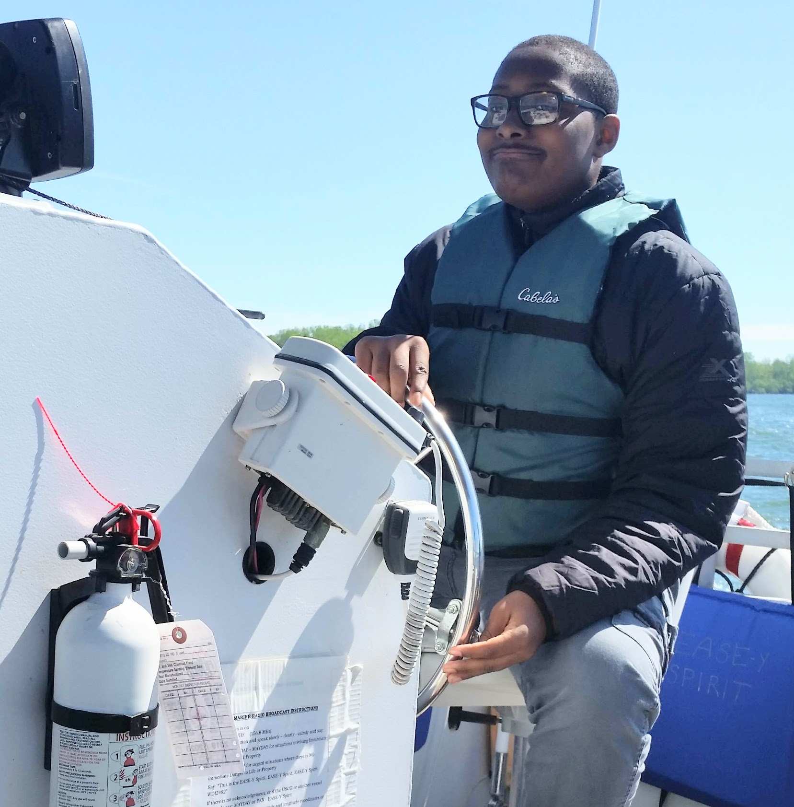
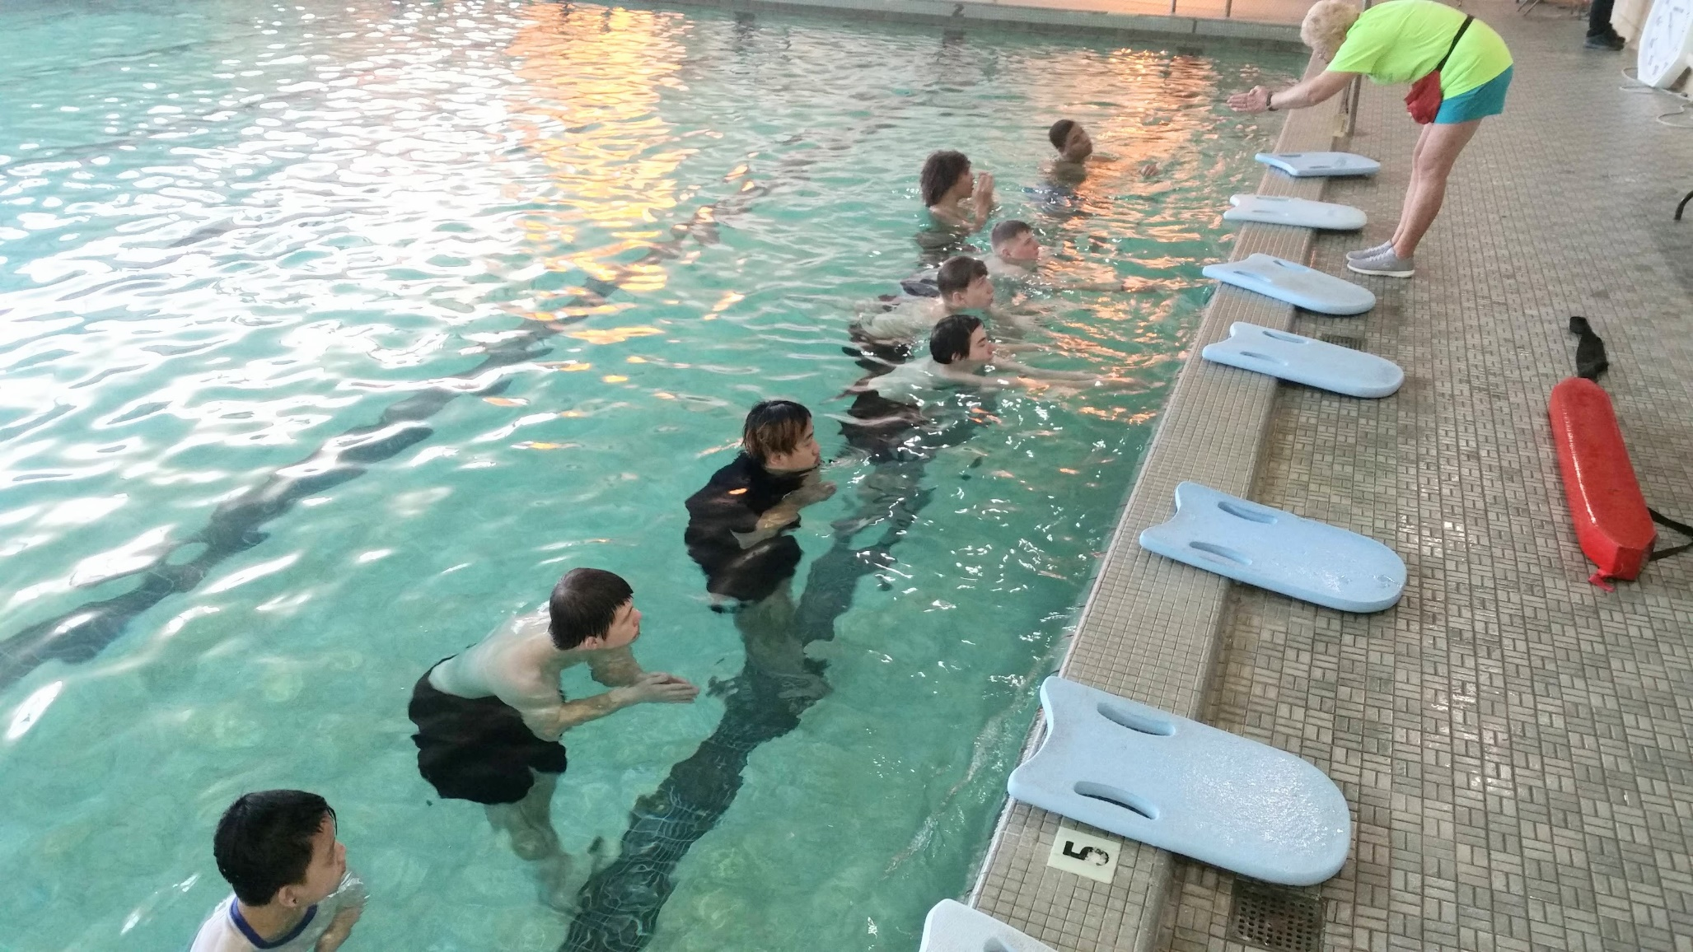
-Getting comfortable in a boat
-Learning to get into a
vessel
-Manuevering a canoe
-Driving a motor boat
-Paddling strokes

Slide 37
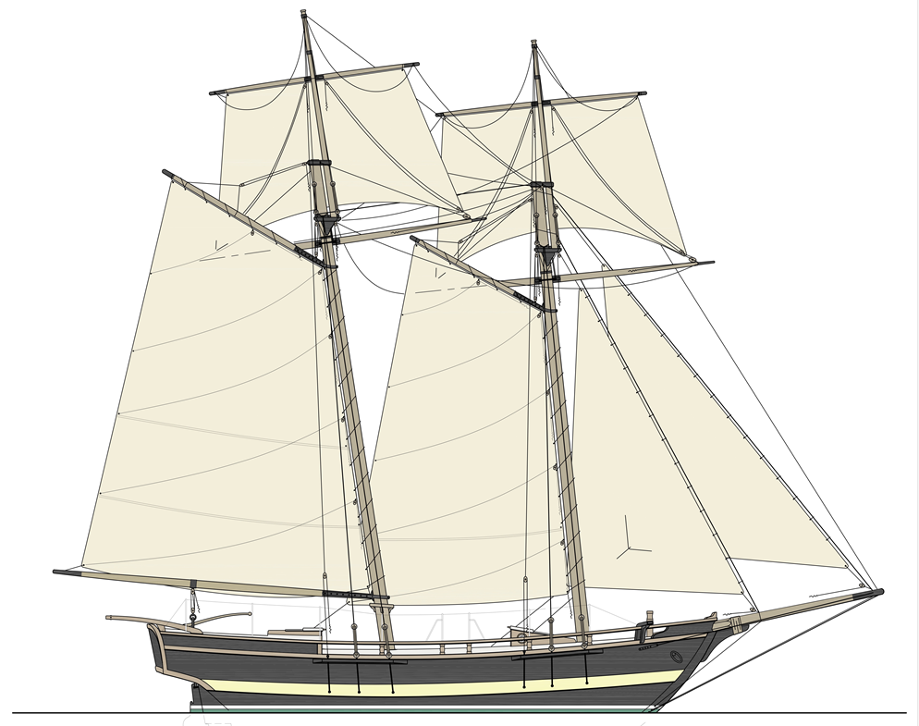
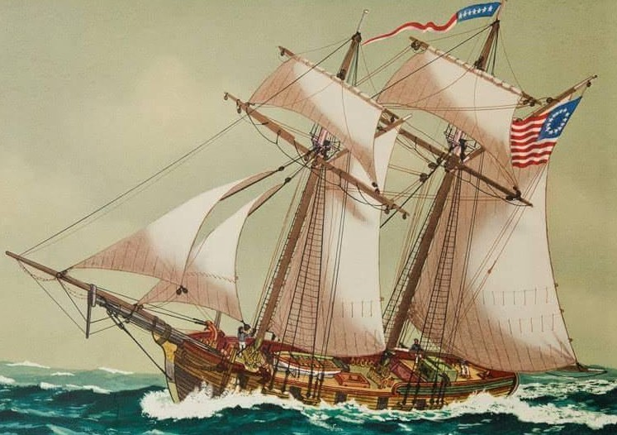
Erie’s 1812 US Navy Gunboat Schooner Porcupine
-Built by Daniel Dobbins
-60 Year Career
-Historic Erie Vessel
Schoolship for Presque Isle Bay
Floating STEM Classroom

Slide 38
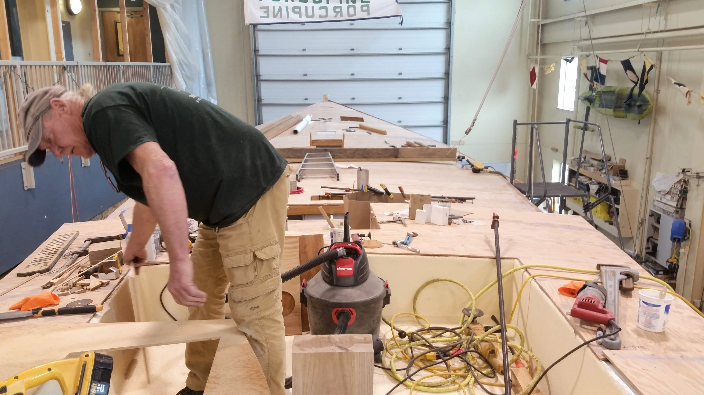

Slide 39
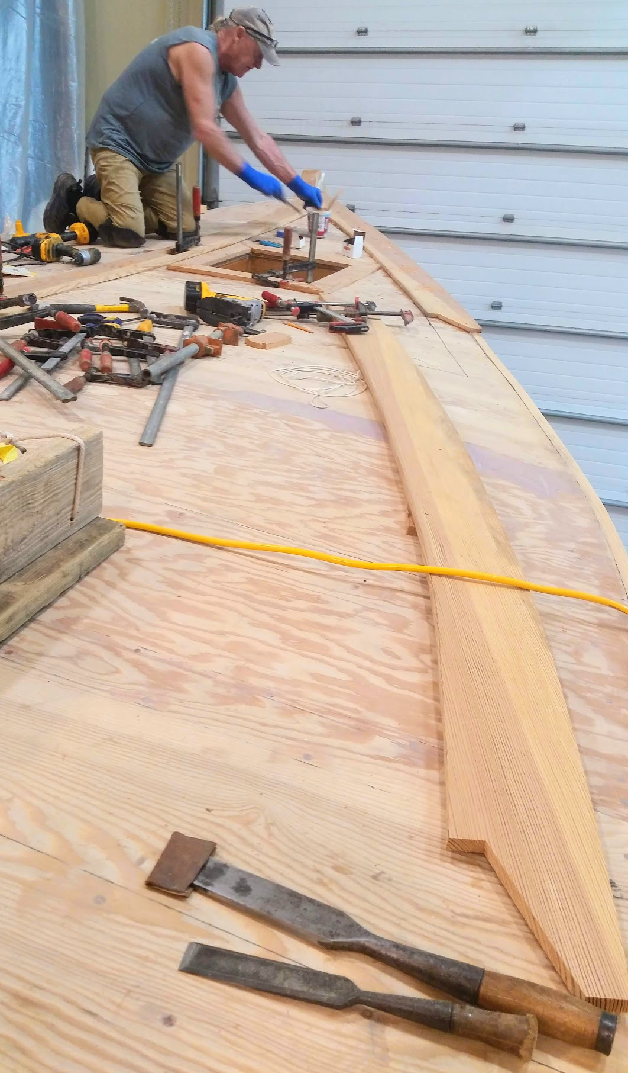




Slide 40



Slide 41




Slide 42

LEARN TO SAIL ON BMC’S HANSA FLEET

Slide 43


Slide 44


Slide 45




Slide 46


Visit BMC to see for yourself.
40 Holland Street ~ Bayfrontcenter.org

