Slide 1
Nonprofit Incorporation 101: Tips, tricks, and things to avoid
nonprofitlaw.com
with Sandra Pfau Englund, Esq. and Drew Englund, Esq.

Slide 2
Organize Properly
Incorporate as a nonprofit corporation
Obtain EIN for corporation
Apply for 501(c)(3) tax-exempt status
Register to fundraise in your state
Apply for sales tax exemption in your state
This Photo by Unknown Author is licensed under CC BY

Slide 3
Incorporate As A Nonprofit Corporation
Incorporating provides
A well-understood legal structure
Additional credibility
Additional liability protection for officers and volunteers

Slide 4
Other Governance Types
LLCs
Complicated, hard to get 501(c)(3) status
B-Corps
Functionally very similar to a nonprofit corporation but not a nonprofit
Unincorporated Association
Serious Liability risks

Slide 5
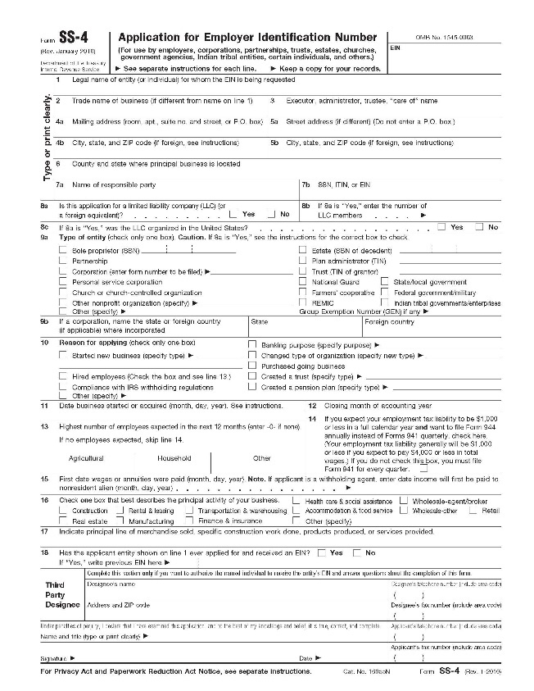
Obtain an EIN
Employer Identification Number or Federal tax ID number
Identifies your group to the IRS
Required to be registered as 501(c)(3) with the IRS
Enables you to open a bank account

Slide 6
Apply for 501(c)(3) Tax-Exempt Status
Provided by the IRS
Form 1023 (or 1023-EZ)
Accept tax-deducible donations
Apply for grants
Eligible for sales tax exemption
May file IRS 990 (no tax on income)

Slide 7
Apply for State Sales Tax Exemption
Many states exempt a 501(c)(3) from sales tax on items purchased for your group.
Some states exempt 501(c)(3)s from collecting sales tax on items your group sells.
Most states require that you apply for these exemptions.

Slide 8
Register To Fundraise In Your State
Required by most states prior to asking for donations
Annual renewal often required
Check your state’s rules for holding “games of chance” fundraisers
Be aware, states are cracking down

Slide 9
Operate Properly
Elect a Board
Adopt Bylaws
Approve an Annual Budget
Ensure proper reporting to federal and state governments

Slide 10
Electing A Board/Adopting Bylaws
Bylaws provide the rules for how your current organization operates
Duties of officers/election process
Meeting guidelines
Budget guidelines
Detailed financial controls

Slide 11
Advisory Boards and Committees
Delegated work from Board of Directors
Allows for individuals with specialized skills and knowledge to take the lead on projects
Should be directed by the Board
Usually no decision-making power

Slide 12
Maintain a Budget
Develop and approve annual budget
Show expected sources of income and line items
Show expected expenses and line items
Track budget to actual
Perform an annual reconciliation/review/audit.
A good use of a committee or advisory board

Slide 13
Exercise Good Reporting / File Required Documents
IRS 990-series return
State annual corporate report
State annual fundraising report
State sales tax exemption renewal
School district reports

Slide 14
ORGANIZE PROPERLY
Incorporate
Obtain EIN
Apply for 501(c)(3) status
Apply for state tax exemption
Register to fundraise with state
OPERATE PROPERLY
Elect officers
Adopt/review/amend bylaws
Adopt budget
Report to members regularly (budget, programs)
File required reports
IRS 990-series return – based on fiscal year end
State corporate report
State sales tax renewal
State fundraising registration
Know your fiscal year dates
Adopt financial controls
Conduct annual financial review
Ensure your fundraisers support your tax-exempt mission
Check your bank accounts – update signature cards, ensure two signatories
Maintain minutes of all board, committee, and other meetings

Slide 15
nonprofitlaw.com

