Slide 1
Teaching With Small Boats Conference
Northwest Maritime Center
Small Boats in Historical Context, April 30, 2015
40 Holland Street
Erie, Pennsylvania
Bayfrontcenter.org

Slide 2
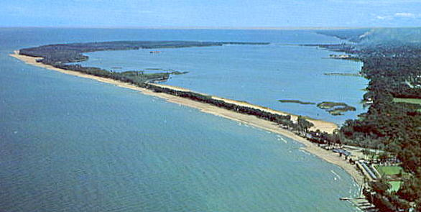
Presque Isle State Park and Presque Isle Bay in Lake Erie, at Erie Pennsylvania

Slide 3
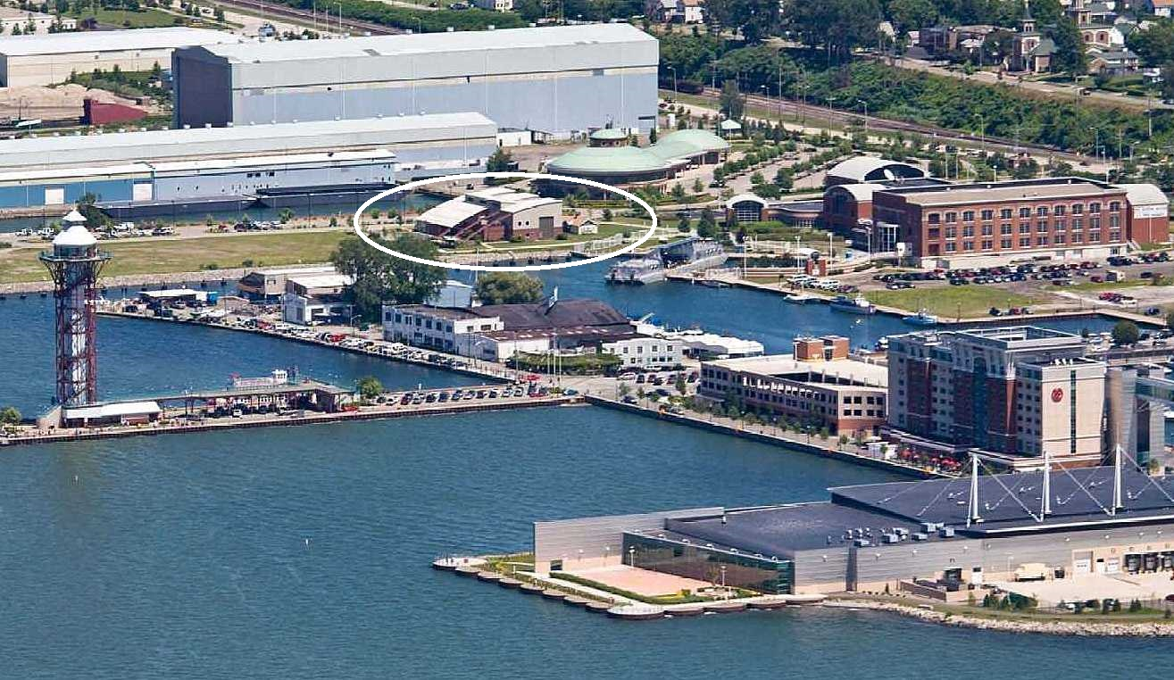
Erie, Pennsylvania Bayfront and East Canal Basin

Slide 4
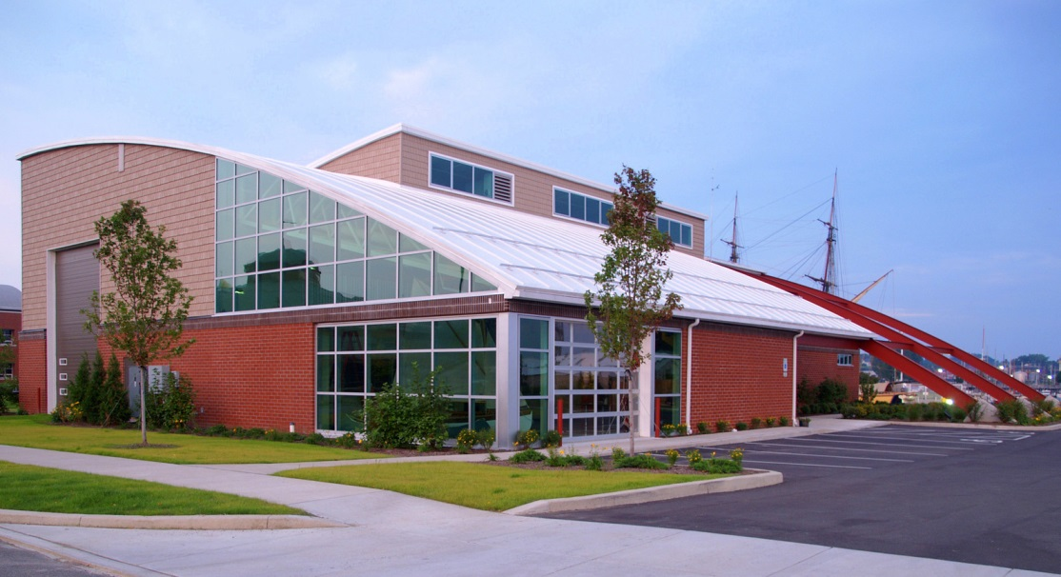
BMC’s mission is: To design and implement hands-on, maritime themed, educational, vocational and recreational activities for the community in a universally accessible waterfront facility.

Slide 5
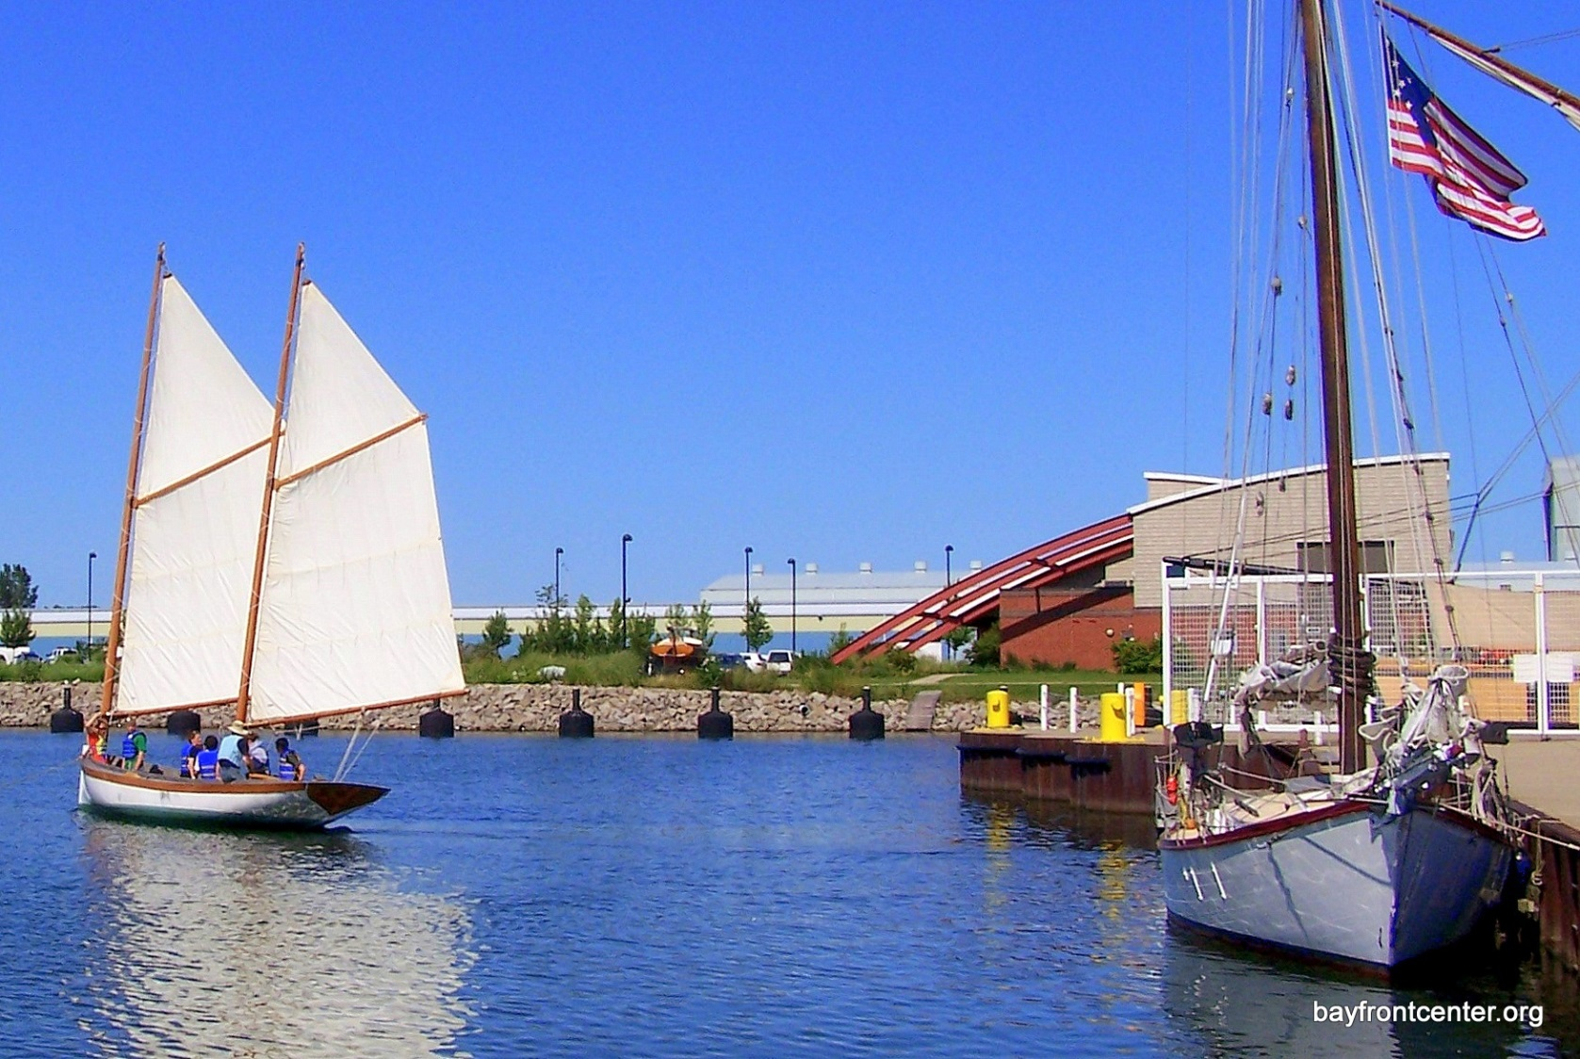
ERIE BOAT SAILING IN EAST CANAL BASIN

Slide 6
BMC’s PRIMARY PROGRAMS
→ Bayfront Alternative Education Program (BAEP)
Partnership: Bayfront Maritime Center & Sarah A. Reed Children’s Center
Erie School District
Provides effective and therapeutic learning opportunities
→ EASE, the Erie Adaptive Sailing Experience
First & only adaptive sailing program in Pennsylvania
→ Veterans At EASE
Assist veterans suffering from Post-Traumatic Stress Disorder (PTSD)
→ Project SAIL
Positive after-school activities for teens (job skills development)
→ Community Rowing Program (launched 2013)
→ Bayfront Summer Program (Award winning)
Educational opportunities for the children of migrant workers, immigrants, refugees

Slide 7
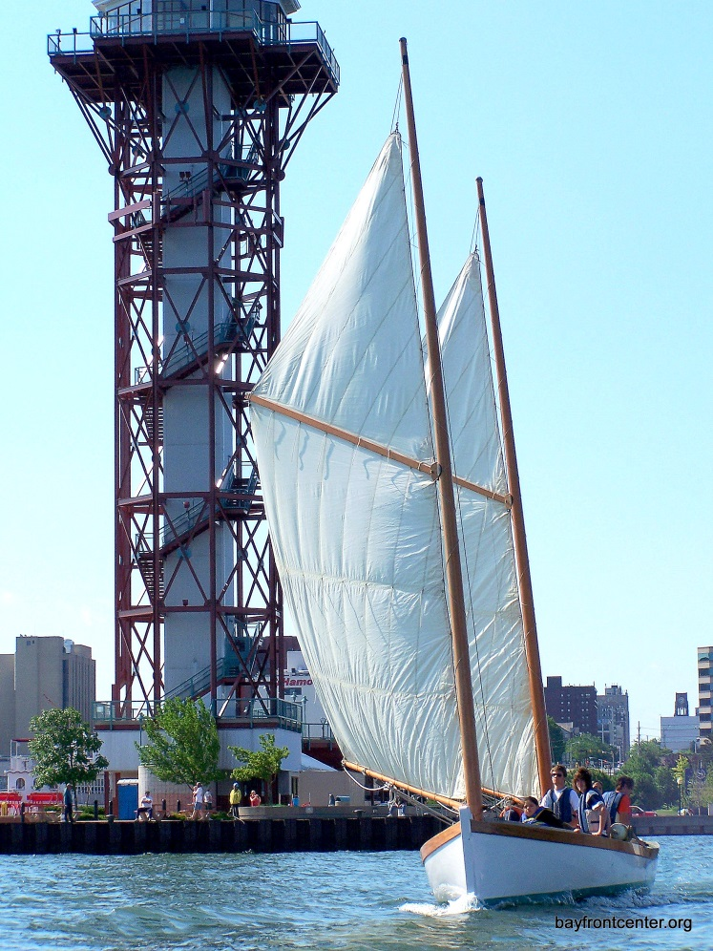
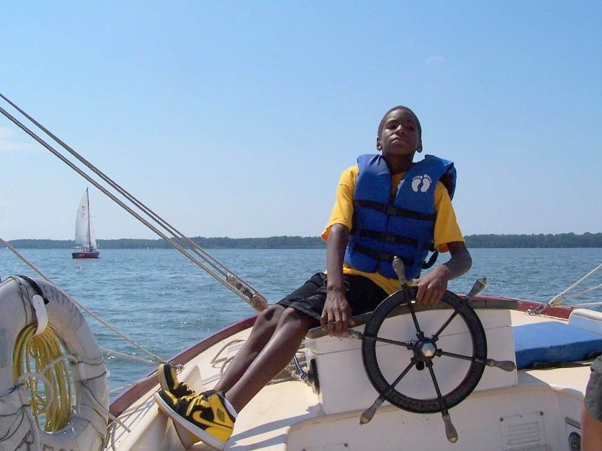
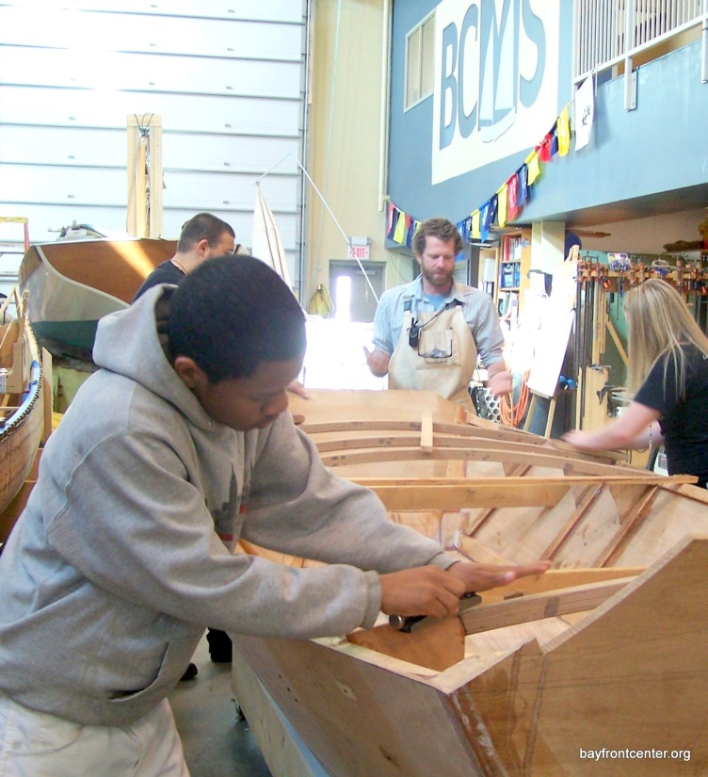
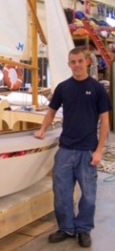
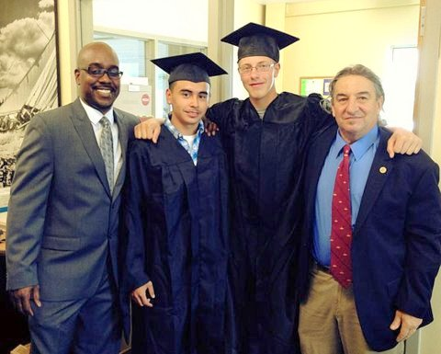
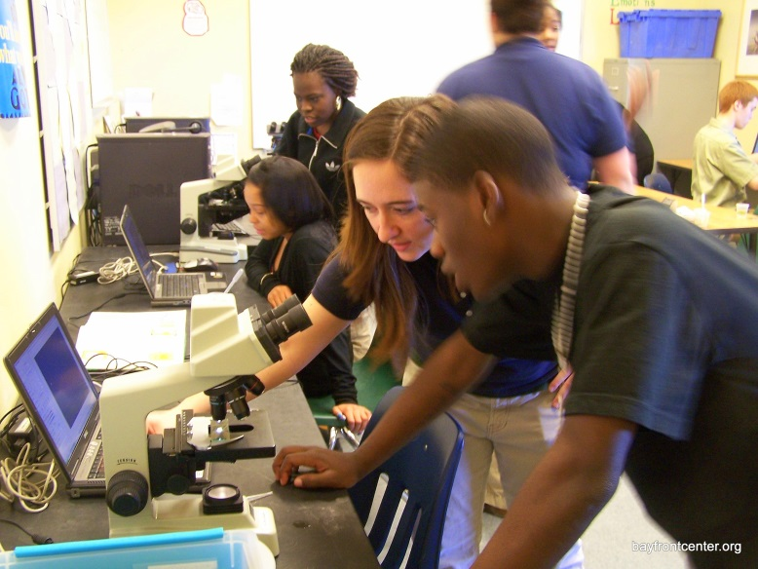
TEAMWORK
CONFIDENCE
PERSEVERENCE
17,000 KIDS
92 BOATS
RISING GRADUATION RATES
STEM-FOCUSED CURRICULUM
MARITIME CAREERS

Slide 8
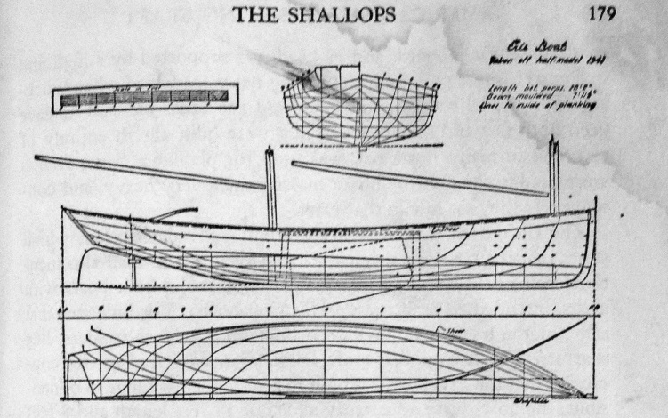
Erie Boat Lines
American Small Sailing Craft Howard Chapelle

Slide 9
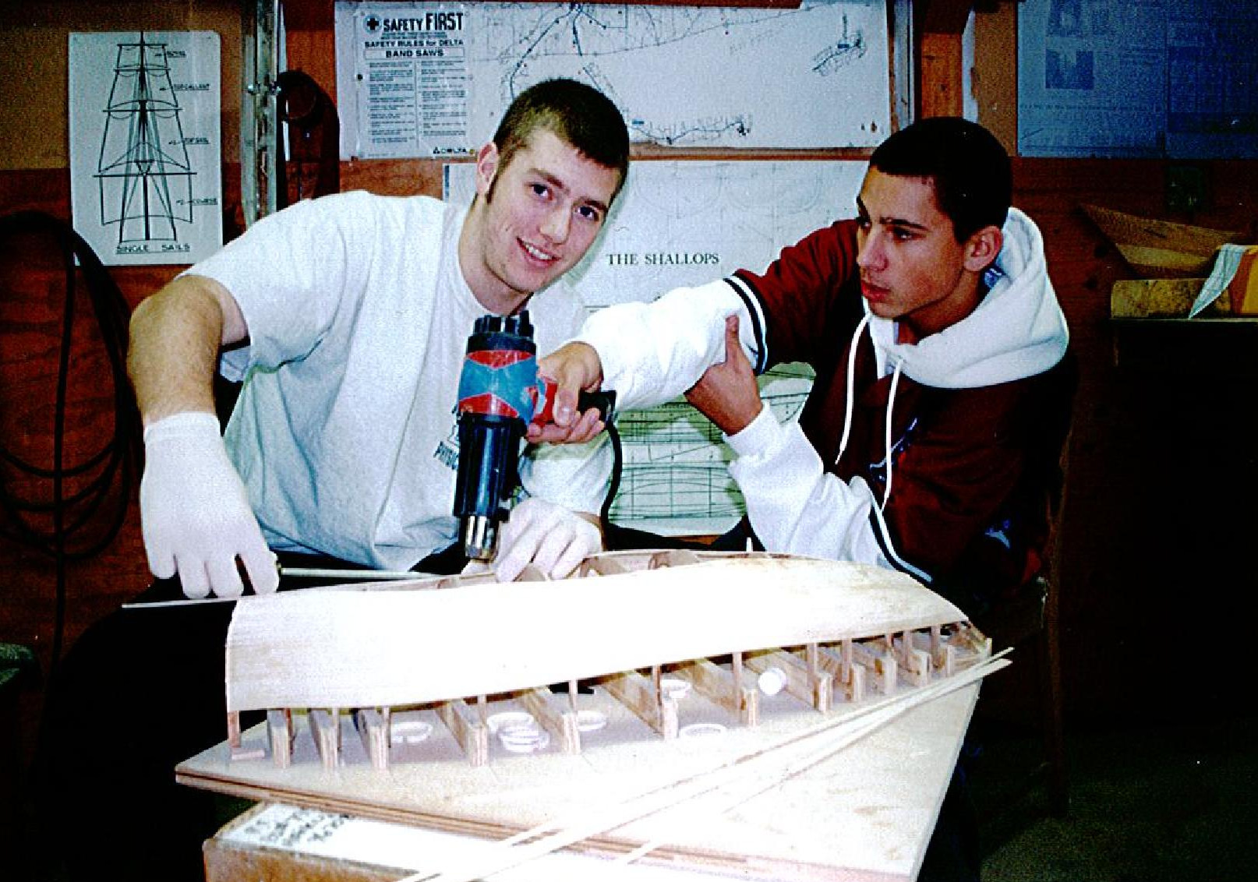

Slide 10
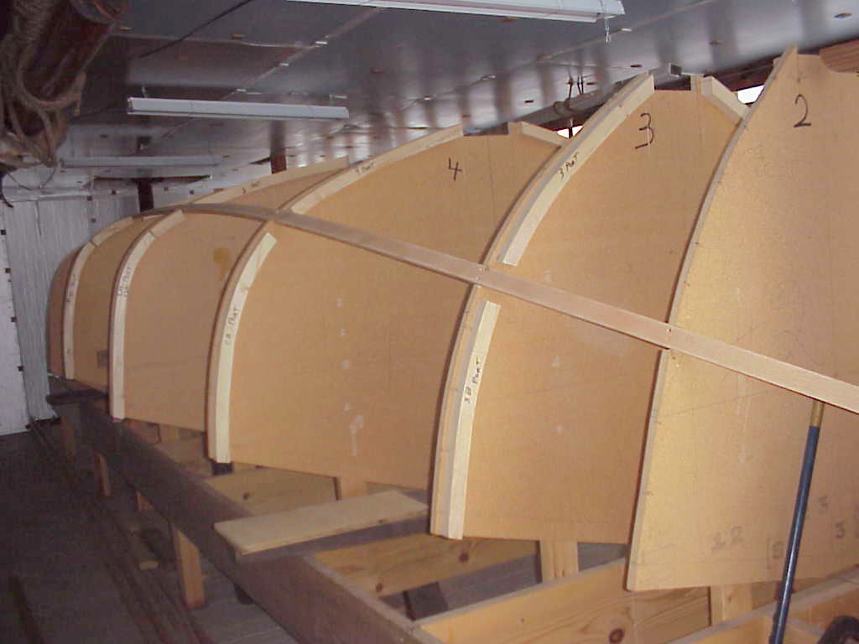

Slide 11
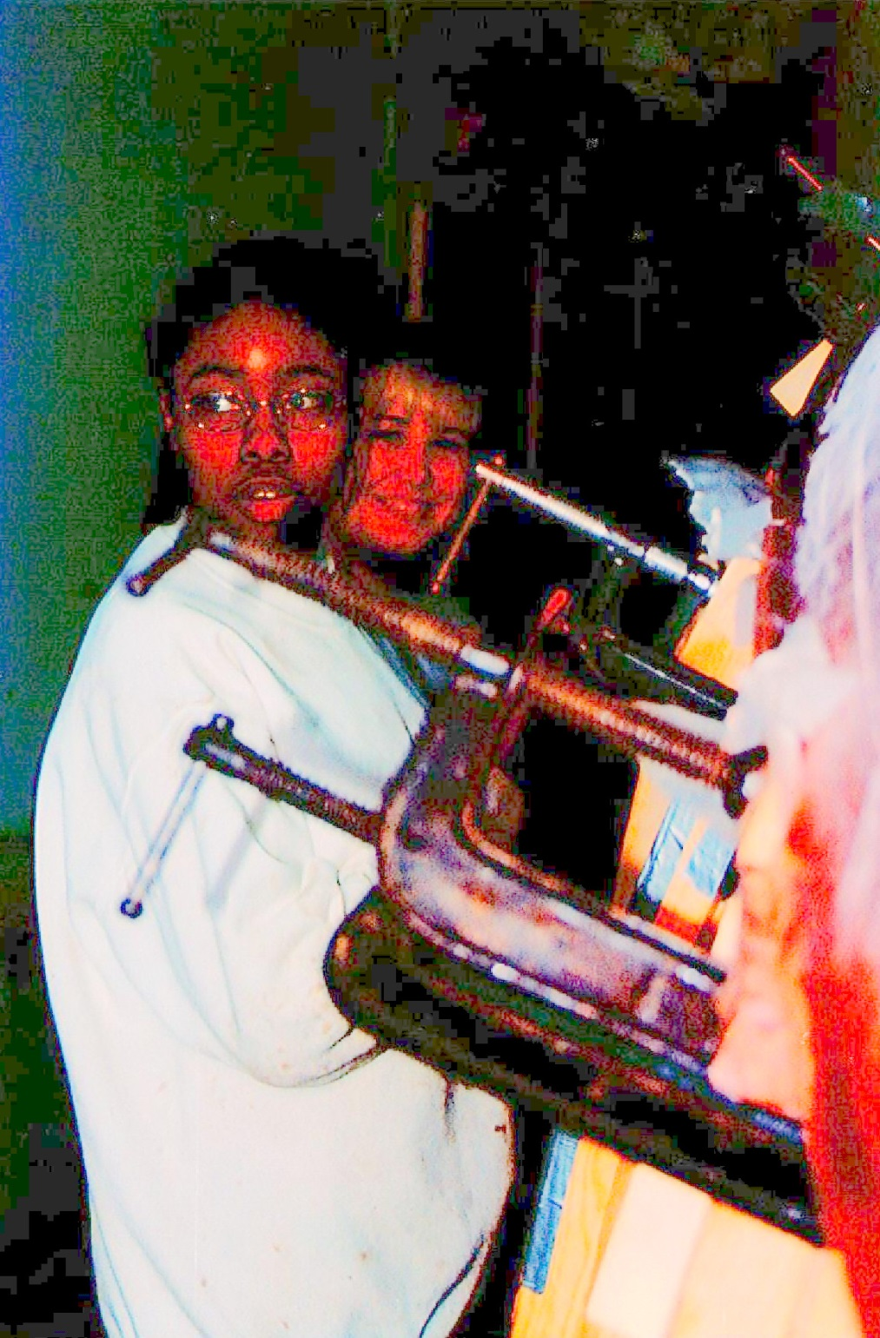

Slide 12
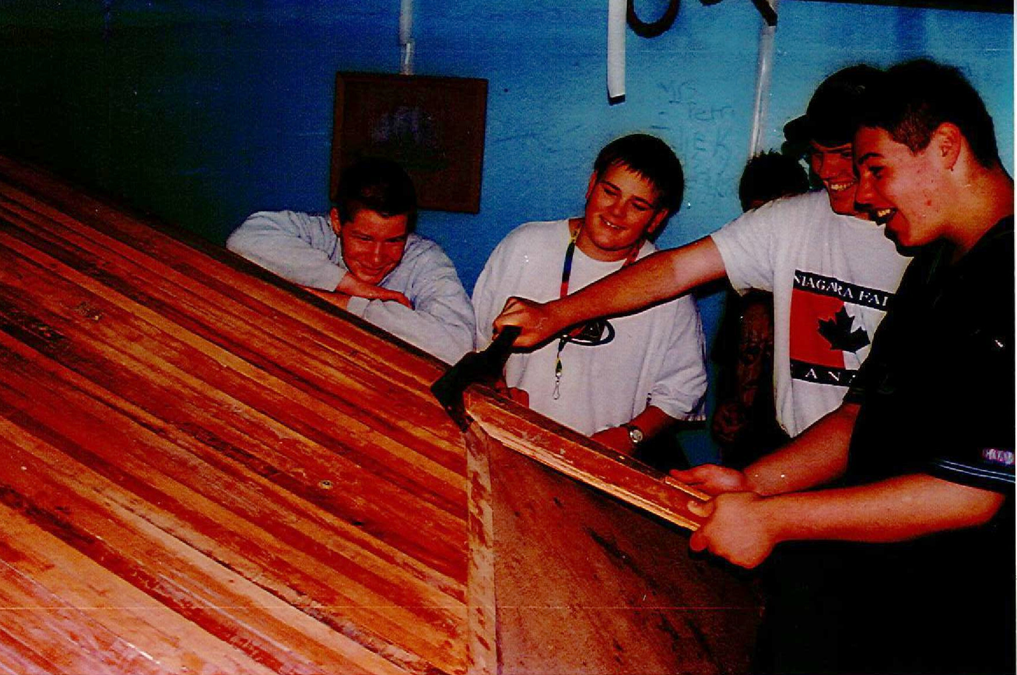

Slide 13
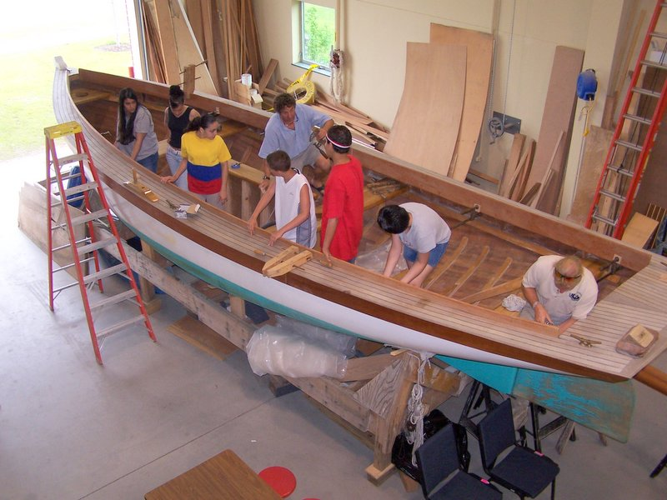

Slide 14
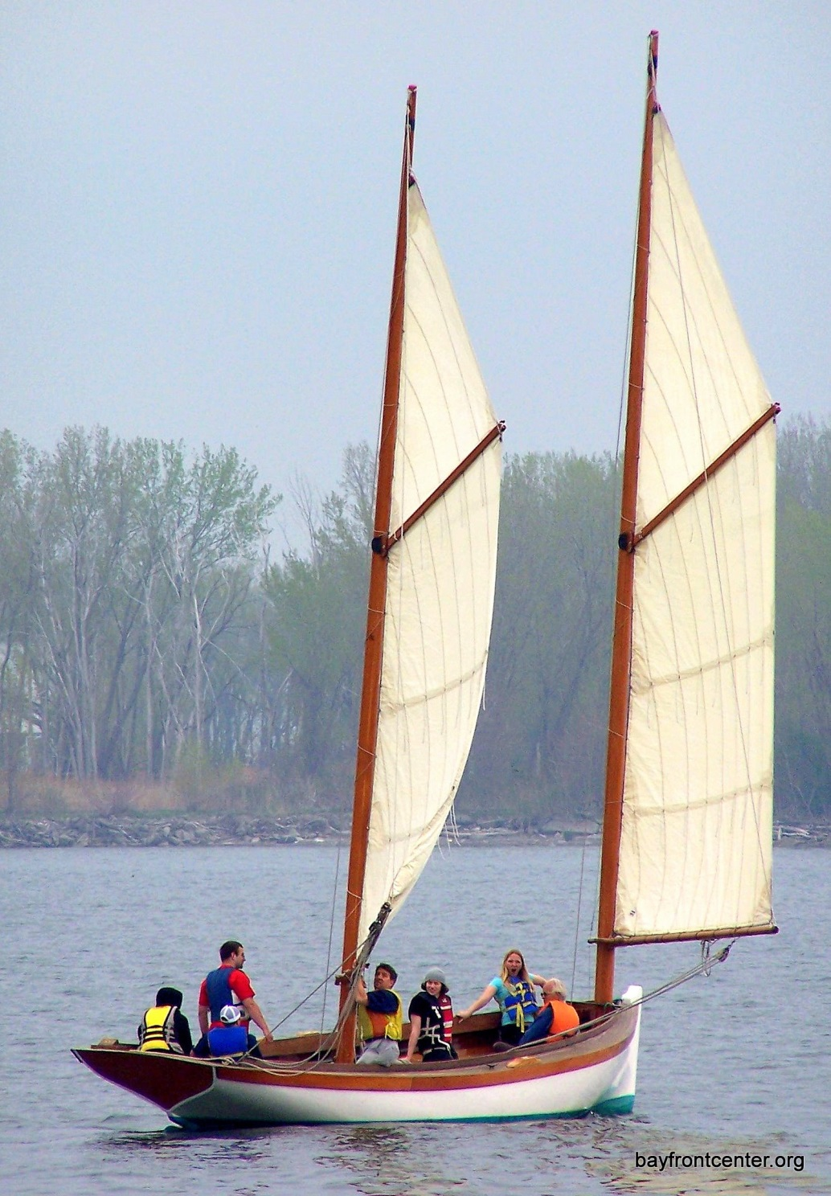

Slide 15
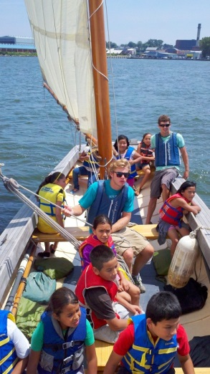

Slide 16
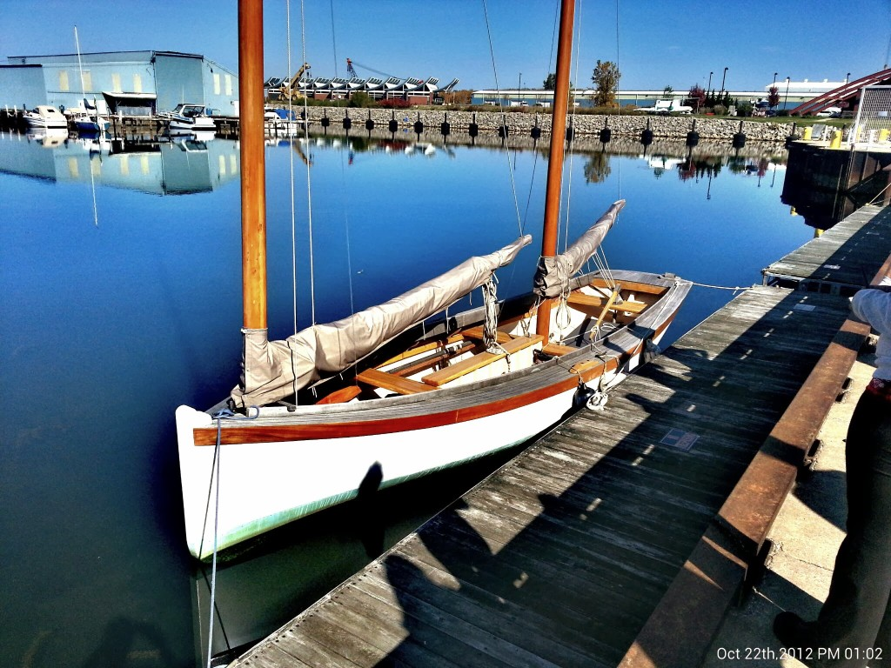

Slide 17
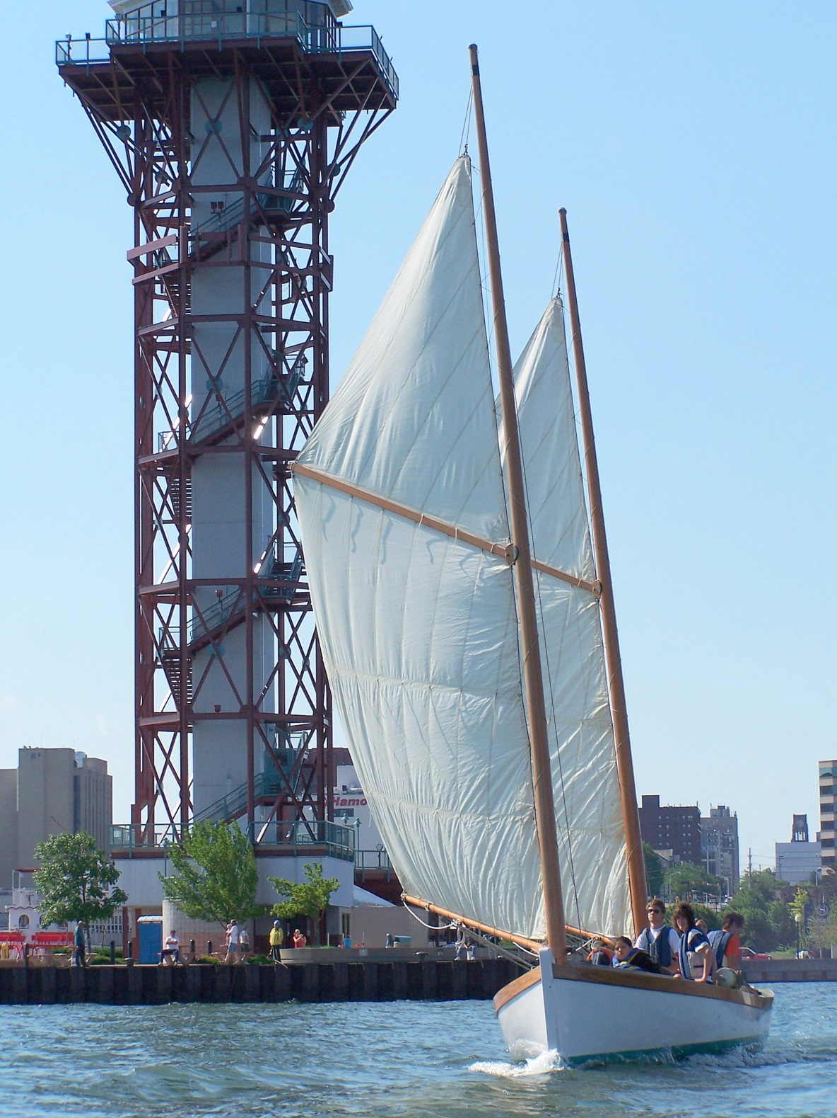

Slide 18
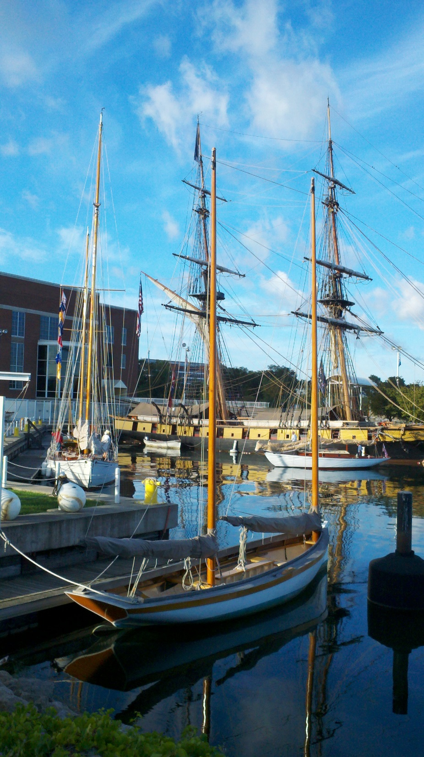

Slide 19
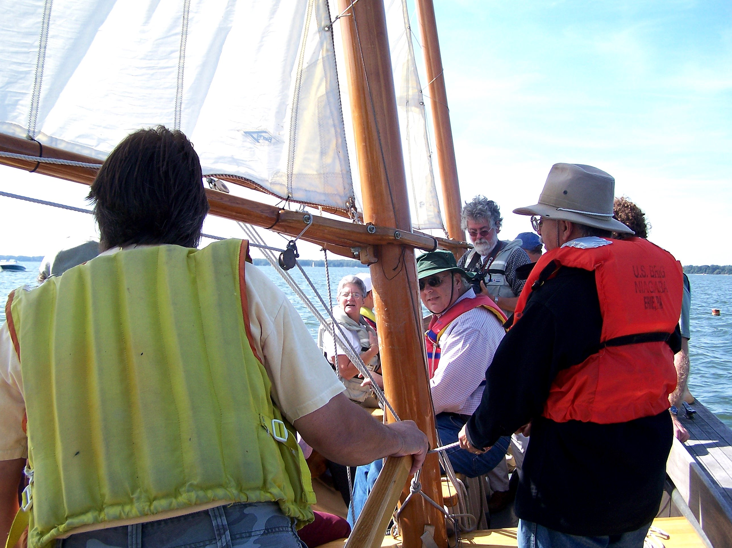

Slide 20
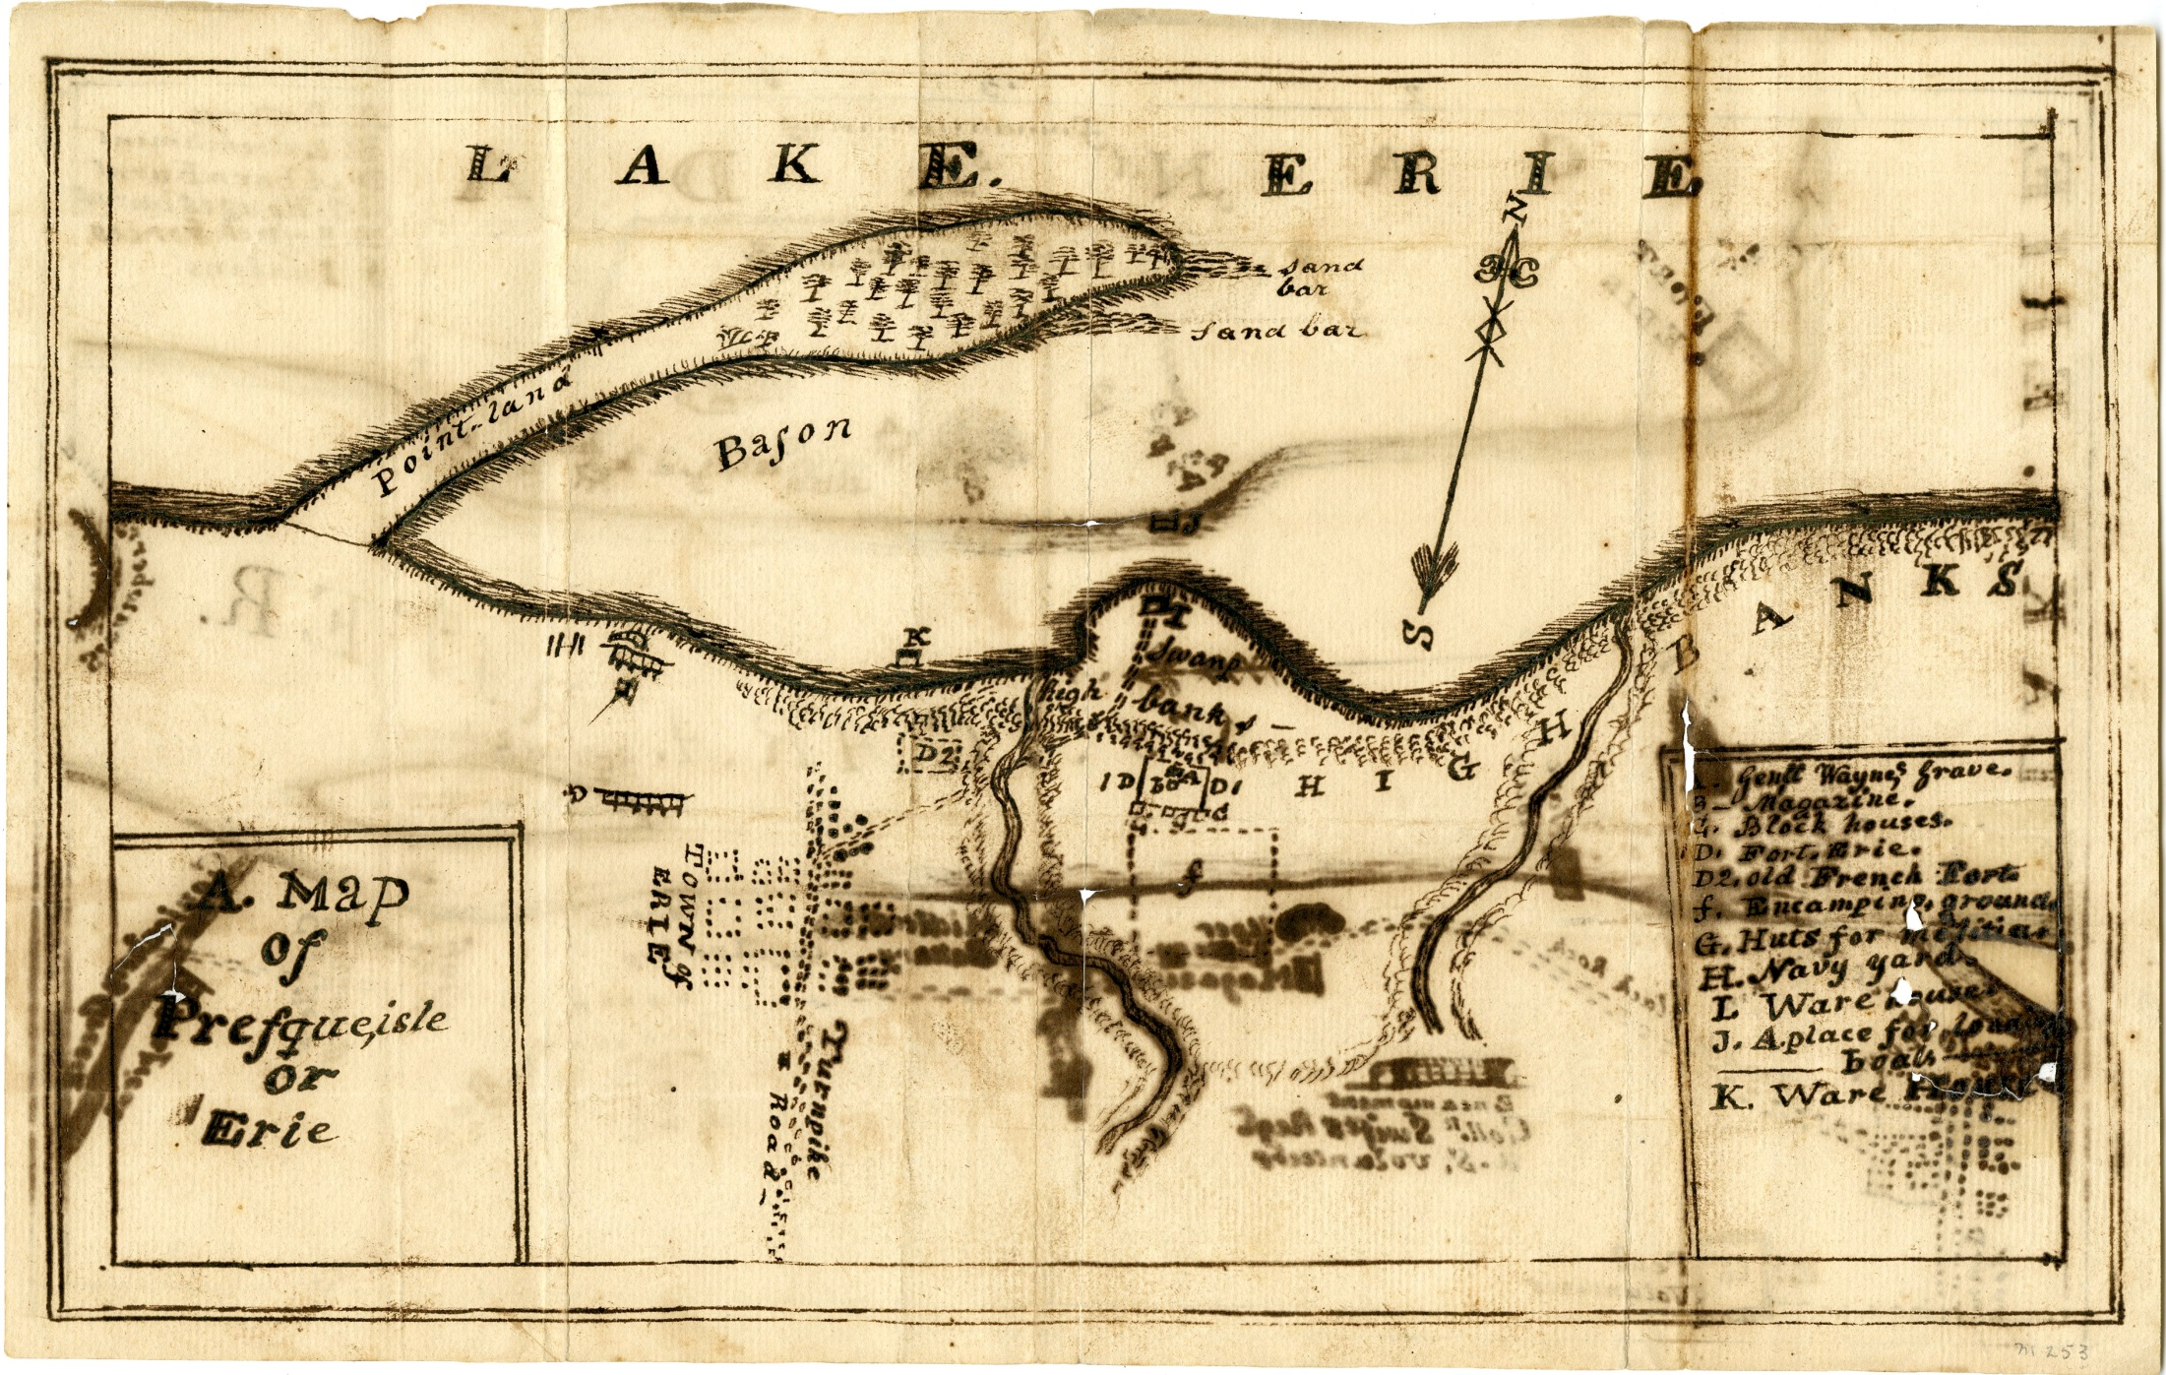

Slide 21
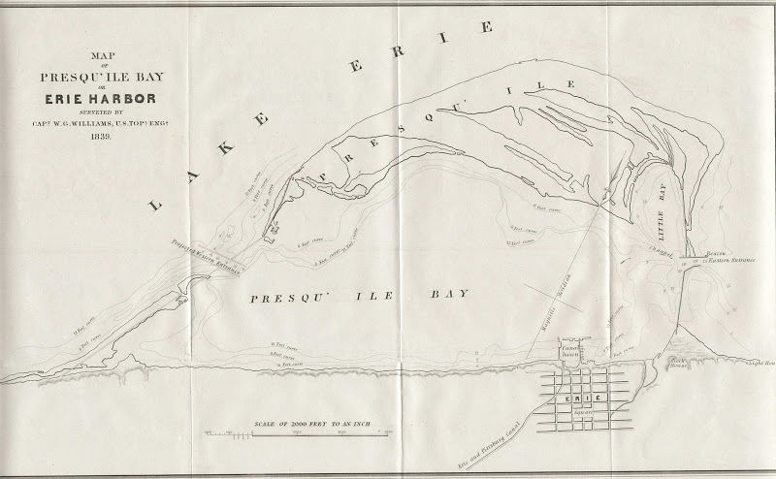
Erie 1839

Slide 22
BMC’s Newest Initiative…

Slide 23
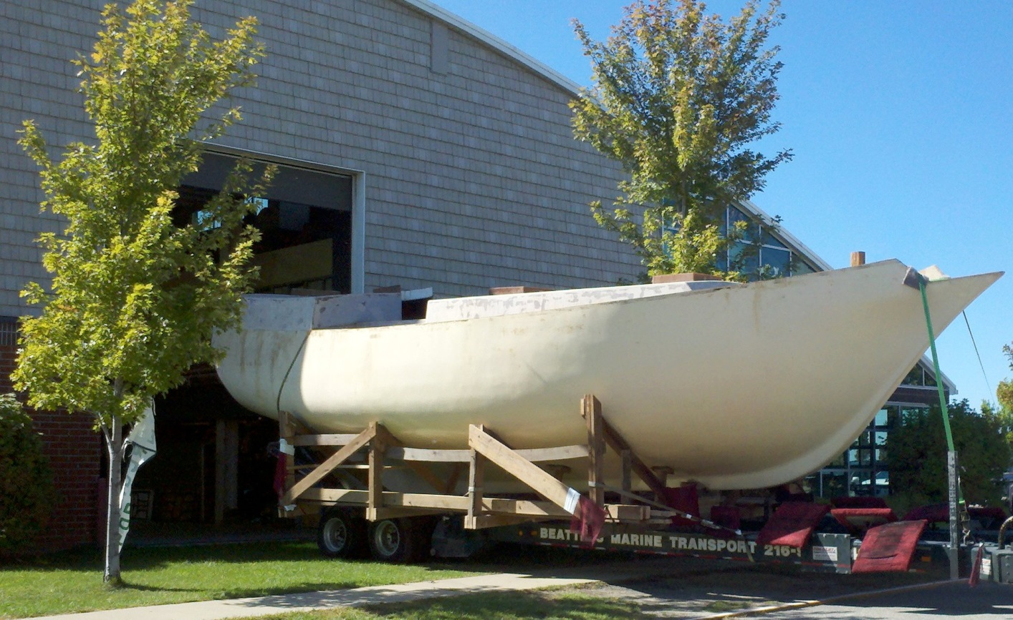
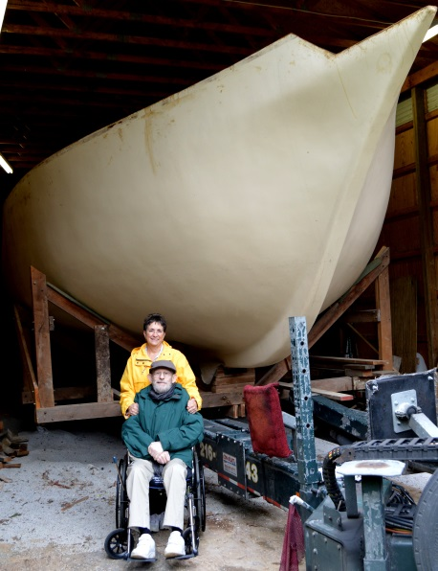
THE HULL ARRIVES AT THE BAYFRONT MARITIME CENTER
Keith and Kathy Palmerton built and donated the 40’ hull

Slide 24
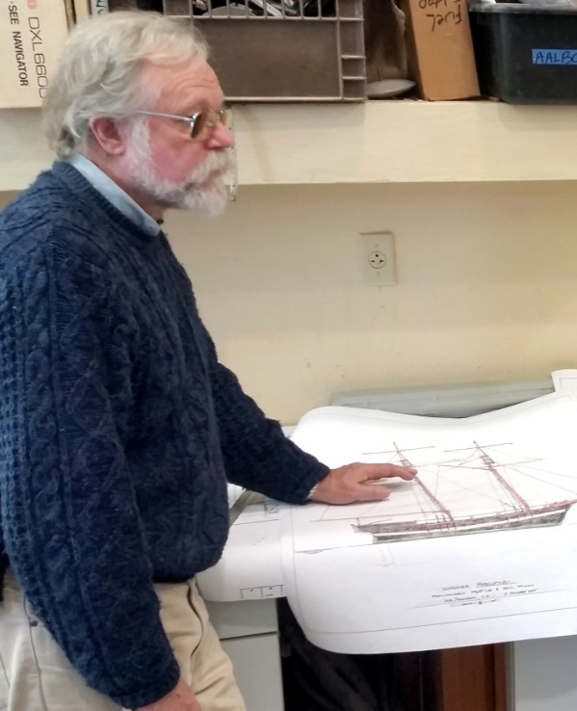
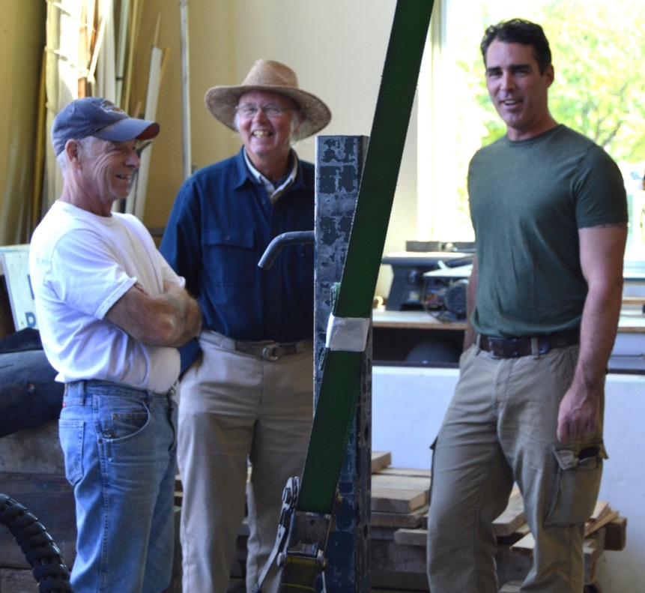
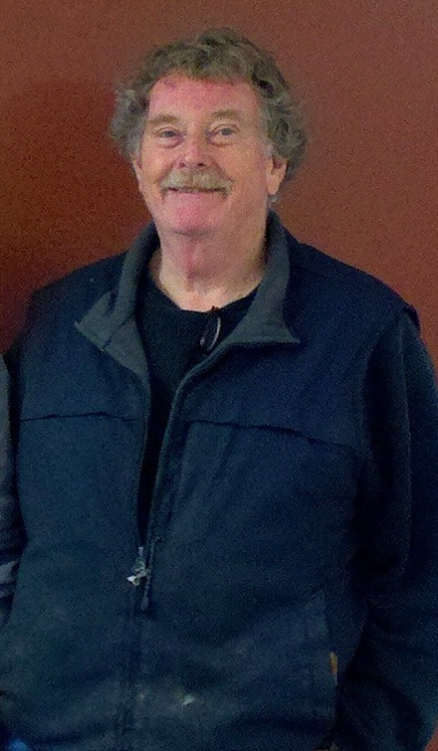
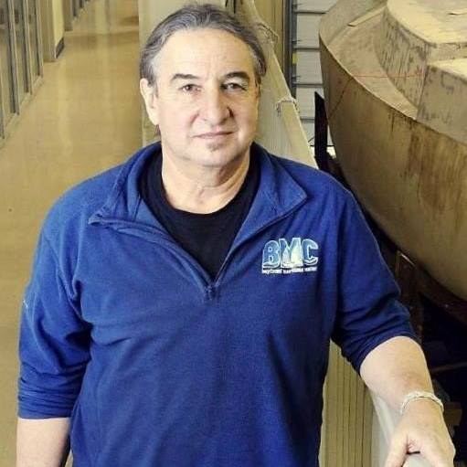
“TEAM PORCUPINE!”
Bob Arlet -Shipwright
David Bierig – Sailmaker
Jamie Trost – Project Manager
Iver Franzen – Naval Architect
David Frew - Fundraiser
Rich Eisenberg – BMC Director

Slide 25
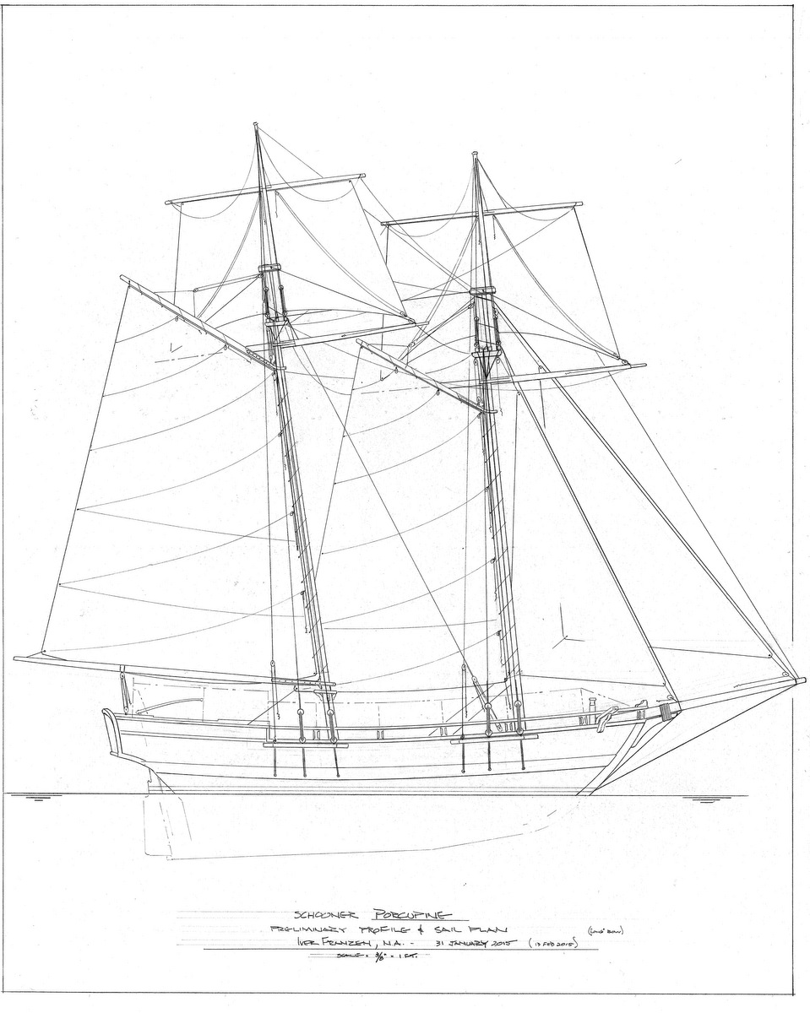
1813 Gunboat Schooner Porcupine
Why the Porcupine?
Right size for donated hull
Dobbins built
Longest continuous career
Diverse service:
Served in Navy, Coastal Survey,
Revenue Cutter, Merchant Fleet
Appeal to students
“Native” to Erie area
Modifying Hull to meet USCG Regs and 19th Gunboat Appearance
Proposed Certification for:
28 Passengers (Daysails)
10-12 Trainees (Overnight Programs)

Slide 26
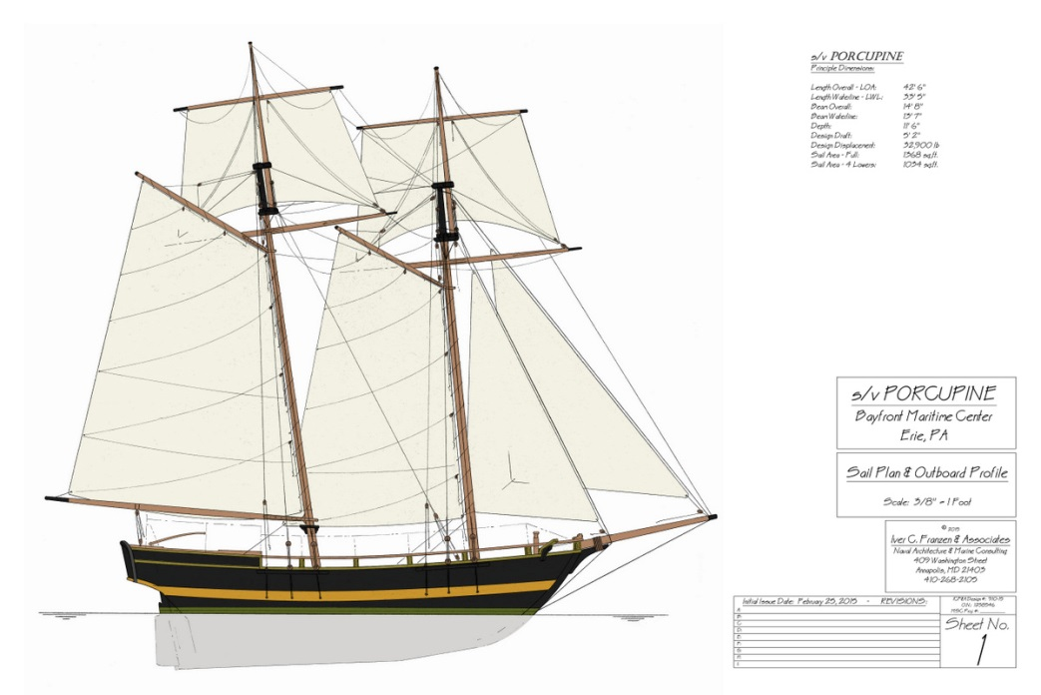
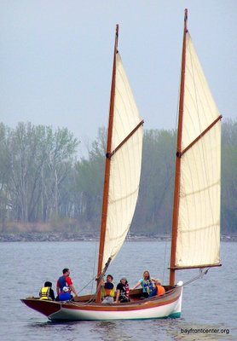
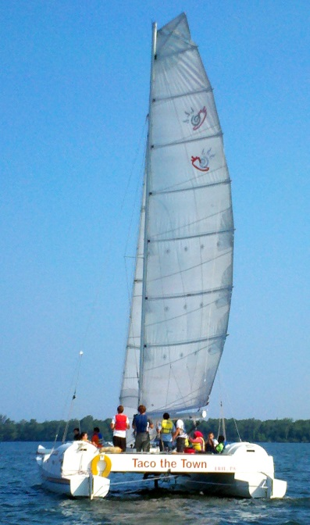
Porcupine – a sustainable, high-profile regional asset to enhance BMC programs
More than doubles current capacity
Extends BMC’s Reach
New Programming as Presque Isle Bay’s “School Ship”

Slide 28
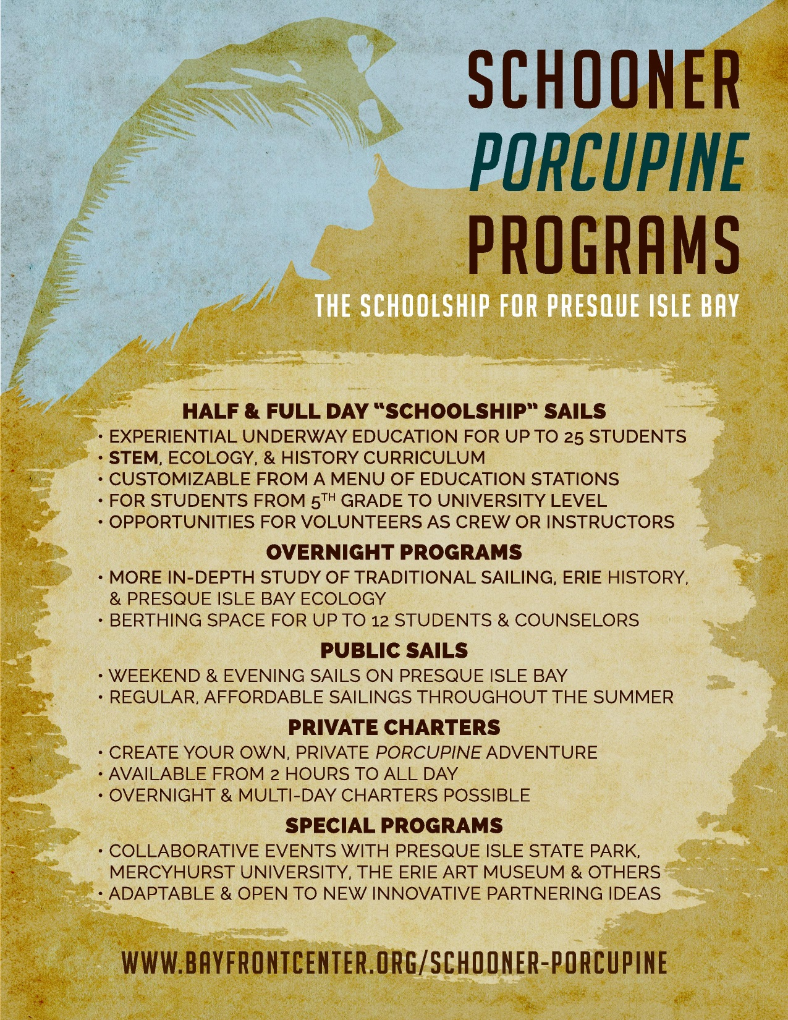

Slide 29
STEM-FOCUSED FLOATING CLASSROOM
Partnering with local school districts in developing programs
Sailing opportunities for up to 3000 students during school year
Programs aimed at 4th-6th grade level – customizable for all ages
Creating a “menu” of science, technology, and humanities stations for teachers to customize programs
Porcupine’s long career perfect for exploring Erie’s History and Technological changes over time

Slide 30
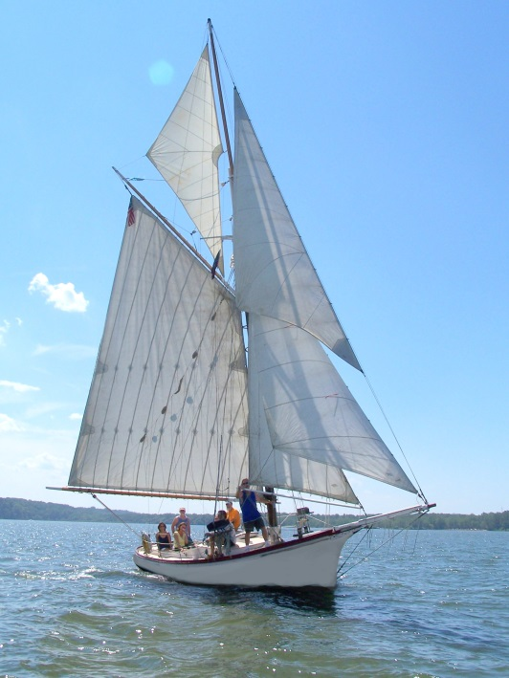
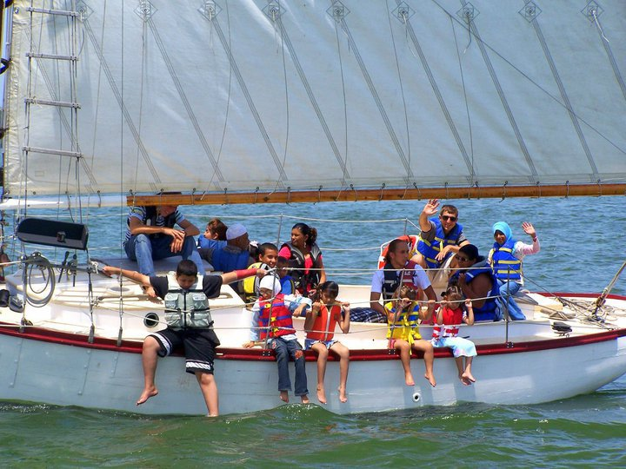
NOT All School and No Play
WILL OFFER PUBLIC DAY SAILS ON WEEKENDS AND SUMMER EVENINGS
AVAILABLE FOR:
Private Charters
Corporate Sails
Dockside Events
All programs – student and public – highlight history and resources of Presque Isle Bay

Slide 31
Helping Float Porcupine
Fundraising Goal : $200,000
Current Donations/Pledges : $78,000
Erie Insurance $25,000
UAW $5,000
GE Matching Funds $2,630
S.O.N.S. of Lake Erie $1,000
Dave Bierig, Bob Arlet, Bill Casey, Sreela Sasi, Jeff Beich, Mark Schreckengost, Howard and Mary Lincoln, Herald Green, Emily Kuhn, Randolph and Cherie Lachowski, Jamie Trost and Kathleen Moore, Stan Schuyler, Harry Bierig, Terrance Cavanaugh, Bill Jackson, Builder’s Hardware, Everett and Susan Walker, Nick Scott, Jr., Jane Manross, Robert Gura, John Eric Lindholm, Ruth Ridley, Charles Ridley, James Hardesty, Bill Coleman, Michael Hill, Alex Nagle, Rick Hersey,
Tim Sedney, Janis Guthrie, Gary Liebel, Pat Dean
We Are Asking You to Join Them

