Slide 1
Organizational Funding Strategies That Work
TWSBA Conference
Northwest Maritime Center, Port Townsend, WA
April 29 – May 2, 2015

Slide 2
Jake Beattie – Northwest Maritime Center
Betsy Davis – Northwest School of Wooden Boatbuilding
Adam Green – Rocking the Boat
Joe Youcha – Building to Teach
Lory Newmyer – Hull Lifesaving Museum (retired)

Slide 3
Organizational Stages of Development
A-ha! Let’s put on a show.
One-legged man in an ass-kicking contest
Funding and programs stabilize, staff grows, Board evolves, context emerges, vision expands
Maturation of funding, programs, staff, Board, planning, and partnerships/collaborations
Major growth decisions appear: Expansion, Replication, Franchise

Slide 4
Organizational Funding
Basic Fundraising/Income Buckets
Useful Considerations
Foundation Grants
Government Grants
Government Contracts
Corporate Sponsorships and Partnerships
Contracts/Earned Income/Fees for Service
In-Kind Donations (goods and services)
Individual Giving
Annual Funds, Major Gifts, Planned Giving, Events
RELATIONSHIPS
Organizational mission and flavor
Organizational development and readiness to handle funders’ demands
Outcomes measurements – how to use data
Communication – how to tell your stories
Low-hanging fruit

Slide 5
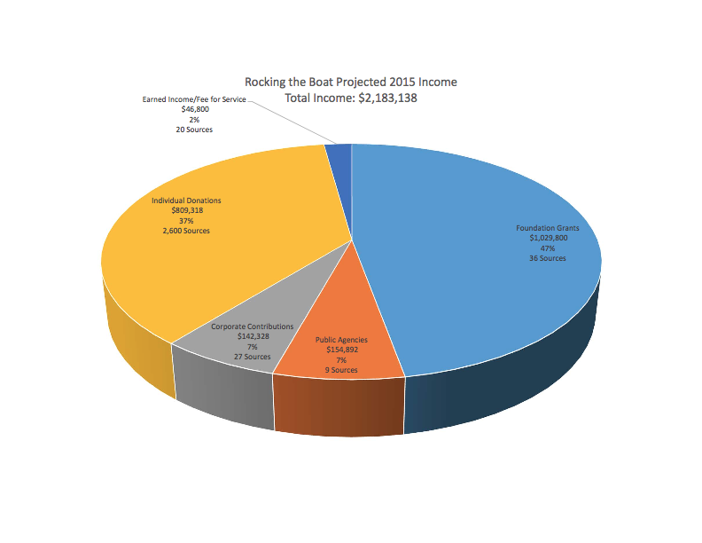

Slide 6
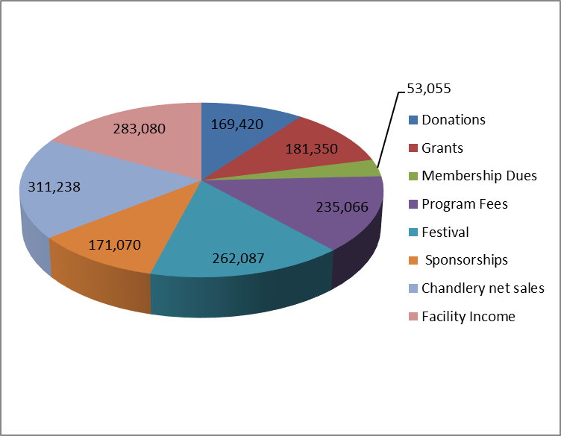
Northwest Maritime Center income model (2015 budget)
Earned income: 80%
Contributed income: 20%

Slide 7
Northwest School of Wooden Boatbuilding
Actuals School Year 2014
90% earned; 10% contributed

