Slide 1
TEACHNG WITH SMALL BOATS
2015 CONFERENCE
April 30 - May 2, 2015
Port Townsend, WA
Connecting to the Common Core Workshop

Slide 2
www.corestandards.org

Slide 4
Mission Statement
The Common Core State Standards provide a
consistent, clear understanding of what students are expected to learn, so teachers and parents know what they need to do to help them. The standards are designed to be robust and relevant to the real world, reflecting the knowledge and skills that our young people need for success in college and careers. With American students fully prepared for the future, our communities will be best positioned to compete successfully in the global economy.

Slide 5
Common Standards
Building on the excellent foundation of standards states have laid, the Common Core State Standards are the first step in providing our young people with a high-quality education. It should be clear to every student, parent, and teacher what the standards of success are in every school.

Slide 6
Language Common Core
Reading: Literature
Reading: Informational Text
Reading: Foundational Skills
Writing
Speaking & Listening
Language
Standard 10: Range, Quality, & Complexity

Slide 7
CCSS
Common Core State Standards

Slide 8
Reading: Literature - Grades 9-12– does not apply
ELA‐Literacy.RL.8.1 Cite the textual evidence that most strongly
supports an analysis of what the text says explicitly as well as
inferences drawn from the text.
ELA‐Literacy.RL.8.2 Determine a theme or central idea of a text and analyze its development over the course of the text, including its relationship to the characters setting and characters, setting, plot; provide an objective summary of the text.
ELA‐Literacy.RL.8.4 Determine the meaning of words and phrases as they are used in a text, including figurative and connotative meanings; analyze the impact of specific word choices on meaning and tone, including analogies or allusions to other texts.
ELA‐Literacy.RL.8.5 Compare and contrast the structure of two or
more texts and analyze how the differing structure of each text
contributes to its meaning and style..

Slide 9
Reading: Informational Text-Grades 9-10 – Applies
ELA-Literacy.RI.9-10.1 Cite strong and thorough textual evidence to support analysis of what the text says explicitly as well as inferences drawn from the text.
ELA-Literacy.RI.9-10.2 Determine a central idea of a text and analyze its development over the course of the text, including how it emerges and is shaped and refined byspecific details; provide an objective summary of the text.
ELA-Literacy.RI.9-10.3 Analyze how the author unfolds an analysis or series of ideas or events, including the order in which the points are made, how they are introduced and developed, and the connections that are drawn between them.
ELA-Literacy.RI.9-10.4 Determine the meaning of words and phrases as they are used in a text, including figurative, connotative, and technical meanings; analyze the cumulative impact of specific word choices on meaning and tone (e.g., how the language of a court opinion differs from that of a newspaper).
ELA-Literacy.RI.9-10.5 Analyze in detail how an author’s ideas or claims are
developed and refined by particular sentences, paragraphs, or larger portions of a text (e.g., a section or chapter).
ELA-Literacy.RI.9-10.6 Determine an author’s point of view or purpose in a text and analyze how an author uses rhetoric to advance that point of view or purpose.

Slide 10
ELA-Literacy.RST.9-10.1 Cite specific textual evidence to support analysis of science and technical texts, attending to the precise details of explanations or descriptions.
ELA-Literacy.RST.9-10.2 Determine the central ideas or conclusions of a text; trace the text’s explanation or depiction of a complex process, phenomenon, or concept; provide an accurate summary of the text.
English Language Arts Standards Science & Technical Subjects 9-10
ELA-Literacy.RST.9-10.3 Follow precisely a complex multistep procedure when
carrying out experiments, taking measurements, or performing technical tasks,
attending to special cases or exceptions defined in the text.
ELA-Literacy.RST.9-10.4 Determine the meaning of symbols, key terms, and other domain-specific words and phrases as they are used in a specific scientific or technical context relevant to grades 9–10 texts and topics.
ELA-Literacy.RST.9-10.5 Analyze the structure of the relationships among concepts in a text.

Slide 11
ELA-Literacy.RST.9-10.6 Analyze the author’s purpose in providing an explanation, describing a procedure, or discussing an experiment in a text, defining the question the author seeks to address.
ELA-Literacy.RST.9-10.7 Translate quantitative or technical information expressed in words in a text into visual form (e.g., a table or chart) and translate information e g words
English Language Arts Standards - Science & Technical Subjects 9-10
ELA-Literacy.RST.9-10.8 Assess the extent to which the reasoning and evidence in a text support the author’s claim or a recommendation for solving a scientific or technical problem.
ELA-Literacy.RST.9-10.9 Compare and contrast findings presented in a text to those from other sources (including their own experiments), noting when the findings support or contradict previous explanations or accounts.
ELA-Literacy.RST.9-10.10 By the end of grade 10, read and comprehend
science/technical proficiency.

Slide 12
Mathematics Common Core
Counting & Cardinality
Operations & Algebraic Thinking
Number & Operations in Base Ten
Number & Operations—Fractions
Measurement & Data
Geometry
Ratios & Proportional Relationships
The Number System
Expressions & Equations
Functions
Statistics & Probability

Slide 13
Understand the connections between proportional relationships, lines, and linear equations Grade 8
Math.Content.8.EE.B.5 Graph proportional relationships, interpreting the unit rate as the slope of the graph. Compare two different proportional relationships represented in different ways. For example, compare a distance-time graph to a distance-time equation to determine which of two moving objects has greater speed.
Math.Content.8.EE.B.6 Use similar triangles to explain why the slope m is the same between any two distinct points on a non-vertical line in the coordinate plane; derive the equation y = mx for a line through the origin and the equation y = mx + b for a line intercepting the vertical axis at b.

Slide 14
Understand congruence and similarity using physical
models, transparencies, or geometry software Grade 8
Math.Content.8.G.A.1 Verify experimentally the properties of
rotations, reflections, and translations:
Math.Content.8.G.A.1a Lines are taken to lines, and line segments to line segments of the same length.
Math.Content.8.G.A.1b Angles are taken to angles of the same
measure.
Math.Content.8.G.A.1c Parallel lines are taken to parallel lines.
Math.Content.8.G.A.2 Understand that a two-dimensional figure is congruent to another if the second can be obtained from the first by a sequence of rotations, reflections, and translations; given two
congruent figures, describe a sequence that exhibits the congruence between them.

Slide 15
Math.Content.8.G.A.3 Describe the effect of dilations, translations,
rotations, and reflections on two-dimensional figures using
coordinates.
Math.Content.8.G.A.4 Understand that a two-dimensional figure is
similar to another if the second can be obtained from the first by a
sequence of rotations reflections translations and dilations; given two
Understand congruence and similarity using physical models, transparencies, or geometry software, rotations, reflections, translations, similar two-dimensional figures, describe a sequence that exhibits the similarity between them.
Math.Content.8.G.A.5 Use informal arguments to establish facts about
the angle sum and exterior angle of triangles, about the angles created when parallel lines are cut by a transversal, and the angle-angle criterion for similarity of triangles. For example, arrange three copies of the same triangle so that the sum of the three angles appears to form a line, and give an argument in terms of transversals why this is so.

Slide 16
Understand and apply the Pythagorean Theorem Grade 8
Math.Content.8.G.B.6 Explain a proof of the Pythagorean Theorem and its converse.
Math.Content.8.G.B.7 Apply the Pythagorean Theorem to determine unknown side lengths in right triangles in real-world and mathematical problems in two and three dimensions.
Math.Content.8.G.B.8 Apply the Pythagorean Theorem to find the
distance between two points in a coordinate system. Solve real-world and mathematical problems involving volume of cylinders, cones, and spheres.
Math.Content.8.G.C.9 Know the formulas for the volumes of cones, cylinders, and spheres and use them to solve real-world and mathematical problems.

Slide 17
TEACHNG WITH SMALL BOATS
2015 CONFERENCE
Connecting to the Common Core Workshop

Slide 18
How can maritime themes, courses, projects and activities be used to meet language arts standards?

Slide 19
“Teaching With Small Boats” is MORE than building a boat! It’s all about….

Slide 20
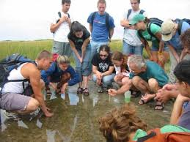
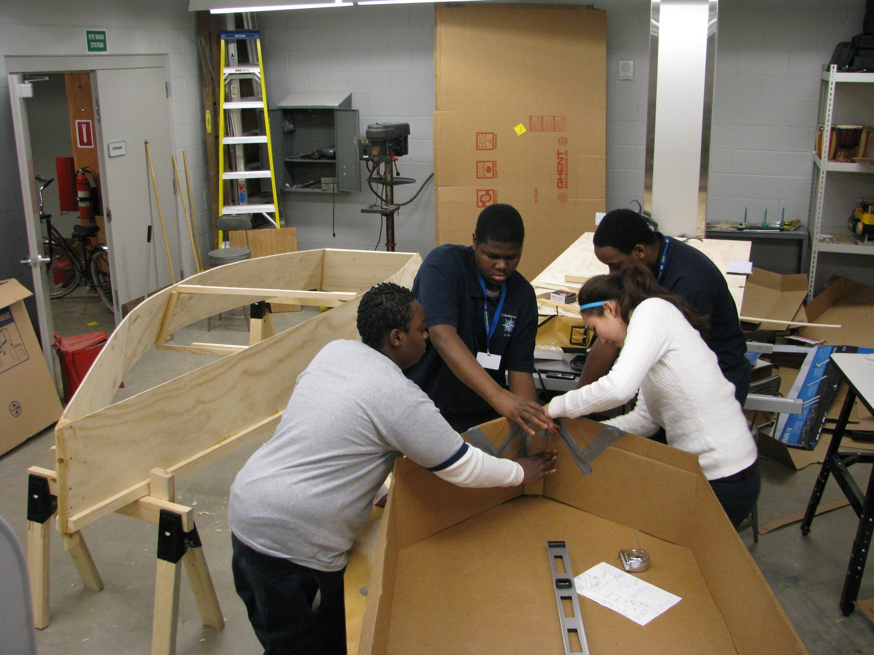
Marine Science
Naval Architecture

Slide 21
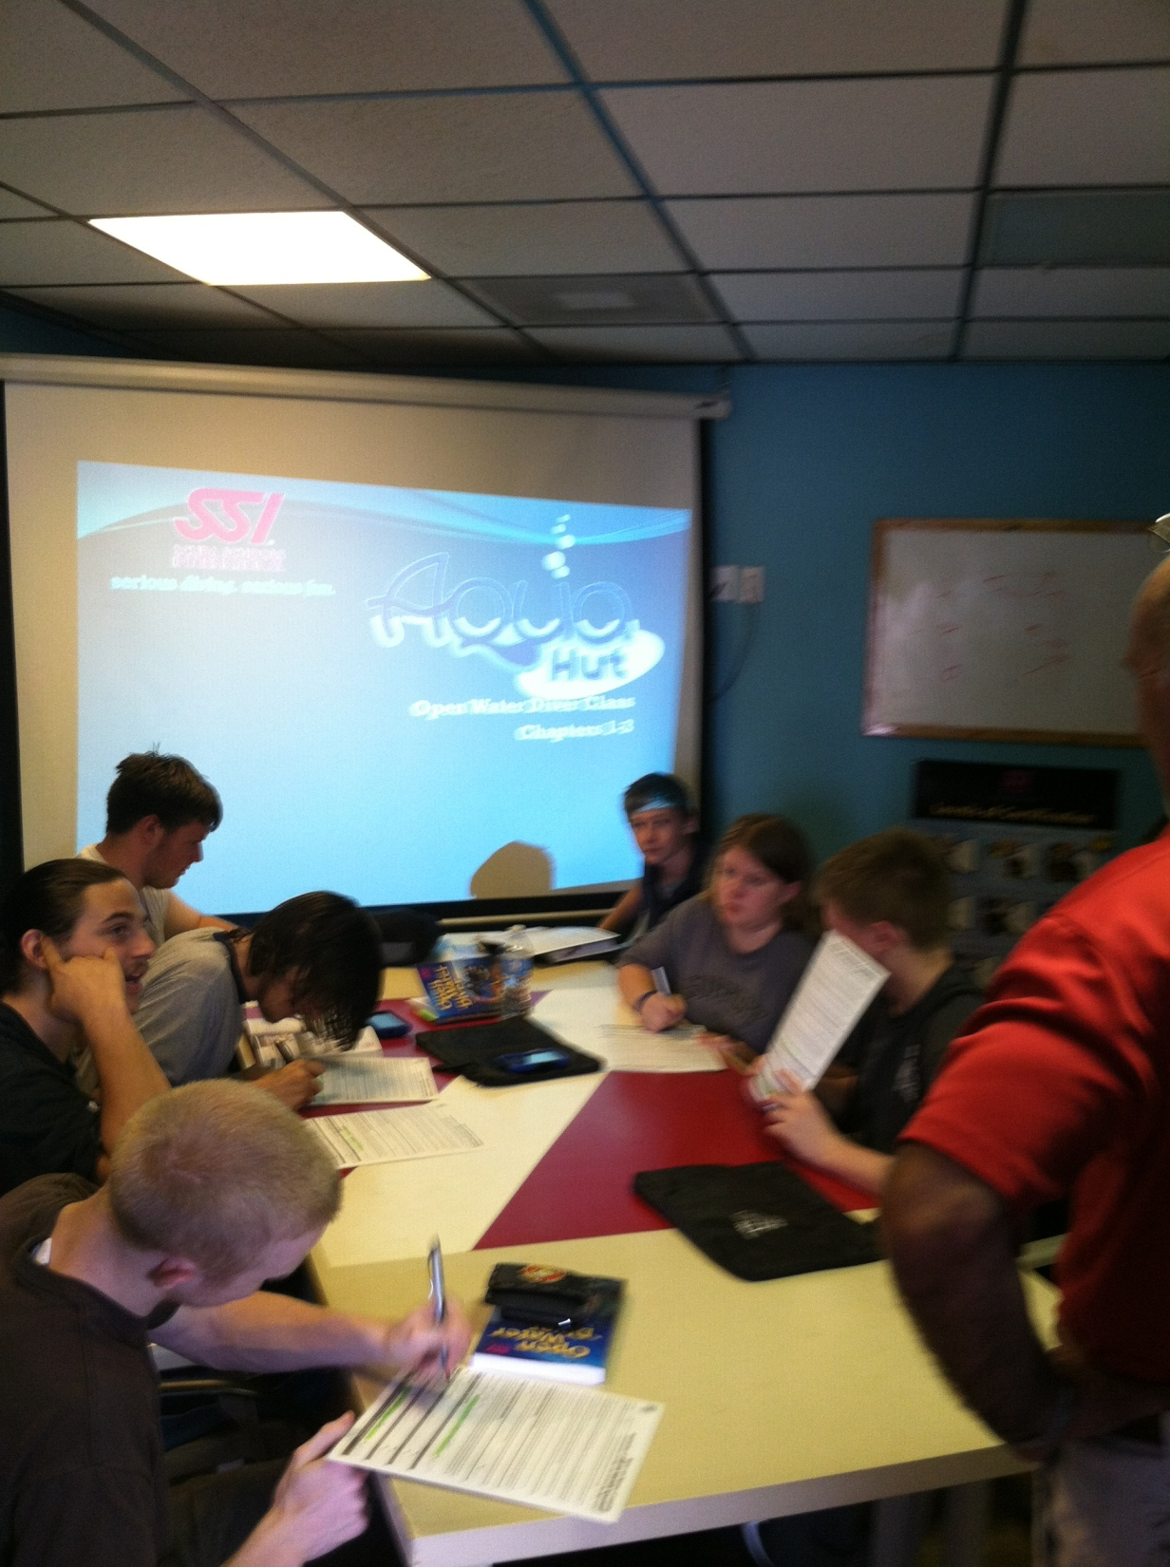
Maritime History (example)
Impact of European maritime history on the Atlantic or Pacific with focus on the resulting social, political, economic, and cultural changes.
Pre- and post - Colonial literature of indigenous people.

Slide 22
Maritime Culture
Relationship between humans and the sea.
History, literature and art of our maritime
Ships as agents of change.
Political and economic challenges of contemporary marine affairs.

Slide 23
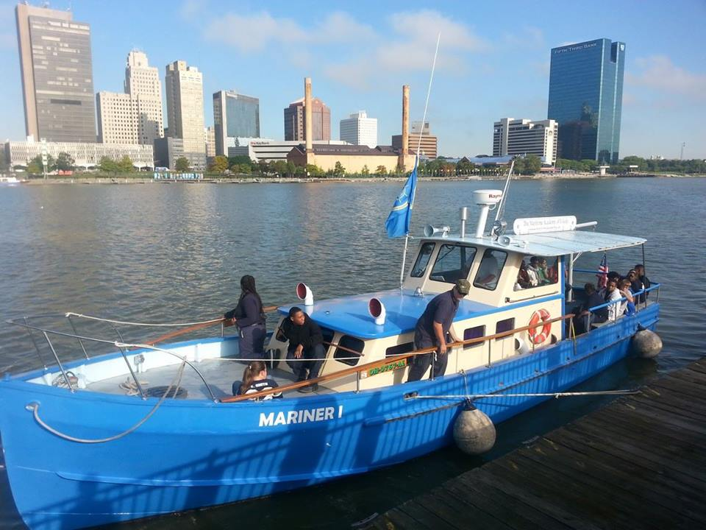
Navigation

Slide 24
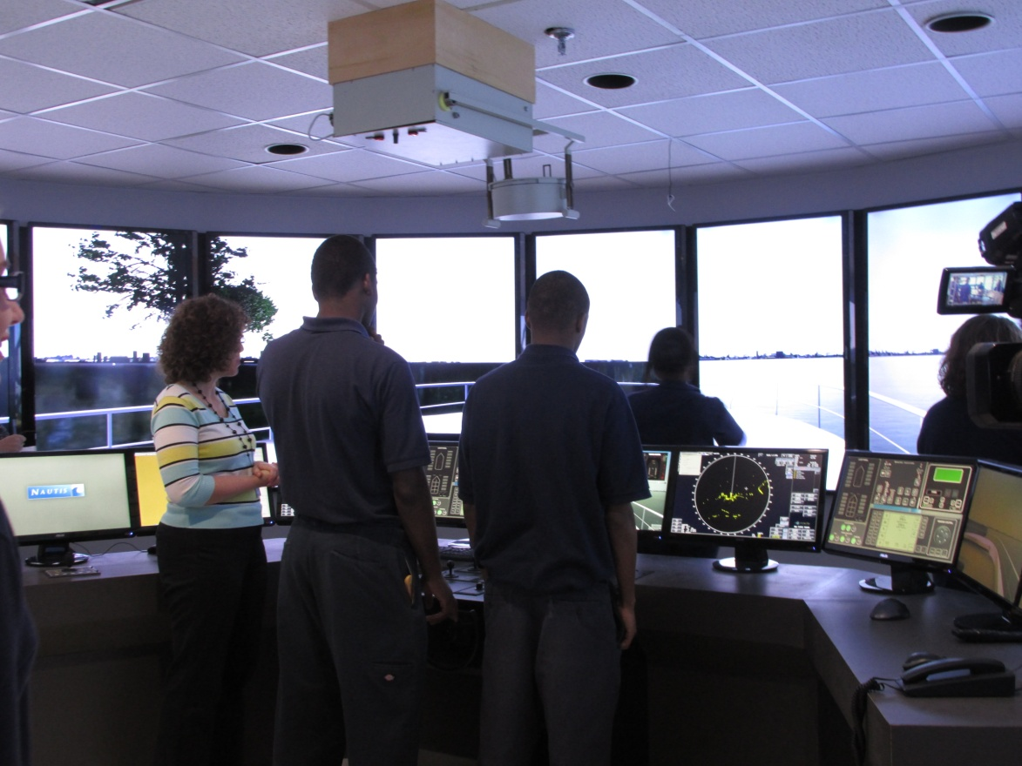
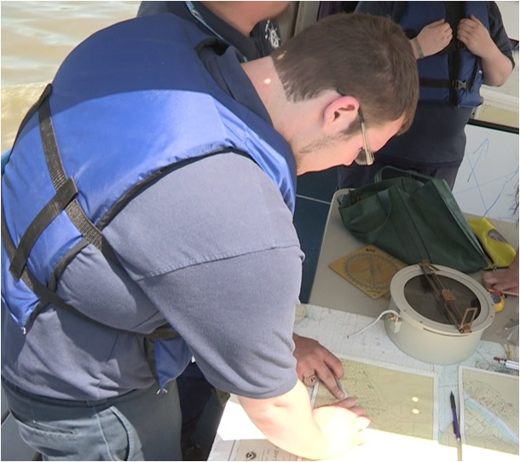
Rules of the Road

Slide 25
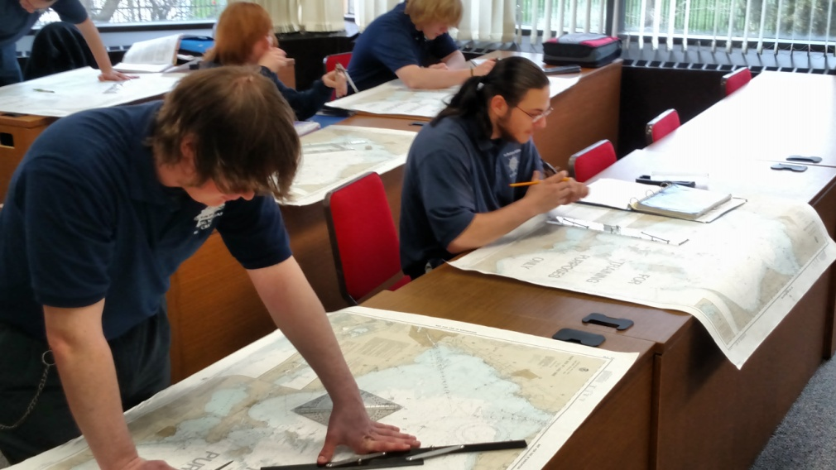
Seamanship
Applied Mathematics

Slide 26
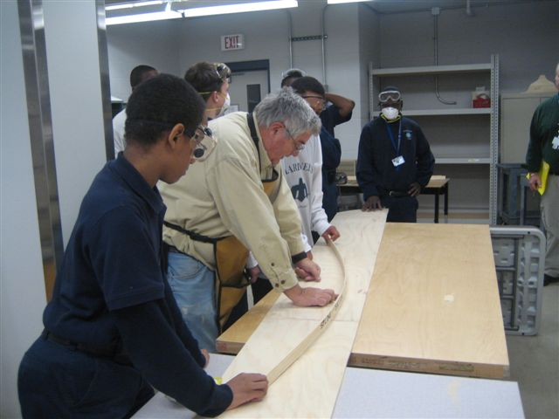
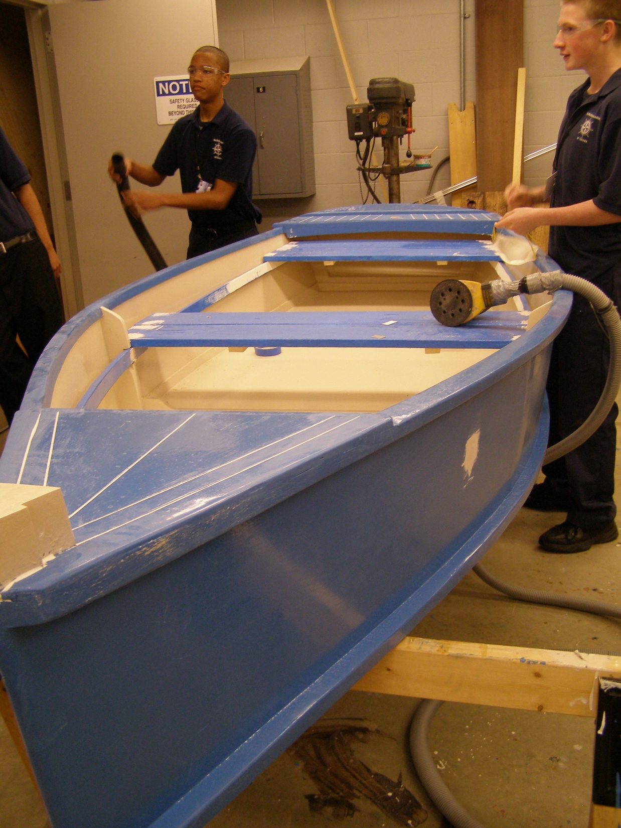
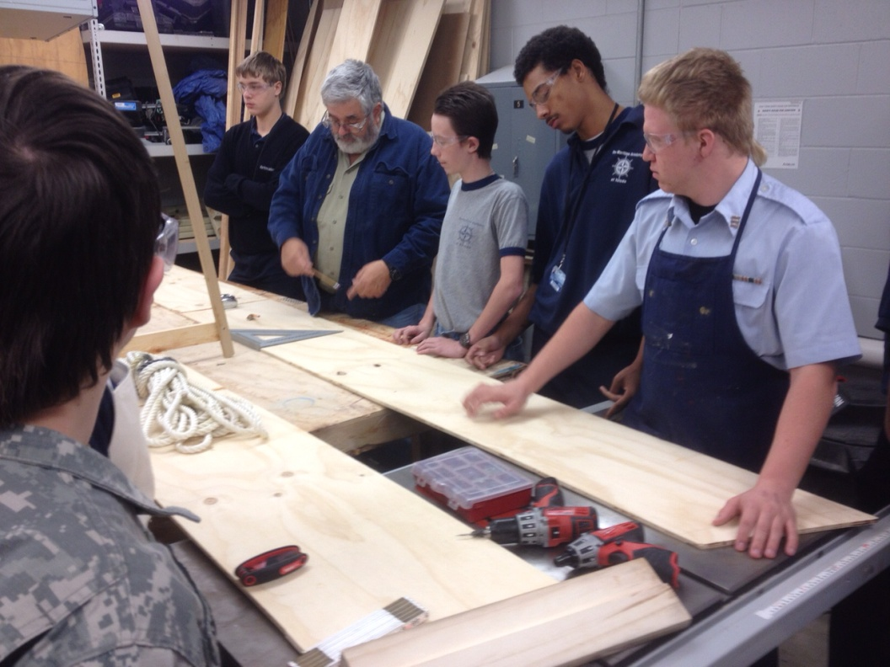
BOATBUILDING I AND II
4 Skiffs 1 Tugboat 4 Corrugated Boats / Races

Slide 27
All linked to sailing and students’ experiences as explorers and sailors!

Slide 28
Threads That Run Through 9-12th Grade Standards
Reading Standards for Literature
Reading Standards for Informational Text
Writing
Speaking and Listening
Language

Slide 29
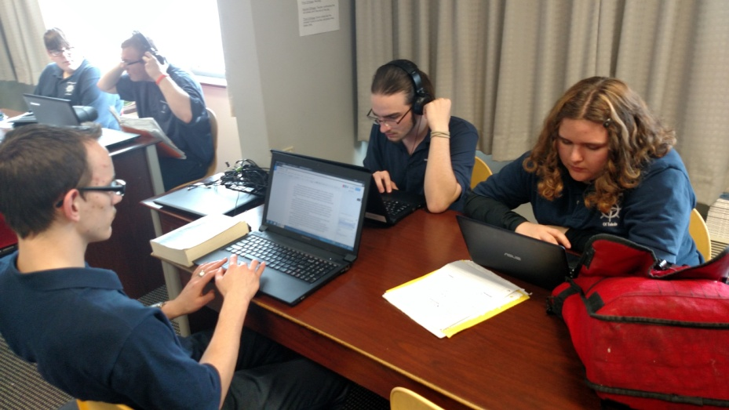
Threads that run through 9-12th Grade Standards
Reading Standards for Literature
Key Ideas and Details
Analyze text – explicitly and inferred
Determine a theme or central idea of a text
Craft and Structure
Determine the meaning of words and phrases
Analyze the impact of specific word choices on meaning and tone
Analyze a particular point of view or cultural experience
Integration of Knowledge and Ideas
Analyze the representation of a subject or topci
Analyze how an author draws on and transforms source material in a specific work
Range of Reading and Level of Text Complexity
Read and comprehend

Slide 30
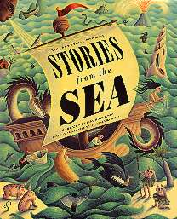
Sea Stories
Moby-Dick, Herman Melville
The Oxford Book of the Sea, ed. Jonathan Raban
Cod, Mark Kurlansky
The Unnatural History of the Sea, Callum Roberts
Typhoon and Other Stories, Joseph Conrad
Under the Sea-Wind, Rachel Carson
Cannery Row, John Steinbeck
The Old Man and the Sea, Ernest Hemingway
Far Tortuga, Peter Matthiessen
Syvlanus Now, Donna Morrissey
Paddle to the Sea,
A Place Where the Sea Remembers by Sandra Benitez

Slide 31
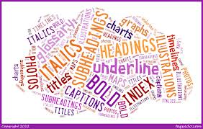
Threads that run through 9-12th Grade Standards Reading Standards for Informational Text
Essence of the Standards:
Understanding big ideas from informational text.
Use word choice and structure to support meaning.
Demonstrate understanding of informational text while actively engaged in reading.

Slide 32
Writing - Essence of the Standards:
Use supporting information in writing.
Revise and publish own writing.
Use technology to produce writing.
Gather and report information in writing.
Write routinely for multiple purposes.

Slide 33
Speaking and Listening - Essence of the Standards:
Initiate collaborative discussions.
Participate in collaborative discussions.
Present information.

Slide 34
Language - Essence of the Standards:
Demonstrate conventions of grammar when speaking or writing.
Demonstrate conventions of capitalization, punctuation and spelling when writing.
Use knowledge of language when writing, speaking, reading or listening.
Acquire and use vocabulary.

Slide 35
Maritime Culture
Relationship between humans and the sea.
History, literature and art of our maritime
Ships as agents of change.
Political and economic challenges of contemporary marine affairs.
Nautical Science
Fundamentals of sailing ship operation, in preparation for direct application at sea.
Navigation (piloting, celestial and electronic), weather, engineering systems, safety, and sail theory.
Being an active member of the ship’s crew on an offshore voyage.
Environmental Science
Ecosystem changes in the atmosphere: warming, acidification, and pollution.
Principles of circulation, water chemistry, nutrient dynamics and biological production.

Slide 36
Cardboard boat building
Stability And Trim
Displacement
Tugboat building
Radar navigation
Radar Wave Theory
Bridge navigation & Charting
Bearings (Geometry/ Trig)
Time/Speed/Distance
Seamanship
Mechanical Advantage
Basic Ships Systems
Electric
Fluid Systems
Propulsion
Pumps
Refrigeration
Weather for the Mariner
Basic Physics

Slide 37
Seamanship Research Technical Reading | Language Arts Determine the meaning of words and phrases as they are used in a text, including figurative, connotative, and technical meanings. Integrate information presented in different media or formats (e.g., visually, quantitatively) as well as in words to develop a coherent understanding of a topic or issue. Determine or clarify the meaning of unknown and multiple-meaning words and phrases by using context clues, analyzing meaningful word parts, and consulting general and specialized reference materials, as appropriate.
The knowledge and skill pertaining to the operation, navigation, management, safety, And maintenance of a ship.
Skill in sailing or operating a ship.
Terminology, signal flags, navigation , watchstanding , ropework, sailing

Slide 38
Ships Systems Electricity Circuits Components Electronics Alternating Current Direct current Electronic Components Electronic Skills Digital Electronics Power Supplies | Technology Learners apply principles of electricity and electronics related to electronic theory ,alternating and direct current, electronic components, electronic skills, digital electronics and power supplies. Knowledge And skills may be applied to fundamentals of electricity, analyzing and evaluating circuits, assembling components into electrical circuits
All Systems aboard a ship

Slide 39
Ships Systems Electricity Circuits Components Electronics Alternating Current Direct current Electronic Components Electronic Skills Digital Electronics Power Supplies | Language Arts Determine the meaning of words and phrases as they are used in a text, including figurative, connotative, and technical meanings. Integrate information presented in different media or formats (e.g., visually, quantitatively) as well as in words to develop a coherent understanding of a topic or issue. Determine or clarify the meaning of unknown and multiple-meaning words and phrases by using context clues, analyzing meaningful word parts, and consulting general and specialized reference materials, as appropriate.

Slide 40
Navigation | Geography Properties and functions of geographic representations (e.g., maps, globes, graphs, diagrams, Internet-based mapping applications, geographic information systems, global positioning systems, remote sensing, and geographic visualizations) affect how they can be used to represent, analyze and interpret geographic patterns and processes. Activities and patterns of trade and communication create interdependence among countries in different regions (e.g., seed corn grown in Iowa and planted in South America, high-definition televisions manufactured in Japan and viewed in the United States, news outlets from many countries available around the world via the Internet, instant access to data affects stock markets in different countries)

Slide 41
Navigation | Language Arts Determine the meaning of words and phrases as they are used in a text, including figurative, connotative, and technical meanings. Integrate information presented in different media or formats (e.g., visually, quantitatively) as well as in words to develop a coherent understanding of a topic or issue. Determine or clarify the meaning of unknown and multiple-meaning words and phrases by using context clues, analyzing meaningful word parts, and consulting general and specialized reference materials, as appropriate.

Slide 42
Knot Tying

Slide 43
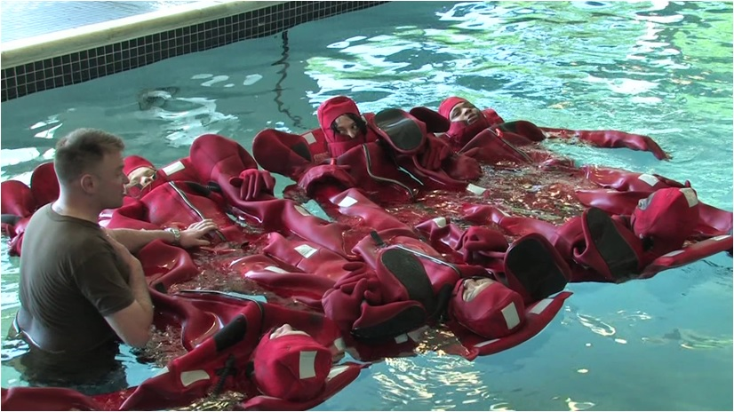
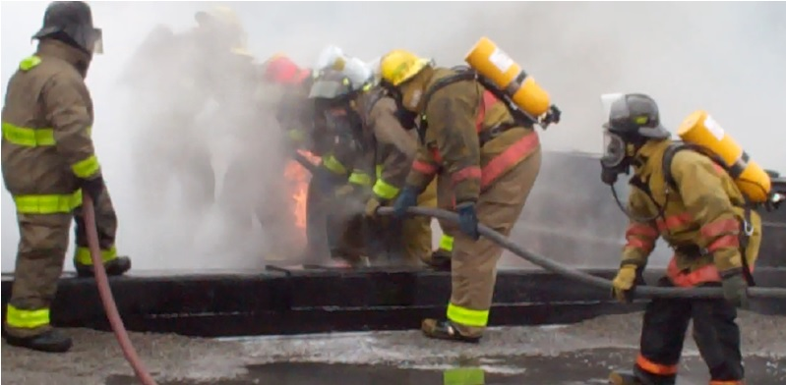
Basic Safety Training

Slide 44
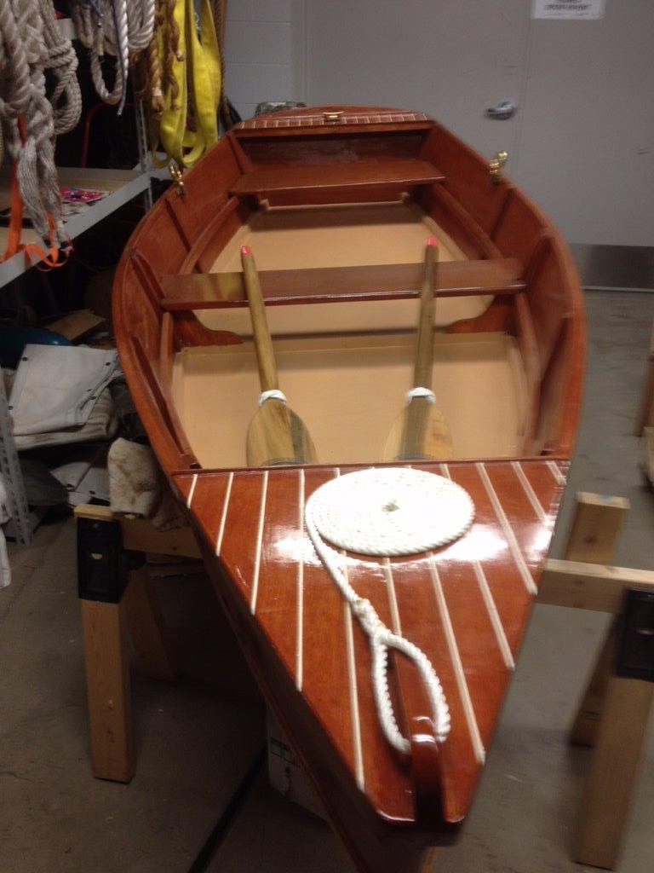
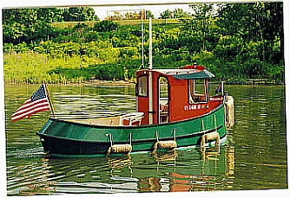
Corrugated Boats
Bevin Skiffs
Tugboat
Ship models
Ship design
Navigation
Radar
Sailing
Design
Draw
Build

Slide 45
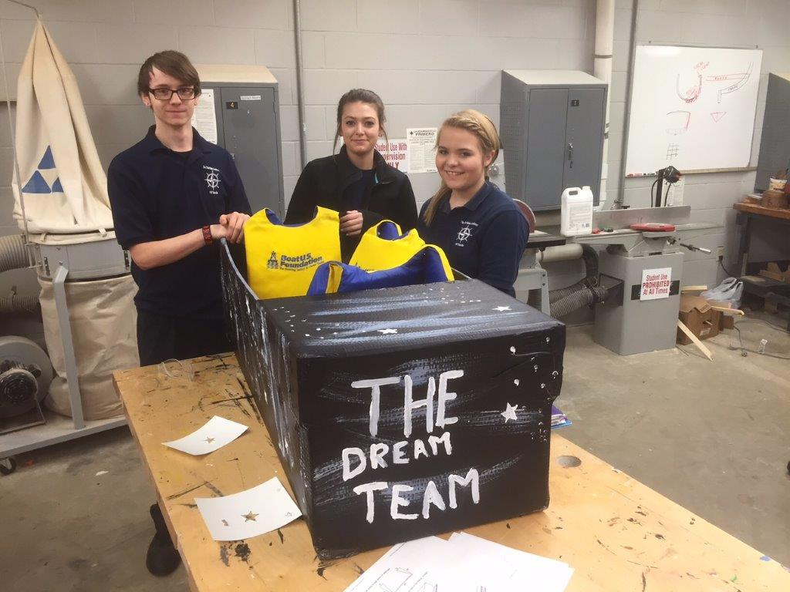
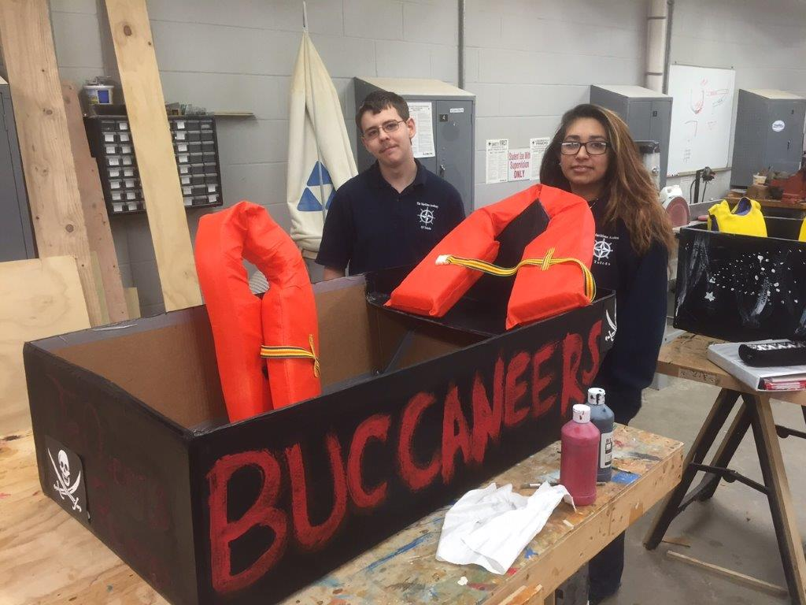
Language Arts 9-12
4th Annual Corrugated Boat Race
Research
Study
Plan
Design
Draw
Build

Slide 46
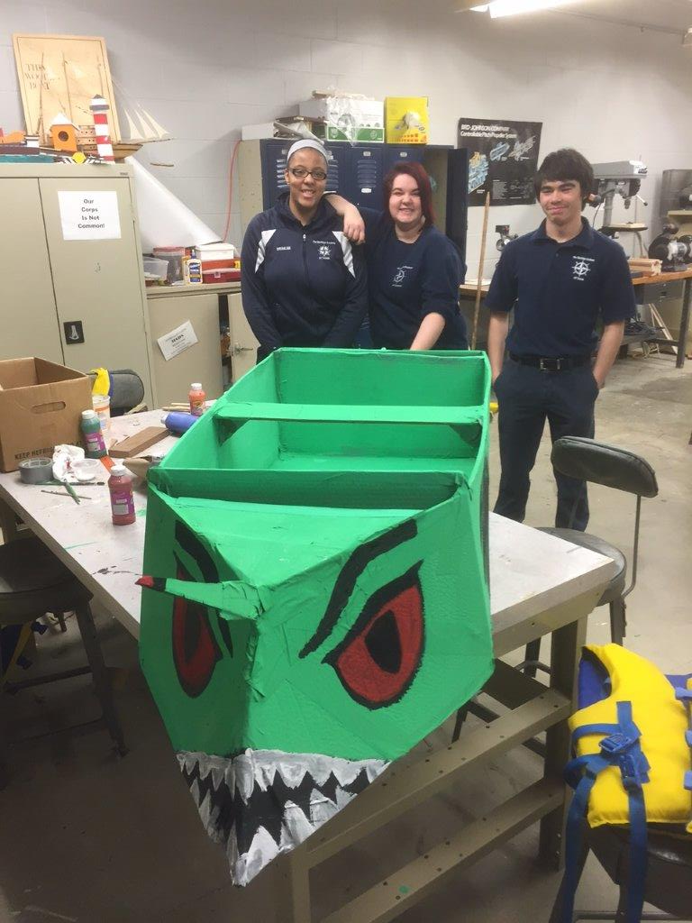
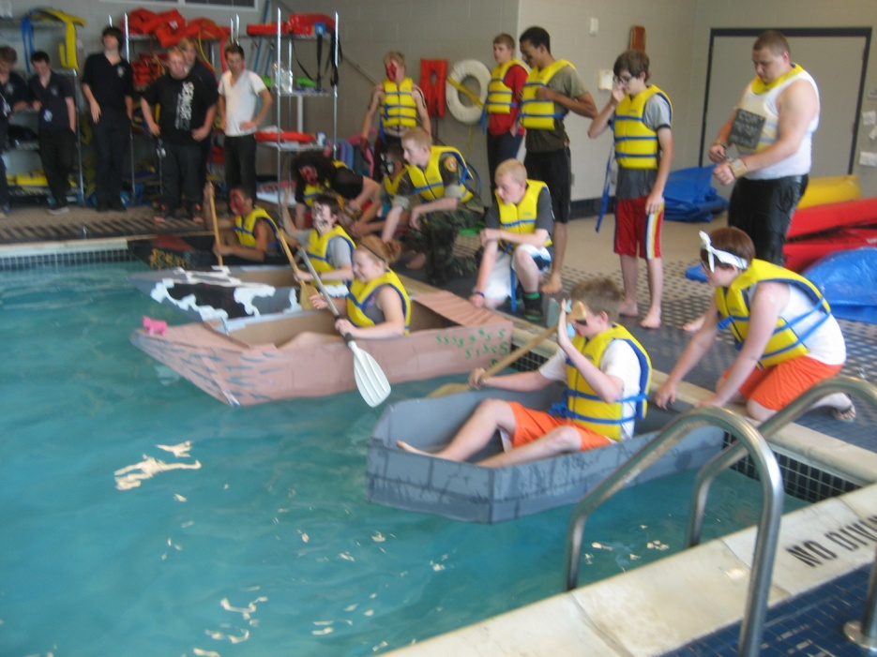
Research
Study
Plan
Design
Draw
Build
Launch

Slide 47
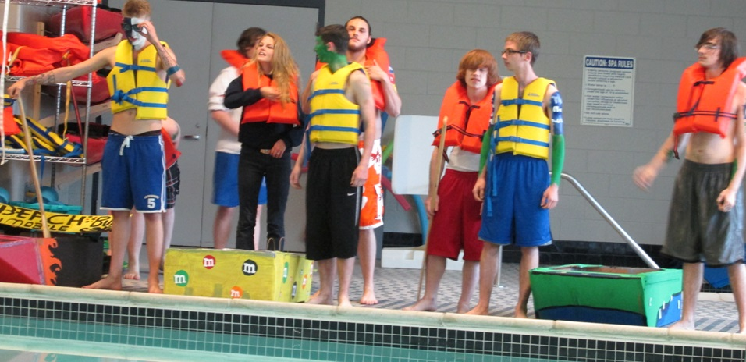
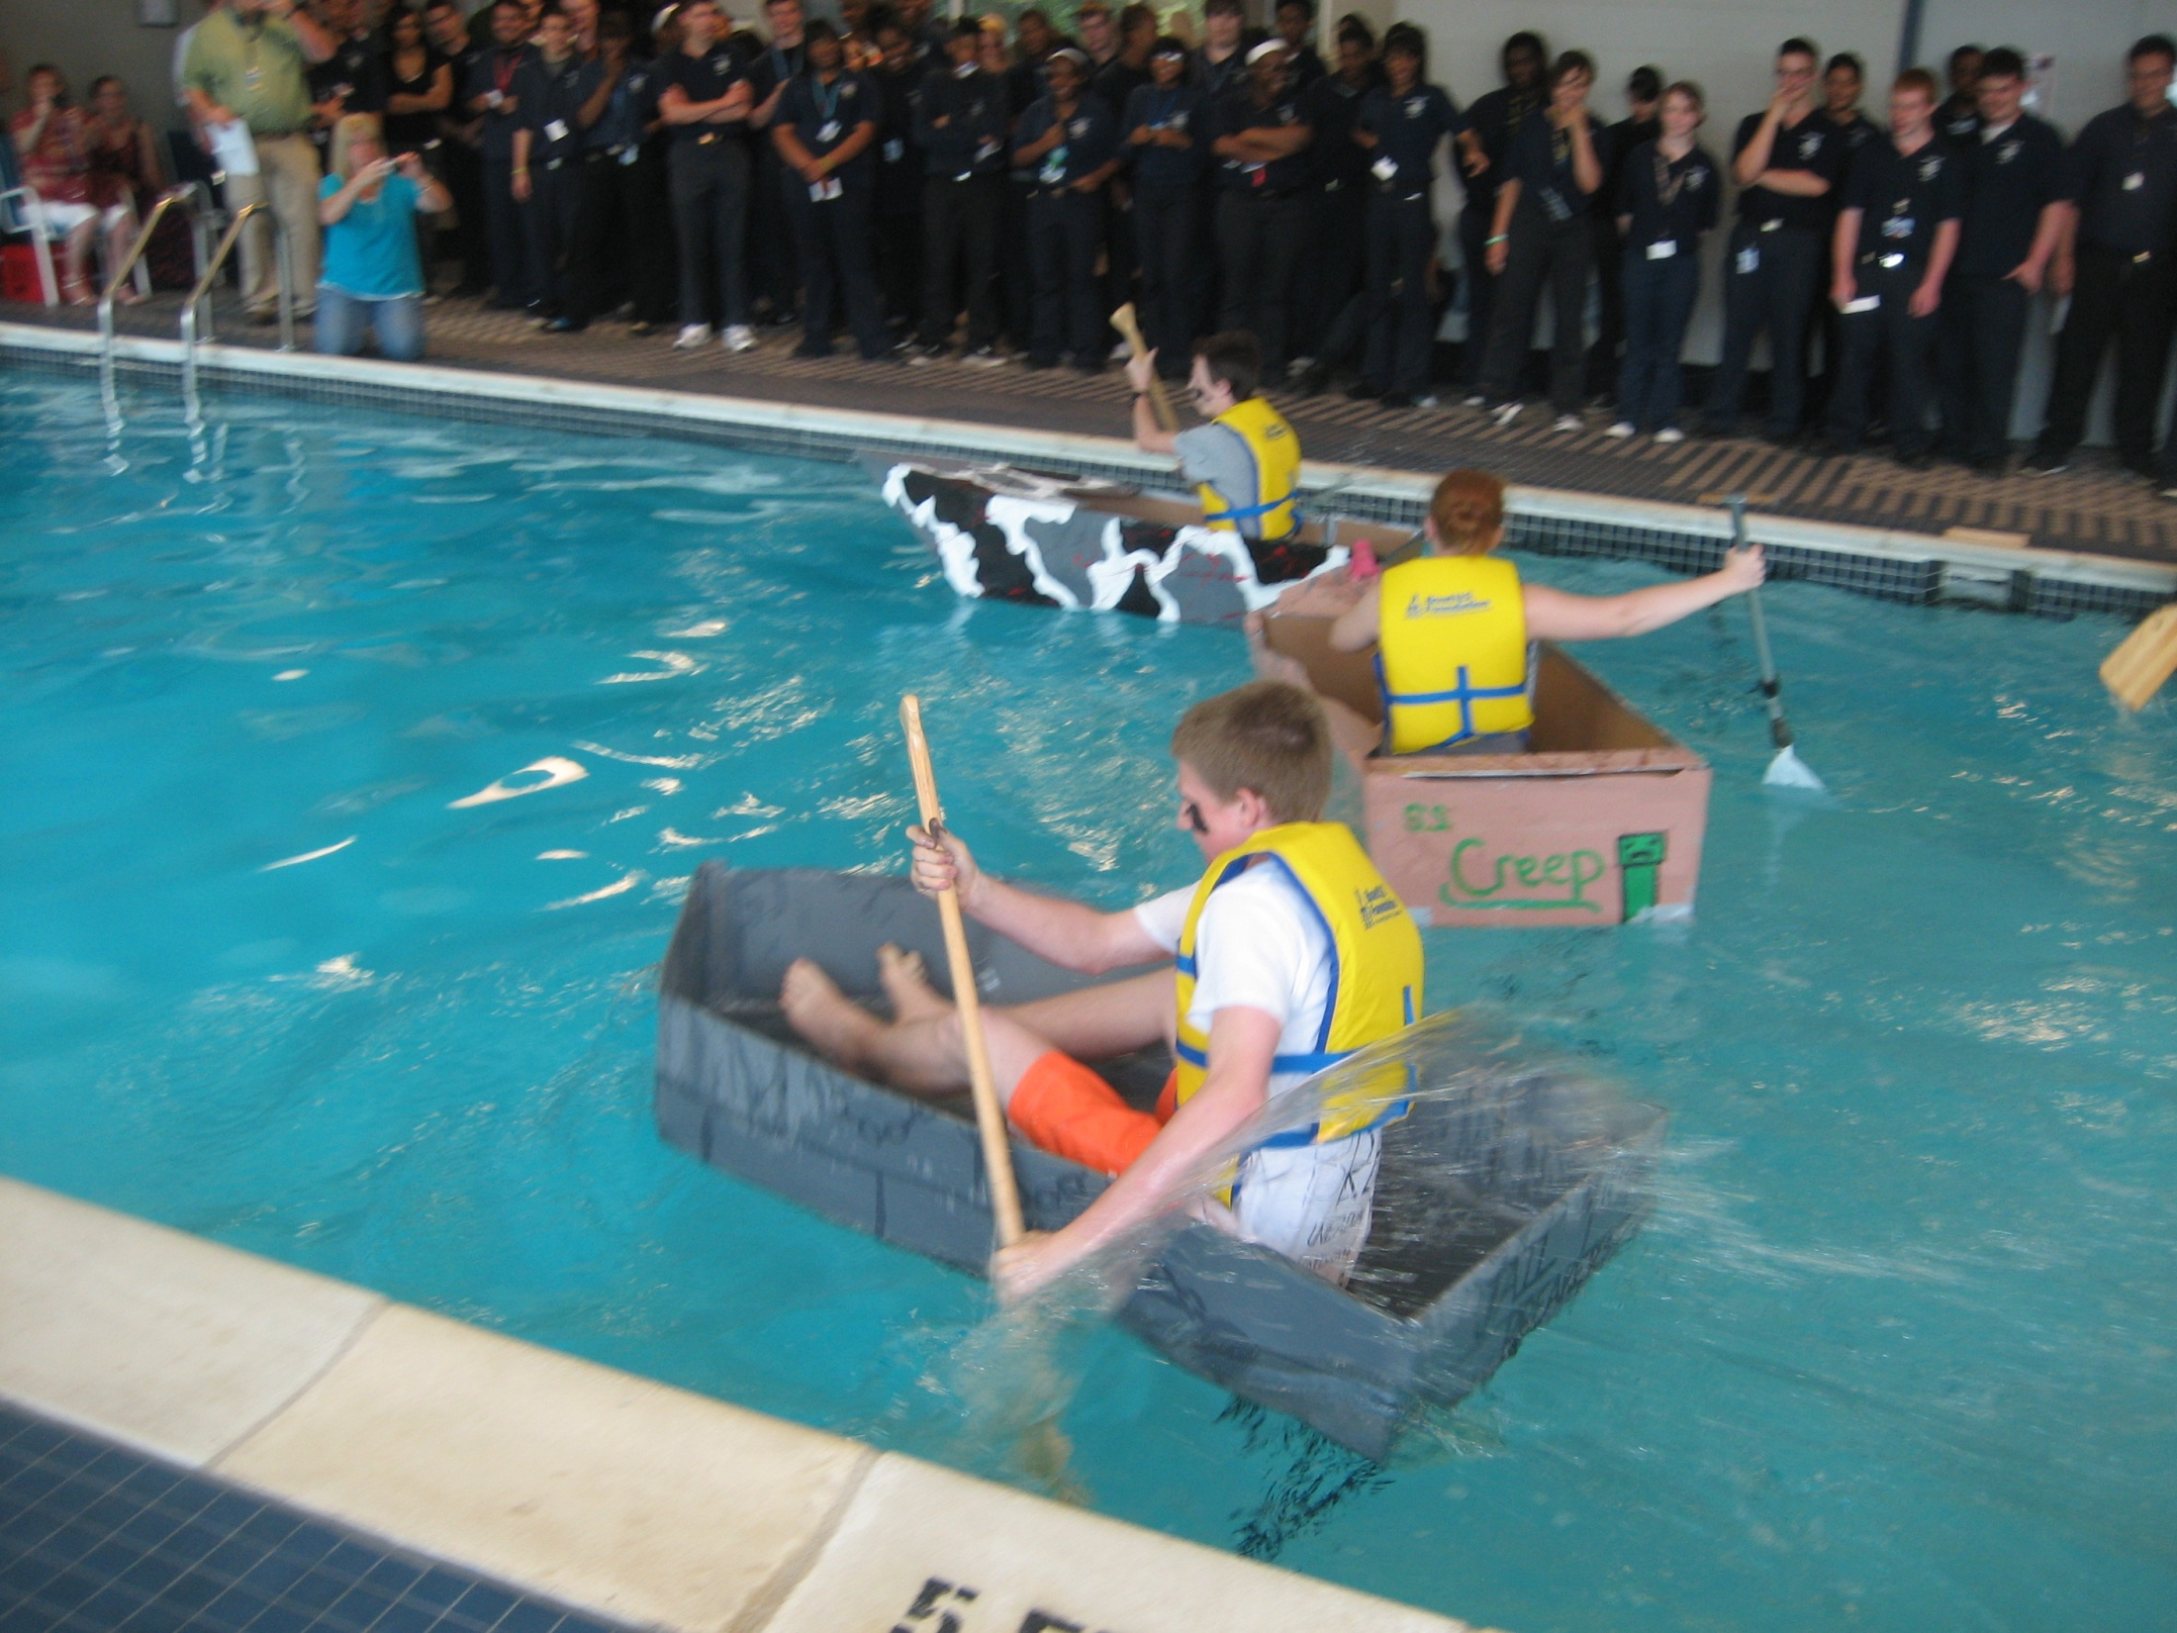
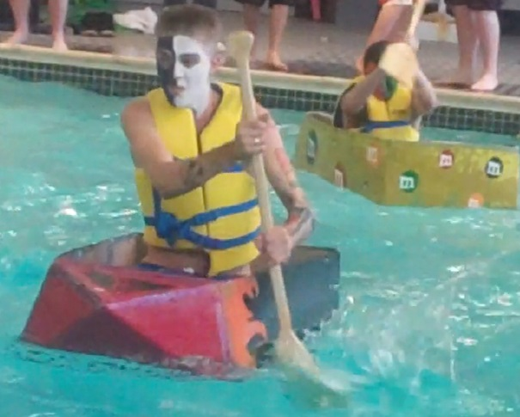
The End Result
The 4th Annual Great American Cardboard Boat Race

Slide 48
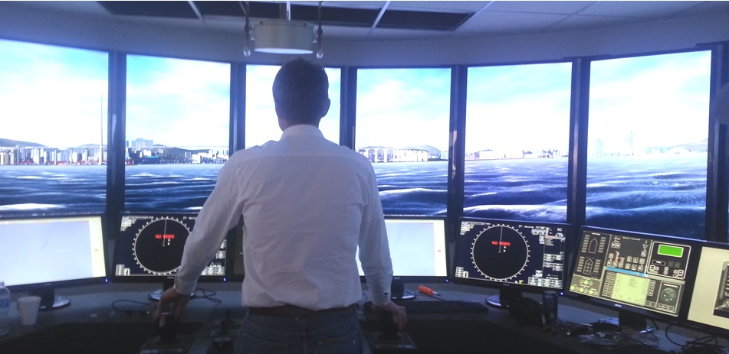
Plotting A Course Navigation Simulation

